Slide 1
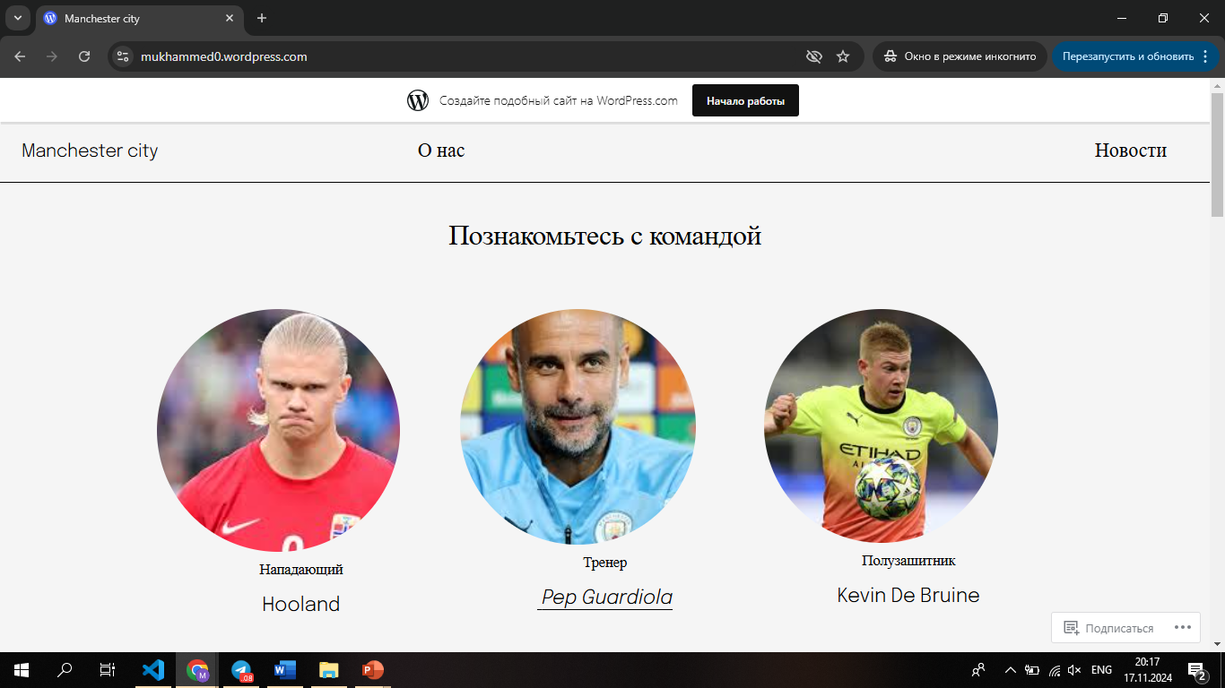
Wordpress

Slide 2

Figma

