Slide 1
How to complete class activity?
Guide to the successful completion of the given class activity

Slide 2
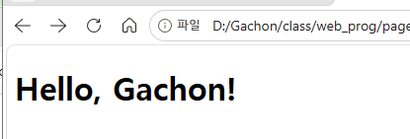
First of all, you should watch the video, read the theory, and study the attached source code. Then do the required task.
Exercise 1
Editor window
Browser window

Slide 3
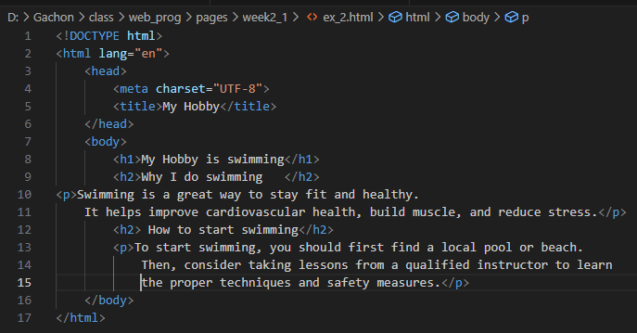
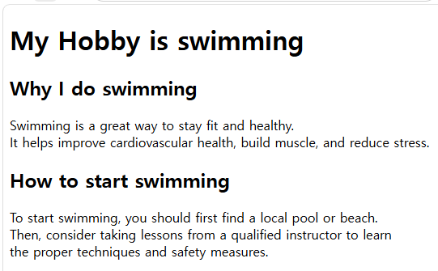
First of all, you should watch the video, read the theory, and study the attached source code. Then do the required task. Here are the results for the Exercise 1~8:
Exercise 2
Editor window
Browser window

Slide 4
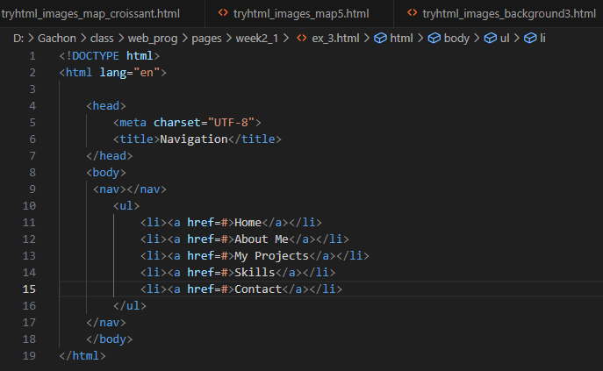
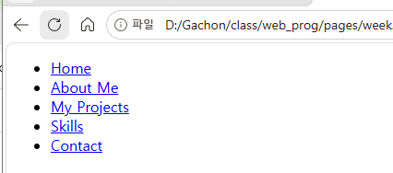
First of all, you should watch the video, read the theory, and study the attached source code. Then do the required task.
Exercise 3
Editor window
Browser window

Slide 5
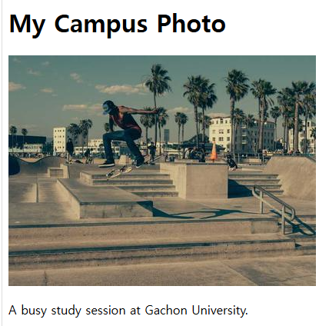
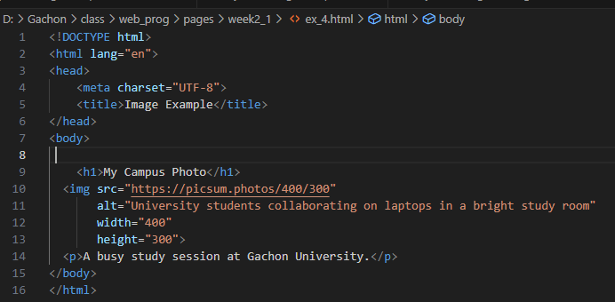
First of all, you should watch the video, read the theory, and study the attached source code. Then do the required task.
Exercise 4
Editor window
Browser window

Slide 6
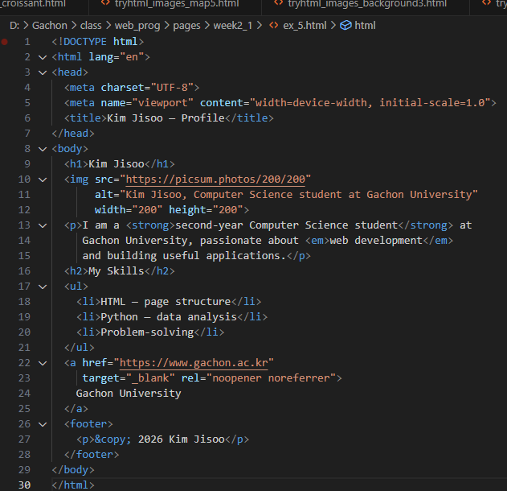

First of all, you should watch the video, read the theory, and study the attached source code. Then do the required task.
Exercise 5
Editor window
Browser window

Slide 7
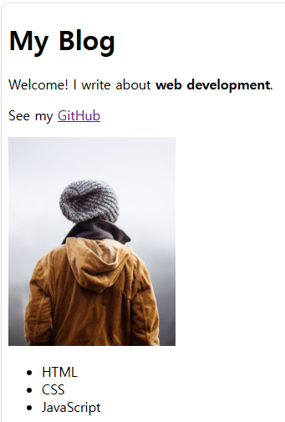
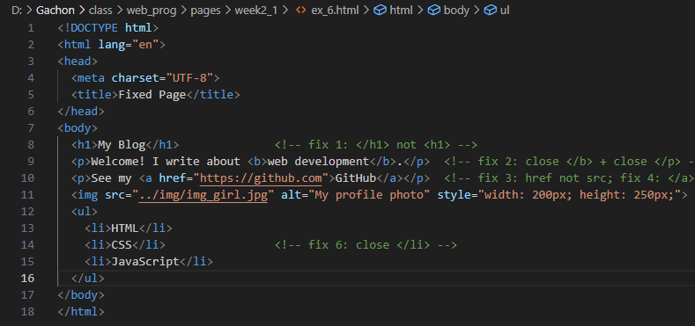
First of all, you should watch the video, read the theory, and study the attached source code. Then do the required task.
Exercise 6
Editor window
Browser window

Slide 8
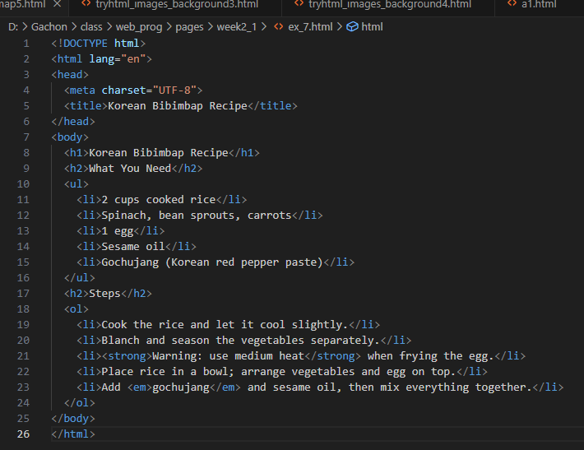
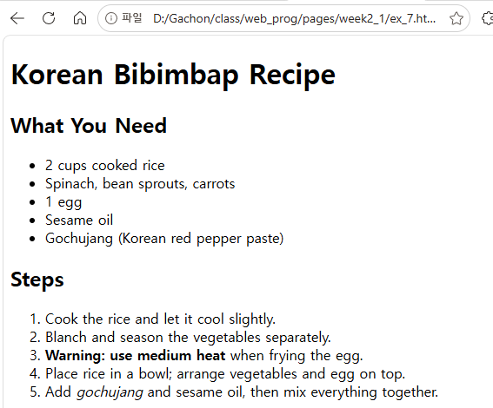
First of all, you should watch the video, read the theory, and study the attached source code. Then do the required task.
Exercise 7
Editor window
Browser window

Slide 9
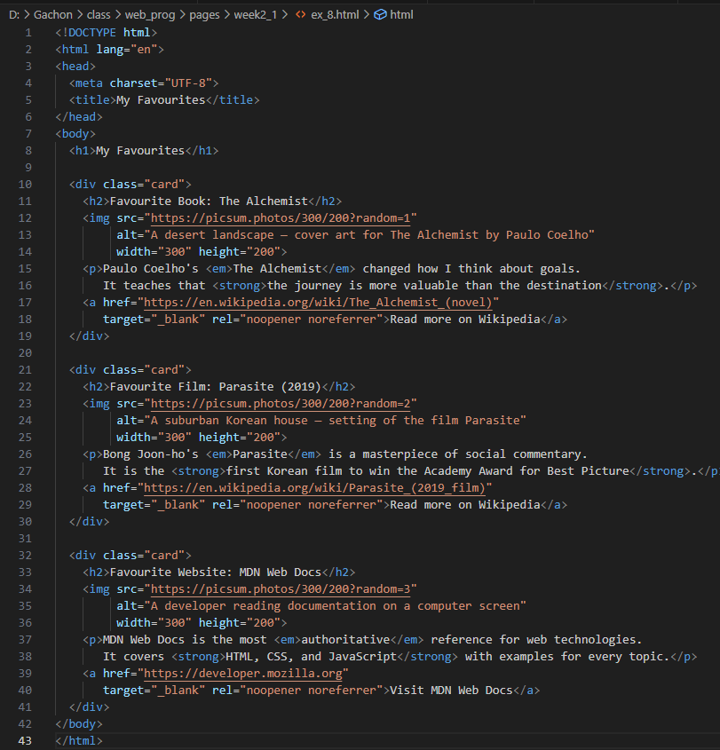
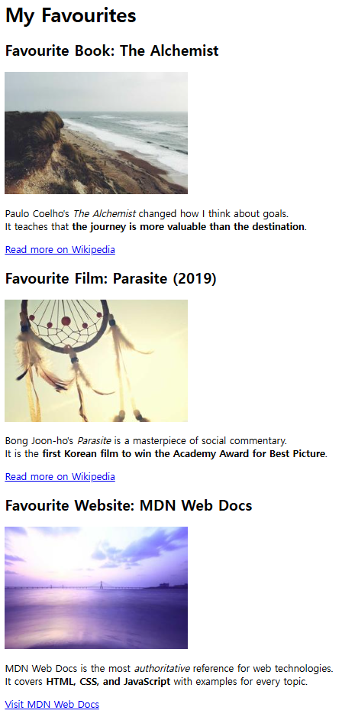
First of all, you should watch the video, read the theory, and study the attached source code. Then do the required task.
Exercise 8
Editor window
Browser window

Slide 10
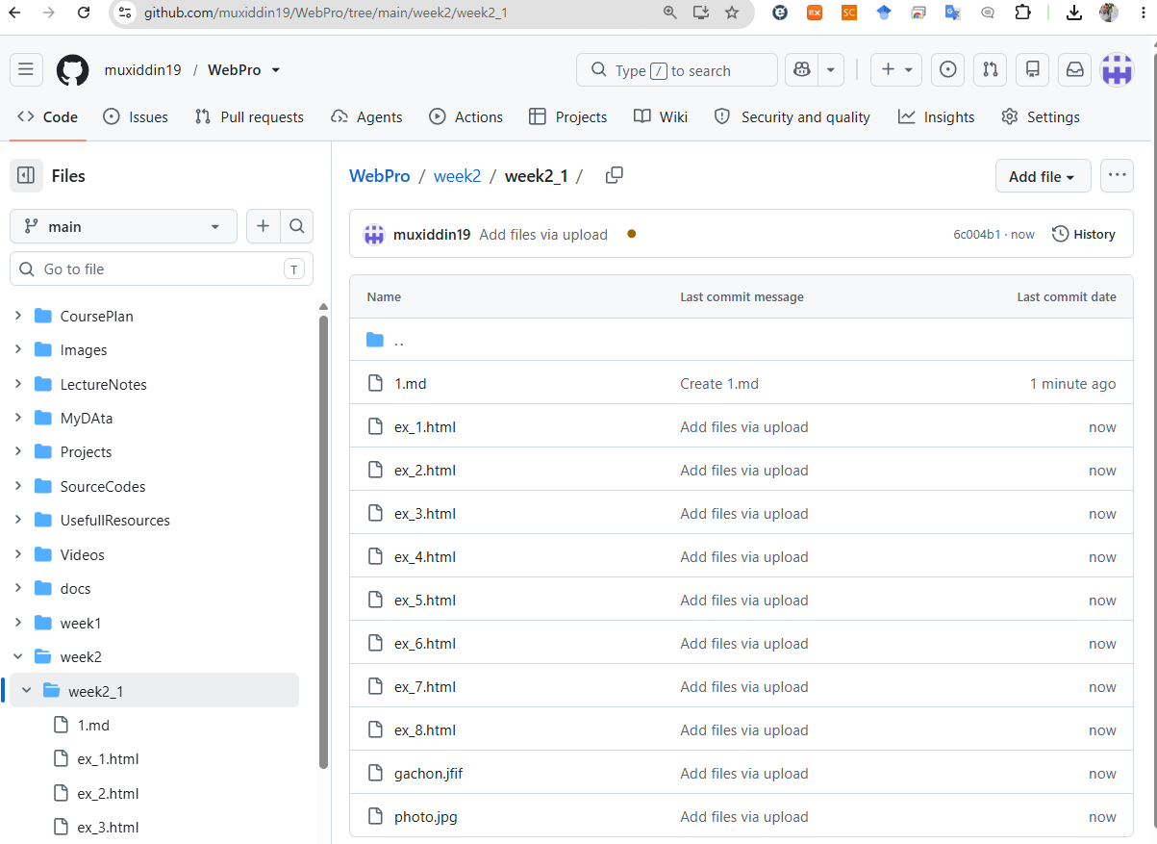
Final submission page
https://github.com/muxiddin19/WebPro/tree/main/week2/week2_1

