Slide 1
React Components & Props
WEB PROGRAMMING · K0126_002
App
↓ props
Card
Card
Card
title="A"
title="B"
title="C"
Week 11 · Friday · Web Programming K0126_002

Slide 2
Today's Agenda
What is a React component?
JSX: HTML inside JavaScript
Props: passing data to components
Composing components
Lists & conditional rendering
Code challenge: build a card component
By the end of class
Wireless Earbuds
89,000원
★★★★½
4.5 / 5 stars
In Stock
A reusable card component
Web Programming · K0126_002

Slide 3
Part 1: What Is a Component?
A function...
function Greeting() {
→
...that returns UI
return <h1>Hi</h1>;
Hi
}
Web Programming · K0126_002

Slide 4
Component = Function That Returns JSX
JSX is not HTML compiler turns <h1>Hi</h1> into React.createElement("h1", null, "Hi")
Capital letter = component. <div> is an HTML tag, and <Greeting /> calls your function.
Re-renders on change. When props or state change, React calls the function again.
Can return null to render nothing.
Props flow down. A parent passes data to a child, and the child shouldn't modify it.
You use it
<Greeting />
↓ React calls the function
The component
function Greeting() {
return <h1>Hi</h1>;
}
↓ returns JSX, shown on screen
Hi
Web Programming · K0126_002

Slide 5
Your First Component
// Simplest possible React component
function Greeting() {
return <h1>Hello, World!</h1>;
}
// Using it in another component
function App() {
return (
<div>
<Greeting />
<Greeting />
<Greeting />
</div>
);
}
Hello, World!
Hello, World!
Hello, World!
https://muxiddin19.github.io/web_pro/week11/Hello,%20World!.html
Notes:
Notice: Greeting is reused 3 times. This is the power of components — write once, use everywhere.

Slide 6
JSX: JavaScript + XML
Not HTML. It compiles to React.createElement()
className, not class. class is a JavaScript keyword.
htmlFor, not for. Same reason.
{ } for JavaScript. Put any expression inside curly braces.
Close every tag. Write <img />, not <img>.
What you write (JSX)
<h1 className="title">Hi</h1>
↓ the compiler turns it into
What React runs (JavaScript)
React.createElement("h1", { className: "title" }, "Hi")
Web Programming · K0126_002

Slide 7
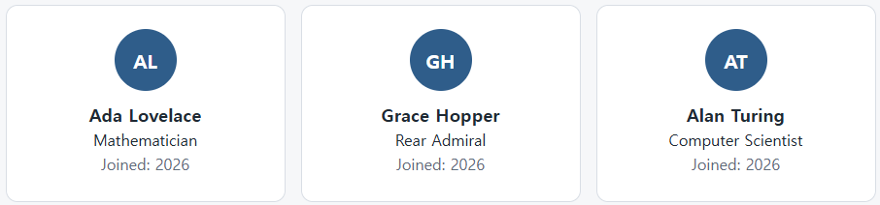
JSX in Practice
function UserCard({ name, role }) {
const initials = name.split(' ').map(w => w[0]).join('');
return (
<div className="card">
<div className="avatar">{initials}</div>
<h2>{name}</h2>
<p className="role">{role}</p>
<p>Joined: {new Date().getFullYear()}</p>
</div>
);
}
https://muxiddin19.github.io/web_pro/week11/User Cards.html
Notes:
Point out: {initials} is a JS expression. Any valid JS expression can go inside {}.

Slide 8
02
Part 2: Props — Passing Data Down
Notes:
Props is short for properties. Think of them like HTML attributes, but for your own components.

Slide 9
Props: Component Arguments
Passed like HTML attributes. <Card title="Hi" />
Received as an object. The component gets props, usually destructured: { title }.
Read-only. A component never modifies its props.
Any JS value works. Strings, numbers, arrays, objects and functions.
Plan for missing values. A prop can be undefined, so use defaults: { title = "Untitled" }.
Parent (App)
<Card title="Hi" />
↓ props = { title: "Hi" }
Child: Card({ title })
Hi
Read-only: Card can't change title.
Web Programming · K0126_002

Slide 10
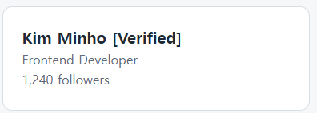
Passing and Using Props
// Parent passes props
function App() {
return (
<ProfileCard
name="Kim Minho"
role="Frontend Developer"
followers={1240}
isVerified={true}
/>
);
}
// Child receives and uses them
function ProfileCard({ name, role, followers, isVerified }) {
return (
<div className="profile">
<h2>{name} {isVerified && '[Verified]'}</h2>
<p>{role}</p>
<p>{followers.toLocaleString()} followers</p>
</div>
);
}
https://muxiddin19.github.io/web_pro/week11/Profile Card.html
Notes:
Destructuring in the function parameter is the preferred pattern. Equivalent to: function ProfileCard(props) { const { name } = props; }

Slide 11
Default Props & PropTypes
Defaults handle missing props. function Button({ label = "Click me", size = "md" }) { ... }
PropTypes (the prop-types package) adds runtime type checks.
TypeScript uses an interface (or type) instead of PropTypes.
Always plan for undefined and null in your JSX.
Missing props use defaults
<Button />
↓ label = "Click me"
Click me
<Button label="Save" />
↓ the passed value wins
Save
Web Programming · K0126_002

Slide 12
Part 3: Composing Components
Header
Card
→
Page
built from small parts
Footer
Web Programming · K0126_002

Slide 13
Component Composition
Small, single-purpose components. Each one does one job.
Compose them into larger ones. Build screens from small parts.
Children let a component wrap others. <Card><p>Hi</p></Card>
Think in React. Each box in a mockup is one component.
Keep trees shallow. Small, focused components are easier to test and debug.
Page
Header
Card
<p>Hi</p>
children
Footer
A screen built from small parts.
Web Programming · K0126_002

Slide 14
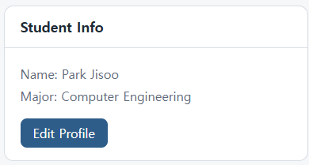
props.children: Wrapper Components
// A reusable card wrapper
function Card({ title, children }) {
return (
<div className="card">
<h3 className="card-title">{title}</h3>
<div className="card-body">
{children}
</div>
</div>
);
}
// Use it to wrap anything
function App() {
return (
<Card title="Student Info">
<p>Name: Park Jisoo</p>
<p>Major: Computer Engineering</p>
<button>Edit Profile</button>
</Card>
);
}
https://muxiddin19.github.io/web_pro/week11/Card.html
Notes:
children is a special prop — whatever is between the opening and closing tags of your component.

Slide 15
Part 4: Lists & Conditional Rendering
Render a list with .map(): one element per array item
Give every item a unique, stable key (an id, not the array index)
Show or hide UI with null, a ternary, or &&
A component can return null to render nothing
List: array to elements
Lee
Park
Kim
↓ students.map(...)
li
li
li
key=1
key=2
key=3
Condition: user ? A : B
user = null
Please log in.
user = { name }
Welcome, Jisoo!
Web Programming · K0126_002

Slide 16
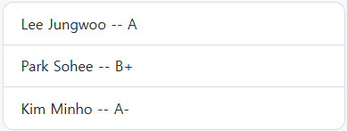
Rendering Lists with .map()
const students = [
{ id: 1, name: 'Lee Jungwoo', grade: 'A' },
{ id: 2, name: 'Park Sohee', grade: 'B+' },
{ id: 3, name: 'Kim Minho', grade: 'A-' },
];
function StudentList() {
return (
<ul>
{students.map(student => (
<li key={student.id}>
{student.name} -- {student.grade}
</li>
))}
</ul>
);
}
https://muxiddin19.github.io/web_pro/week11/Student List.html
Notes:
THE most common React bug: forgetting the key prop. React uses key to track list items. It must be unique and stable (use id, not index).

Slide 17
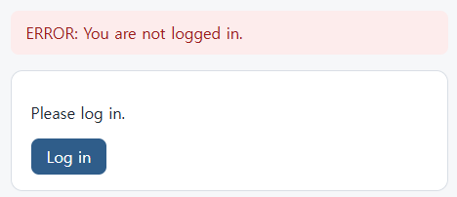
Conditional Rendering
function Alert({ type, message }) {
if (!message) return null; // render nothing
return (
<div className={"alert alert-" + type}>
{type === 'error' ? 'ERROR:' : 'OK:'} {message}
</div>
);
}
function Dashboard({ user }) {
return (
<div>
{user && <p>Welcome, {user.name}!</p>}
{!user && <p>Please log in.</p>}
</div>
);
}
https://muxiddin19.github.io/web_pro/week11/Conditional Rendering.html
Notes:
Three patterns: if/return early, ternary (a ? b : c), && shortcut. null tells React to render nothing.

Slide 18
Component Best Practices
One component, one responsibility. This is the Single Responsibility Principle.
Keep them small. If a component does too much, split it.
Name them clearly. ProductCard, not Comp1.
One file per component in larger apps.
Default export for the main component, named exports for utilities.
ProductCard.jsx
ProductImage
ProductTitle
shows the photo
shows the name
PriceTag
BuyButton
formats the price
handles the click
One job each: easy to test and reuse.

Slide 19
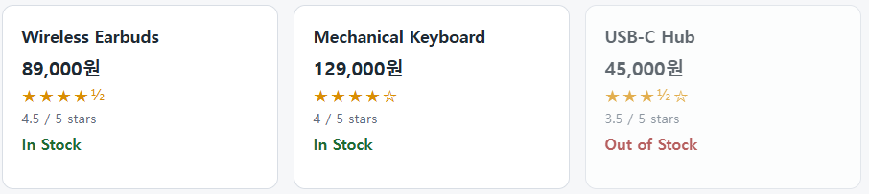
Code Challenge: Build a ProductCard
// Challenge: Build a ProductCard component
// that accepts these props:
// name (string) — product name
// price (number) — price in KRW
// rating (number) — 0 to 5 stars
// inStock (boolean) — is it available?
// Expected usage:
// <ProductCard
// name="Wireless Earbuds"
// price={89000}
// rating={4.5}
// inStock={true}
// />
// Bonus: display rating/5 (e.g., "4.5 / 5 stars")
// Bonus 2: show "Out of Stock" label if !inStock
https://muxiddin19.github.io/web_pro/week11/Product Card.html
Notes:
Give students 10 minutes. Walk around and check. Common mistake: forgetting to handle inStock=false.

Slide 20
Homework: Portfolio Gallery Component
Create a React project: npx create-react-app portfolio-gallery
Build a ProjectCard component (title, description, tech stack, GitHub link, demo link)
Build a ProjectList that renders an array of 3+ ProjectCards
Add a FilterBar component that filters cards by technology
Submit your GitHub repo URL on Cybercampus before next class
App
FilterBar
All · React · Node · CSS
ProjectList
ProjectCard
title · tech · GitHub · demo
ProjectCard
title · tech · GitHub · demo
ProjectCard
title · tech · GitHub · demo
Web Programming · K0126_002

Slide 21
Key Takeaways
Components are functions that return JSX
Props flow ONE WAY: parent to child (never the reverse)
Every list item needs a unique, stable key prop
Conditional rendering: null, ternary, or && operator
Compose small components into larger ones: this is how React apps are built
App (parent)
↓ props, one way
ProjectList (child)
↓ renders items with keys
Card
Card
Card
key=1
key=2
key=3
Web Programming · K0126_002

Slide 22
Next Session & Resources
Monday: React State: components that remember things (useState Hook)
React official docs: react.dev (new docs, excellent)
Scrimba React course (free tier): scrimba.com/learn/learnreact
CodeSandbox: codesandbox.io. Run React in the browser, no setup needed
Video: React in 100 Seconds by Fireship on YouTube
Monday: useState
Counter
count = 3
↓ click
+1
↓ state changes
React re-renders
count = 4
Web Programming · K0126_002

