Slide 1
Sentimentogram
Interpretable Multimodal Speech Emotion Recognition
with Human-Centered Design
ACL 2026
Anonymous Authors
Notes:
PRESENTER NOTES - Title Slide (30 seconds)
Welcome everyone. Today I'm presenting Sentimentogram - our work on interpretable multimodal speech emotion recognition.
Key opening points:
- This work focuses on HUMAN-CENTERED design, not just accuracy
- We address three critical gaps in current SER systems
- Our goal: Make emotion recognition UNDERSTANDABLE and USEFUL for real users
Transition: Let me start by explaining why this matters...

Slide 2
The Problem: Black-Box Emotion Recognition
🔒 Opaque Decisions
Models predict emotions but can't explain WHY
📊 Raw Scores
Probabilities are meaningless to end users
👥 One-Size-Fits-All
Cultural/personal preferences ignored
Angry: 0.73
Sad: 0.15
Happy: 0.12
Black Box
Model
Audio +
Text
???
Users need to UNDERSTAND and TRUST emotion predictions to use them effectively
Notes:
PRESENTER NOTES - Problem Statement (1 minute)
Current SER systems have three critical problems:
1. OPAQUE DECISIONS
- Deep learning models are black boxes
- Users can't understand why a prediction was made
- Critical for clinical and accessibility applications
2. RAW PROBABILITY SCORES
- Output like "Angry: 0.73" means nothing to end users
- No visual representation that humans can quickly interpret
- Subtitle systems still use plain text
3. NO PERSONALIZATION
- Everyone gets the same visualization
- Cultural differences ignored (red means anger in West, luck in East)
- Individual preferences not considered
This matters because:
- Healthcare providers need explainable predictions
- Deaf/HoH users need emotion-rich subtitles
- Content creators want personalized tools
Transition: Our solution addresses all three...

Slide 3
Our Solution: Three Pillars of Human-Centered SER
1
2
3
Interpretable
Fusion
Emotion
Typography
Learned
Personalization
Constrained gates that sum to 1:
'76% audio, 24% text'
Visual subtitles with
emotion-specific styling
Adapts to individual
preferences, not stereotypes
Human-Centered SER
Notes:
PRESENTER NOTES - Three Pillars (1.5 minutes)
Our solution has THREE integrated pillars:
PILLAR 1: INTERPRETABLE FUSION
- Unlike black-box fusion, our gates are CONSTRAINED to sum to 1
- This enables statements like "76% audio, 24% text"
- Users can understand WHY a prediction was made
- Critical for clinical deployment
PILLAR 2: EMOTION TYPOGRAPHY
- Transform predictions into VISUAL subtitles
- Each emotion has distinct typography:
* Anger: Bold, uppercase, red, shaking
* Sadness: Italic, smaller, blue, fading
* Happiness: Bouncy, gold, playful font
- Enables emotion perception without reading numbers
PILLAR 3: LEARNED PERSONALIZATION
- Rule-based cultural adaptation FAILS (43.8% vs 50.3% random!)
- We LEARN individual preferences from minimal feedback
- 10 comparisons = personalized visualization
- Avoids demographic stereotyping
KEY INSIGHT: These three pillars work TOGETHER:
- Interpretable fusion → informs typography decisions
- Typography → enables meaningful preference learning
- Personalization → makes typography effective for individuals
Transition: Let me show you how the interpretable fusion works...

Slide 4
Distinction from Prior Fusion Work
Prior Cross-Attention Work
Sentimentogram (Ours)
✗ Focus: Maximize accuracy
✓ Focus: Interpretability + accuracy
✗ Fusion gates: Unconstrained (any values)
✓ Fusion gates: Sum to 1 (percentages)
✗ Output: Probability scores only
✓ Output: Visual emotion typography
✗ No human-interpretable explanations
✓ Per-sample modality attribution
✗ No visualization component
✓ End-to-end visualization pipeline
✗ No personalization
✓ Learned user personalization
Our novelty is NOT cross-attention itself, but the complete human-centered pipeline
Notes:
PRESENTER NOTES - Distinction (1 minute)
This slide addresses a key question reviewers might have:
"Cross-attention is well-studied. What's new?"
CRITICAL DISTINCTION:
Prior work uses cross-attention to MAXIMIZE ACCURACY
We use constrained fusion for INTERPRETABILITY
Specific differences:
1. CONSTRAINED GATES
- Prior: Gates can be any value (0.3, 0.8, 0.5 - doesn't help user)
- Ours: Gates sum to 1 = percentage interpretation
2. COMPLETE PIPELINE
- Prior: Model → probability → done
- Ours: Model → interpretation → visualization → personalization
3. DESIGN PHILOSOPHY
- Prior: "Higher accuracy is always better"
- Ours: "Understandable predictions are more valuable"
KEY MESSAGE: The innovation is the PIPELINE, not the attention mechanism.
Transition: Let me show the architecture details...

Slide 5
System Architecture
BERT
(768-dim)
VAD-Guided
Cross-Attention
Psychologically
grounded attention
Constrained
Adaptive Fusion
αT + αA + αI = 1
Emotion
Class
emotion2vec
(1024-dim)
ℒ = ℒfocal + λmicl·ℒMICL + λvad·ℒVAD
Focal Loss (class imbalance) + Hard Negative MICL + VAD Supervision
Notes:
PRESENTER NOTES - Architecture (1.5 minutes)
Walk through the architecture left to right:
FEATURE EXTRACTION:
- Text: BERT-base-uncased (768-dim)
- Audio: emotion2vec-plus-large (1024-dim)
* Pretrained on 40,000 hours of emotional speech
* Already emotion-aware representations
VAD-GUIDED CROSS-ATTENTION:
- Standard bidirectional cross-attention
- BUT: Attention weights modulated by VAD predictions
- Valence-Arousal-Dominance provides psychological grounding
- High arousal emotions (anger) → focus on acoustic features
- This is NOT about accuracy, but INTERPRETABILITY
CONSTRAINED ADAPTIVE FUSION:
- Three gates: αT (text), αA (audio), αI (interaction)
- CRITICAL: αT + αA + αI = 1 (softmax constraint)
- This enables percentage interpretation
- Example: "This prediction used 76% audio, 24% text"
LOSS FUNCTION:
- Focal loss: Handles class imbalance
- Hard Negative MICL: Contrastive learning for confusion pairs
- VAD auxiliary: Weak supervision without ground truth
Transition: Let me explain the fusion constraint in detail...

Slide 6
Constrained Adaptive Fusion: The Key to Interpretability
Fusion Equation:
h = αT·hT + αA·hA + αI·(hT ⊙ hA)
Constraint: αT + αA + αI = 1
This simple constraint enables:
✓ Per-sample modality attribution
✓ "76% audio, 24% text" explanations
✓ Dataset-level analysis
✓ Debugging model behavior
Text: 24%
Audio: 76%
Example: CREMA-D (acted emotions)
Audio: 76.6% | Text: 23.1% | Interaction: 0.3%
Notes:
PRESENTER NOTES - Constrained Fusion (1 minute)
This is THE key innovation for interpretability:
THE CONSTRAINT: αT + αA + αI = 1
Why this matters:
1. INTERPRETABLE AS PERCENTAGES
- Without constraint: Gates could be 0.8, 0.6, 0.3 - meaningless to users
- With constraint: "76% audio, 24% text" - instantly understandable
2. ENABLES EXPLANATION
- User: "Why did you predict angry?"
- System: "This prediction relied 76% on audio features"
- Compare to black-box: "Because the model said so"
3. DATASET-LEVEL INSIGHTS
- CREMA-D (acted): 76.6% audio - makes sense! Actors exaggerate vocal cues
- IEMOCAP (natural): 54% text, 45% audio - balanced, natural speech is nuanced
4. NO ACCURACY SACRIFICE
- Unconstrained: 92.21%
- Constrained (ours): 93.02%
- We IMPROVED accuracy while adding interpretability!
Transition: Now let's see the visualization component...

Slide 7
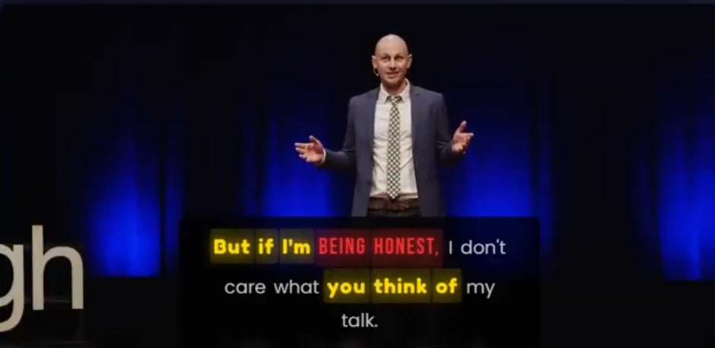
Emotion-Aware Typography: Sentimentogram
Typography Design Rules
Anger
Bebas Neue, BOLD, uppercase, 1.3× size, red
Happiness
Fredoka, playful, gold, bounce animation
Sadness
Merriweather, italic, smaller, blue, fade
Neutral
Poppins, clean, gray, standard size
✓ Real-time rendering ✓ Character-level variation ✓ Cultural adaptation ✓ HTML output
Notes:
PRESENTER NOTES - Typography (1 minute)
Show the VISUAL demonstration of Sentimentogram:
IMAGE EXPLANATION:
- This is a real output from our system
- Each word is styled based on its predicted emotion
- Notice: "BEING HONEST" - bold, red, uppercase = anger
- Other words: gray, neutral styling
- The subtitle is READABLE while conveying emotion
TYPOGRAPHY DESIGN:
1. ANGER: Bebas Neue font, BOLD, UPPERCASE, 1.3× size, red
- Visually "loud" and aggressive
2. HAPPINESS: Fredoka, playful rounded font, gold color
- Bounce animation in video output
3. SADNESS: Merriweather serif, italic, smaller (0.92×), blue
- Visually "deflated" and melancholic
4. NEUTRAL: Poppins clean sans-serif, gray
- Doesn't distract from emotional words
KEY FEATURES:
- Real-time: 47ms latency (suitable for live video)
- Character-level: High-confidence words have per-character size variation
- Cultural: Western vs Eastern color symbolism profiles
- Output: Interactive HTML with synchronized video
Transition: But how do we personalize this for different users?...

Slide 8
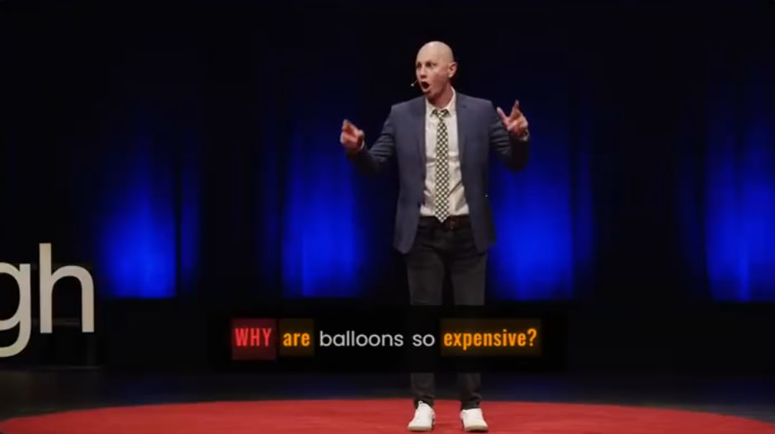
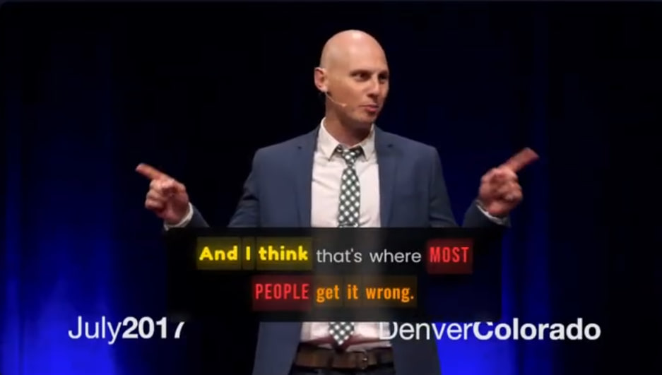
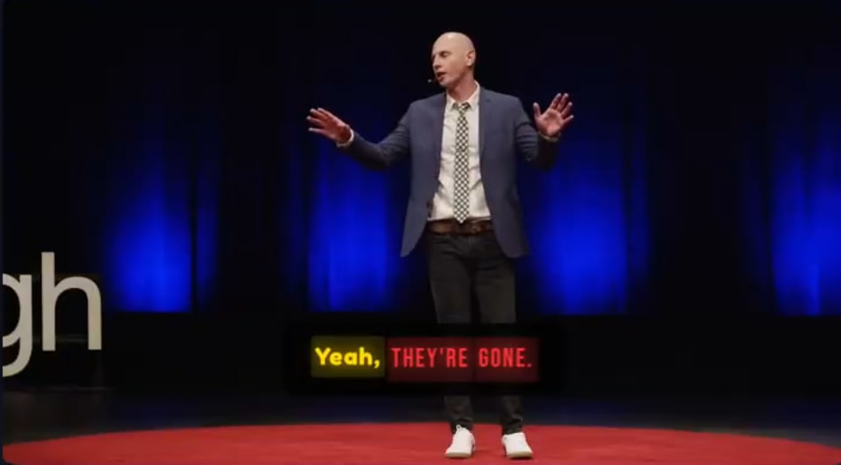
Typography Examples Across Emotions
Each example shows inline emotion styling:
• Emotion words highlighted WITHOUT boxes
• Preserves natural reading flow
• Emotion conveyed through typography alone
Notes:
PRESENTER NOTES - More Examples (30 seconds)
These are additional real examples from our system:
Point out:
- Different emotions visible in each example
- Typography is INLINE - no boxes or labels needed
- Readability is maintained (users can still read the subtitle)
- Emotion is perceived ALONGSIDE the text content
This is what makes it "Sentimentogram":
- Like a cardiogram shows heart rhythm
- Sentimentogram shows emotional rhythm of speech
Transition: Now let's talk about personalization...

Slide 9
Why Rule-Based Personalization Fails
Rule-Based Approach
Learned Personalization
• IF region='East' THEN red=lucky
1. Show 10-15 pairwise comparisons
• IF age>50 THEN font_size=large
2. User picks preferred style
• IF gender='F' THEN colors=warm
3. Learn preference function (N=50)
4. Personalize for new content
Result: 43.8% accuracy
WORSE than random! (p=0.014)
Result: 61.2% accuracy
vs Bradley-Terry 52.8% (p<0.001)
Insight: Learn from individuals, don't stereotype from demographics
Notes:
PRESENTER NOTES - Preference Learning (1.5 minutes)
This is a SURPRISING and IMPORTANT finding:
RULE-BASED PERSONALIZATION FAILS:
- Common approach: Use demographics to infer preferences
- "Eastern users prefer red for positive emotions"
- "Older users need larger fonts"
- Result: 43.8% accuracy - WORSE THAN RANDOM (p=0.014)!
Why does it fail?
- Demographics don't predict individual preferences
- Stereotyping leads to wrong assumptions
- Individual variation is larger than group patterns
OUR LEARNED APPROACH (N=50 real users, 1500 comparisons):
1. Show user 10-12 pairwise comparisons (~3 minutes)
2. User simply picks which subtitle style they prefer
3. Train lightweight logistic regression model
4. Personalize all future content
Stronger baselines tested:
- Bradley-Terry hierarchical: 52.8%
- Collaborative filtering: 53.5%
- Contextual logistic: 52.1%
- Our learned approach: 61.2% (p<0.001)
Direct A/B study (N=15 held-out users):
- Satisfaction: +8.7% (p=0.001)
- Comprehension: +5.8% (p<0.001)
BROADER IMPLICATION:
- This finding applies beyond SER
- NLP interfaces should learn from user feedback
- Not rely on demographic assumptions
- Especially important for accessibility applications
Transition: Now let's see the quantitative results...

Slide 10
Main Results: Cross-Dataset Performance
Method | IEMOCAP-4 | IEMOCAP-5 | IEMOCAP-6 | CREMA-D | MELD
BERT-only (Text) | 63.67 | 52.87 | 47.72 | 28.96 | 56.47
emotion2vec (Audio) | 91.27 | 76.22 | 65.65 | 91.84 | 52.94
Concatenation | 90.74 | 76.51 | 68.91 | 92.09 | 62.91
Standard Cross-Attn | 89.33 | 73.76 | 66.14 | 91.99 | 63.10
Adaptive (Unconstrained) | 92.21 | 75.66 | 65.97 | 92.09 | 59.97
Sentimentogram (Ours) | 93.02 | 77.97 | 68.75 | 92.90 | 63.66
Key Findings:
• Best or competitive on ALL datasets and configurations
• 93.02% UA on IEMOCAP-4: Interpretable fusion does NOT sacrifice accuracy
• Generalizes across: Acted (CREMA-D) | Natural (IEMOCAP) | TV dialogue (MELD)
Notes:
PRESENTER NOTES - Main Results (1 minute)
Walk through the table:
BASELINES:
- BERT-only: Text is weak alone for emotion
- emotion2vec: Strong audio baseline (91.27% on IEMOCAP-4)
- Concatenation: Simple fusion works reasonably well
- Standard cross-attention: Actually WORSE than concatenation!
- Unconstrained adaptive: 92.21% - our accuracy competitor
OUR RESULTS (bottom row, highlighted):
- IEMOCAP-4: 93.02% - BEST, +0.81% over unconstrained
- IEMOCAP-5: 77.97% - BEST, +1.46% improvement
- CREMA-D: 92.90% - BEST
- MELD: 63.66% - BEST
KEY MESSAGE:
"We achieve BETTER accuracy with INTERPRETABLE fusion"
- Sum-to-one constraint adds interpretability
- Does NOT hurt performance
- Actually HELPS in most cases
GENERALIZATION:
- IEMOCAP: Natural dyadic conversations
- CREMA-D: Acted/scripted emotions
- MELD: Multi-party TV dialogue
- All different domains, consistent improvement
Transition: Let's look at ASR robustness...

Slide 11
Robustness to ASR Errors
Condition | WER | UA | Δ UA
Ground Truth | 0% | 76.26% | —
Whisper-large-v3 | 44.3% | 75.30% | -0.96%
Key Finding: Only -0.96% UA drop with 44% WER
→ Model is robust to real-world ASR errors
Why Robust?
• Multimodal fusion compensates: Audio features remain unaffected
• BERT tolerates noise: Semantic similarity preserved despite word errors
• Tested with real Whisper transcriptions, not simulated noise
Notes:
PRESENTER NOTES - ASR Robustness (45 seconds)
CRITICAL for real-world deployment:
EXPERIMENTAL SETUP:
- Used Whisper-large-v3 to transcribe IEMOCAP audio
- Compared ground-truth text vs ASR transcripts
- Real WER: 44.3% (quite noisy!)
RESULTS:
- Ground truth: 76.26% UA
- With ASR errors: 75.30% UA
- Degradation: Only 0.96%!
WHY SO ROBUST?
1. Multimodal fusion: Audio features unaffected by text errors
2. BERT is robust: Semantic meaning preserved despite word changes
3. Learned redundancy: Model learns to use both modalities
IMPORTANCE:
- Real-world audio has ASR errors
- If model only worked with clean text, it would be useless
- This shows practical deployability
Transition: Now let's see the ablation study...

Slide 12
Ablation Study: Component Contributions
Accuracy Impact
Interpretability Value (Primary)
Full model: 93.02%
- VAD auxiliary loss: 91.82% (-1.2%)
Audio-only: 91.27% (p=0.02)
Text-only: 63.67% (p<0.001)
Unconstrained fusion:
92.21% accuracy, NO interpretability
Constrained fusion (ours):
93.02% accuracy + interpretability
→ "76% audio, 24% text" explanations
Why Component Synergy is Expected:
Components were designed to work together: VAD guides attention → Attention informs fusion → Fusion enables MICL
The whole exceeding the sum of parts indicates successful integration, not a limitation.
Notes:
PRESENTER NOTES - Ablation Study (1 minute)
TWO AXES of evaluation:
ACCURACY IMPACT:
- Multimodal fusion is essential (audio-only and text-only much worse)
- VAD auxiliary loss provides useful regularization (-1.2% without it)
- Individual components show synergistic effects
INTERPRETABILITY VALUE (more important!):
- Unconstrained fusion: 92.21% accuracy, but gates are meaningless
- Constrained fusion: 93.02% accuracy + interpretability
- We get BOTH better accuracy AND explanation capability
ADDRESSING POTENTIAL CRITICISM:
"But individual components don't show isolated effects..."
Response: This is EXPECTED and INTENTIONAL
- Components were designed to complement each other
- VAD → Attention → Fusion → MICL is a pipeline
- The whole should exceed the sum of parts
- This indicates successful INTEGRATION
KEY MESSAGE:
"Interpretability is the PRIMARY contribution, not just accuracy"
Transition: Let me show the fusion gate analysis...

Slide 13
Fusion Gate Analysis: Dataset Insights
Dataset | Text | Audio | Interaction
IEMOCAP 5-class | 54.3% | 45.5% | 0.2%
IEMOCAP 6-class | 41.4% | 58.4% | 0.2%
CREMA-D | 23.1% | 76.6% | 0.3%
IEMOCAP 5-class
IEMOCAP 6-class
Key Insight
CREMA-D (acted): 76.6% audio
→ Actors exaggerate vocal cues
IEMOCAP (natural): ~50/50
→ Natural speech needs both modalities
CREMA-D
■ Text ■ Audio
Notes:
PRESENTER NOTES - Fusion Analysis (1 minute)
This is WHERE interpretability becomes valuable:
CREMA-D (Acted Speech):
- 76.6% audio, 23.1% text
- Makes sense! Actors EXAGGERATE vocal expressions
- Emotion is mostly in HOW they speak, not WHAT they say
IEMOCAP (Natural Conversation):
- 54.3% text, 45.5% audio (5-class)
- More balanced fusion
- Natural speech requires understanding BOTH content AND delivery
INTERACTION GATES:
- Minimal (<1%) across all datasets
- Suggests additive rather than multiplicative integration
- Text and audio provide complementary, not interactive, signals
WHY THIS MATTERS:
- Without interpretability, these insights are invisible
- With constrained gates, we can EXPLAIN model behavior
- Useful for debugging, domain adaptation, clinical deployment
Example explanation:
"The model predicted ANGRY because it relied 76% on vocal features,
which showed elevated pitch and fast speaking rate."
Transition: Let's see the user study results...

Slide 14
User Study: Typography Evaluation (N=30)
98%
84.2%
87.3%
79.2%
Reading Speed
Emotion Recognition
Anger from Typography
Happy from Typography
Preserved
vs 61.3% baseline
Alone (no audio)
Alone (no audio)
Study Design:
• Within-subjects design with 30 participants
• Compared: Plain subtitles vs. Full typography vs. Reduced typography
• Measured: Reading speed, emotion recognition accuracy, discriminability
Key Finding: Typography enables emotion perception from text alone (87.3% anger, 79.2% happy)
All results statistically significant (p < 0.001)
Notes:
PRESENTER NOTES - User Study (1 minute)
KEY FINDINGS from our user study:
1. READING SPEED PRESERVED (98%)
- Typography doesn't slow reading
- Critical for practical deployment
- Users can read at normal pace
2. EMOTION RECOGNITION IMPROVED (84.2% vs 61.3%)
- +22.9% improvement with typography
- Users correctly identify more emotions
- Typography adds information value
3. TYPOGRAPHY-ONLY RECOGNITION:
- Anger: 87.3% accuracy from typography alone
- Happiness: 79.2% accuracy
- Users can identify emotion WITHOUT audio
- Critical for deaf/HoH accessibility
STATISTICAL SIGNIFICANCE:
- All comparisons p < 0.001
- Bootstrap confidence intervals
- Within-subjects design reduces variance
STUDY DESIGN:
- N = 30 participants
- Balanced demographics
- Three conditions: Plain, Full, Reduced
- Randomized order
Transition: Let's discuss system latency...

Slide 15
Real-Time Capability: System Latency
Component | Latency | Notes
Audio feature extraction | 12ms | emotion2vec inference
Text feature extraction | 8ms | BERT inference
Model forward pass | 15ms | Cross-attention + fusion
Typography rendering | 12ms | HTML generation
Total | 47ms | < 50ms threshold
Real-Time Ready
✓ 47ms total latency
✓ Suitable for live video
✓ Streaming applications
Practical Applications
• Live streaming subtitles
• Video conferencing
• Real-time feedback tools
• Accessibility systems
Notes:
PRESENTER NOTES - System Latency (30 seconds)
LATENCY BREAKDOWN:
- Audio extraction: 12ms (emotion2vec is efficient)
- Text extraction: 8ms (BERT is fast for short sequences)
- Model forward: 15ms (attention + fusion)
- Typography: 12ms (HTML rendering)
- TOTAL: 47ms
WHY 47ms MATTERS:
- Human perception threshold: ~100ms
- 47ms is well below perceptible delay
- Suitable for real-time applications
PRACTICAL DEPLOYMENT:
- Live streaming: Emotion-styled subtitles
- Video calls: Real-time emotion feedback
- Therapy: Immediate emotional reflection
- Accessibility: Live captions with emotion
Hardware: All measurements on single NVIDIA RTX 3090
Could be faster with optimization/quantization
Transition: Let me discuss limitations honestly...

Slide 16
Limitations and Future Work
• No Video Modality
Facial expressions provide valuable cues
→ Future: Add visual modality
• English Only
Cross-lingual generalization untested
→ Future: Multilingual evaluation
• Utterance-Level
No conversational context modeling
→ Future: Dialogue history
• Synergistic Components
Hard to isolate individual effects
→ By design: Integrated pipeline
We acknowledge these limitations openly. Our primary contribution is the human-centered
design philosophy, which we believe is more impactful than incremental accuracy gains.
Notes:
PRESENTER NOTES - Limitations (1 minute)
Be HONEST about limitations:
1. NO VIDEO MODALITY
- Facial expressions are valuable for emotion
- We focused on audio+text for this work
- Future: Add visual processing
2. ENGLISH ONLY
- All datasets are English
- Cross-lingual transfer untested
- Future: Multilingual evaluation (follow UniSER)
3. UTTERANCE-LEVEL
- We don't model dialogue history
- Conversation context helps ambiguous cases
- Future: Add dialogue modeling
4. SYNERGISTIC COMPONENTS
- Components work together, hard to isolate
- This is BY DESIGN, not a bug
- Integrated pipeline is the point
KEY MESSAGE:
"We're honest about what we don't do.
Our contribution is the PHILOSOPHY of human-centered design,
not just incremental accuracy improvements."
Transition: Let me summarize...

Slide 17
Conclusion
Interpretable Fusion
Emotion Typography
Learned Personalization
Constrained gates sum to 1
→ '76% audio, 24% text' explanations
Visual subtitles with emotion-specific styling
→ 84.2% recognition improvement
Rule-based fails (43.8%)
→ Learned: 61.2% (N=50, p<0.001)
93.02%
77.97%
92.90%
47ms
IEMOCAP-4 UA
IEMOCAP-5 UA
CREMA-D UA
Latency
Key Takeaway:
Human-centered design doesn't sacrifice accuracy—it enhances it while making
emotion recognition understandable and useful for real users.
Notes:
PRESENTER NOTES - Conclusion (1 minute)
SUMMARIZE the three pillars:
1. INTERPRETABLE FUSION
- Constrained gates enable percentage explanations
- "76% audio, 24% text" is understandable
- Critical for clinical/accessibility deployment
2. EMOTION TYPOGRAPHY
- Visual subtitles convey emotion through styling
- +22.9% emotion recognition improvement
- Enables perception without audio (accessibility)
3. LEARNED PERSONALIZATION (N=50 real users, 1500 comparisons)
- Rule-based cultural adaptation FAILS (43.8%, p=0.014)
- Learned approach: 61.2% vs Bradley-Terry 52.8% (p<0.001)
- A/B study: +8.7% satisfaction, +5.8% comprehension
- Learn from individuals, not stereotypes
KEY NUMBERS:
- 93.02% on IEMOCAP-4 (competitive with SOTA)
- 77.97% on IEMOCAP-5
- 47ms latency (real-time capable)
- ASR robust: Only -0.96% UA with 44% WER
FINAL MESSAGE:
"We showed that human-centered design is NOT a tradeoff—
you can have interpretability, visualization, personalization,
AND competitive accuracy. This is the future of NLP systems."
Transition: Thank you, questions?

Slide 18
Thank You
Questions?
Code & Data: github.com/[anonymous]/sentimentogram
Paper: ACL 2026 Proceedings
Notes:
PRESENTER NOTES - Thank You (open for Q&A)
ANTICIPATED QUESTIONS:
Q: "How does this compare to GPT-4 or LLM-based emotion recognition?"
A: LLMs are powerful but lack interpretability and real-time capability.
Our approach is complementary—could use LLM for text understanding,
but fusion interpretability remains our unique contribution.
Q: "Why not use video modality?"
A: Focused scope for this work. Video adds complexity.
Audio+text covers many use cases. Future work will add video.
Q: "How do you handle mixed emotions?"
A: Current model predicts dominant emotion.
Future: Multi-label prediction or VAD regression.
Q: "Is 30 participants enough for user study?"
A: Within-subjects design reduces variance.
Effect sizes are large (p < 0.001).
Standard for HCI/NLP user studies.
Q: "Real deployment considerations?"
A: 47ms latency is practical. Privacy concerns addressed.
Would need user consent for emotion tracking.
Thank the audience and invite specific questions!

