Slide 1
Code Cracker
Yuxi Chen

Slide 2
It’s a PUZZLE GAME

Slide 3
Goal of the game
The goal of the game is to guess the combination of colors of the 4 hidden pieces.
The color repetition is possible.
There are 6 possible colors.
The maximum number of guesses is 7.
6*6*6*6=1296
7/1296

Slide 4







Slide 5


Same color
And
right position
Same color
But
wrong position

Slide 6
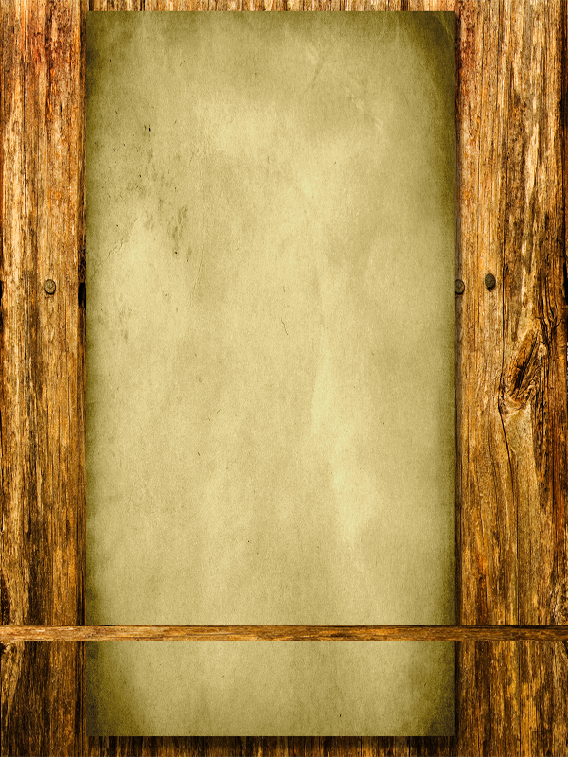








The APP looks like THIS
……
You win!

Slide 7
More features in the future
Skins!!!
PK mode!!!
Levels!!!
Tutorials!!!~

Slide 8
Thank you

