Slide 1
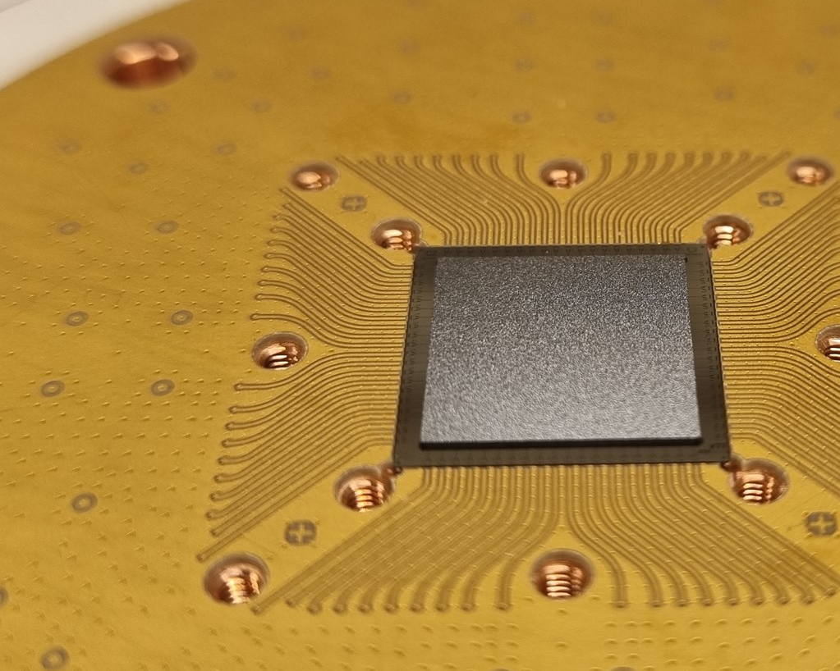


Control-Signal Crosstalk in Flip-Chip Superconducting Quantum Processors Sandoko Kosen (Chalmers University of Technology)
CHALMERS Team
VTT Team
Tahereh Abad Anuj Aggarwal Janka Biznárová Liangyu Chen Miroslav Dobsicek Jorge Fernández-Pendás
Simon Pettersson Fors Göran Johansson Sandoko Kosen Christian Križan Hang-Xi Li Eleftherios Moschandreou Andreas Nylander Amr Osman Robert Rehammar Marcus Rommel Anita Fadavi Roudsari Daryoush Shiri Tom Vethaak Christopher Warren
Alexey Zadorozhko
Anton Frisk Kockum
Giovanna Tancredi Per Delsing Jonas Bylander
Marco Caputo Leif Grönberg Kestutis Grigoras Joonas Govenius
Q72.00010
Packaged Flip-Chip Module
Chip Design & Fabrication by Chalmers Flip-Chip Packaging by VTT
Sample Holder & PCB concept by Chalmers

Slide 2
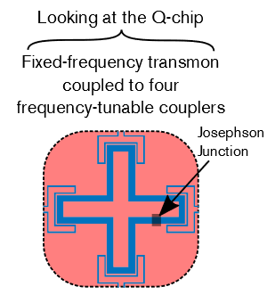
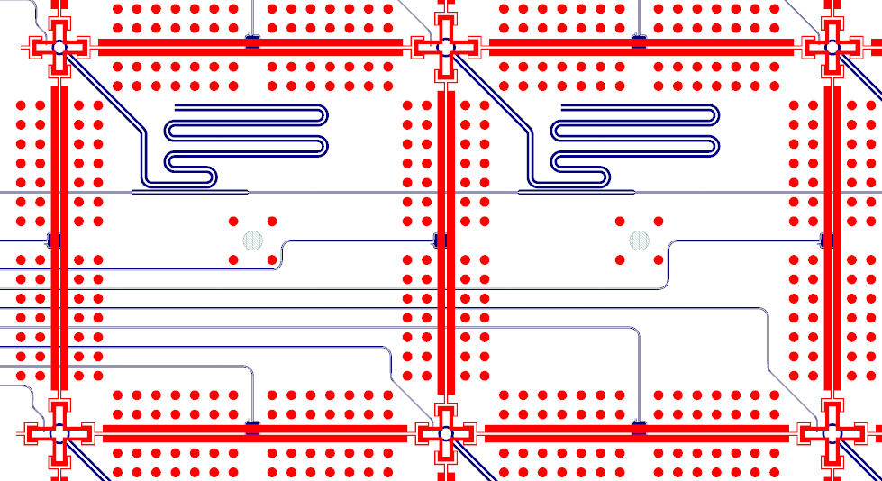
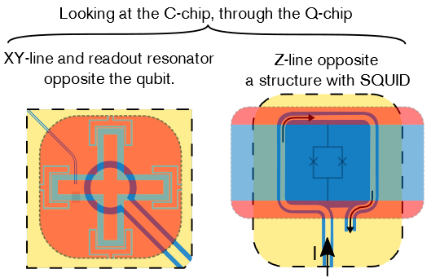
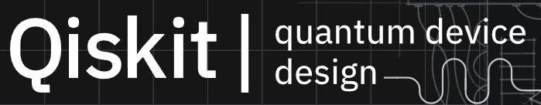

1st generation flip-chip processors with a scalable layout and routing strategy
Basic elements
Routing corridor between two qubit rows
Q-chip
readout
Z
Z
Z
C-chip
XY
Z
XY
Z
XY
Automation of design and simulation
Chalmers code

