Slide 1

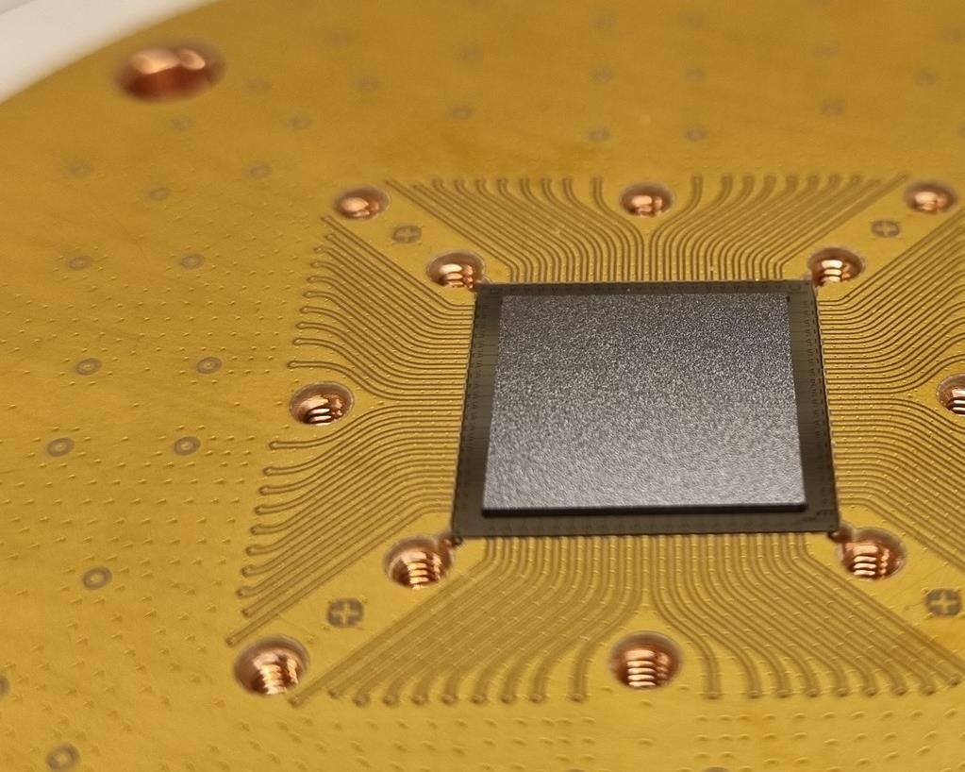


Control-Signal Crosstalk in Flip-Chip
Superconducting Quantum Processors
Sandoko Kosen (Chalmers University of Technology)
CHALMERS Team
Tahereh Abad
Anuj Aggarwal Janka Biznárová Liangyu Chen Miroslav Dobsicek
Jorge Fernández-Pendás Simon Pettersson Fors Göran Johansson Sandoko Kosen Christian Križan
Hang-Xi Li
Eleftherios Moschandreou
Andreas Nylander
VTT Team
Marco Caputo Leif Grönberg Kestutis Grigoras Joonas Govenius
Amr Osman Robert Rehammar Marcus Rommel
Anita Fadavi Roudsari
Daryoush Shiri
Tom Vethaak Christopher Warren Alexey Zadorozhko Anton Frisk Kockum Giovanna Tancredi Per Delsing
Jonas Bylander
Q72.00010
Packaged Flip-Chip Module
Chip Design & Fabrication by Chalmers
Flip-Chip Packaging by VTT
Sample Holder & PCB concept by Chalmers

Slide 2
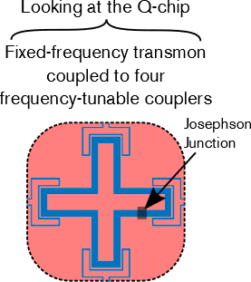
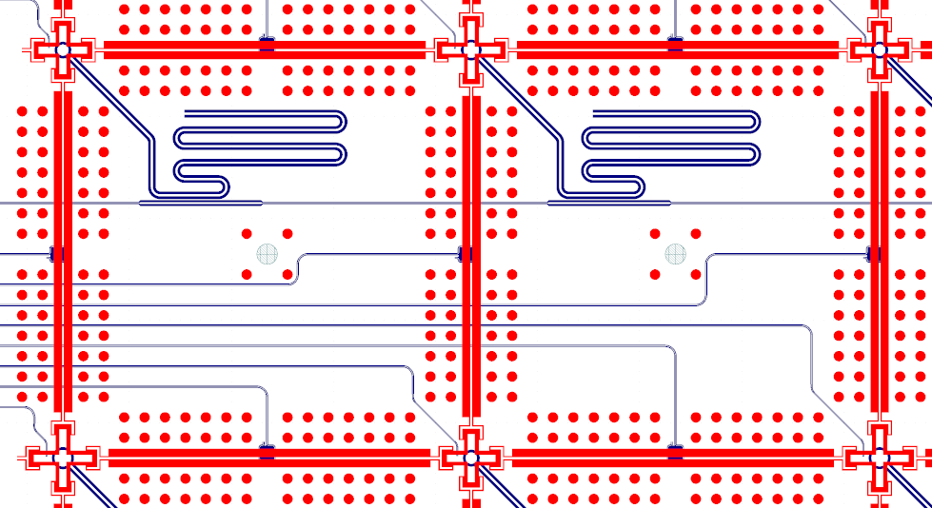


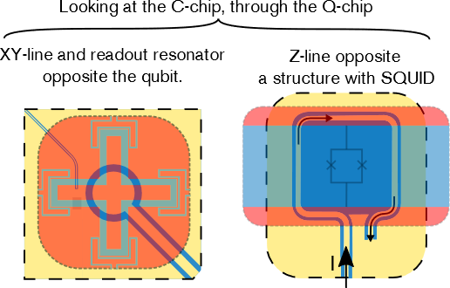


1st generation flip-chip processors with a scalable layout and routing strategy
Basic elements
Routing corridor between two qubit rows
Q-chip
readout
Z
Z
Z
C-chip
XY
Z
XY
Z
XY
Automation of design and simulation
Chalmers code

Slide 3


1.1 General properties of quantum measurements
𝐻_{𝑄𝑄}
^{𝐻}𝑖𝑖𝑛𝑡
^{𝐻}𝑚𝑒𝑡𝑒𝑟
0 1
Controlled Coupling
“Meter”
=
Auxiliary system
Qubit
Desirable properties:
Projective and Quantum non-demolition (QND)
Coupling to the meter does not change the state of the qubit
Repeated measurement yields the same outcome.
Good ON/OFF ratio
^{𝐻}𝑄𝑄^{, 𝐻}𝑖𝑖𝑛𝑡
= 0.
▪
▪
^{𝐻}𝑖𝑖𝑛𝑡 ^{, 𝐻}𝑚𝑒𝑡𝑒𝑟
^{𝐻}𝑖𝑖𝑛𝑡 ^{, 𝐻}𝑚𝑒𝑡𝑒𝑟
= 0 during “OFF”
≠ 0 during “ON”
No spontaneous decay/excitation due to measurement apparatus
Fast and high fidelity

Slide 4


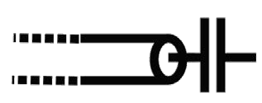
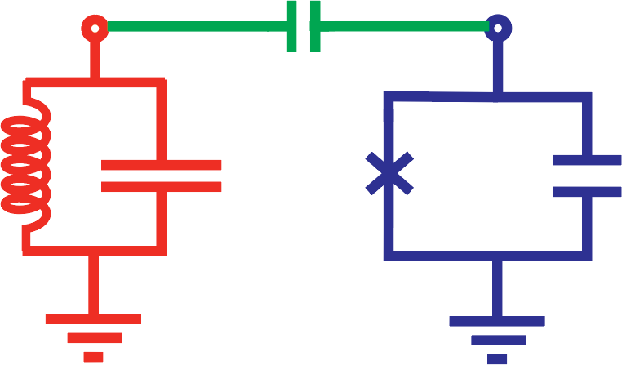





1.2 Circuit QED
photon decay
1 𝐶_{𝑐}
𝑔 ≈
Light field confined
2
^{𝜔}𝑔𝑔𝑒 ^{𝜔}𝑟
^{𝐶}𝑟𝑒𝑠^{𝐶}𝑞
between mirrors
Input field
atom
Circuit
Light-matter coupling
equivalent
LC
resonator
SC qubit
Output
qubit decay
System Hamiltonian (compare chapter 2):
Rotating wave approximation (RWA)
Two-level approximation
Jaynes-Cummings Hamiltonian
Resonator field qubit
coupling
S. Haroche & J. Raimond, Exploring the Quantum, OUP Oxford (2006)

Slide 5






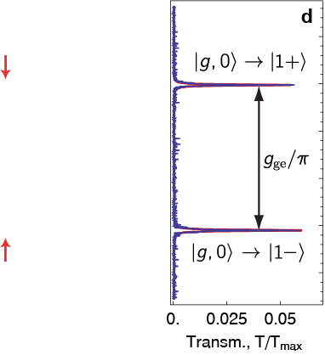
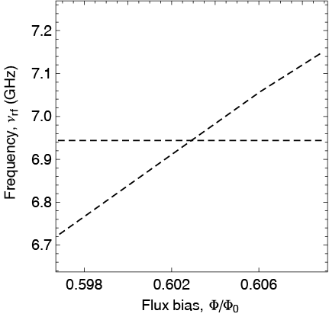
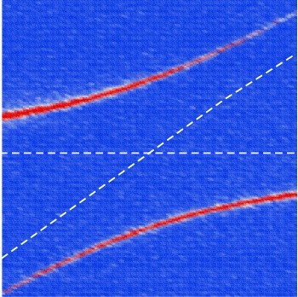
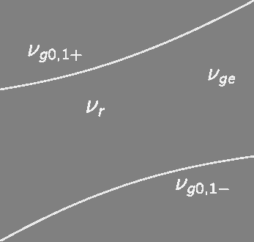



1.3 Circuit QED: Resonant case and dispersive limit
Jaynes-Cummings Hamiltonian:
Energy level diagram for resonant case 𝜔_{𝑟} = 𝜔_{𝑔𝑔𝑒}:
2𝑔
quantized field
coupling
qubit
Strong coupling regime:
What happens
in the limit of large detuning?
Dispersive coupling
Limit of large detuning is referred to as the dispersive limit. No resonant exchange of excitations.
In the dispersive regime coupling Hamiltonian commutes with qubit Hamiltonian.
A. Wallraff et al., Nature 431, 162 (2004), J. Fink et al., Nature (London) 454, 315 (2008)
Christopher Eichler, HS 2019, QSSC |
|
01.11.2019 72

Slide 6
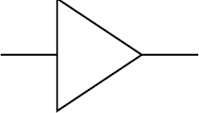






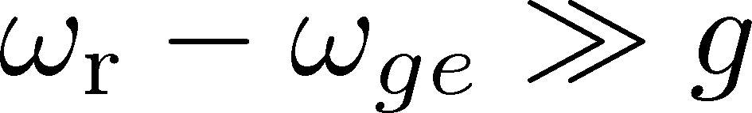
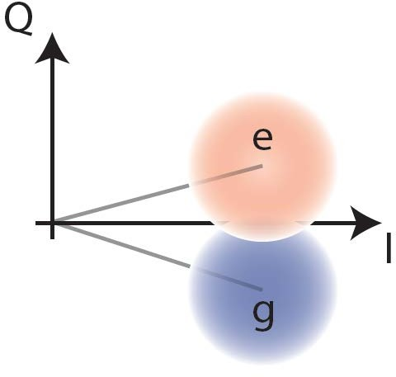
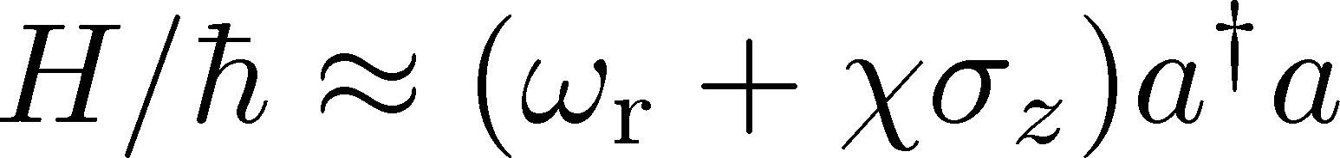
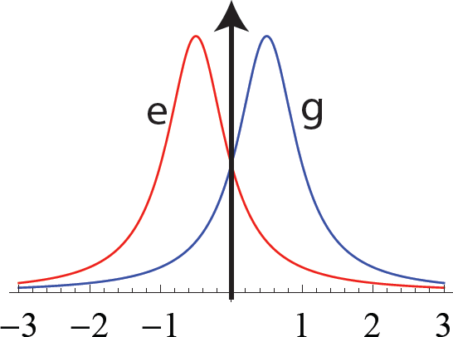
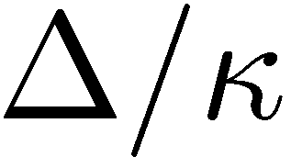
1.4 Principle of Dispersive Qubit Measurement
probe
I
output
ADC
𝑖𝑖𝜙𝜙
𝐴 𝑒
= 𝐼 + 𝑖𝑖 𝑄𝑄
Q
field
field
signal
Phase
amplitude
In-phase and quadrature components
In the limit of large detuning
:
,with 𝜒𝜒 ≈ −𝛼
_{𝑔𝑔}2
Δ(Δ−𝛼𝛼)
2𝜒𝜒
Amplitude of
transmitted signal:
readout frequency
A. Wallraff et al., Phys. Rev. Lett. 95, 060501 (2005).
R. Vijay et al., Phys. Rev. Lett. 106, 110502 (2011).

Slide 7
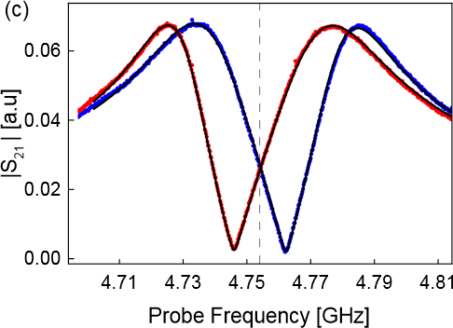
1.5 Readout Resonator Response
Transmission amplitude or readout resonator extracted through Purcell filter for qubit prepared in ground (g) or excited (e) state :
Parameter fit (input-output model): Readout resonator κ_{r}/2π = 37.5 MHz
State dependent resonator shift 2χ/2π ⋍ -16 MHz
In ground/excited state:
Data measured after state prep. (*,*) Fit to resonator response model (-)
Walter et al., Phys. Rev. Applied 7, 054020 (2017)

Slide 8


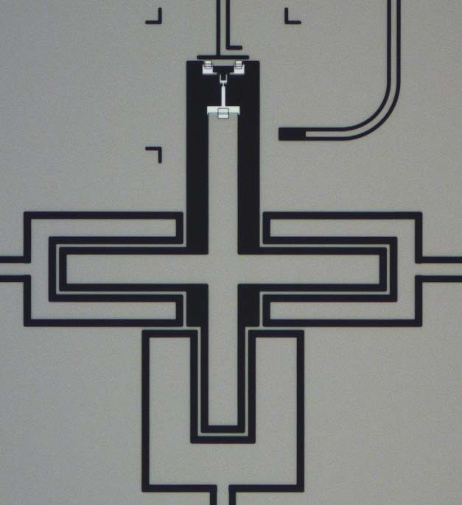
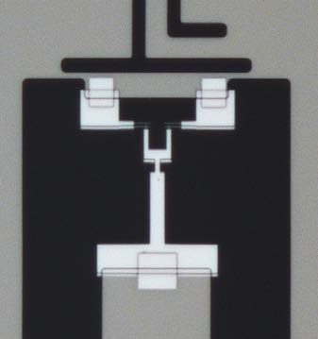


2.1 Control and Characterization of superconducting qubits
XY control
On-chip control
Frequency
(Z) control
Microwave drive 𝑏_{𝑖𝑖𝑛} t resonant with qubit frequency rotates Bloch vector about X and Y
Drive 𝑏 (t) at carrier
𝑖𝑖𝑛
frequency 𝜔_{𝑔𝑔𝑒}
+
axis. Drive power 𝑃 = ℏ𝜔𝑏 𝑏 .
𝑖𝑖𝑛 𝑖𝑖𝑛 𝑖𝑖𝑛
Arbitrary waveform generators (AWG) used to generate pulses, up-converted to the MW frequency band by mixing with a local oscillator field.
Charge
line
Flux line
Current 𝐼(𝑡)
Capacitance 𝐶
Φ(t)
𝐶²𝑍𝑍 𝜔²
𝑐 0
𝑐
Coupling rate to charge line 𝛾𝛾 = imposes
mediates coupling with
𝐶_{Σ}
decay and therefore needs to be 𝛾𝛾 ≪ 1/𝑇₁.
Tunability of the qubit achieved by sending a current 𝐼 𝑡 to a separate control line generating a magnetic flux Φ 𝑡 in the SQUID loop.
Used for both static (DC) control of the qubit frequency and for applying pulses on nanosecond timescales.
rate 𝛾𝛾
Qubit island
15um

Slide 9

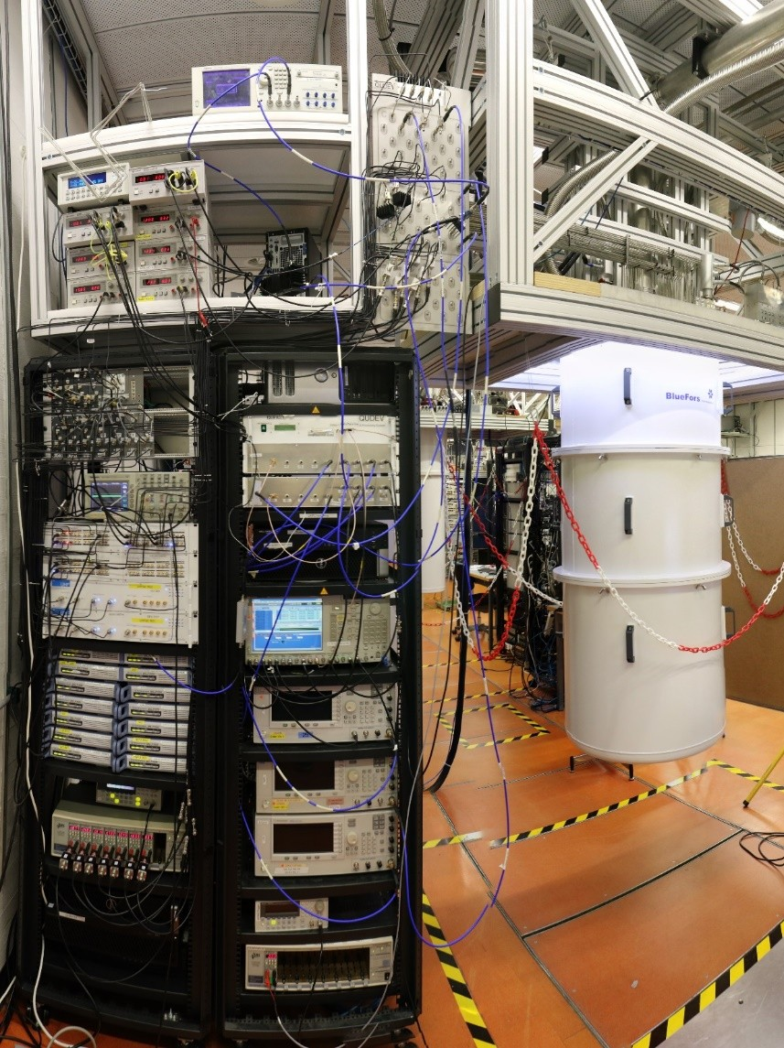

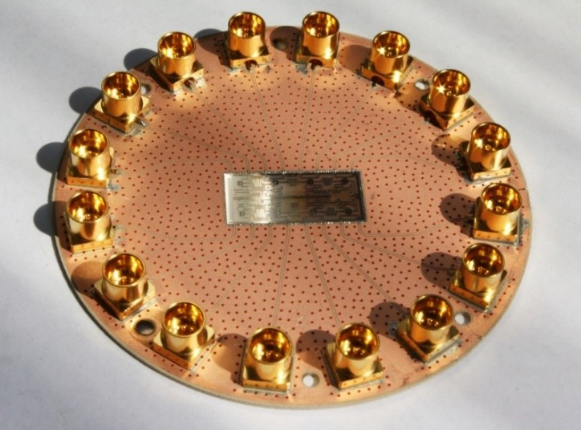
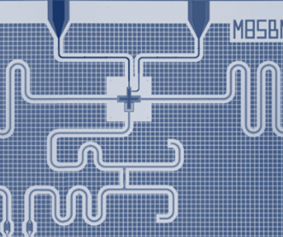
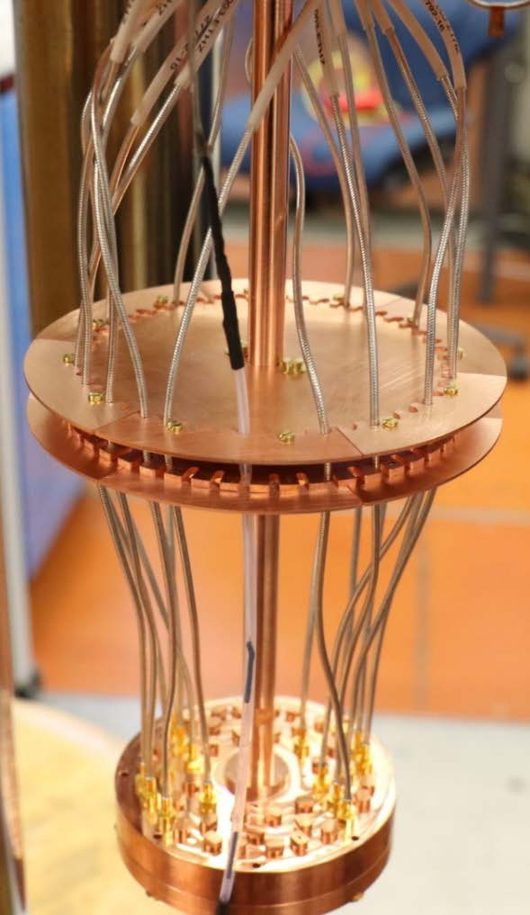
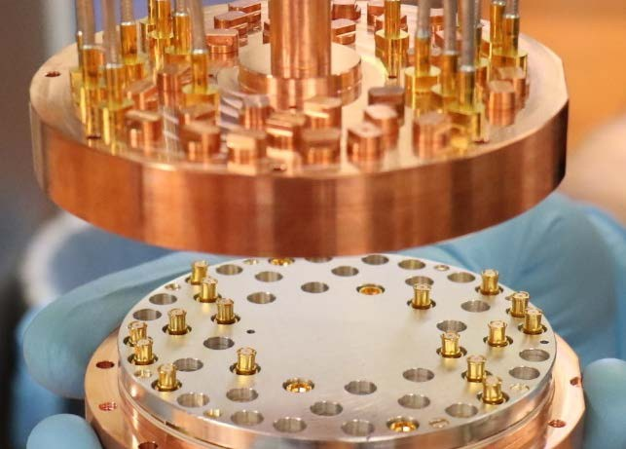
2.1 Control and Characterization of superconducting qubits

Slide 10
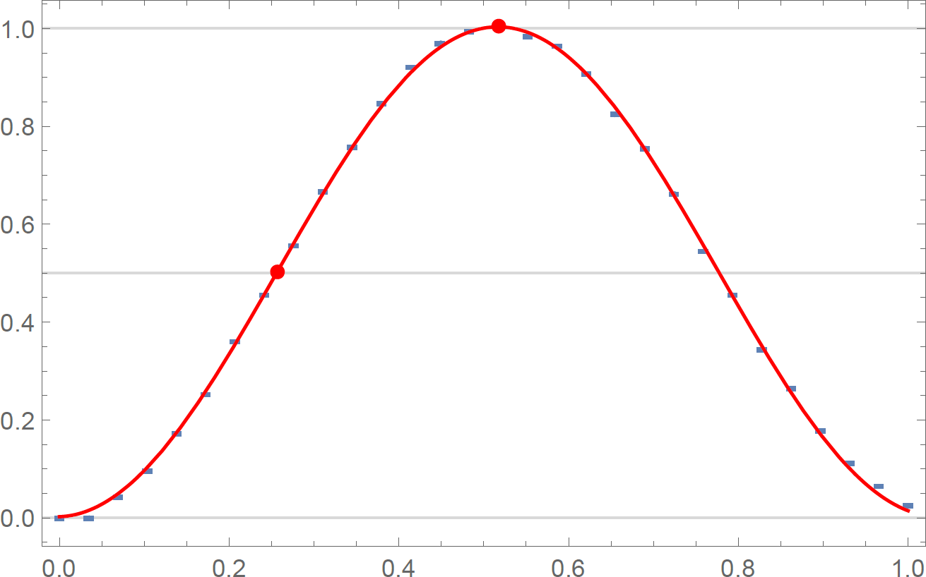
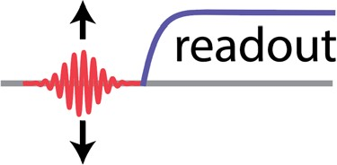
2.2 Measurement of Rabi oscillations
Ω₀
Excited state population 𝑝_{𝑒}
𝜋 − pulse.
Qubit frequency 𝜔_{𝑔𝑔𝑒}/2𝜋 = 5.758 GHz
determined spectroscopically.
Initialize qubit in ground state.
Apply pulse at 𝜔_{𝑔𝑔𝑒} with variable
amplitude Ω₀.
Gaussian pulse envelop with characteristic 𝜎 ~ 5 − 10𝑛𝑠.
Readout qubit state and average over
~10³ repetitions.
Sinusoidal fit to extract 𝜋- and 𝜋/2- pulse amplitude.
𝜋/2 − pulse.
^{Ω}0^{/Ω}0,max

Slide 11
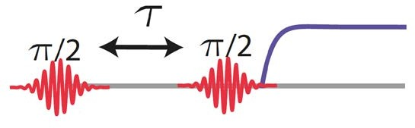
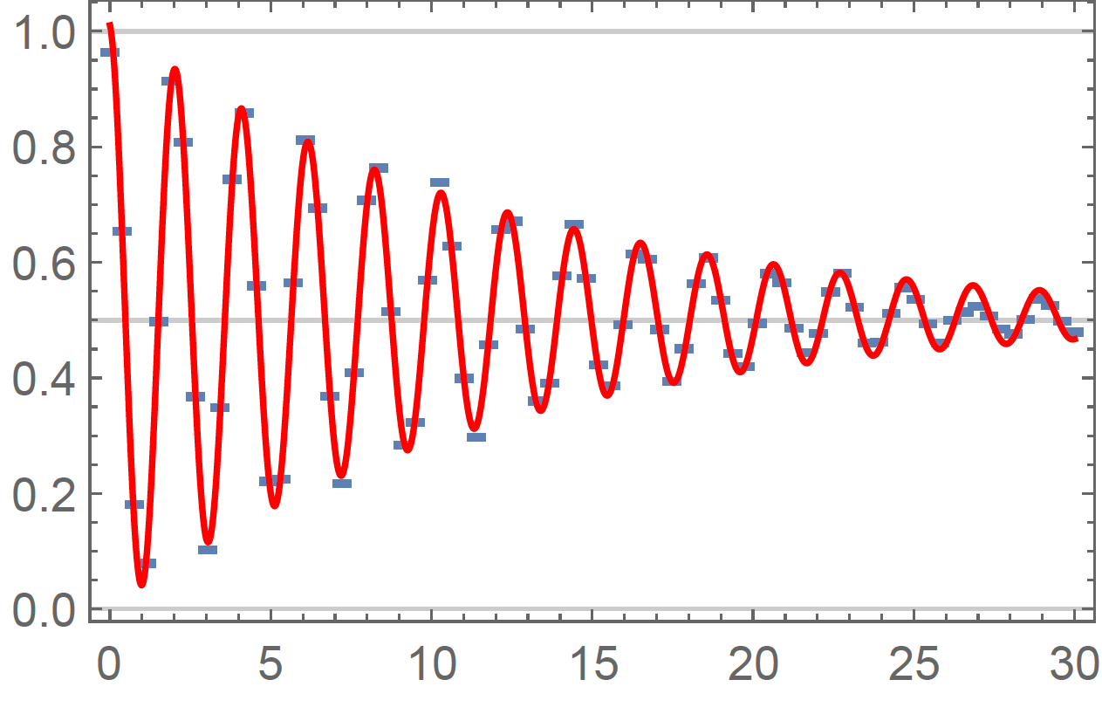
2.3 Measurement of dephasing time
readout
Initial ^{𝜋} -pulse prepares 𝑔 + |𝑒〉.
Map remaining coherence after time 𝑟 to excited
2
state using a second ^{𝜋}- pulse, and measure.
2
Excited state population 𝑝_{𝑒}
Detune pulse by f_{IF} = 0.5 MHz from qubit frequency to obtain oscillating pattern. → Higher accuracy in estimating the qubit frequency.
Fit Characteristic decay time 𝑇∗ = 13 𝜇s
In this case, decay reasonably well described by
2
exponential function 𝑒
−𝑐/𝑇
∗
2
Depending on spectral properties of the dominant noise source, decay better described by different functional form, e.g. Gaussian decay for 1/f – noise.
If relaxation is only source of decoherence: 𝑇₂ = 2 𝑇₁ (“T1 limit of dephasing time”).
𝑟 [𝜇𝑠]
Ithier, G. et al. PRB 72, 134519 (2005).

Slide 12
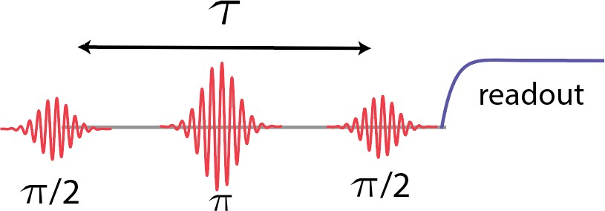
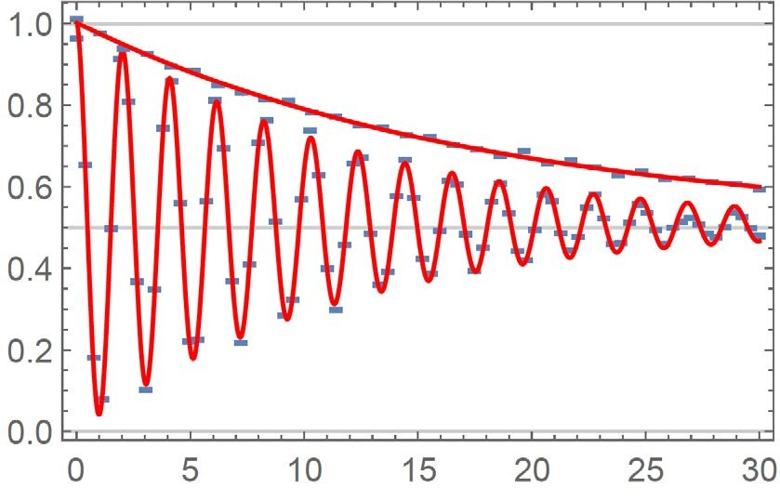
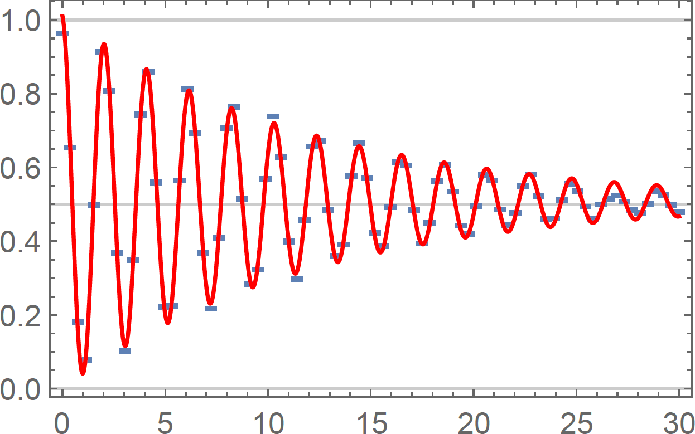
2.3 Measurement of dephasing time
Additional echo pulse
Low frequency noise can be partly compensated for by applying an echo 𝜋-pulse after 𝑟/2 to reverse the direction of the Lamor precision.
-
The resulting decay time 𝑇^{𝑒𝑐ℎ𝑜} = 18 𝜇𝑠 is longer
Excited state population 𝑝_{𝑒}
2
than 𝑇∗.
2
Explanation: Low frequency noise which causes the qubit frequency to change on timescales longer than 𝑟_{𝑚𝑎𝑥} will cancel out.
Variants of such dynamical decoupling sequences can be used to do noise spectroscopy → See e.g. Bylander et al., Nat. Phys. (2011)
𝑟 [𝜇𝑠]
Ithier, G. et al. PRB 72, 134519 (2005).

Slide 13
3.1 Characterization & Benchmarking of Quantum Processes
Ideally
Realistically
𝑈
ℰ
|𝜓𝜓_{in}〉
^{|𝜓𝜓}out〉
^{𝜌}in
^{𝜌}out
Questions:
General properties of the map ℰ?
How to measure the map ℰ?
State and process tomography
Measure of distance between quantum states and processes: Fidelity
How to benchmark quantum gates with fidelities close to one?
Randomized Benchmarking

Slide 14
3.2 Randomized benchmarking
For simplicity, consider single-qubit case.
Apply sequence of 𝑛 gate operations 𝑈_{𝑖𝑖} before measuring.
…
0 1
|0〉
𝑈
1
𝑈
2
𝑈
3
^{𝑈}𝑛+1
Gates 𝑈_{𝑖𝑖} are chosen randomly from the Clifford group, mapping an element of the Pauli group to an element of the Pauli group. For a single qubit there are 24 Clifford gates.
Last gate 𝑈_{𝑛+1}is chosen such that in the absence of errors state is brought back to initial state, i.e. 𝑈_{𝑛+1} … 𝑈₂𝑈₁ = 𝐼.
Average over 𝑚 different such sequences.
Success probability 𝑝₀ to recover the initial state decays exponentially with # of gates 𝑝₀ 𝖺
𝛼^{𝑛}, with depolarization parameter 𝛼.
The error per gate is given by 𝜖𝜖 = 1 − 𝛼
space (d=2 for a single qubit).
(𝑑−1)
where 𝑑 is the dimension of Hilbert
𝑅𝐵
𝑑
Knill et al., PRA 77, 012307 2008

Slide 15
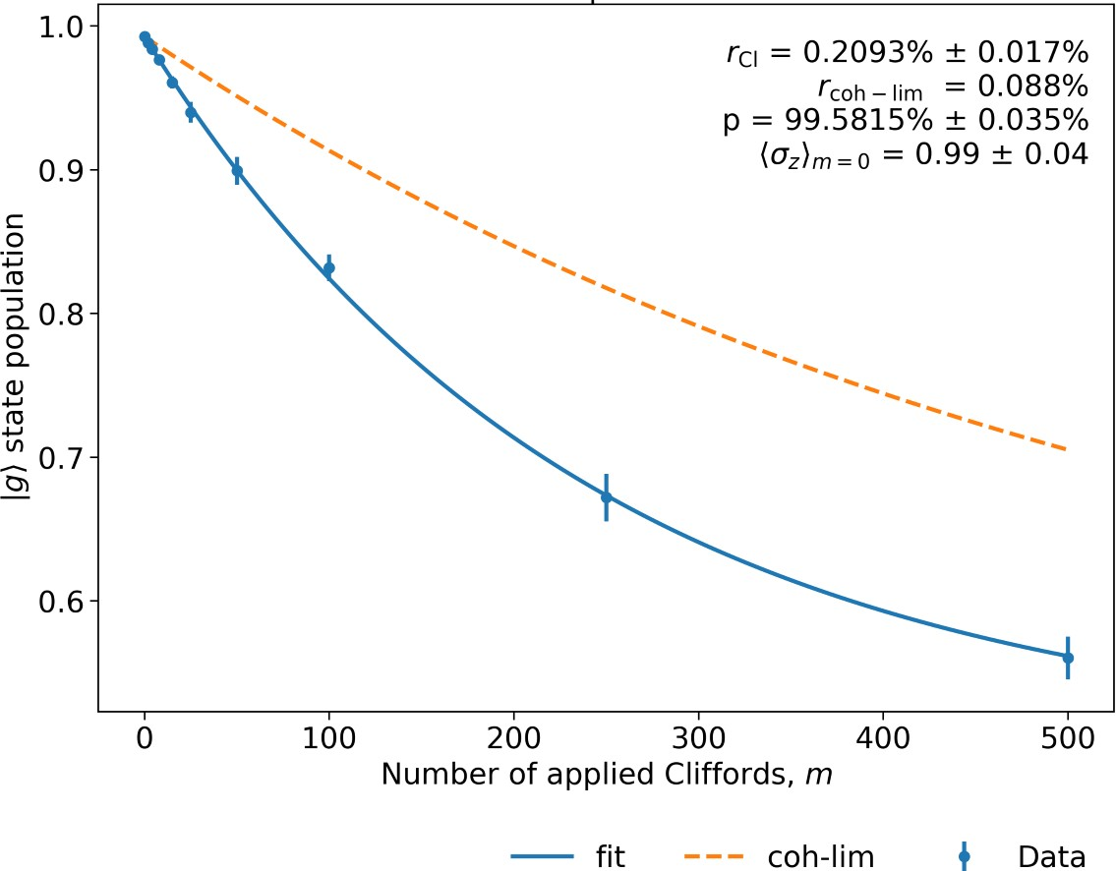
3.3 Randomized benchmarking: Example single qubit gates
Pulse duration typically between 15 to 50 ns. Leakage into second excited state avoided by using (DRAG*) pulse parametrization.
Use Clifford decomposition in terms of X rotations and virtual Z gates (see McKay et al., PRA (2017)).
Population of ground state decays exponentially.
Fitted depolarization parameter 𝛼 ≈99.6% and gate error 𝜖𝜖 ≈ 0.2% in this example.
Orange dashed line indicates the limit expected when only considering qubit decoherence.
Deviation from coherence limit hints at finite control errors, e.g. resulting in leakage to the f- level.
*Motzoi et al., PRL 103, 110501 (2009)

Slide 16
3.4 Interleaved Randomized benchmarking (IRB)
Question how to characterize the fidelity of one particular Clifford gate 𝑉?
Compare decay of standard RB sequence …
…
^{𝑈}𝑛+1
0 1
|0〉 𝑈₁ 𝑈₂ 𝑈
3
…with result of a 2nd experiment, in which gate 𝑉 gets interleaved with random Clifford gates.
0 1
|0〉 𝑈
𝑉
𝑈
𝑉
𝑈
…
𝑉
^{𝑈}𝑛+1
1
2
3
Difference between the depolarization parameters 𝛼_{𝑅𝐵} and 𝛼_{𝐼𝑅𝐵} results in an estimate for the
error 𝜖𝜖 =
𝑑
(1 − ^{𝛼𝐼𝑅𝐵}) per gate 𝑉.
𝑉
𝑑+1
^{𝛼}𝑅𝐵
Randomized Benchmarking can be generalized to multi-qubit gates.
Magesan et al., PRL 109, 080505 (2012)

