Slide 1
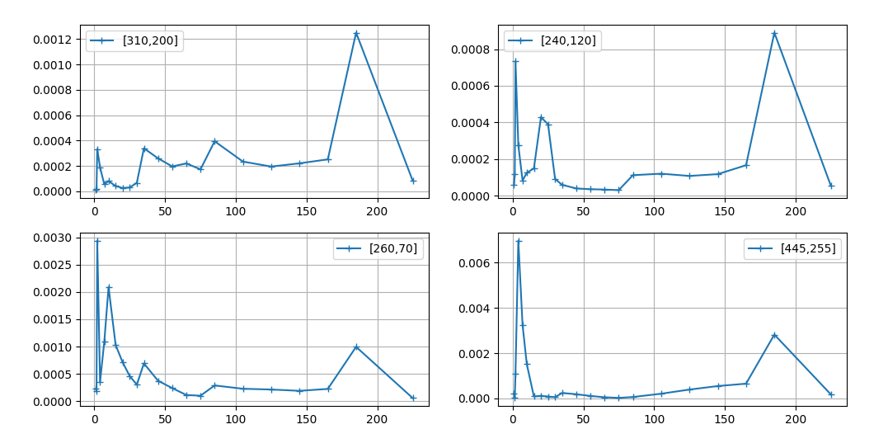
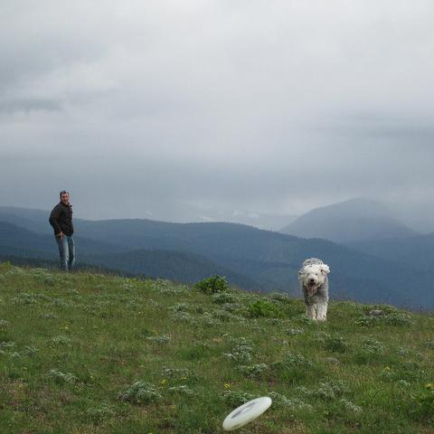
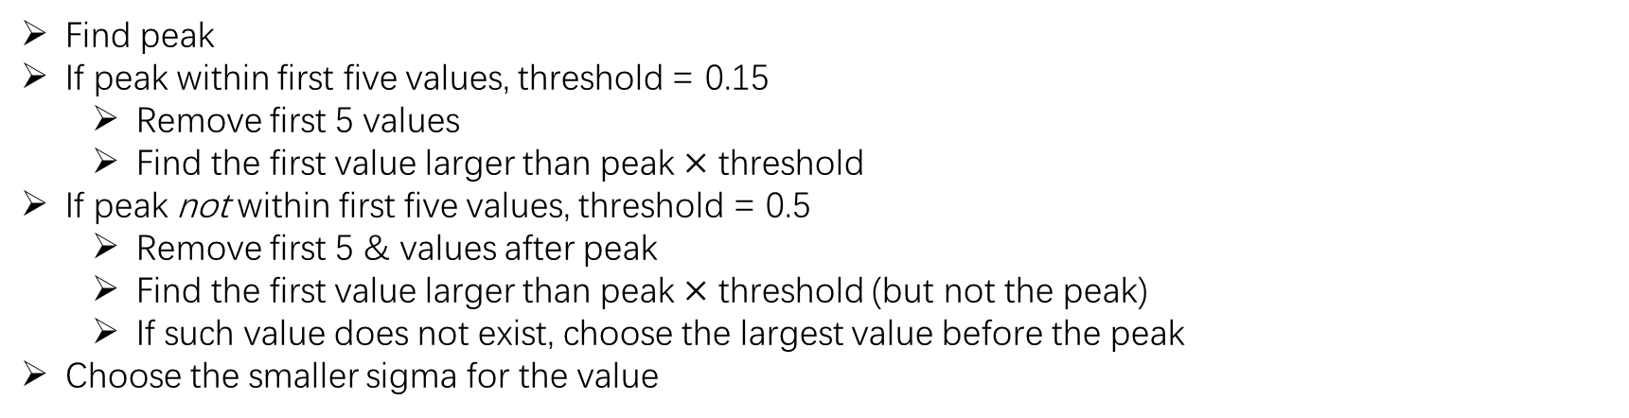
σ-map rule
Find peak
If peak within first five values, threshold = 0.15
Remove first 5 values
Find the first value larger than peak $×$ threshold
If peak not within first five values, threshold = 0.5
Remove first 5 & values after peak
Find the first value larger than peak $×$ threshold (but not the peak)
If such value does not exist, choose the largest value before the peak
Choose the smaller sigma for the value
Notes:
tg

Slide 2
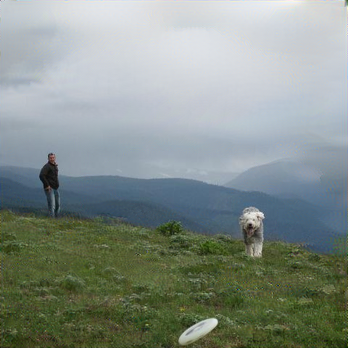


Slide 3
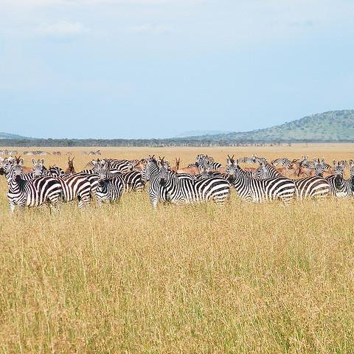
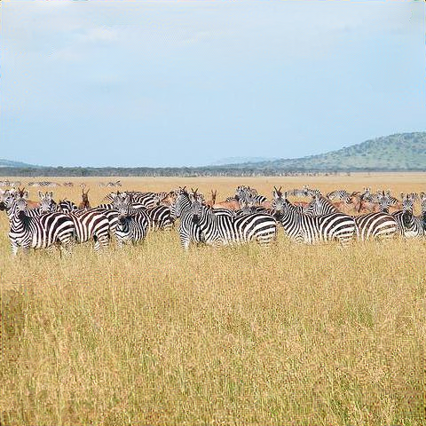


Slide 4
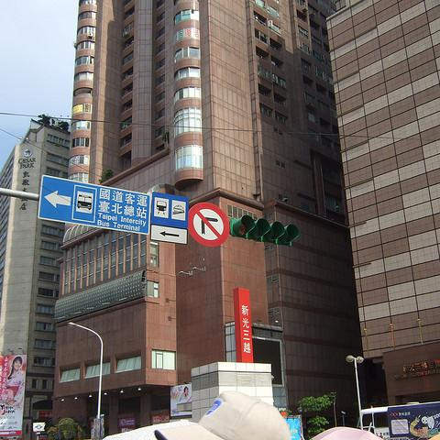



Slide 5


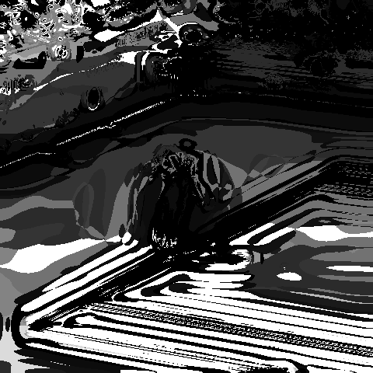

Slide 6
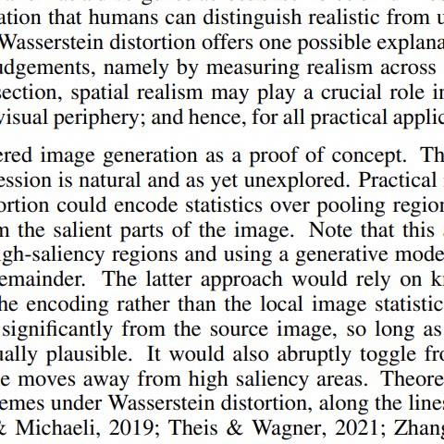
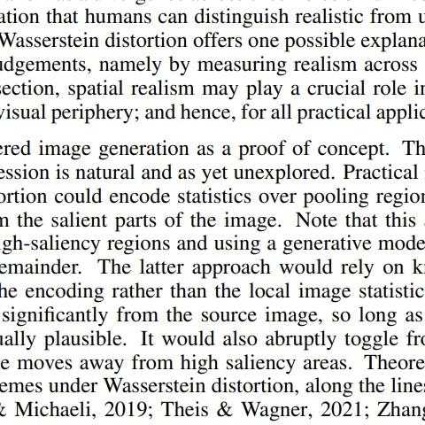


Slide 7




Slide 8

