Slide 1
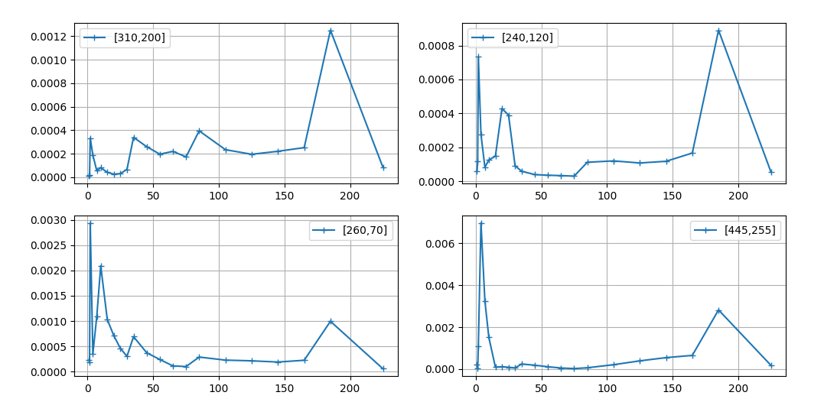
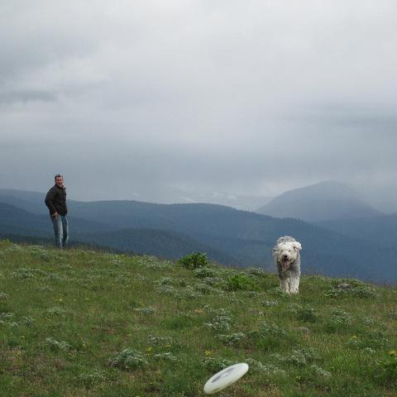
σ-map rule
Find peak
If peak within first five values, threshold = threshold_low, else threshold = threshold_high
If the value does not exist:
σ = 0 --> non-texture
Else:
Find the related σ and back 1 step --> texture
Notes:
tg

Slide 2


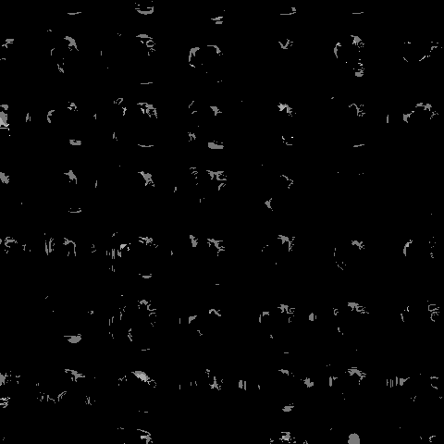

Slide 3


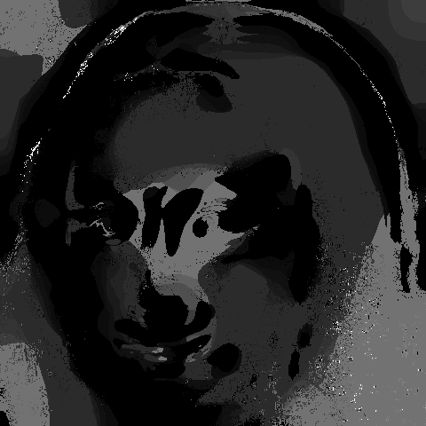

Slide 4
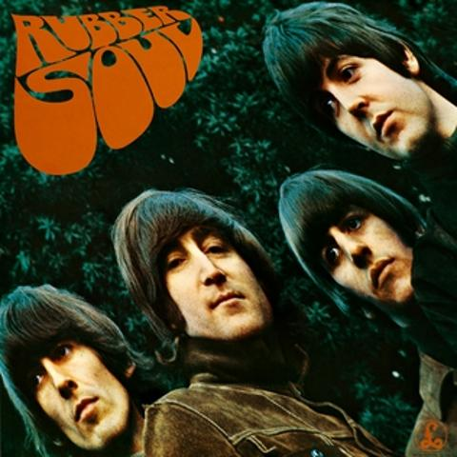

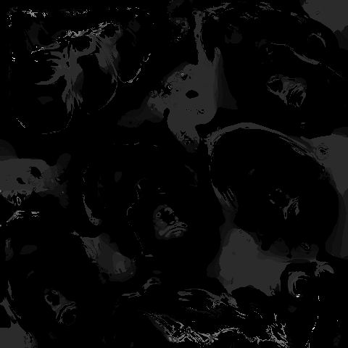

Slide 5

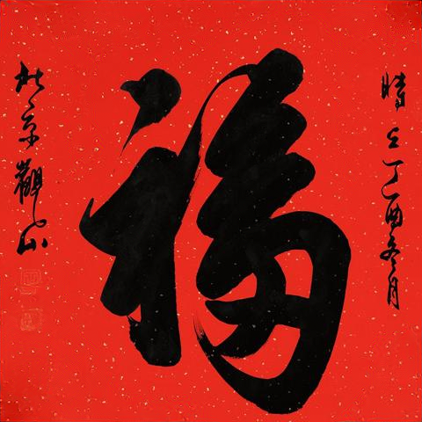
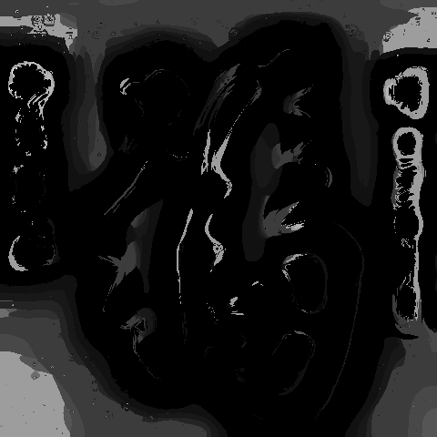

Slide 6
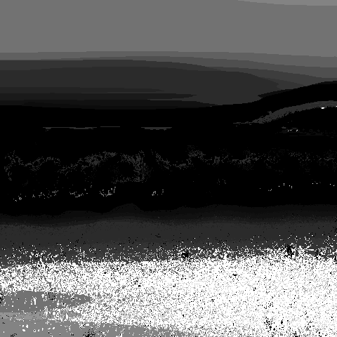
How to convert σ-map to Saliency Map
Data Processing:
Local Neighborhood Analysis: For each pixel in the image, a circular neighborhood around it is analyzed.
Zero Value Proportion Calculation: Within this neighborhood, the proportion of zero values is calculated to capture the local texture characteristics.
Thresholding: Apply a threshold to the saliency map, setting all values below the threshold to zero, highlighting only the most significant regions

Slide 7
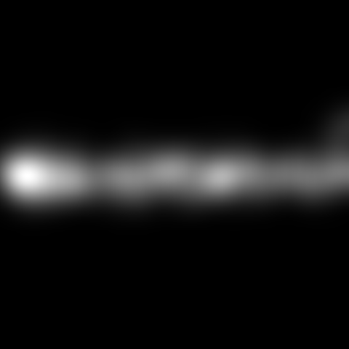
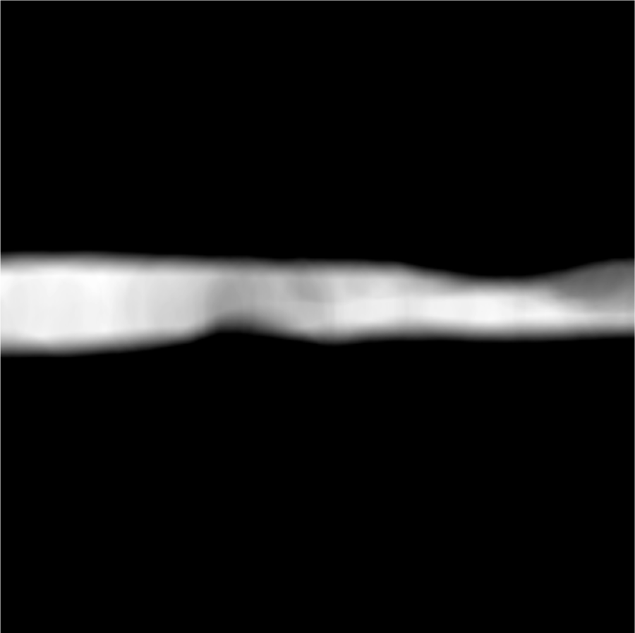
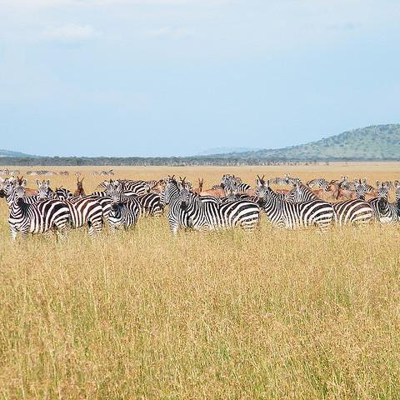

Slide 8

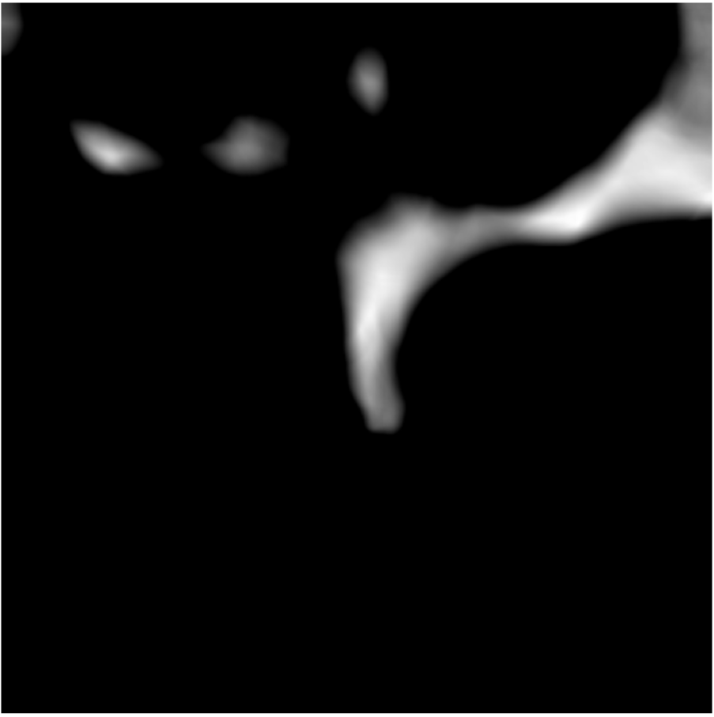
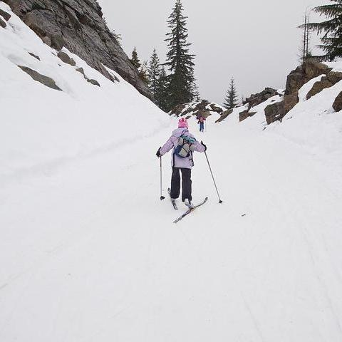

Slide 9

