Slide 1
Java Programming for Non-Specialists
Welcome !!!

Slide 2
CGS3416 Course Logistic
It is intro level programming course
Using Java programming language
Textbook “Java: How to Program” by Deitel & Deitel
Programming environment “Eclipse”
MWF 11:15 AM – 12:05 PM
Pre-requisite
Can recognize a computer by yourself
Know how to turn on or turn off a computer
Have used computer for anything before

Slide 3
Contact and Grading
Contact Information
Instructor: Muye Liu
Email: mliu@cs.fsu.edu or ml11an@my.fsu.edu
Office location: MCH 114
Office hour: TBA
Grading Policy
Programming Assignment/Quiz 40%
Test1 17.5%
Test2 17.5%
Final Exam 25%

Slide 4
More about grading
Total 8 Programming Assignments
3 Exams (2 mid-term and 1 final)
Letter | Numerical Average
A | 92.00 - 100
A- | 90.00 - 91.99
B+ | 88.00 - 89.99
B | 82.00 - 87.99
B- | 80.00 - 81.99
C+ | 78.00 - 79.99
C | 72.00 - 77.99
C- | 69.00 - 71.99
D | 62.00 - 68.99
D- | 60.00 - 61.99
F | 0.00 - 59.99

Slide 5
Attendance & Assignment Submission
Attendance and participation is expected
Quizzes may be given to help students
gauge their progress in the class
gauge attendance
No makeup quizzes will be given (no exceptions)
Turn in all assignments on time
Late assignments will be accepted two days after the due date, with the 10% deduction
Assignments more than two days late will not be accepted
Make sure your code compiles before you submit

Slide 6
Extension Policy
2 free days extension for entire semester
2 calendar days
Use them all in one assignment
Or split them into two assignments
Try not to use them
Excused absences include documented illness, deaths in the family and other documented crises, call to active military duty or jury duty, religious holy days, and official University activities. These absences will be accommodated in a way that does not arbitrarily penalize students who have a valid excuse. Consideration will also be given to students whose dependent children experience serious illness.

Slide 7
Academic Honor Policy
Florida State University Academic Honor Policy can be found
http://fda.fsu.edu/content/download/21140/136629/AHPFinal2014.pdf
No code rule
DO NOT Share Code

Slide 8
Software Bug
According to Wikipedia,
A software bug is an error, flaw, failure, or fault in a computer program or system that causes it to produce an incorrect or unexpected result, or to behave in unintended ways.
Most bugs arise from mistakes and errors made by people in either a program's source code or its design, or in frameworks and operating systems used by such programs, and a few are caused by compilers producing incorrect code.
A program that contains a large number of bugs, and/or bugs that seriously interfere with its functionality, is said to be buggy.

Slide 9
Example of software bugs (from Wikipedia)
Space exploration
A mis-sent command from Earth caused the software of the NASA Mars Global Surveyor to incorrectly assume that a motor had failed, causing it to point one of its batteries at the sun. This caused the battery to overheat
Medical
A bug in the code controlling the Therac-25 radiation therapy machine was directly responsible for at least five patient deaths in the 1980s when it administered excessive quantities of X-rays
Transportation
Toyota's electronic throttle control system (ETCS) had bugs that could cause unintended acceleration.^{[38]} At least 89 people were killed as a result

Slide 10
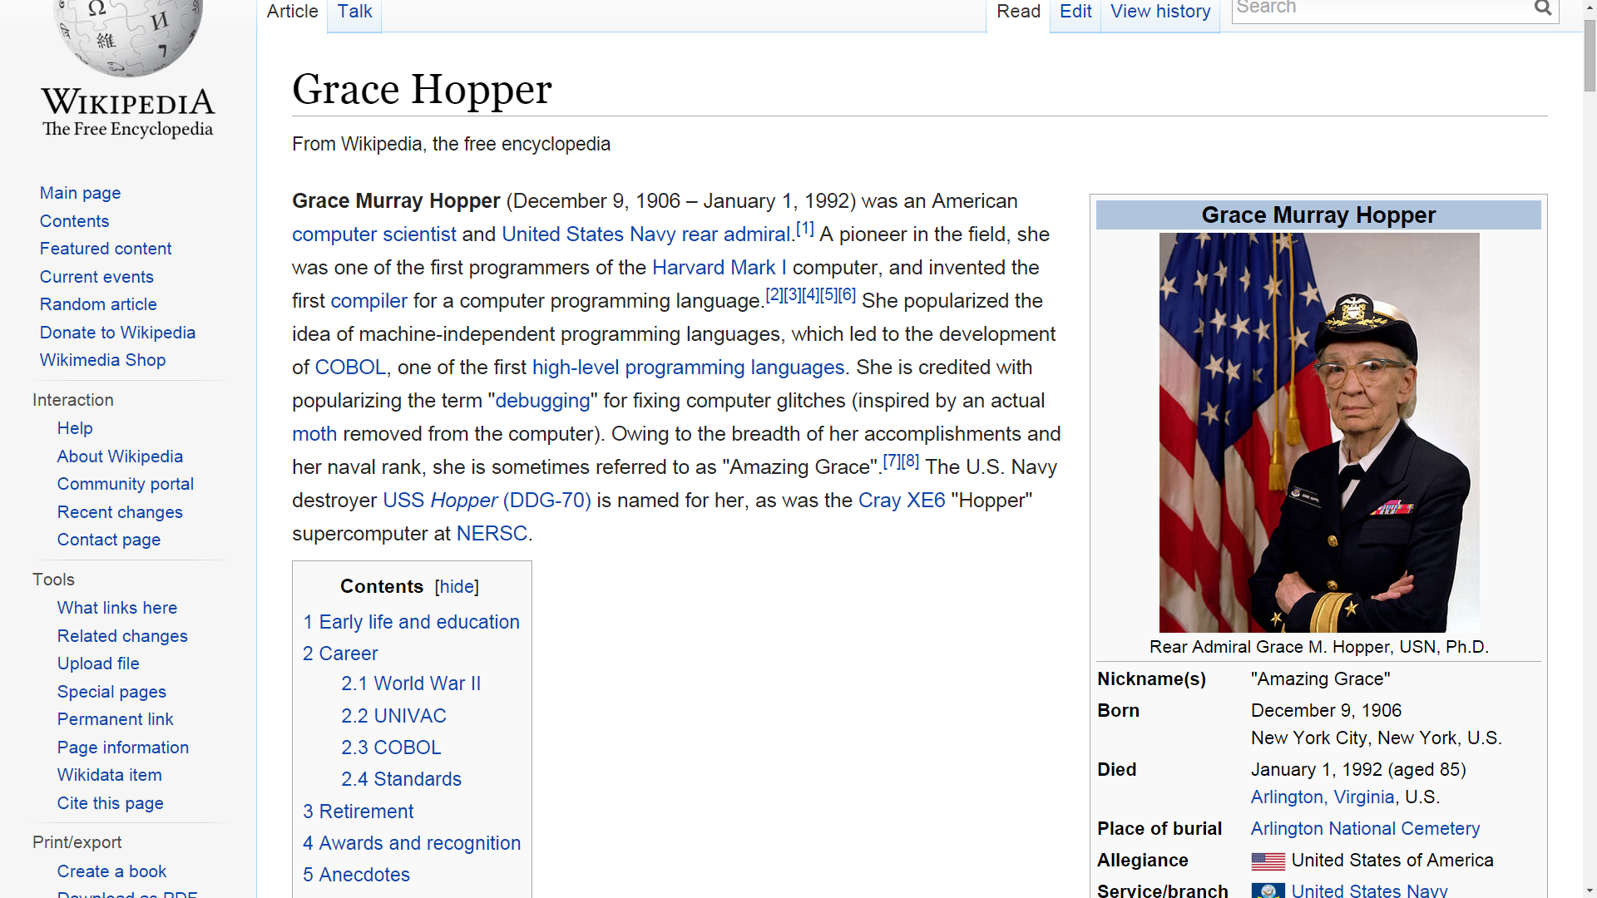

Slide 11
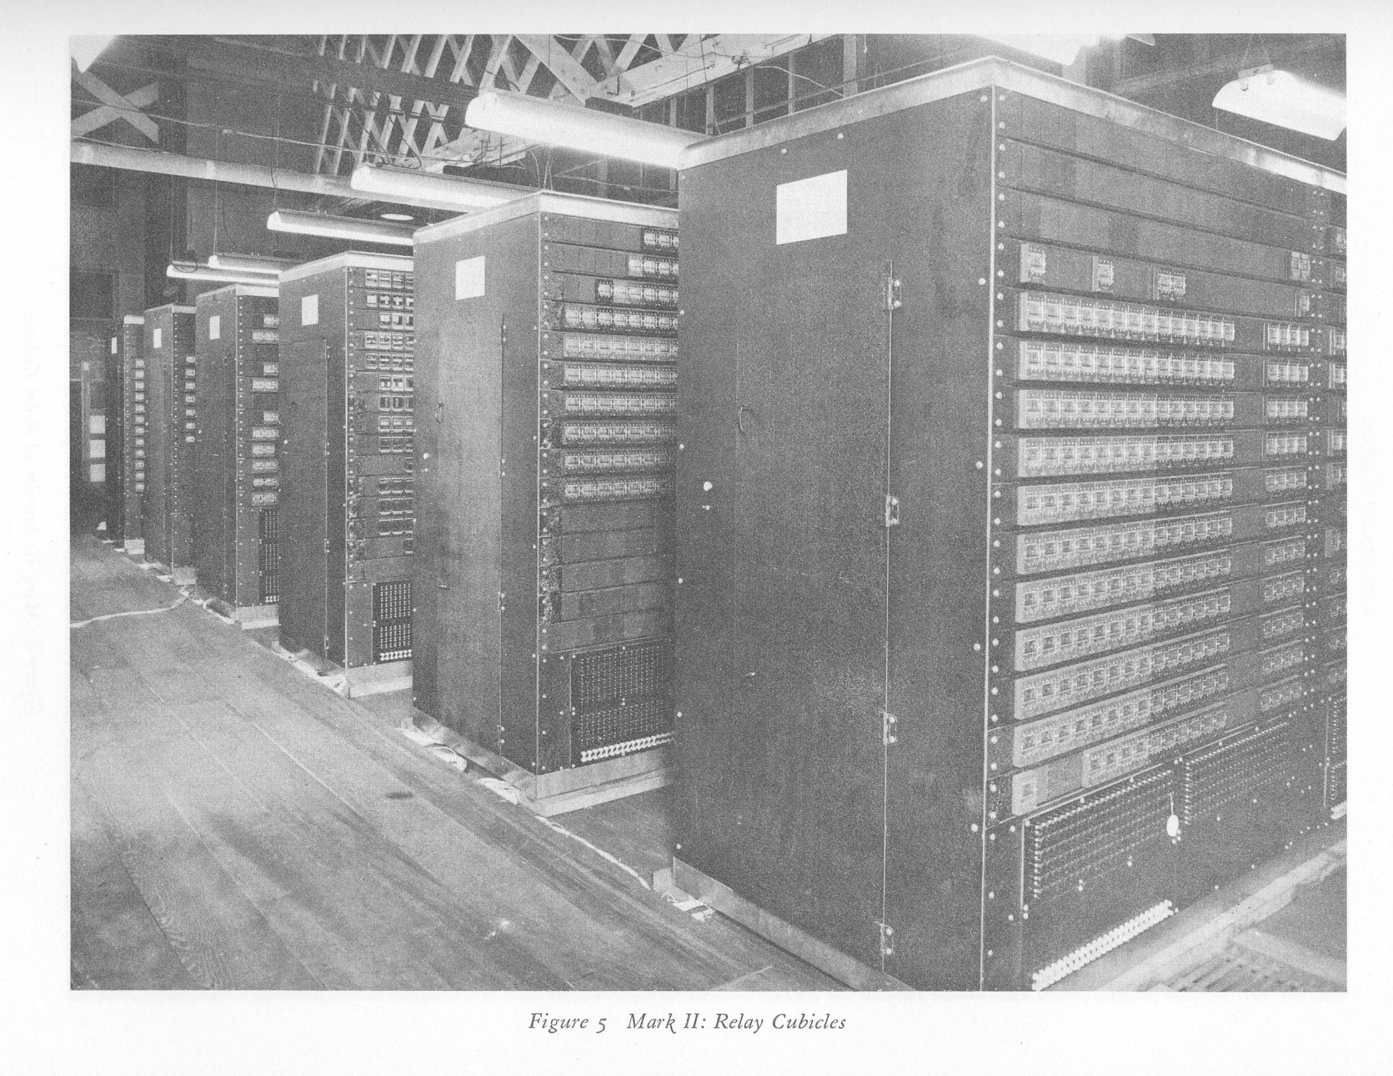
Harvard Mark II

Slide 12
