Slide 1
“this” in java

Slide 2
this keyword in java
6 usage of java this keyword.
this keyword can be used to refer current class instance variable.
this() can be used to invoke current class constructor.
this keyword can be used to invoke current class method (implicitly)
this can be passed as an argument in the method call.
this can be passed as argument in the constructor call.
this keyword can also be used to return the current class instance.

Slide 3
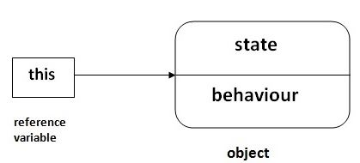
Picture in mind

Slide 4
If you are beginner to java, lookup only two usage of this keyword.
1) The this keyword can be used to refer current class instance variable.
If there is ambiguity between the instance variable and parameter, this keyword resolves the problem of ambiguity.
2) this() can be used to invoked current class constructor.
The this() constructor call can be used to invoke the current class constructor (constructor chaining). This approach is better if you have many constructors in the class and want to reuse that constructor.

Slide 5
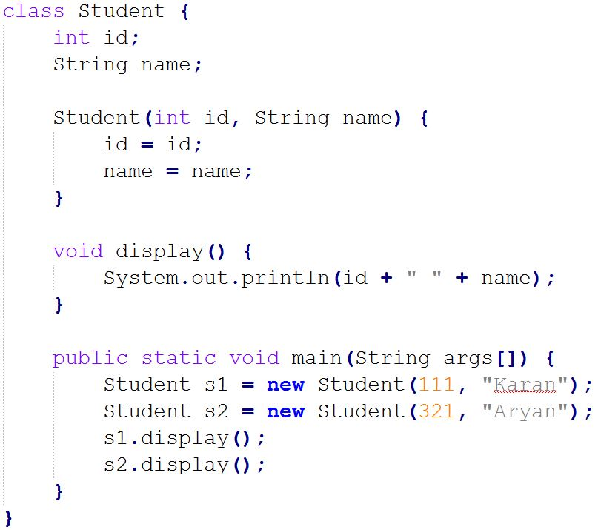
this keyword can be used to refer current class instance variable
Anything wrong with this code?

Slide 6
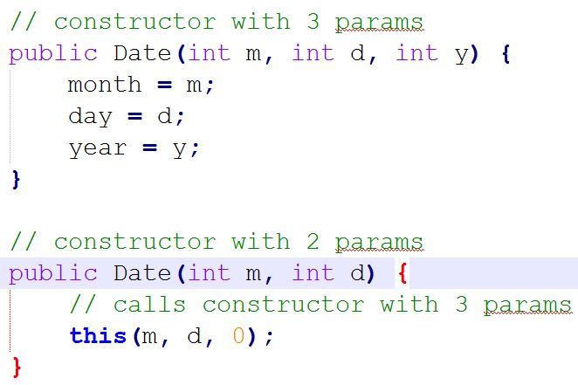
this() can be used to invoked current class constructor.

