Slide 1
Post Increment/Decrement Pre Increment/Decrement break, continue

Slide 2
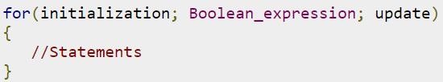
The for Loop
The initialization step is executed first, and only once. This step allows you to declare and initialize any loop control variables. You are not required to put a statement here, as long as a semicolon appears.
Next, the Boolean expression is evaluated. If it is true, the body of the loop is executed. If it is false, the body of the loop does not execute and flow of control jumps to the next statement past the for loop.
After the body of the for loop executes, the flow of control jumps back up to the update statement. This statement allows you to update any loop control variables. This statement can be left blank, as long as a semicolon appears after the Boolean expression.
The Boolean expression is now evaluated again. If it is true, the loop executes and the process repeats itself (body of loop, then update step, then Boolean expression). After the Boolean expression is false, the for loop terminates.

Slide 3
Arrays
Say that you are writing a program that reads in 100 numbers. Would you like to declare 100 variables and write 100 input statements?
Probably not. It would be useful to have an organized way of reading and storing the values.
An array is an object that is used to store a list of values. It is made out of a contiguous block of memory that is divided into a number of cells. Each cell holds a value, and all the values are of the same type. Sometimes the cells of an array are called slots.

Slide 4
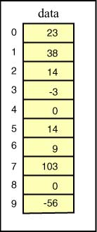
In the example array pictured at right, each cell holds an int.
The name of this array is data. The cells are indexed 0 through 9. Each cell can be accessed by using its index. For example, data[0] is the cell which is indexed by zero (which contains the value 23). data[5] is the cell which is indexed by 5 (which contains the value 14).
Facts:
The cells are numbered sequentially starting at zero.
If there are N cells in an array, the indexes will be 0 through N-1.
The value stored in a cell of an array is sometimes called an element of the array. An array has a fixed number of cells. The values in the cells (the elements) can be changed.
What is the value of the
arithmetic expression
data[2] + data[6]

Slide 5
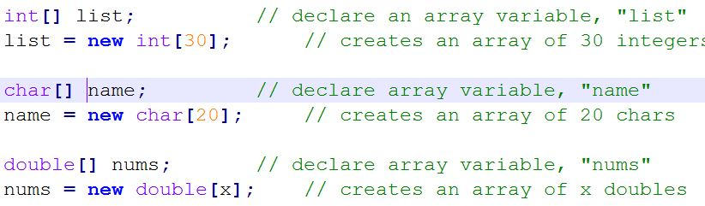
Two steps for creating Arrays:
Step 1: Declare an array variable (a reference to the array)
Step 2: Create the array
Formats for declaring an array variable:
type[] arrayName; // preferred
type arrayName[]; // alternate form
Format for creating the array (with the operator new)
arrayName = new type[size];
Note type should match the type of the arrayName variable
Examples:

Slide 6

Combined format:
type[] arrayName = new type[size];
Examples:
The array's size is stored in arrayName.length.
For example, the size of the "list" array above is: list.length

Slide 7
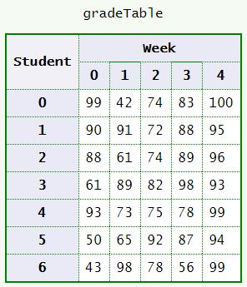
2D Array
Often data comes naturally in a two dimensional form.
Imagine a class of 7 students that have a quiz every week for 5 weeks. The instructor records the grades in a table. A particular cell of the table is designated by student number and week number. For example:
The grade for student 0 week 1 is 42
The grade for student 3 week 4 is 93
The grade for student 6 week 2 is 78
A compact notation for specifying a cell
uses the row and column indexes like this:
gradeTable[ row ][ col ]
As with one dimensional arrays, indices start at zero. For example:
gradeTable[ 0 ][ 1 ] is 42
gradeTable[ 3 ][ 4 ] is 93
gradeTable[ 6 ][ 2 ] is 78

Slide 8
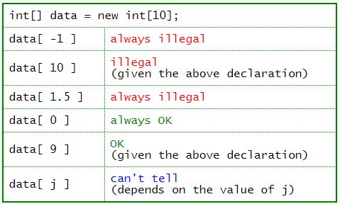
Bounds Checking
Recall that:
The length of an array is how many cells it has. An array of length N has cells indexed 0..(N-1)
Indexes must be an integer type. It is OK to have spaces around the index of a subscripted variable, for example data[1] and data[ 1 ] are exactly the same as far as the compiler is concerned.
It is not legal to refer to a cell that does not exist.
Say that an array were declared:
int[] data = new int[10];
The table shows some subscripted variables of this array.
If your program contains an expression that is always illegal, it will not compile. But often the size of an array is not known to the compiler. The size of an array often is determined by data at run time. Since the array is constructed as the program is running, the compiler does not know its length and can't detect some errors.
As a Java program is running, each time an array index is used it is checked to be sure that it is OK. This is called bounds checking, and is extremely important for catching errors. If an executing program refers to a cell that does not exist, an ArrayIndexOutOfBoundsException is thrown, and (usually) the program is terminated.

Slide 9
In Java, a method is a function that belongs to a class.
Every function belongs to a class.
A function is a reusable portion of a program, sometimes called a procedure or subroutine.
Like a mini-program (or subprogram) in its own right
Can take in special inputs (arguments)
Can produce an answer value (return value)
Similar to the idea of a function in mathematics
Why write and use functions?
Divide-and-conquer
Can breaking up programs and algorithms into smaller, more manageable pieces
This makes for easier writing, testing, and debugging
Also easier to break up the work for team development
Reusability
Functions can be called to do their tasks anywhere in a program, as many times as needed
Avoids repetition of code in a program
Functions can be placed into libraries to be used by more than one "program"
With methods (functions), there are 2 major points of view
Builder of the method -- responsible for creating the declaration and the definition of the method
Caller -- somebody (i.e. some portion of code) that uses the method to perform a task

Slide 10

Methods are also known as Procedures or Functions:
Procedures: They don't return any value.
Functions: They return value.
The syntax
The syntax shown above includes:
modifier: It defines the access type of the method and it is optional to use.
returnType: Method may return a value.
nameOfMethod: This is the method name. The method signature consists of the method name and the parameter list.
Parameter List: The list of parameters, it is the type, order, and number of parameters of a method. These are optional, method may contain zero parameters.
method body: The method body defines what the method does with statements.

Slide 11
void methods and empty parameter lists
Parameter lists
Mathematical functions must have 1 or more parameters
Java methods can have 0 or more parameters
To define a method with no parameters, leave the parentheses empty
Same goes for the call. (But parentheses must be present, to identify it as a method call)
Return types
A mathematical function must return exactly 1 answer
A Java method can return 0 or 1 return value
To declare a method that returns no answer, use void as the return type
A void method can still use the keyword return inside (this is optional), but not with an expression (only by itself). One might do this to force early exit from a method.
To CALL a void method, call it by itself -- do NOT put it in the middle of any other statement or expression
Sample prototypes:
char getALetter() // no parameters
void printQuotient(int x, int y) // void return type
void killSomeTime() // both

Slide 12
Scope of Identifiers
The scope of an identifier (i.e. variable) is the portion of the code where it is valid and usable
A variable declared within a block (i.e. a compound statement) of normal executable code has scope only within that block.
Includes method bodies
Includes other blocks nested inside methods
(like loops, if-statements, etc)
Does not include some special uses of block notation to be seen later (like the declaration of a class -- which will have a separate scope issue)
Variables declared in the formal parameter list of a method definition have scope only within that method.
These are considered local variables to the method.
Variables declared completely inside the method body (i.e. the block) are also local variables

Slide 13
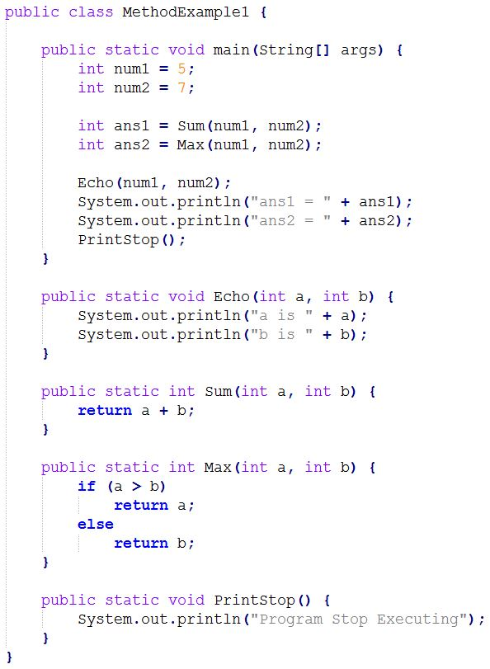
Process of method calling
When a program invokes a method, the program control gets transferred to the called method.
This called method then returns control to the caller in two conditions, when:
1. return statement is executed.
2. reaches the method ending closing brace.

Slide 14
Method Overloading
The method signature consists of the method name and the parameter list
The term method overloading refers to the fact that it is perfectly legal to have more than one method in the same class with the same name, as long as they have different parameter lists. The difference can be in the number of parameters, or in the types of parameters.
Example:
int process(double num) { } // method 1
int process(char letter) { } // method 2
int process(double num, int position) { } // method 3
Notice that although all three methods above have the same exact name, they each have a different parameter list. Some of them differ in the number of parameters (2 parameters vs. 1 parameter), and the first two differ in types (double vs. char). The compiler will distinguish which function to invoke based on what is actually passed in when the function is called.
x = process(3.45, 12); // invokes the third function above
x = process('f'); // invokes the second function

Slide 15
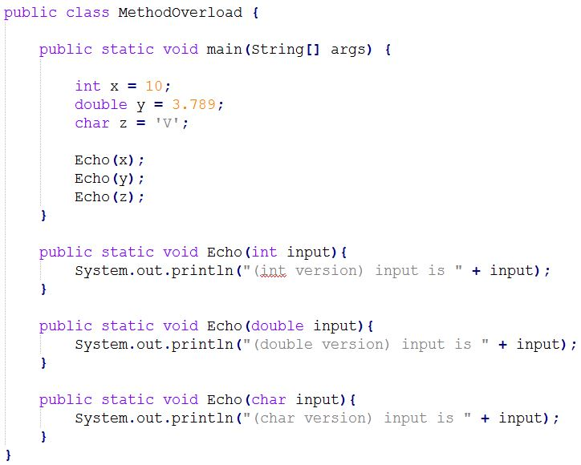
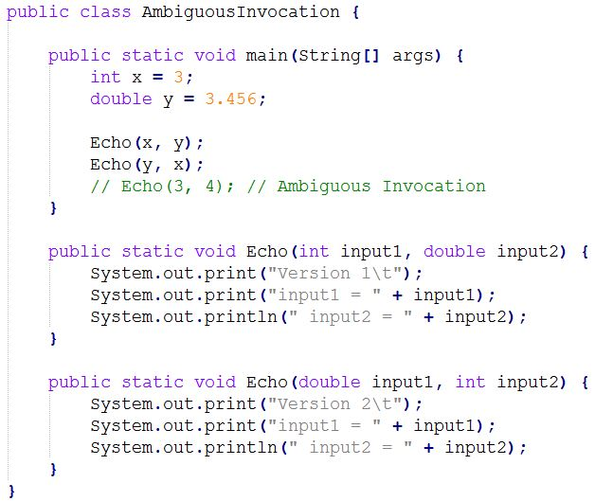

Slide 16
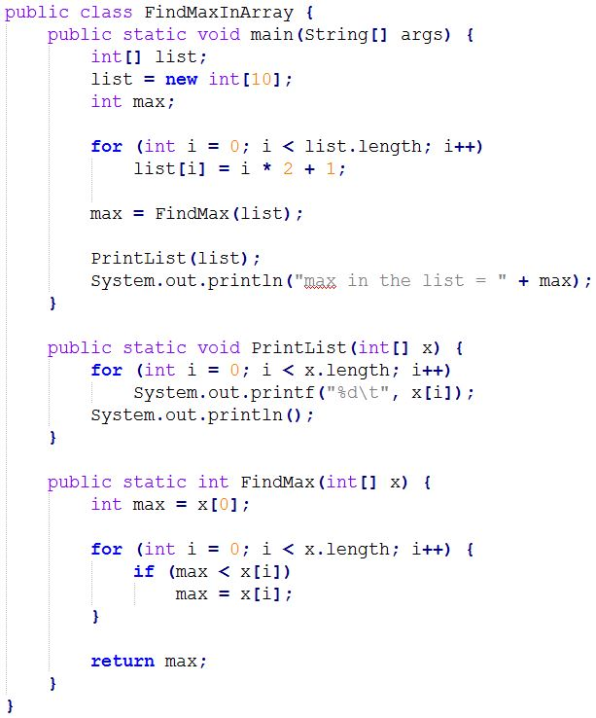
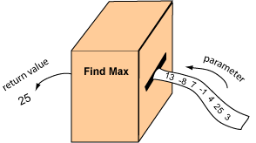
Maximum-finding Method
Say that we want a method that finds the maximum element in an array of integers. Think of this method as a machine that inputs an array and outputs the maximum.
The array is passed into the method as a parameter, and the maximum is returned by the method.

Slide 17
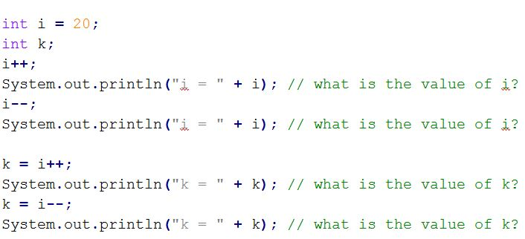
Post increment and decrement
Post increment example: i++;
Post decrement example: i--;

Slide 18
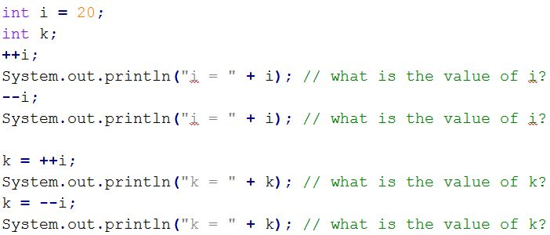
Pre increment and decrement
Pre increment example: --i;
Pre decrement example: ++i;

Slide 19
Operator | Description | Level | Associativity
[] . () ++ -- | access array element access object member invoke a method post-increment post-decrement | 1 | left to right
++ -- + - ! ~ | pre-increment pre-decrement unary plus unary minus logical NOT bitwise NOT | 2 | right to left
() new | cast object creation | 3 | right to left
* / % | multiplicative | 4 | left to right
+ - + | additive string concatenation | 5 | left to right
<< >> >>> | shift | 6 | left to right
< <= > >= instanceof | relational type comparison | 7 | left to right
== != | equality | 8 | left to right
& | bitwise AND | 9 | left to right
^ | bitwise XOR | 10 | left to right
| | bitwise OR | 11 | left to right
&& | conditional AND | 12 | left to right
|| | conditional OR | 13 | left to right
?: | conditional | 14 | right to left
= += -= *= /= %= &= ^= |= <<= >>= >>>= | assignment | 15 | right to left

Slide 20
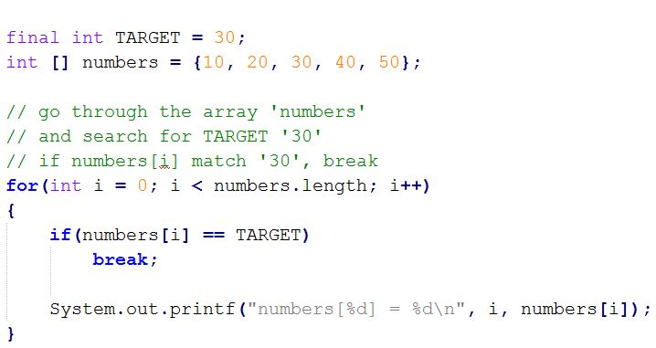
The break keyword:
The break keyword is used to stop the entire loop. The break keyword must be used inside any loop or a switch statement.
The break keyword will stop the execution of the innermost loop and start executing the next line of code after the block.

Slide 21
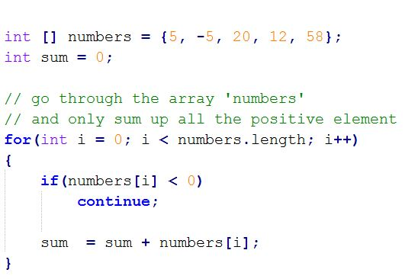
The continue keyword:
The continue keyword can be used in any of the loop control structures. It causes the loop to immediately jump to the next iteration of the loop.
In a for loop, the continue keyword causes flow of control to immediately jump to the update statement.
In a while loop or do/while loop, flow of control immediately jumps to the Boolean expression.

Slide 22
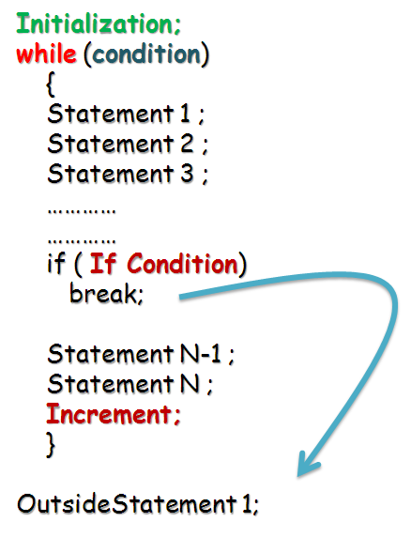
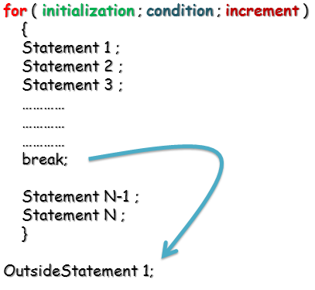
break in for loop
break in while loop

Slide 23
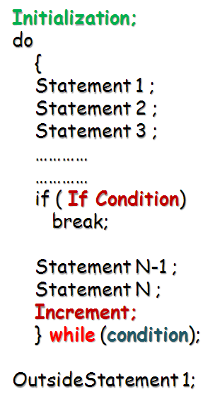
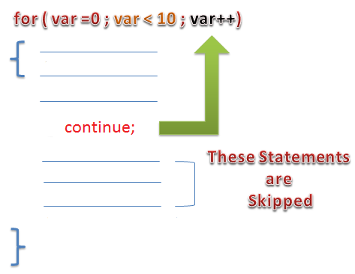
break in do...while loop
continue in for loop

Slide 24
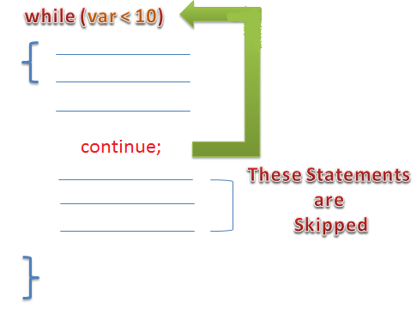
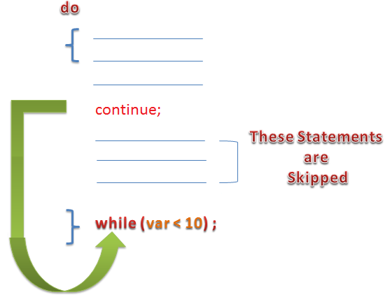
continue in while loop
continue in do…while loop

