Slide 1
Selection

Slide 2
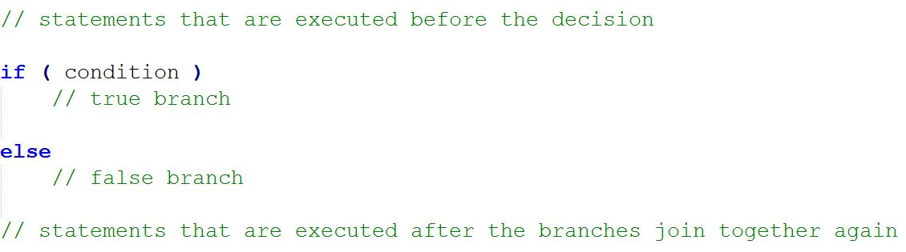
Outline of a Two-way Decision
Here is an outline of a two-way decision structure:
The condition can compare what is held in a variable to other values. You can use the comparisons <, >, and so on. (More about these later.) The first statement after the false branch will be executed no matter which branch is chosen.

Slide 3
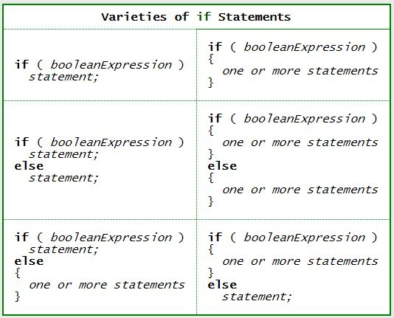
Varieties of if Statements

Slide 4
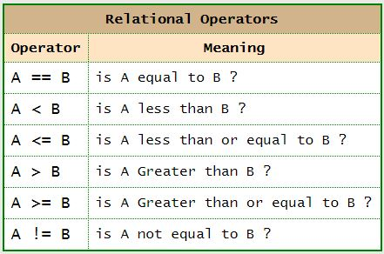
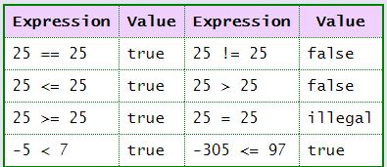
Boolean Expressions
A Boolean expression is an expression that evaluates either to be true or false.
Boolean expressions often compare numbers. A relational operator says how the numbers are compared.

Slide 5
We have Boolean operators for combining expressions.
Again, these operators return true or false
!x // the NOT operator (negation) -- true if x is false
x && y // the AND operator -- true if both x and y are true
x || y // the OR operator -- true if either x or y (or both) are true
x ^ y // the exclusive or operator -- true if exactly one operand is true and one is false
Examples of expressions
(x > 0 && y > 0 && z > 0) // all three of (x, y, z) are positive
(x < 0 || y < 0 || z < 0) // at least one of the three variables is negative
( numStudents >= 20 && !(classAvg < 70))
// there are at least 20 students and the class average is at least 70
( numStudents >= 20 && classAvg >= 70)
// means the same thing as the previous expression

Slide 6
Some common errors
What's wrong with these if-statements? Which ones are syntax errors and which ones are logic errors?
if (x == 1 || 2 || 3)
System.out.print("x is a number in the range 1-3");
if (x > 5) && (y < 10)
System.out.print("Yahoo!");
if (response != 'Y' || response != 'N')
System.out.print("You must type Y or N (for yes or no)");

Slide 7
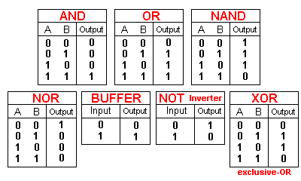
Truth Table

Slide 8
The Conditional Operator
There is a special operator known as the conditional operator that can be used to create short expressions that work like if/else statements.
Format:
boolean_expression ? true_expression : false_expression
How it works:
The boolean_expression is evaluated for true/false value. This is like the test expression of an if-statement
If the expression is true, the operator returns the true_expression value
If the test expression is false, the operator returns the false_expression value
Note that this operator takes three operands. It is the one ternary operator in the Java language

Slide 9
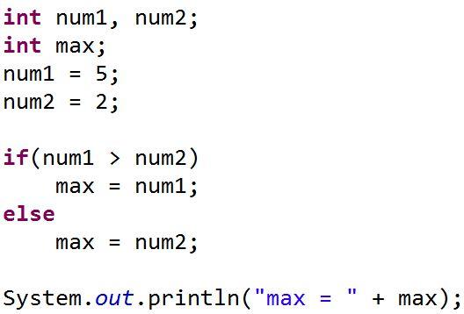
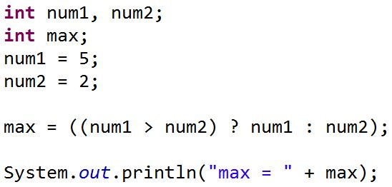
Using if/else statement
Using conditional Operator

Slide 10
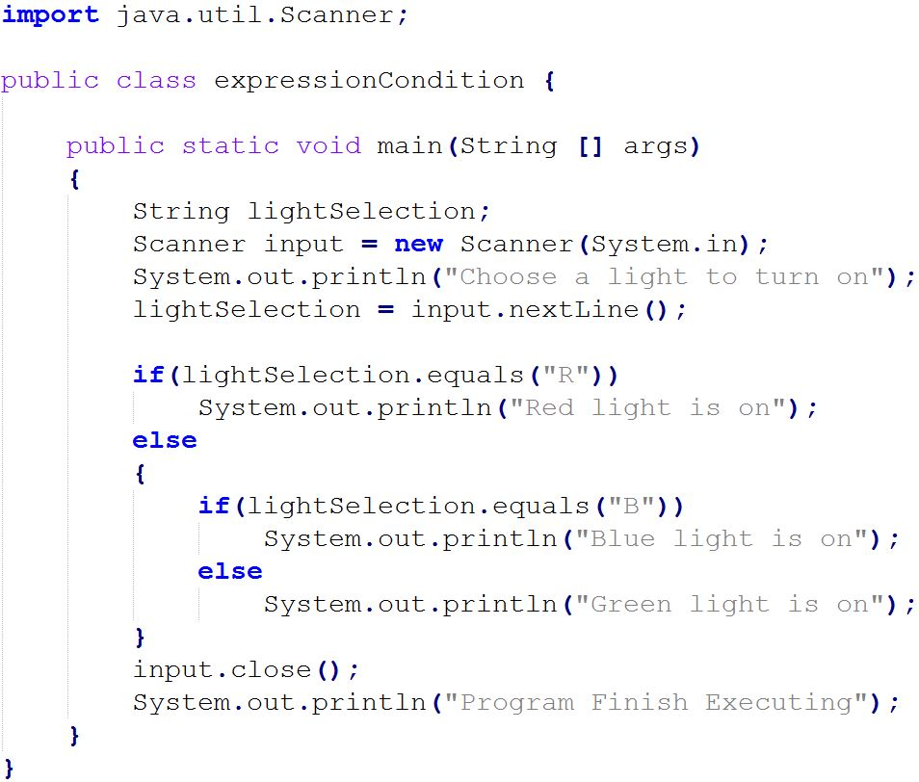
Light control program
Write a simple light control program.
It allows user to control 3 lights in a room

Slide 11
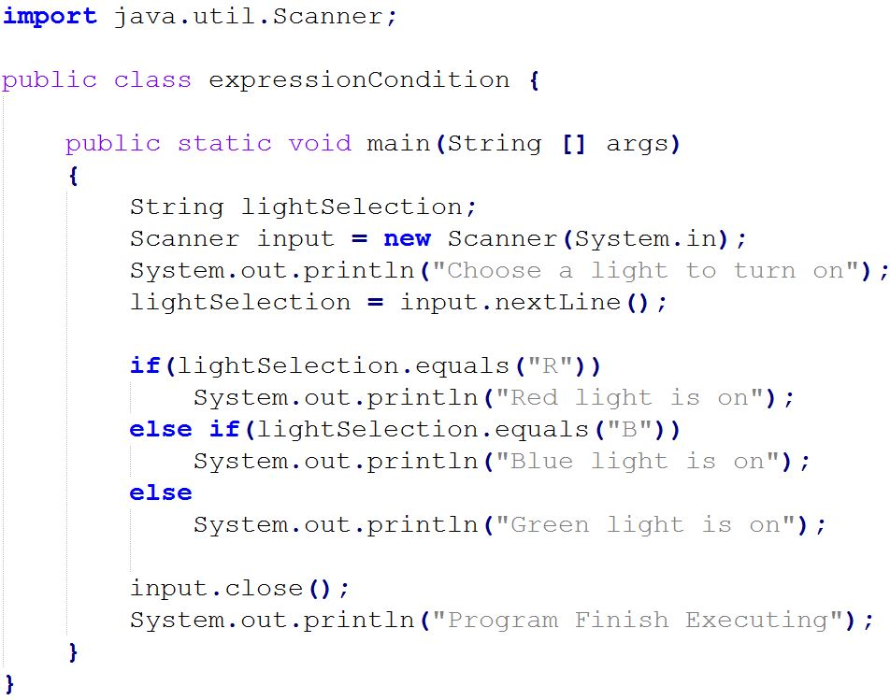
Light control program
Write a simple light control program.

Slide 12
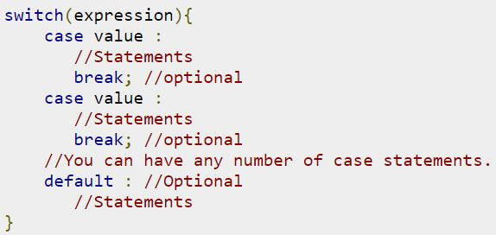
The switch statement
A switch statement allows a variable to be tested for equality against a list of values. Each value is called a case, and the variable being switched on is checked for each case.
A switch statement is often convenient for occasions in which there are multiple cases to choose from. The syntax format is:

Slide 13
Rules apply to a switch statement
The variable used in a switch statement can only be a byte, short, int, or char.
You can have any number of case statements within a switch. Each case is followed by the value to be compared to and a colon.
The value for a case must be the same data type as the variable in the switch and it must be a constant or a literal.
When the variable being switched on is equal to a case, the statements following that case will execute until a break statement is reached.
When a break statement is reached, the switch terminates, and the flow of control jumps to the next line following the switch statement.
Not every case needs to contain a break. If no break appears, the flow of control will fall through to subsequent cases until a break is reached.
A switch statement can have an optional default case, which must appear at the end of the switch. The default case can be used for performing a task when none of the cases is true. No break is needed in the default case.

Slide 14
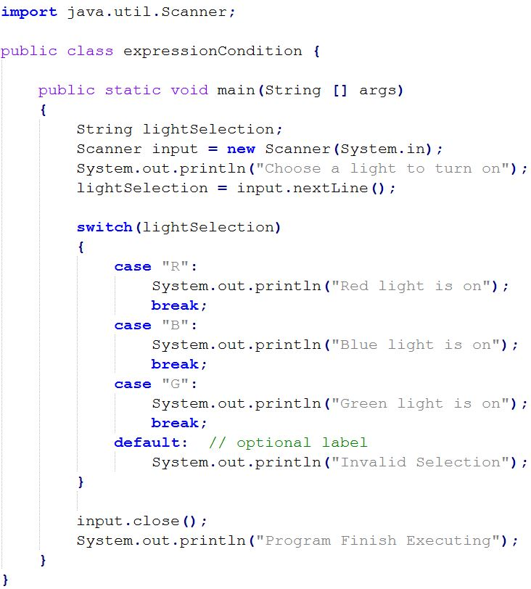
Light control in switch statement

