Slide 1
Inheritance continue

Slide 2
Why Inheritance
Object oriented languages have a feature called inheritance. Inheritance enables you to define new classes based upon an existing class.
The new classes are similar to the existing class, but have additional member variables and methods.
This makes programming easier because you can build upon an existing class instead of starting out from scratch.
We will discusses the syntax and semantics of inheritance using some simple examples.

Slide 3
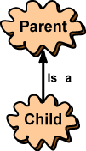
Single Inheritance
In diagrams that show inheritance, an arrow points from the new class to the class it is based upon. The arrow is sometimes labeled "is a".
The class that is used to define a new class is called a parent class (or superclass or base class.) The class based on the parent class is called a child class (or subclass or derived class.)
In Java, (unlike with humans) children inherit characteristics from just one parent. This is called single inheritance. Some languages allow a child to inherit from more than one parent. This is called multiple inheritance.

Slide 4
There are three sets of phrases for describing inheritance relationships:
parent/child,
base class/derived class,
superclass/subclass
Inheritance is between classes, not between objects
A parent class is a blueprint that is followed when an object is constructed.
A child class of the parent is another blueprint (that looks much like the original), but with added features.
The child class is used to construct objects that look like the parent's objects, but with added features.

Slide 5
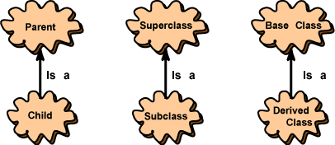
There are three sets of phrases for describing inheritance relationships: parent/child,
base class/derived class, superclass/subclass.
Inheritance is between classes, not between objects
A parent class is a blueprint that is followed when an object is constructed. A child class of the parent is another blueprint (that looks much like the original), but with added features. The child class is used to construct objects that look like the parent's objects, but with added features.

Slide 6
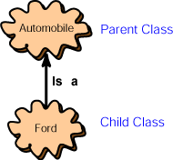
There are three sets of phrases for describing inheritance relationships:
parent/child,
base class/derived class,
superclass/subclass
Inheritance is between classes, not between objects
A parent class is a blueprint that is followed when an object is constructed.
A child class of the parent is another blueprint (that looks much like the original), but with added features.
The child class is used to construct objects that look like the parent's objects, but with added features.

Slide 7
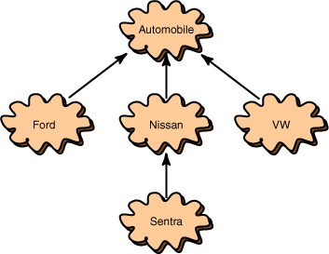
Hierarchies
This picture shows a hierarchy of classes. It shows that "Ford is-a automobile," "Nissan is-a automobile," and that "VW is-a automobile." It also shows that "Sentra is-a Nissan."
In a hierarchy, each class has at most one parent but might have several children classes. The class at the top of the hierarchy has no parent. This class is called the root of the hierarchy.

Slide 8
Syntax
The syntax for deriving a child class from a parent class is:
class childClass extends parentClass { // new characteristics of the child class go here
}

Slide 9
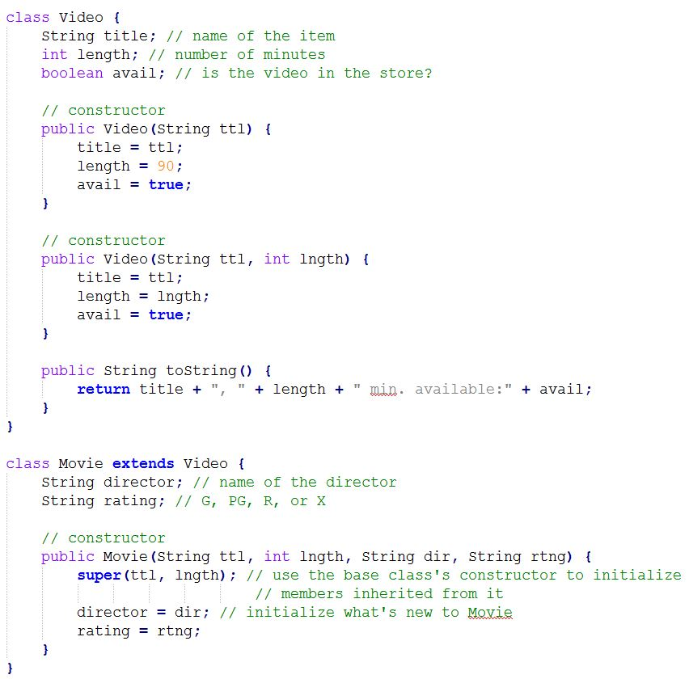

Slide 10
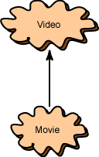
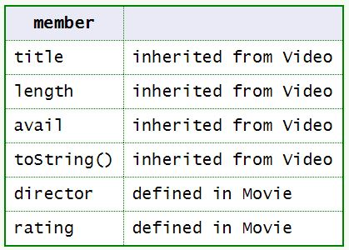
The class Movie is a subclass of Video.
An object of type Movie has these members:

Slide 11
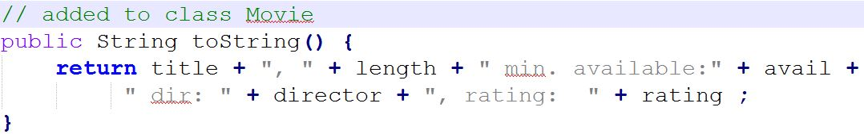
Overriding Methods
Now, even though the parent has a toString() method, the new definition of toString() in the child class will override the parent's version.
A child's method overrides a parent's method when it has the same signature as a parent method. Now the parent has its method, and the child has its own method with the same signature.
(Remember that the signature of a method is the name of the method and its parameter list.)

Slide 12
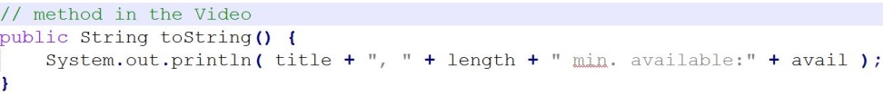
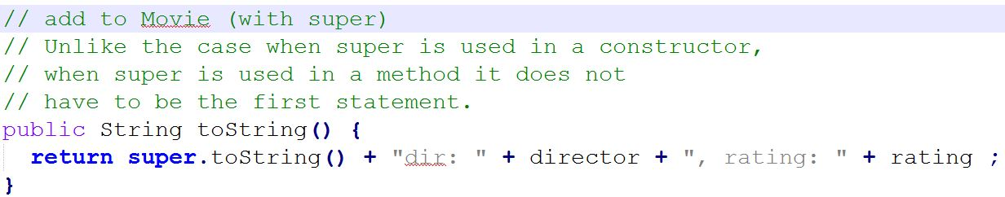
Using super in a Child's Method
Sometimes (as in the example) you want a child class to have its own method, but that method includes everything the parent's method does. You can use the super reference in this situation. For example, here is Video's method:
Here is Movie's method without using super:
Movie's method would better be written using super:

Slide 13
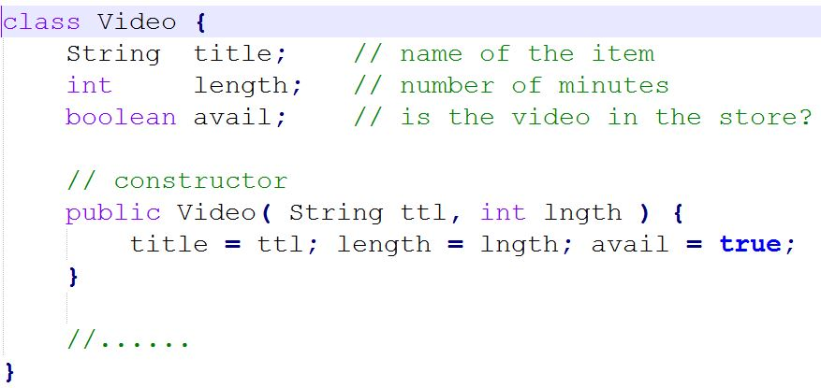
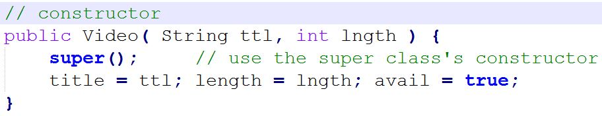
The Object Class
Remember the rule: every constructor starts out with a super() constructor. If you don't explicitly put it in, then the Java compiler automatically puts it in for you. Now look at the definition of Video:
According to the rule, the compiler automatically does this:

Slide 14
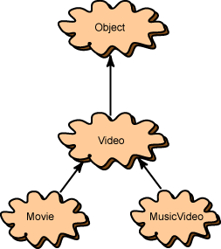

The Object Class
This is correct. All classes have a parent class (a super class) except one. The class at the top of the Java class hierarchy is called Object.
If a class definition does not specify a parent class then it automatically has Object as a parent class. The compiler automatically assumes, for example:

Slide 15
The Object Class
In Java, every class is derived automatically from a class called Object. If no specific inheritance is declared for a class, it automatically has Object as a superclass.
While there are several methods in class Object, here are three important such methods, inherited by every Java class
public boolean equals(Object object)
public String toString()
public Object clone()
Let's look at each.

Slide 16
public boolean equals(Object object)
public boolean equals(Object object)
tests whether two objects are equal
// returns true if equal, false if not
// (object1 and object2 same class type)
object1.equals(object2)
Default implementation is:
public boolean equals(Object obj) {
return (this == obj);
}
Note that this default implementation is equivalent to the == operator, since it only tests the reference variables for equality.
The intent is that subclasses of Object should override the equals method whenever they want a test of equality of two objects' contents.

Slide 17
public String toString()
public String toString()
returns a string that represents the object. Call format:
objectName.toString();
The default version of the string might not always be useful, but this can be overridden in any derived class.
Example for a class called Fraction:
public String toString() {
return numerator + "/" + denominator;
}
Assuming the above function for a Fraction class, the following illustrates its usage:
Fraction f1 = new Fraction(4,5); // create the fraction 4/5
System.out.print(f1.toString()); // will print "4/5“
// also prints "4/5" as this
// always invokes a class' toString method
System.out.print(f1);

Slide 18
public Object clone()
public Object clone()
direct assignment between object names will only copy one reference variable to another.
Use the clone() method to make copies of objects.
newObject = someObject.clone();
Not all objects can be cloned. Only objects implement the java.lang.Cloneable interface can use the clone method.
The clone() method from the object class does a "shallow copy" (i.e. copies reference variables).
If a "deep copy" is needed (a copy constructors in C++), you should override clone()for a class.

Slide 19
The protected and final modifier
Protected
Recall that public data and methods can be accessed by anyone, and private data and methods can be accessed only within the class
protected data and methods of a public class can be accessed by any classes derived from the given class (this is also true in C++)
In Java, a protected member can also be accessed by any class in the same package (to be discussed later)
final
In addition to creating constant variable identifiers, the keyword final can be used for a couple of special purposes involving inheritance:
When used on a class declaration, it means that the class cannot be extended. (i.e. it cannot become a parent class to a new subclass)
When used on a method declaration, it means that the method cannot be overridden in a subclass. (i.e. this is the final version of the method)

