Slide 1
Components of a Computer System
A computer system consists of both hardware and software
The hardware components of a computer system are the electronic and mechanical parts
The software components of a computer system are the data and the computer programs
A typical desktop computer has processor, main memory, secondary memory, power supply, various input devices (such as the keyboard and mouse) and output devices (such as the monitor)
Many of the components are connected to the main circuit board of the computer, called the motherboard

Slide 2
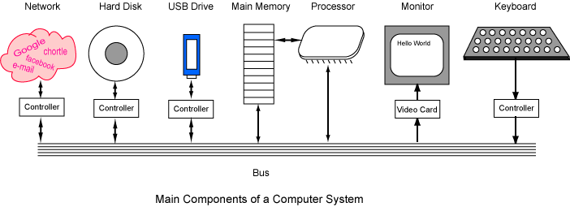
A bus is a group of wires on the main circuit board of the computer. It is a pathway for data flowing between components. Most devices are connected to the bus through a controller which coordinates the activities of the device with the bus.

Slide 3
The processor is sometimes called the Central Processing Unit or CPU.
performs all the fundamental computation of the computer system.
Main memory:
closely connected to the processor
stored data are quickly and easily changed
holds the programs and data that the processor is actively working with
interacts with the processor millions of times per second
needs constant electric power to keep its information
Secondary memory:
connected to main memory through the bus and a controller
stored data are easily changed, but changes are slow compared to main memory
used for long-term storage of programs and data
before data and programs can be used, they must be copied from secondary memory into main memory
does not need electric power to keep its information

Slide 4
Computer software consists of both programs and data. Programs consist of instructions for the processor. Data can be any information that a program needs: character data, numerical data, image data, audio data, and countless other types.
There are two categories of programs.
Application programs (usually called just "applications") are programs that people use to get their work done.
Systems programs keep the hardware and software running together smoothly.
Application Programs | Systems Programs
Word processors Game programs Spreadsheets Data base systems Graphics programs Web browsers | Operating system Networking system Programming language software Web site server Data backup

Slide 5
Bit and Byte
In both main and secondary memory, information is stored as patterns of bits.
A bit is a single on/off value. Only these two values are possible.
Smallest unit of storage in a computer
Stores the value 0 or 1
Each eight bit group is called a byte
One byte is about enough memory to hold a single character. Typically, four bytes are used to represent integers.
Smallest addressable unit of storage in a computer
Storage units (variables) in a program are 1 or more bytes
Each byte in memory has an address (a number that identifies the location)

Slide 6
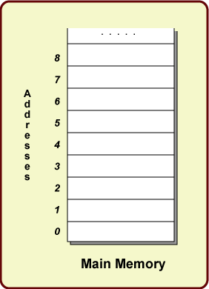
Picture of Main Memory
Main memory consists of a very long list of bytes.
In most modern computers, each byte has an address that is used to locate it. The picture shows a small part of main memory

Slide 7
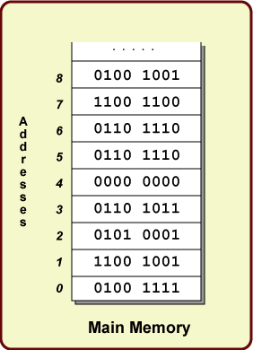
Picture of Main Memory
Main memory consists of a very long list of bytes.
In most modern computers, each byte has an address that is used to locate it. The picture shows a small part of main memory
The only thing that can be stored at one memory location is eight bits, each with a value of "0" or "1". The bits at a memory location are called the contents of that location.

Slide 8
Reading and Writing Memory
The processor can do two fundamental things with in main memory:
It can write to a byte at a given memory location.
The previous bit pattern in that location will be destroyed.
The new bit pattern is now saved for future use.
It can read a byte from a given location.
The processor gets the bit pattern stored at that location.
The contents of that location are NOT changed.
For example, if the processor needs to get the byte stored at location 5, it can read it. It gets the byte "0110 1110" as the data it needs (but location 5 in memory does not change.)
Most processors can write (and read) more than a single byte at a time. This speeds things up. But the two operations above are fundamental.

Slide 9
Programming, and Programming Languages
Program
The collection of machine instructions in main memory
Machine Language
Based on machine's core instruction set
Needed by computer, hard for humans to read (1's and 0's)
Example: 1110110101010110001101010
The processor runs one machine instruction at a time
Assembly Language
translation of machine instructions to symbols, slightly easier for humans to read
Example: ADD $R1, $R2, $R3
High-level Programming languages
Allow programmer creates a program using powerful, "big" operations which will later be converted into many little machine operations
Example: Java, C, C++, or BASIC

Slide 10
A source program is a text file that contains instructions written in a high level language. It can not be executed (made to run) by a processor without some additional steps
For example, here is a complete program in C
#include <stdio.h>
main()
{
int sum = 0;
sum = 2 + 2;
printf( "%d\n", sum );
}

Slide 11
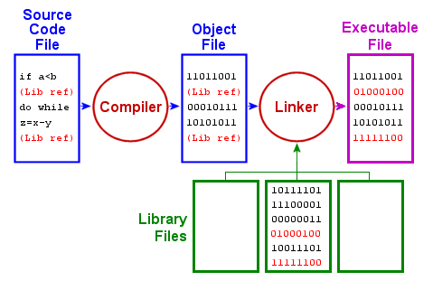
Program Translation (One)
A source program is translated into a machine language program.
An application program called a translator takes a source program
as input and produces a machine language program as output

Slide 12
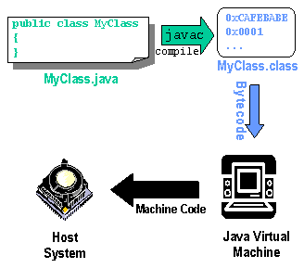
Program Translation (Two)
Programs are written in Java and stored in .java files (for example, MyClass.java)
The .java files are compiled by the Java compiler into byte code and stored in .class files
(for example, MyClass.class)
The JVM loads the bytecode (the .class files), and then converts it to the machine code
of the target platform that executes it

Slide 13
Software Bug
According to Wikipedia,
A software bug is an error, flaw, failure, or fault in a computer program or system that causes it to produce an incorrect or unexpected result, or to behave in unintended ways.
Most bugs arise from mistakes and errors made by people in either a program's source code or its design, or in frameworks and operating systems used by such programs, and a few are caused by compilers producing incorrect code.
A program that contains a large number of bugs, and/or bugs that seriously interfere with its functionality, is said to be buggy.

