Slide 1
Loop

Slide 2
Java Loops - for, while and do...while
There may be a situation when we need to execute a block of code several number of times, and is often referred to as a loop.
Java has very flexible three looping mechanisms. You can use one of the following three loops:
while Loop
do...while Loop
for Loop
The number of repetitions is based on criteria defined in the loop structure, usually a true/false expression

Slide 3
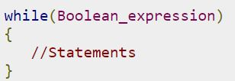
The while loop
A while loop is a control structure that allows you to repeat a task a certain number of times.
The syntax of a while loop is:
When executing, if the boolean_expression result is true, then the actions inside the loop will be executed. This will continue as long as the expression result is true.
Here, key point of the while loop is that the loop might not ever run. When the expression is tested and the result is false, the loop body will be skipped and the first statement after the while loop will be executed.

Slide 4
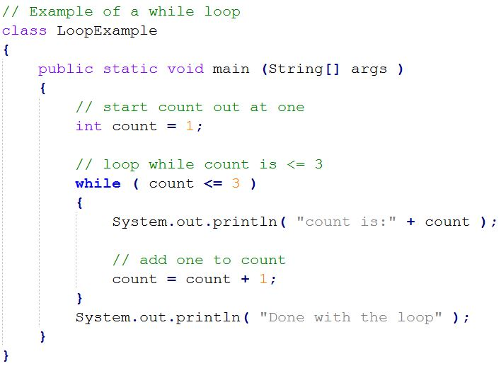
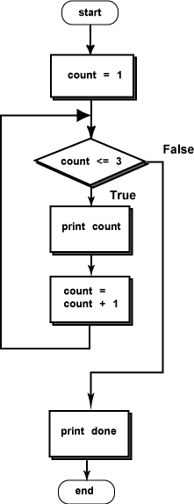
Quick Question:
What is the value stored in variable “count” after the while loop?

Slide 5
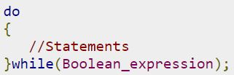
The do…while loop
A do...while loop is similar to a while loop, except that a do...while loop is guaranteed to execute at least one time.
The syntax of a do...while loop is:
Notice that the Boolean expression appears at the end of the loop, so the statements in the loop execute once before the Boolean is tested.
If the Boolean expression is true, the flow of control jumps back up to do, and the statements in the loop execute again. This process repeats until the Boolean expression is false.

Slide 6
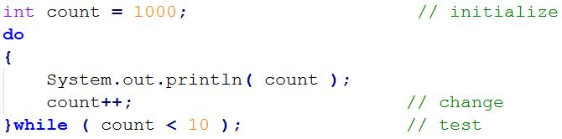
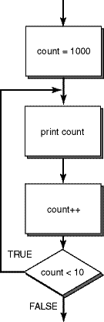

Slide 7
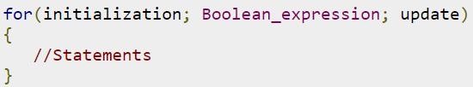
The for Loop
A for loop is a repetition control structure that allows you to efficiently write a loop that needs to execute a specific number of times.
A for loop is useful when you know how many times a task is to be repeated.
The syntax of a for loop is

Slide 8
The for Loop
The initialization step is executed first, and only once. This step allows you to declare and initialize any loop control variables. You are not required to put a statement here, as long as a semicolon appears.
Next, the Boolean expression is evaluated. If it is true, the body of the loop is executed. If it is false, the body of the loop does not execute and flow of control jumps to the next statement past the for loop.
After the body of the for loop executes, the flow of control jumps back up to the update statement. This statement allows you to update any loop control variables. This statement can be left blank, as long as a semicolon appears after the Boolean expression.
The Boolean expression is now evaluated again. If it is true, the loop executes and the process repeats itself (body of loop, then update step, then Boolean expression). After the Boolean expression is false, the for loop terminates.

