Slide 1
Inheritance

Slide 2
Why Inheritance
Object oriented languages have a feature called inheritance. Inheritance enables you to define new classes based upon an existing class.
The new classes are similar to the existing class, but have additional member variables and methods.
This makes programming easier because you can build upon an existing class instead of starting out from scratch.
We will discusses the syntax and semantics of inheritance using some simple examples.

Slide 3
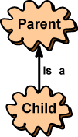
Single Inheritance
In diagrams that show inheritance, an arrow points from the new class to the class it is based upon. The arrow is sometimes labeled "is a".
The class that is used to define a new class is called a parent class (or superclass or base class.) The class based on the parent class is called a child class (or subclass or derived class.)
In Java, (unlike with humans) children inherit characteristics from just one parent. This is called single inheritance. Some languages allow a child to inherit from more than one parent. This is called multiple inheritance.

Slide 4
There are three sets of phrases for describing inheritance relationships:
parent/child,
base class/derived class,
superclass/subclass
Inheritance is between classes, not between objects
A parent class is a blueprint that is followed when an object is constructed.
A child class of the parent is another blueprint (that looks much like the original), but with added features.
The child class is used to construct objects that look like the parent's objects, but with added features.

Slide 5
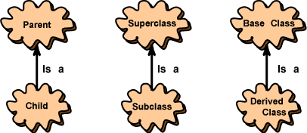
There are three sets of phrases for describing inheritance relationships: parent/child,
base class/derived class, superclass/subclass.
Inheritance is between classes, not between objects
A parent class is a blueprint that is followed when an object is constructed. A child class of the parent is another blueprint (that looks much like the original), but with added features. The child class is used to construct objects that look like the parent's objects, but with added features.

Slide 6
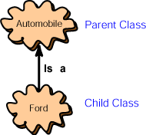
There are three sets of phrases for describing inheritance relationships:
parent/child,
base class/derived class,
superclass/subclass
Inheritance is between classes, not between objects
A parent class is a blueprint that is followed when an object is constructed.
A child class of the parent is another blueprint (that looks much like the original), but with added features.
The child class is used to construct objects that look like the parent's objects, but with added features.

Slide 7
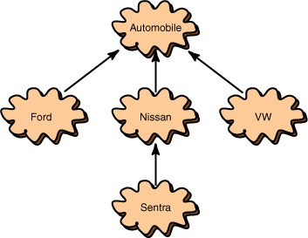
Hierarchies
This picture shows a hierarchy of classes. It shows that "Ford is-a automobile," "Nissan is-a automobile," and that "VW is-a automobile." It also shows that "Sentra is-a Nissan."
In a hierarchy, each class has at most one parent but might have several children classes. The class at the top of the hierarchy has no parent. This class is called the root of the hierarchy.

Slide 8
Syntax
The syntax for deriving a child class from a parent class is:
class childClass extends parentClass { // new characteristics of the child class go here
}

Slide 9
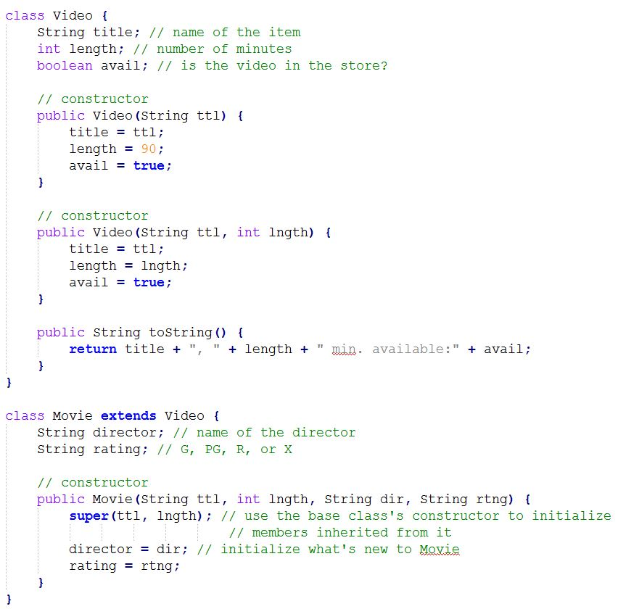

Slide 10
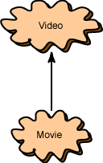
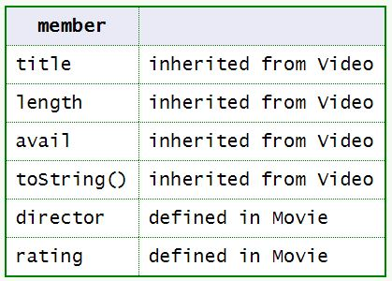
The class Movie is a subclass of Video.
An object of type Movie has these members:

