Slide 1
COP 3330 Recitation

Slide 2
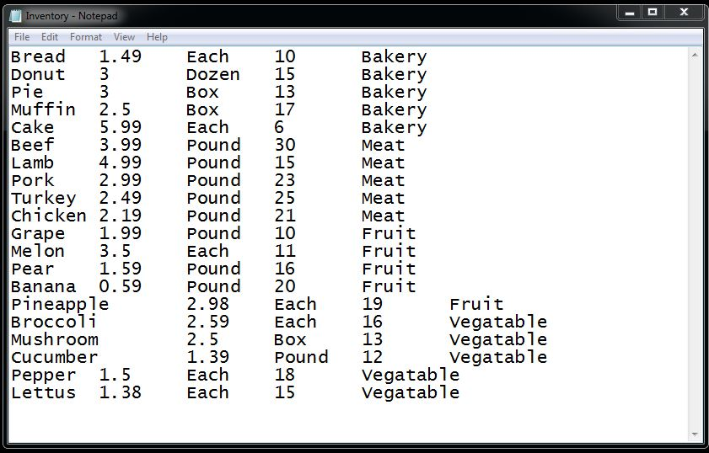
Implement a Farm class
Write a simple program to help a local farm to keep track of its merchandise
Information stored in a text file

Slide 3
Farm class
Read information from file
Generate summary
Search the inventory
Search for specific item
Search for certain category

