Slide 1
COP 3330 Recitation
Inheritance

Slide 2
C++ Inheritance
Inheritance allows us to define a class in terms of another class
we can create classes that absorb an existing class's data and behaviors and enhance them with new capability
the programmer can designate that the new class should inherit the members of an existing class. This existing class is called the base class, and the new class is referred to as the derived class.
idea of inheritance implements the is a relationship. For example, mammal IS-A animal, dog IS-A mammal hence dog IS-A animal as well and so on.

Slide 3
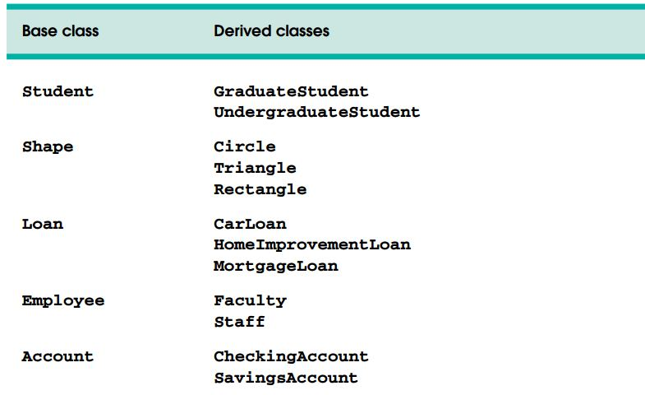
Few Examples

Slide 4
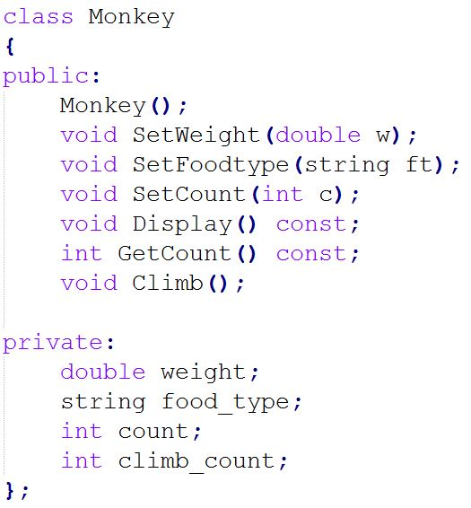
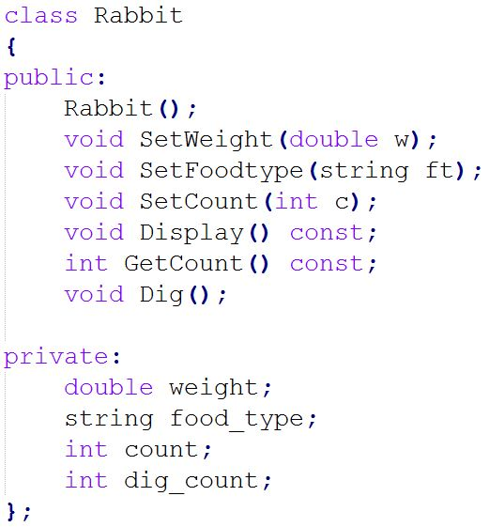
Class Monkey and Rabbit

Slide 5
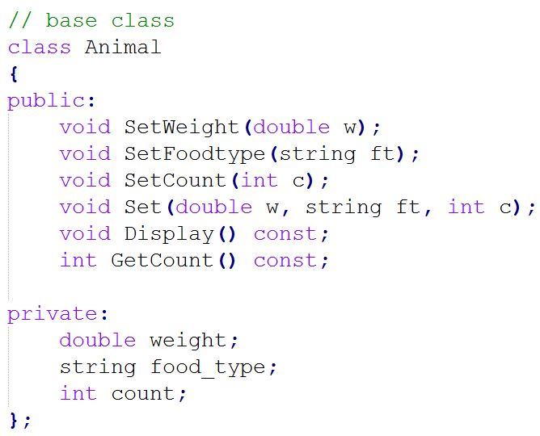
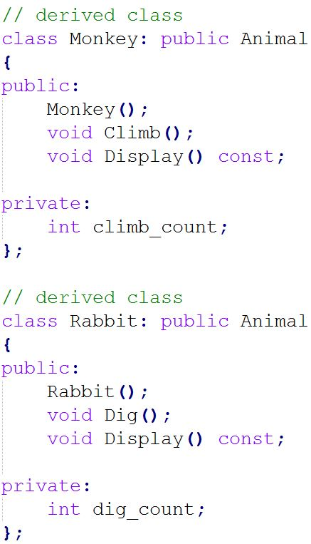
Inheritance ➔ factor out the common features

