Slide 1
COP 3330 Recitation
Big Number

Slide 2
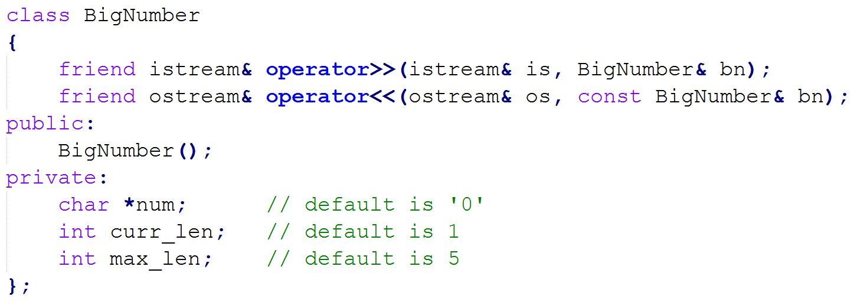
BigNumber (Insertion and Extraction Overloading)
Create BigNumber Class for storing any positive integer of arbitrary length
Implement insertion and extraction operator overloading

