Slide 1



APACHE
NIFI ARCHITECTURE

Slide 2
CONTENT
In this presentation, we will cover:
What is Apache NiFi?
History of NiFi
Features of Apache NiFi
Apache NiFi Architecture
NiFi Cluster
Key concepts of Apache NiFi

Slide 3
What Is Apache NiFi ?
Open source data ingestion platform
Manage and automate the flow of data between the systems.
Developed by NSA as Niagara File, but now maintained by Apache foundation
Cluster based and scalable
Supports all the devices that run Java.
Has web based user interface
Supports of a wide variety of data formats and protocols
Provides real-time control that eases the movement of data between source and destination.

Slide 4
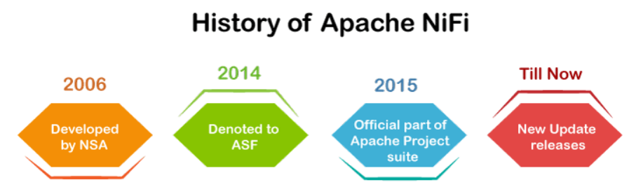
History of NiFi
Year | Description
2006 | Niagara Files (NiFi) was developed by the NSA (United State National Security Agency) in 2006 for over eight years.
2014 | In November 2014, NSA released it as open-source software and donated to Apache Software Foundation (ASF).
2015 | In July 2015, it reached to ASF top-level project status and became an official part of Apache Project Suite.
Till now | Every 6-8 months since then, Apache releases a new update of Apache NiFi.

Slide 5
Features of Apache NiFi
Web-based UI
Guaranteed Delivery
Data Provenance or Data Lineage
Extensible
Visual Command and control
Security

Slide 6
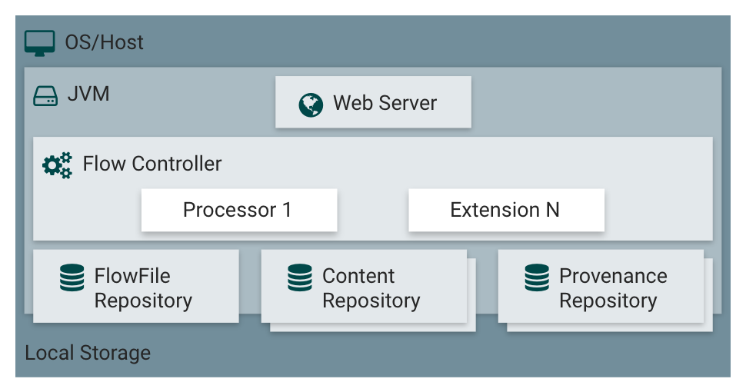
Apache Nifi Architecture
Comprise of a processor, flow controller, and web server that executes on the JVM machine.
Includes three repositories, which are FlowFile repository, Content repository, and Provenance repository.
NiFi runs within a JVM (Java Virtual Machine) on a host Operating System and every data or metadata store in repositories.

Slide 7
The components of Apache NiFi architecture are:
Web Server: Hosts the HTTP-based commands and control API of NiFi.
Flow Controller: Provides threads to execute the extensions.
Extension: Type of plugin that allows Apache NiFi to interact with different systems
FlowFile repository: Contains the current state and attribute of each FlowFile that passes through the data flows of NiFi.
Content repository: Stores all the data present in all the flowfiles.
Provenance repository: Stores all the provenance event data.
- Volatile provenance repository
- Persistence provenance repository
Notes:
Uses ZooKeeper for configuration/coordination
One node as a Cluster Coordinator
One node as a primary
JVM encapsulates
Web server
Processor / Extensions
Repositories for
FlowFile / Content / Data Provenance

Slide 8
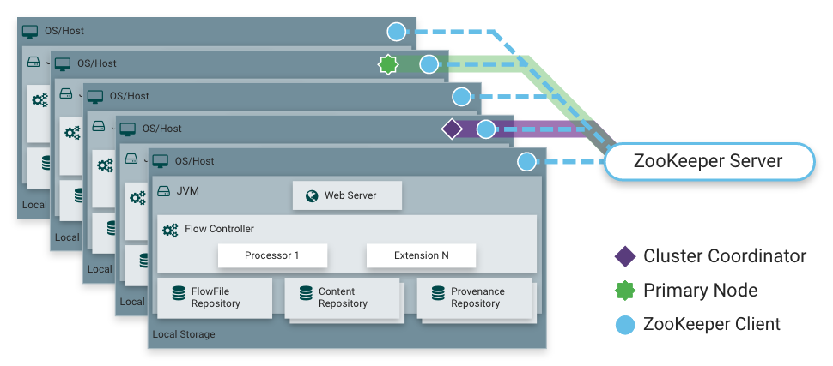
Nifi Cluster
In NiFi cluster, each node works on a different set of data, but it performs the same task on the data.
Zookeeper chooses a single node as the cluster coordinator and handles the failure automatically.
Each node of the cluster reports to the cluster coordinator about heartbeat and status.
The cluster coordinator is responsible for connecting or disconnecting the nodes.

Slide 9
Key concepts of Apache NiFi
Flow: Setup by connecting two or more different processors, and used to transfer the data from one data source to another destination data source.
Processor: Java module used to either fetch data from the source system or to be stored in the destination system.
Connection: Link between processors that connects the processors.
Process Group: Set of NiFi flows
FlowFile: Original data with which meta-information is associated
Data Provenance: Repository that allows the user to check information about FlowFile.

Slide 10
Thank you for listening

