Slide 1
Question Answering
Reference:
- D. Jurafsky and J. Martin, “Speech and Language Processing”

Slide 2
Introduction
By early 60s, two major paradigms of question answering (QA)
Information retrieval (IR) based
Knowledge based
In 2011, IBM’s Watson QA system won the TV game-show Jeopardy
Surpassing humans at answering questions like:
“William Wilkinson’s “An Account of the Principalities of Wallachia and Moldovia” inspired this author’s most famous novel.”

Slide 3
Introduction
Factoid questions – questions that can be answered with simple facts expressed in short texts such as:
“Where is the Louvre Museum located?”
Some paradigms for factoid question answering:
IR based QA (also called open domain question QA)
Knowledge-based QA
Pretrained language model based QA
We focus on factoid QA, but there are other QA tasks such as long-form QA (long answers), and community QA.

Slide 4
IR with Dense Vectors
The traditional IR algorithms have known to have a limitation: they work only if there is exact overlap of words between the query and document.
Vocabulary mismatch problem
E.g. User might decide to search for “a tragic love story”, but Shakespeare writes instead about “star-crossed lovers”
The solution is to use an approach that can handle synonymy
Instead of sparse word-count vectors, we use dense embeddings.
Modern methods all make use of encoders like BERT.

Slide 5
IR-based Factoid Question Answering
The goal of IR-based QA is to answer a user’s question by finding short text segments from a text collection
The dominant paradigm for IR-based QA is the retrieve and read model
retrieve relevant passages from a text collection
a reading comprehension algorithm passes over each passage and finds spans that are likely to answer the question
Some question answering systems focus only on the reading comprehension task

Slide 6
IR-based QA: Reader
The reader’s job is to take a passage as input and produce a span of text in the passage as the answer
E.g. a Question like “How tall is Mt. Everest?”, and a passage that contains the clause Reaching 29,029 feet, the reader will output 29,029 feet
The answer extraction task is commonly modeled by span labeling: identifying in the passage a span that constitutes an answer
A standard baseline algorithm for Reader is to pass the question and passage to any encoder like BERT

Slide 7
IR-based QA: Reader

Slide 8
Entity Linking

Slide 9
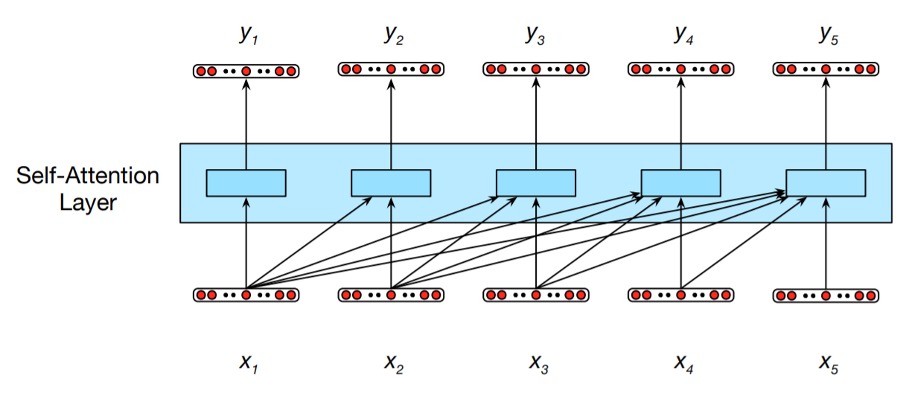
Self-Attention Layers
Fig. 1
Information flow in a causal (or masked) self-attention model. In processing each element of the sequence, the model attends to all the inputs up to, and including, the current one. Unlike RNNs, the computations at each time step are independent of all the other steps and therefore can be performed in parallel.

Slide 10
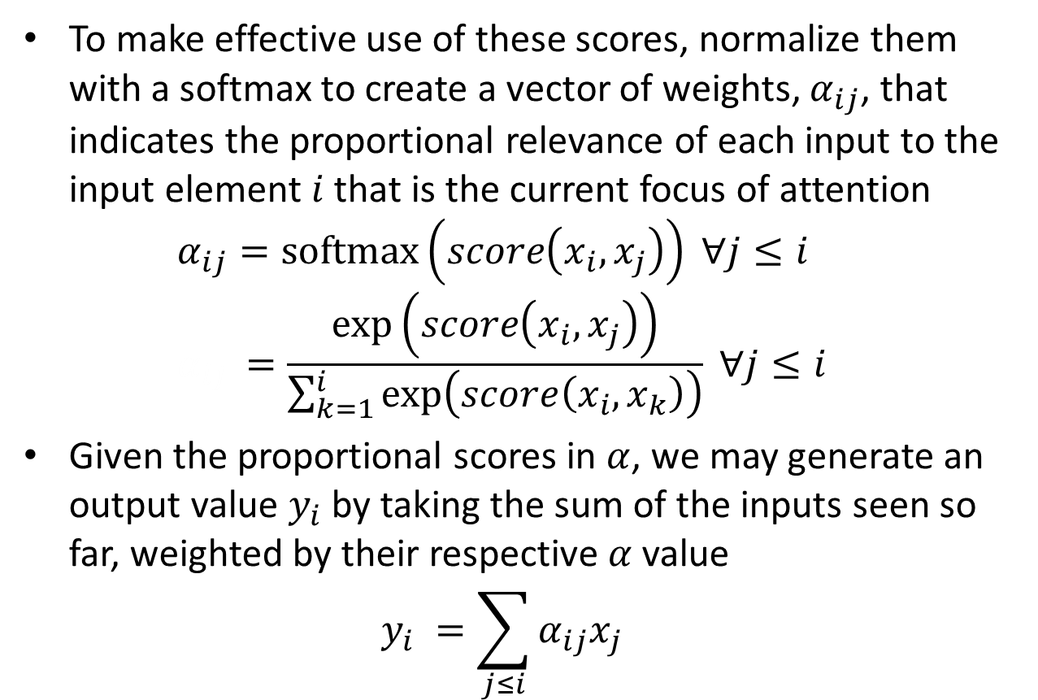
Self-Attention – the Simplest Form

