Slide 1
Question Answering
Reference:
- D. Jurafsky and J. Martin, “Speech and Language Processing”

Slide 2
Introduction
By early 60s, two major paradigms of question answering (QA)
Information retrieval (IR) based
Knowledge based
In 2011, IBM’s Watson QA system won the TV game-show Jeopardy
Surpassing humans at answering questions like:
“William Wilkinson’s “An Account of the Principalities of Wallachia and Moldovia” inspired this author’s most famous novel.”

Slide 3
Introduction
Factoid questions – questions that can be answered with simple facts expressed in short texts such as:
“Where is the Louvre Museum located?”
Some paradigms for factoid question answering:
IR based QA (also called open domain question QA)
Knowledge-based QA
Pretrained language model based QA
We focus on factoid QA, but there are other QA tasks such as long-form QA (long answers), and community QA.

Slide 4
IR with Dense Vectors
The traditional IR algorithms have known to have a limitation: they work only if there is exact overlap of words between the query and document.
Vocabulary mismatch problem
E.g. User might decide to search for “a tragic love story”, but Shakespeare writes instead about “star-crossed lovers”
The solution is to use an approach that can handle synonymy
Instead of sparse word-count vectors, we use dense embeddings.
Modern methods all make use of encoders like BERT.

Slide 5
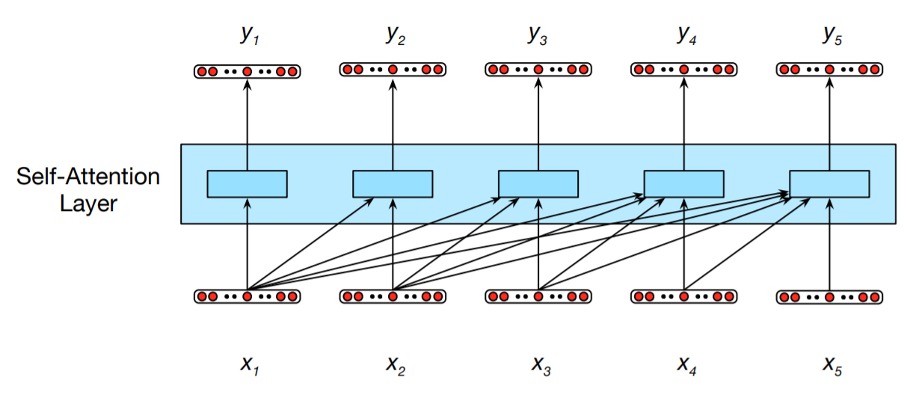
Self-Attention Layers
Fig. 1
Information flow in a causal (or masked) self-attention model. In processing each element of the sequence, the model attends to all the inputs up to, and including, the current one. Unlike RNNs, the computations at each time step are independent of all the other steps and therefore can be performed in parallel.

Slide 6
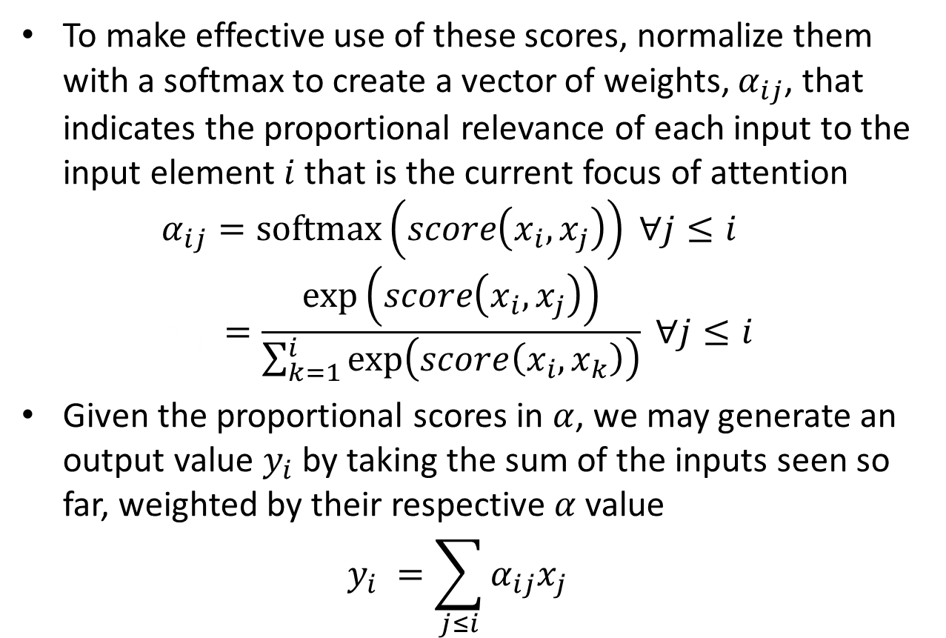
Self-Attention – the Simplest Form
To make effective use of these scores, normalize them with a softmax to create a vector of weights, $α_{ij}$, that indicates the proportional relevance of each input to the input element $i$ that is the current focus of attention $α_{ij}=softmax\left(score\left(x_{i}, x_{j}\right)\right) ∀j≤i$ $α_{ij }=\frac{exp\left(score\left(x_{i}, x_{j}\right)\right)}{\sum_{k=1}^{i}{exp\left(score\left(x_{i}, x_{k}\right)\right)}} ∀j≤i$
Given the proportional scores in $α$, we may generate an output value $y_{i}$ by taking the sum of the inputs seen so far, weighted by their respective $α$ value $y_{i} =\sum_{j≤i}{α_{ij}x_{j}}$

