Slide 1
Question Answering
Reference:
- D. Jurafsky and J. Martin, “Speech and Language Processing”

Slide 2
Introduction
By early 60s, two major paradigms of question answering (QA)
Information retrieval (IR) based
Knowledge based
In 2011, IBM’s Watson QA system won the TV game-show Jeopardy
Surpassing humans at answering questions like:
“William Wilkinson’s “An Account of the Principalities of Wallachia and Moldovia” inspired this author’s most famous novel.”

Slide 3
Introduction
Factoid questions – questions that can be answered with simple facts expressed in short texts such as:
“Where is the Louvre Museum located?”
Some paradigms for factoid question answering:
IR based QA (also called open domain question QA)
Knowledge-based QA
Pretrained language model based QA
We focus on factoid QA, but there are other QA tasks such as long-form QA (long answers), and community QA.

Slide 4
IR with Dense Vectors
The traditional IR algorithms have known to have a limitation: they work only if there is exact overlap of words between the query and document.
Vocabulary mismatch problem
E.g. User might decide to search for “a tragic love story”, but Shakespeare writes instead about “star-crossed lovers”
The solution is to use an approach that can handle synonymy
Instead of sparse word-count vectors, we use dense embeddings.
Modern methods all make use of encoders like BERT.

Slide 5
IR-based Factoid Question Answering
The goal of IR-based QA is to answer a user’s question by finding short text segments from a text collection
The dominant paradigm for IR-based QA is the retrieve and read model
retrieve relevant passages from a text collection
a reading comprehension algorithm passes over each passage and finds spans that are likely to answer the question
Some question answering systems focus only on the reading comprehension task

Slide 6
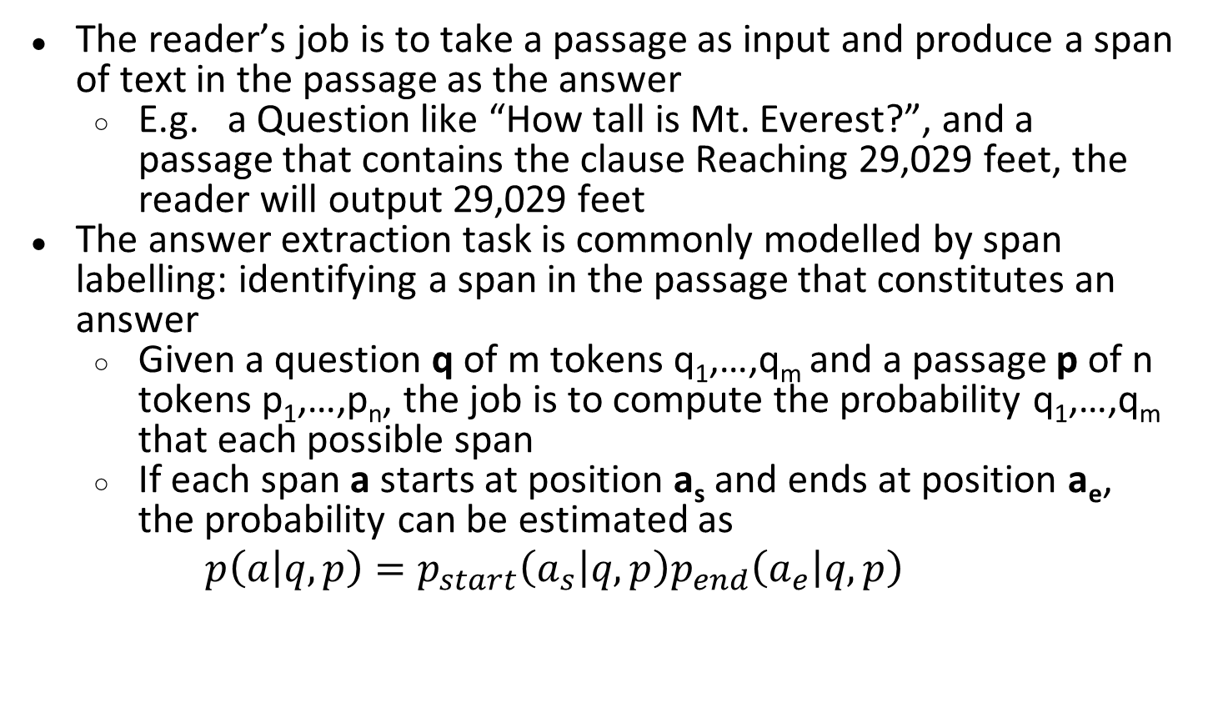
IR-based QA: Reader
The reader’s job is to take a passage as input and produce a span of text in the passage as the answer
E.g. a Question like “How tall is Mt. Everest?”, and a passage that contains the clause Reaching 29,029 feet, the reader will output 29,029 feet
The answer extraction task is commonly modelled by span labelling: identifying a span in the passage that constitutes an answer
Given a question q of m tokens q₁,…,q_{m} and a passage p of n tokens p₁,…,p_{n}, the job is to compute the probability q₁,…,q_{m} that each possible span
If each span a starts at position a_{s} and ends at position a_{e}, the probability can be estimated as
$$p\left(\left.a\right|q,p\right)=p_{start}\left(\left.a_{s}\right|q,p\right)p_{end}\left(\left.a_{e}\right|q,p\right)$$

Slide 7
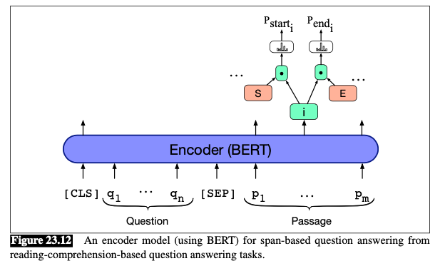
IR-based QA: Reader
A standard baseline algorithm for Reader is to pass the question q_{i} and passage p_{i} to any encoder like BERT

Slide 8
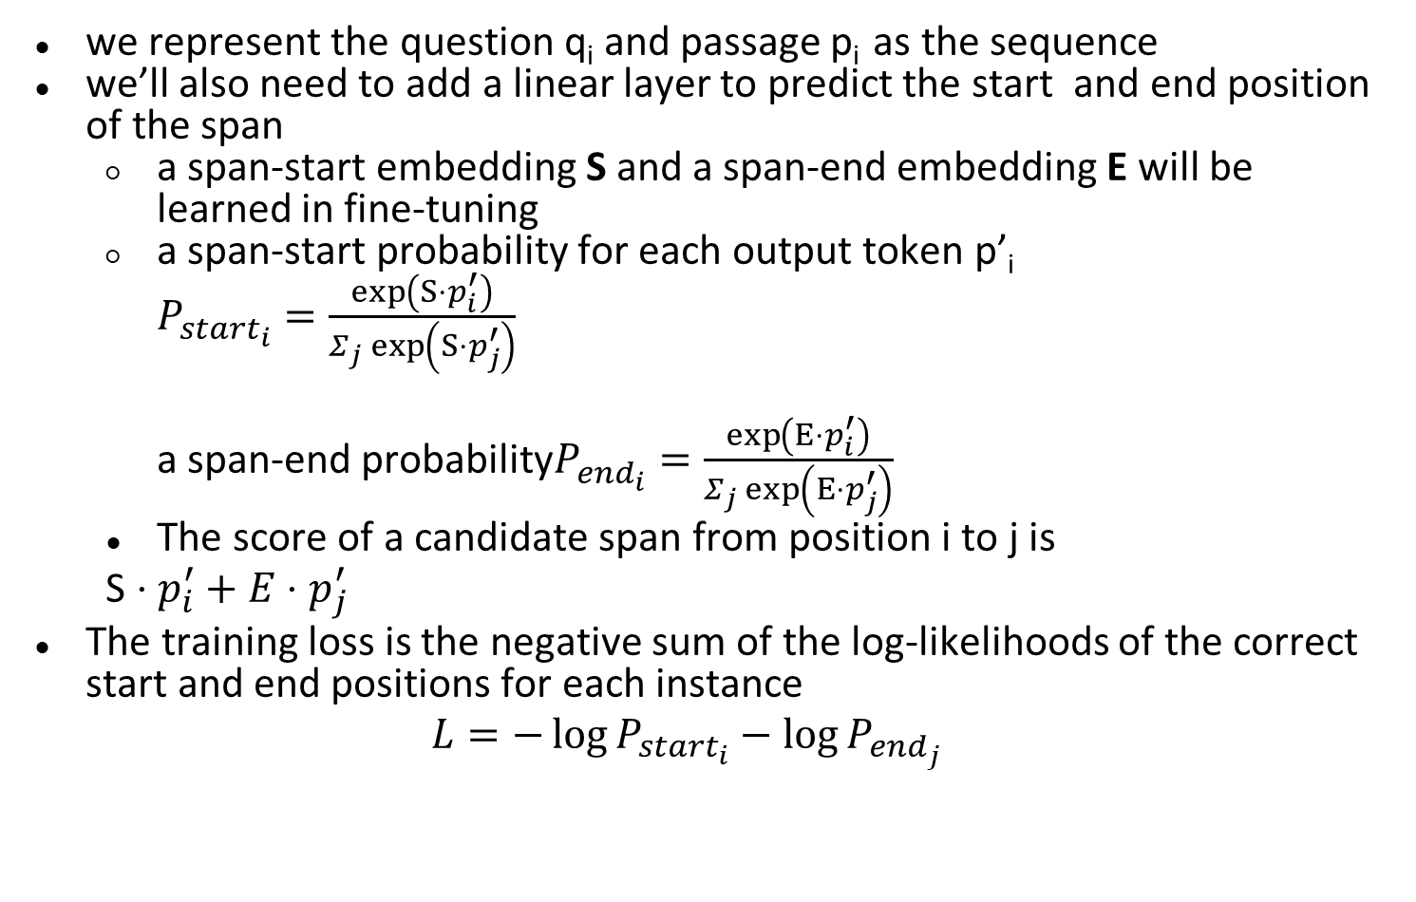
IR-based QA: Reader
we represent the question q_{i} and passage p_{i} as the sequence
we’ll also need to add a linear layer to predict the start and end position of the span
a span-start embedding S and a span-end embedding E will be learned in fine-tuning
a span-start probability for each output token p’_{i}
$P_{{start}_{i}}^{}=\frac{\exp\left(S⋅p_{i}^{′}\right)}{Σ_{j}\exp\left(S⋅p_{j}^{′}\right)}$
a span-end probability$P_{{end}_{i}}^{}=\frac{\exp\left(E⋅p_{i}^{′}\right)}{Σ_{j}\exp\left(E⋅p_{j}^{′}\right)}$
The score of a candidate span from position i to j is
S $⋅p_{i}^{′}+E⋅p_{j}^{′}$
The training loss is the negative sum of the log-likelihoods of the correct start and end positions for each instance
$$L=−\log{P_{{start}_{i}}}−\log{P_{{end}_{j}}}$$

Slide 9
Entity Linking
Entity linking is the task of associating a mention in text with the representation of some real-world entity in an ontology
The most common ontology for factoid question-answering is Wikipedia
we will give two algorithms
one baseline is to use anchor dictionaries and information from the Wikipedia graph structure
another one is modern neural algorithm
we focus here on the application of entity linking to questions

Slide 10
Entity based on Anchor Dictionaries and Web Graph
A classic baseline is the TAGME algorithm, using anchor dictionaries and information from the Wikipedia graph structure
The TAGME algorithm defines the set of entities as the set of Wikipedia pages
each Wikipedia page as a unique entity e
the total number of in-links in(e) from other Wikipedia pages that point to e
an anchor dictionary lists its anchor texts a for each Wikipedia page e

Slide 11
The TAGME algorithm
the 1st stage: entity mention detection
Given a question, TAGME detections by querying the anchor dictionary for each token; the large set of sequences is pruned with some simple heuristics
E.g. a Question like “When was Ada Lovelace born?”, might cause the anchor Ada Lovelace or Ada, but substrings spans like Lovelace might be pruned as having too low a linkprob
the 2nd stage: entity mention disambiguation
TAGME uses prior probability and relatedness/coherence for disambiguating ambiguous spans

Slide 12
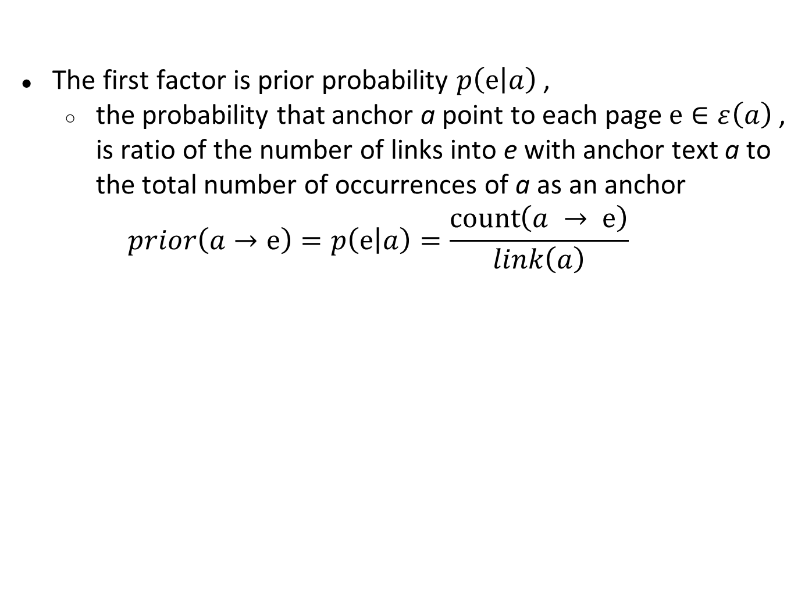
The TAGME algorithm - mention disambiguation
The first factor is prior probability $p\left(\left.ⅇ\right|a\right)$,
the probability that anchor a point to each page $ⅇ∈ε\left(a\right)$ , is ratio of the number of links into e with anchor text a to the total number of occurrences of a as an anchor
$$prior\left(a→ⅇ\right)=p\left(\left.ⅇ\right|a\right)=\frac{\operatorname{count}\left(a → ⅇ\right)}{link\left(a\right)}$$

Slide 13
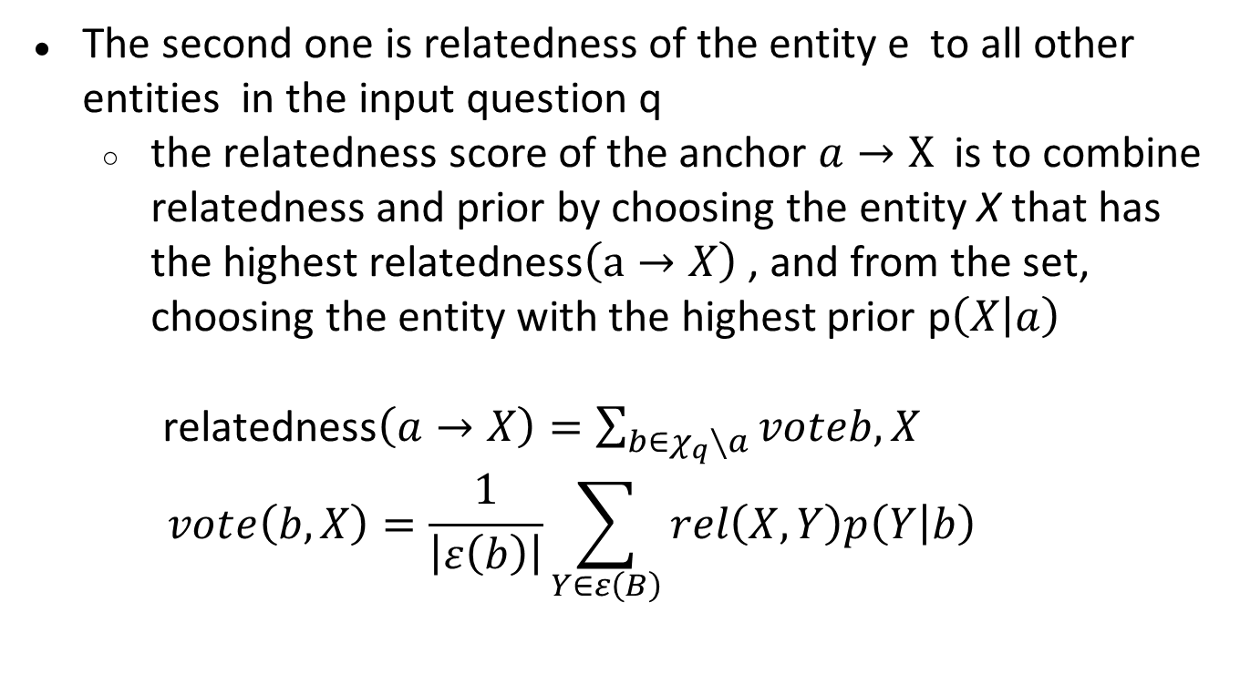
The TAGME algorithm - mention disambiguation
The second one is relatedness of the entity e to all other entities in the input question q
the relatedness score of the anchor $a→X$ is to combine relatedness and prior by choosing the entity X that has the highest relatedness$\left(a→X\right)$ , and from the set, choosing the entity with the highest prior p$\left(\left.X\right|a\right)$
relatedness$\left(a→X\right)=\sum_{b∈χ_{q}∖a}{vot{eb,X}_{}}$
$$votⅇ\left(b,X\right)=\frac{1}{\left|ε\left(b\right)\right|}\sum_{Y∈ε\left(B\right)}{rel\left(X,Y\right)p\left(\left.Y\right|b\right)}$$

Slide 14
Neural Graph-based linking
More recent entity linking models are based on biencoders

Slide 15
Knowledge-based Question Answering
knowledge-based QA is to map a natural language question to a query over a structured database

Slide 16
Language Model

Slide 17
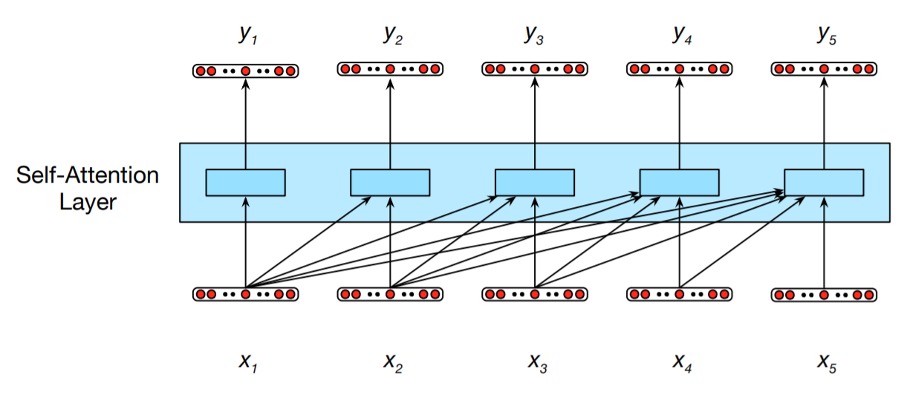
Self-Attention Layers
Fig. 1
Information flow in a causal (or masked) self-attention model. In processing each element of the sequence, the model attends to all the inputs up to, and including, the current one. Unlike RNNs, the computations at each time step are independent of all the other steps and therefore can be performed in parallel.

Slide 18
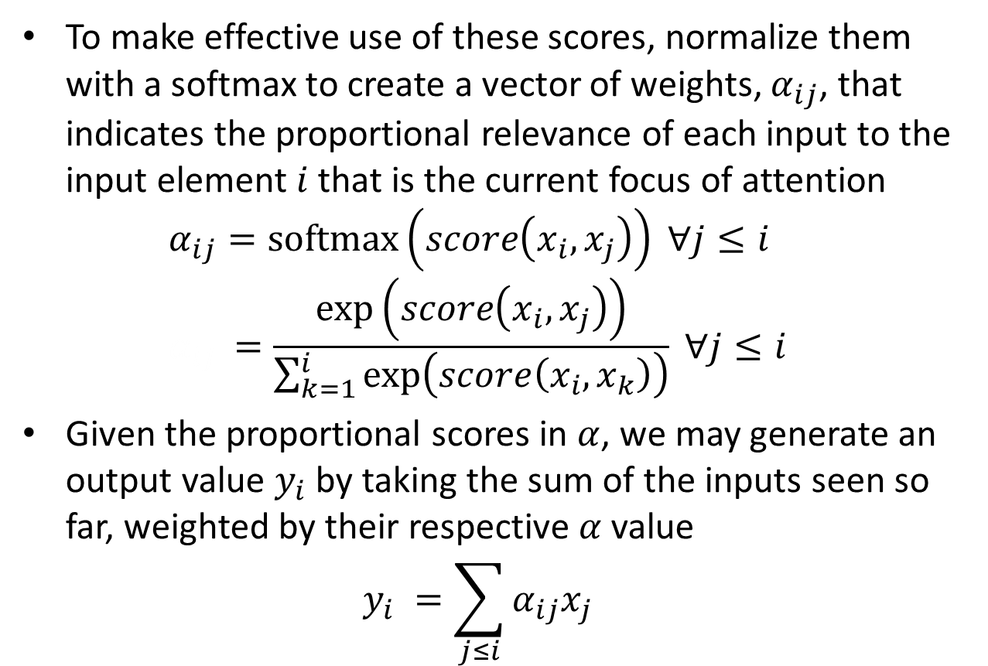
Self-Attention – the Simplest Form

