Slide 1
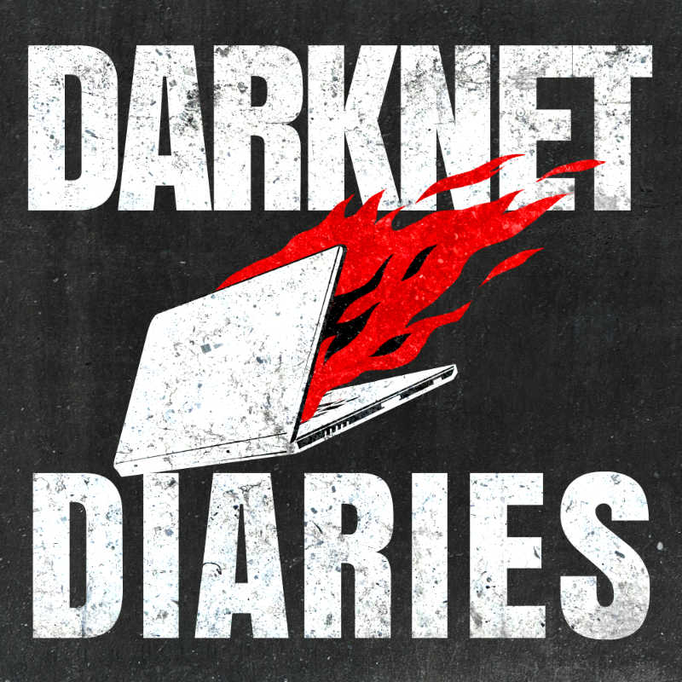
Case Study
Courtesy of : Darknet Diaries Ep: 103 Cloud hopper
By: M. Muzni
Notes:
I Thought this case study is very interesting & could be helpful so made this presentation. we may end up working in SOC & could face with this sort of a situation one day.
This is a 1hr podcast ill try my best to go through briefly in 15mins

Slide 2
Who is the most powerful person in a Company?
CEO
System Administrator
Janitor
Notes:
You might think it's a CEO or owner, since they can call all the shots and make policy changes that everyone has to adhere to, but I think the most powerful person in the workplace might be the sys admin.
The person who has administrative access to the core machines that are required for the business to operate. They can see what's in the database and they can read anyone's email in the whole company and they can see what files are on your computer. And they could sniff all the network traffic from your computer to see where you go and what you downloaded.
Now, not every network is set up like this where someone can see everything about everyone and not all networks have one person who has all this access. But some networks are set up like this where one person that has control of everything with the Press of a button they can bring business to a halt or potentially re route customer payments or paychecks to them.
It's crazy how much power they have and so it goes without saying. Never ever want some unauthorized person to have admin access to your network because using this power maliciously can be incredibly destructive to your business. But there's another person who also has a lot of power that we sometimes forget about. That's the overnight janitor. The person who has a key to the building and every room in the office, including the CEO's office.
On top of that, they're always there when nobody else is, which gives them the opportunity and capability for some serious mining. The only thing they need is the motivation. what's even crazier is that some of these janitorial services have many businesses that they service each night so that's quite the key ring to have access to you especially in the right parts of town imagine if the janitors key ring got into the wrong hands into the hands of someone with a lot of motivation and malicious intent. What if that someone was extremely skilled at computers and hacking that would surely be trouble.

Slide 3

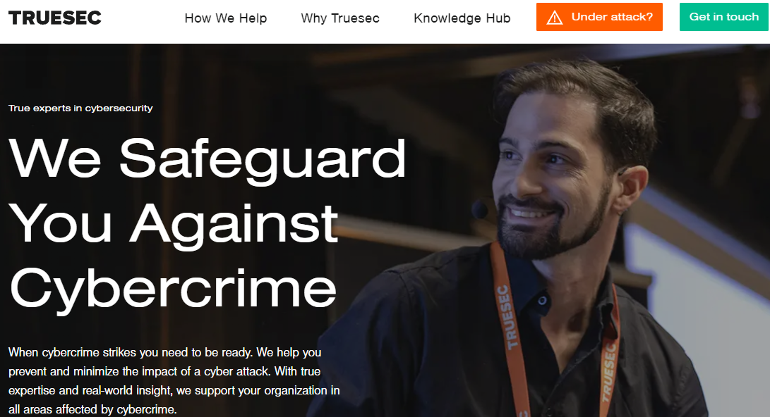

2016 – Swedish Sec. Service Tips off TRUESEC
Swedish Client - Typical large enterprise org. with thousands of computers | Remotely Managed by an MSP (Managed Service Provider).
Jump Server Talks to a command and control in another country.
Two IPs of Command in Control Servers that client's infrastructure was communicating with
Time Windows of when the connections started and ended
Clients Internal Host name and IP address that was suspected to be the infected server
Notes:
Fabio Viggiani (it’s his real pic. You can YouTube him as well) Security Team Leader – Offensive Security.
works for a company called TrueSEC which is based in Sweden, when businesses, organizations get attacked, they can call TRUESEC up to come investigate and remediate the issue. That's when Fabio will go on site to a customer location to help them out.
Fabio is the technical lead of Truesec Security Team. He also works closely with Truesec Security Operations Center, focusing on Threat Hunting and detection.
This gives him a strong insight in the current threat landscape and the latest attacks and detection techniques. https://career.truesec.com/people/596083-fabio-viggiani
Fabio has been with this company for eight years now and in that time he's seen lots. of network intrusions and handled many incidents but there's one incident in particular that he'll always remember which we going to discuss today
Now Fabio had actually done work for this company before advising them on how to secure their network better and reviews of their security.
The Client has thousands and thousands of computers in the network. What Fabio knew from the beginning is that they had been contacted by the Swedish Security Service.
Because one of their system, one of the systems, has been talking to a commander control server somewhere on the Internet. It was located at a Foreign State and that's basically all we knew when we got that call.
Now this is actually a big deal when the Swedish Security Service calls you up to tip you off of a potential problem. You should definitely sit up straight in your chair and ask for help, because the Swedish Security Service is the government agency in Sweden that investigates espionage and counter terrorism, and any threats against national security. It's sort of like the FBI in the US/ GCSB in New Zealand and so you can imagine if the FBI calls you to say, hey, one of the computers in your network is reaching out to a really bad computer on the Internet, you're gonna want a spring in action with the Swedish Security Service was saying was a computer at this company was talking to a known bad actor. a command control server and they gave the IPS that were involved with this but is about IT.
Just the fact that this is information coming from the Security Service. Tells you that you know it's not just random. You know command and control server by you know some some whatever criminal group that is doing ground somewhere that they don't tell that they focus on nation state. So when you get a call from them it's probably related to something bigger. But even though this isn't much information, it's coming from such a reliable source that you can assume a few things. First they set a computer was reaching out to a command and control server. When malware infects a computer, it needs instructions on what to do. Once it's there. Sometimes it's built into the malware, other times it calls out to another computer and says. What should I do now? Or here's what I have. This is what a command and control server is, something that can interact with an infected computer. The fact that a computer is reaching out to panic control server at all. Means it's probably infected with something like malware that you definitely want to remove, but this is the Swedish Security Service notifying them, which might mean that this is either a very serious threat actor, or it could mean that other companies in Sweden have been hit by this too, and notified the Swedish Security Service, who then looked into it and found this company may. also being affected anyway all that is to say is that this was such a reliable tip that it really did warrant calling up fabio and telling him to come to report immediately and that’s what he did…

Slide 4
MSP Managed Client
MSP is a Multination company had thousands of client in 12 countries
MSP (Remote)
Jump Server
Multiple Internal Servers
VPN
Notes:
Jump Server – MSP uses this Jump Server to manage all of the other servers within clients organization.
this company outsourced the monitoring and management of most of their servers to another company to take care of which is MSP And making figuration changes for this company and they also monitor for faults and incidents, so if one server in this network had a high CPU it would alert the MSP and then someone from the MSP would log into that server and fix the issue.
But this MSP managed all these servers remotely from another country Even so they needed a good reliable way to access.
All these computers in this network and to do that they set up a VPN to a server that they could use to jump off of when they needed to get in this network, which is a jump server.
So when someone in the MSP needed to check out server on this network first they connected into this jump server which then had access to all the other servers in the network and it was this jump server that was reaching out to a known command and control server.
Since this jump server is used by an MSP and meant it had access to pretty much every important server in the network of all the servers to be infected, this was probably one of the worst possible ones.
The server was up and running, so Fabio asked can we get access to it? but the problem was that server was fully controlled by the But the problem was that server was fully controlled by the MSP.
MSP was defensive didn’t wanted initially give access no wonder in a situation like this however Fabio contacted the Client directly and got access to the server Managed by MSP which is in Question.

Slide 5

Forensics Investigation
Disk image – exact copy of the hard disk
Memory dump – copy of the RAM which copies any running Malware as well.
Mounted the external Hard Disk as Read-Only.
Auto Scan takes hours to detect so carried out manual check
C:\Temp – best place to check first
Found an output file Hostnameoftheserver.mimicatz.hash with 100’s of credentials users logged in to this server ever in clear text. (Not Hashed)
Including several Active Directory Administrators
The issue was immediately escalated | Business Leaders called in
Notes:
Fabio took a Disk Image and Memory Dump
But in order to know what's not normal, you really have to know what is normal. So it's incredibly important for someone who wants to be good at digital forensics to know how computers normally work inside and out. What processes are normally supposed to be running.
forensic investigation at this image is an exact copy of the entire hard drive and a memory dump is a copy of what's currently stored in the systems RAM memory, which will tell you what programs are running, including any malware.
OK, so Fabio has been doing this type of work for awhile and gets red to work analyzing the disk image.
The disk image was put Onto an external hard drive, and so he just mounts it to his computer as an external drive.
But what do you do with this? Where do you even look on this hard drive to try to find malware? Yeah, sure. You could run an antivirus scan on it, but this jump server already had antivirus running on it and all was quiet.
Nothing had triggered. So now what? Well, This is why you need someone who's trained in digital forensics.
What makes a good digital forensics analyst is the ability to spot things that aren't normal. But in order to know what's not normal, you really have to know what is normal. So it's incredibly important for someone who wants to be good at digital forensics to know how computers normally work inside and out. What processes are normally supposed to be running.
Where do those programs typically live? What stuff belongs in the Windows directory and what stuff doesn't this jump server was a Windows computer and Fabio is pretty familiar with Windows, so he got right to work looking through files manually,
you just mount it, read only mount on your computer and you just have a quick look at it 'cause you know. Just from experience, you know with this type of things tend to be the first place he checked was if anything was in the temp folder. He likes checking here often because this is where intruders like to stage files and put things.
Mimikatz definition
Mimikatz is a leading post-exploitation tool that dumps passwords from memory, as well as hashes, PINs and Kerberos tickets. Other useful attacks it enables are pass-the-hash, pass-the-ticket or building Golden Kerberos tickets. This makes post-exploitation lateral movement within a network easy for attackers.
https://www.csoonline.com/article/3353416/what-is-mimikatz-and-how-to-defend-against-this-password-stealing-tool.html

Slide 6
Findings
Something you can get out from memory is network connections. Current or historical, if there is still left in memory somewhere.
VBA 32 8rkit.exe = Legitimate software Called VBA 32 anti rootkit scanner
VBA328rkit.exe was in a very unusual location
it was under C:\Windows\web. Which is a folder that exists. But it doesn't have that type of software in there. So just having that binary located in that directory was strange. And next to that file, there were another few file, a couple of DLLS, another couple of files.
DLL Sideloading Attack – Very well-known technique and very effective
Notes:
It was a legitimate software looking for rootkits and malware own systems.
It was scanning system looking for malware. And that process, it was assigned binary by this company producing this software signed binary is a way to show authenticity of a file. That file really was actual software that detects malware from a legitimate company, and it specifically looked for rootkits, which is malware trying to get access to something it's not supposed to. But it was this anti rootkit software that was connecting to the bad IP. The command and control server that the Swedish Security Service told them about
Signed Binary – is a way to show authenticity of a software
VBA 32 8rkit.exe was in a very unusual location
What is DLL Side Loading Attack ?
DLL file is just some extra data that program needs in order for it to load properly and when the program tries to load they'll try to find the required files and this process can be manipulated by placing a malicious DLL file in a certain place so the program will load it into memory programs have sort of an order of operation of how they for their needed DLLs This can be exploited. So this partucular DLL has specific instruction to communicate with an outside server. This type of an attack is much harder for an Anti-Virus to detect because the program that are running are all fine and good.
DLL Side loading Attack – Very well known technique and very effective | Easy to deploy but very hard to detect and fix if multiple DLLS are running. Very challenging and expensive.
Fabio Examined the DLL and found it will read another DLL file from the Disk which is encrypted then it will decrypt the data with the key that was stored in another DLL then compresses it and then it will inject/ execute it into the memory.
So again, this would be done within the context of the legitimate binary. So if you look at who's doing what on the system, you would see that it's this process that now is executing this code.

Slide 7
Findings Cont..
3 types of DLL sideloading Malware
Connecting to different Command in Control servers in different points in time
Time stamps of this DLLL sideloading execution goes months back
search widened in to 2 directions
Notes:
Now that we know this threat actor likes to inject itself into known good processes, they start looking for more instances of DLL side loading and were found three more instances of DLL sideloading. Implants.
And they would start the same type of malware but connecting to different command in control servers
To Find out
What are other PC’s and Servers have been infected
How the threat actor got into the jump server in the first place

Slide 8
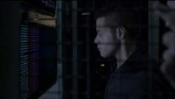

Memory Analysis
Do Not to shut down & wipe off the compromised server immediately
Further memory analysis found someone remotely logged with valid credential and dumped a malware
Found a note in the Malware analysis & found a note for the Forensics Investigators
EP. 2 -1:29 – 2.20
Have your bosses given you the space try to be a hacker..? Common man don’t kill me.
Notes:
Fabio found that one of the employee credential was used to log in to the Jump Server. Upon checking the logs the employee was off on the day the threat actor logged in the Server.
Threat actor hacked MSP employees computer and stole his credentials to login to the Jump Server
The message is not very clear however whoever wrote the malware code wants the Investigators to leave the malware there and ignore.
This recalls a scene of TV show Mr. Robot >> Every Attacker loves attention ….
https://www.youtube.com/watch?v=zHdn7Jnr5Qk Time Line 1.29 – 2.20

Slide 9
Found more interesting evidence
Executable nbt.exe = which is a legitimate tool to scan NetBIOS scanner
p.Txt – was an empty txt file
Batch file called pp.cmd >> had 33 line each line was commands executing nbt.exe (NETBIOS scanner) followed by a public IP range address and then put the output in to the p.txt file
Had 33 public IP address ranges on that batch file that was scanned|
Found these public IP address ranges 19 of those are belong to US Department of Defense
Few weeks later the Nation State Actor logged back in to the Jump Server with whole lots new tools including a known malware and DLL files which talked to a totally new command in control server.
known malware which PLUGX is a known RAT (Remote Access Trojan)
Notes:
On the same server where they found the DLL’s found 3 more files that changed the perspective of this investigation
(NETBIOS is a Windows network scanner that Scans the entire network to find what shared network drives on them and may be able to share files on them)
The threat actor was using this jump server to scan US Department of Defense (combination of NSA, ARMY, NAVY, AIR FORCE
) server to find out open ports to see if there are files sharing ports open to share with this company (MSP). Threat actor couldn’t find any therefore the p.txt file was empty and then dropped out of the server immediately. And was quiet for few weeks.
This is a Nation state actor Fabio was dealing with because Threat actor aim was not the jump server their motivation was from the network they were in to connect to the final target which is DOD.
known malware which PLUGX is a known RAT (Remote Access Trojan) which can be used to control you computers remotely which has been used many years by various threat actor group mainly based in China.
Looking at the forensic data, it's as if there were two or three different teams that were part of this attack. One team to just establish initial connection to the system. Once that happened, there was an immediate scan of the DoD network to look for a shared connections. Then two weeks later, another connection into this server where they brought all new malware and tools and it was then when Mimecast was run where they grabbed all the credentials and started pivoting and traversing to other s In fact, it got into the domain controller of this network and had full admin access there, which pretty much gave them control over the whole business.
And this is consistent with how nation state attackers work. There's sometimes one team that's just there to get initial access and then another team takes it from there and carries out objectives.

Slide 10
MSP Breached
Three Weeks later MSP confirms they had been hacked into and didn't know it until TRUESEC (Fabio & his team) showed them the evidence for them.
This must have been a really bad day for the MSP to discover.
In weeks, More of their customers have been compromised with the same Malware.
MSP had privilege access to some US Gov. Agencies networks
Reuters journalists Jack Stubbs, Joseph Manning Christopher Bean did an investigation and found that seven different service providers were compromised and they listed Hewlett-Packard Enterprise, IBM, Fujitsu, Tata Consultancy, entity data, dimension data and Computer Sciences Corporation.
Notes:
So our customer was not the only one and we also know that. They found keyloggers on the jump servers at the MSP side.
Those were. You know, just to give the picture of the infrastructure here, the LSP has a lot of customer to match. We're talking about global month. So you know name that everyone knows about, they manage a lot of customers and they have an infrastructure as a jump layer between their turn infrastructure and different customers infrastructure and jump servers are used to access more than one.
So the one that was used to jump into the customer we were handling was also used to jump into a lot of our customers and that system had keyloggers on it. So. To threat after was able to see the credentials for the different MSP customers and we're able to jump into multiple customer environments from there. And if you put this together with what we found in our immigration, I could only imagine like they did the scan on the server that we were investigating.
This is not starting to come together for me. If a Chinese threat actor wants to get into EU S Department of Defense network, how can they do it? Well, they might have intelligence that says, well, some companies do have a shared connection with DoD, maybe because they're outsourcing something or connected with them in some way. And so the threat actor might know that the deal allows some companies to connect to it through Netbios, will need specific companies or countries. So they thought was maybe they could find the network or a company that does have access to DOD's network and to do that, they could just hack into an MSP quest, access to lots of networks and then spider into each of the customers networks and run scans on the DOD's IPS to see if there's any shared folders open to that company or network. Wow, this is what an advanced persistent threat is and aptt. Whoever was behind this had quite the resources to try to penetrate DOD's network and had no problem hacking into potentially hundreds of networks around the world to try unbelievable.
As this incident winding down, Fabio still had no idea who did this, and that mystery held up for years. But a few years after that news hits that told him exactly who did it,

Slide 11
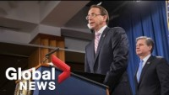
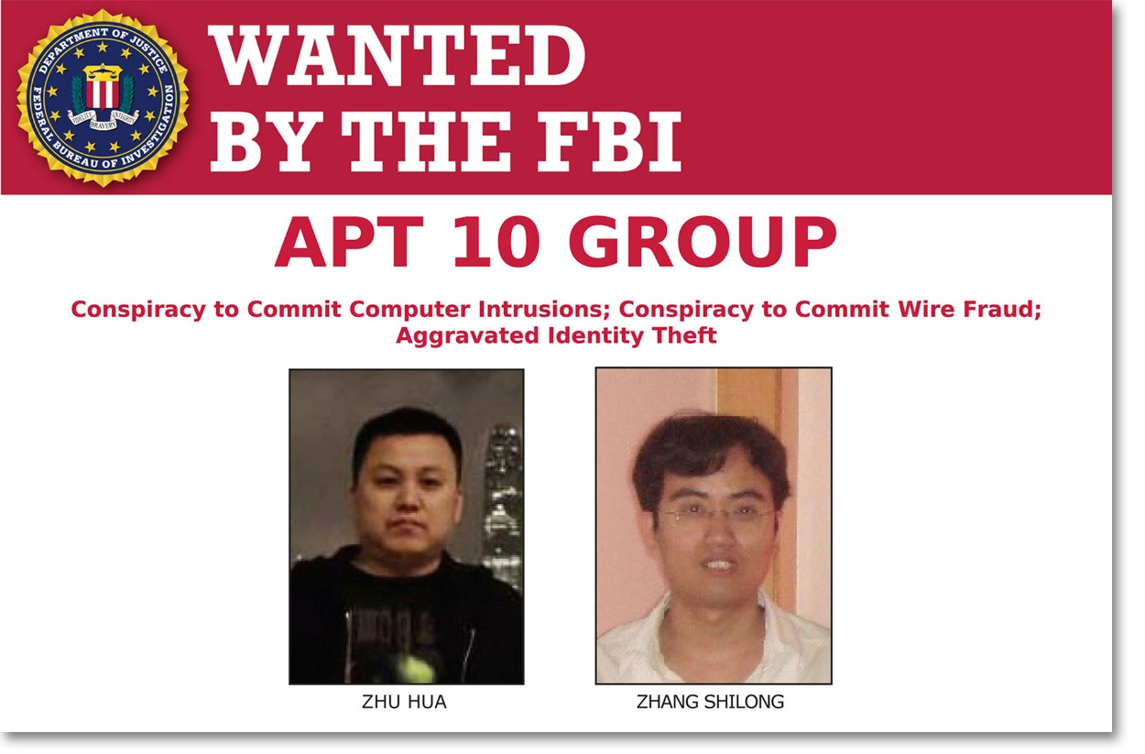
Press Release
Deputy attorney general Rod Rosenstein and FBI director Christopher Wray are announced indictments on two Chinese hackers for their alleged roles in a global hacking campaign.
APT 10 compromised MSP clients Data from 12 countries.
https://www.fbi.gov/wanted/cyber/apt-10-group
Notes:
https://www.youtube.com/watch?v=277A09ON7mY >>> Time stamp 8:43 | 17: 35 – 20:00 | 21:50
here's a clip from a press conference where EU S deputy Attorney General, Rod Rosenstein, addressed the public today. The partner justice is announcing a criminal indictment of two hackers associated with the Chinese government. the charges include conspiracy to commit

Slide 12
One of the most sophisticated data breaches of all time
APT 10 compromised the data of MSP clients located in 12 countries
Brazil, Canada, France, Finland, Germany, India, Japan, Sweden, Switzerland the United Arab Emirates, the United Kingdom and the United States
the defendants hacking campaigns also targeted US government agencies including the laboratories of NASA the United States Department of Energy and the US Navy members
APT 10 stole personal confidential information including Social Security numbers and dates of birth from over 100,000 Navy personnel
American companies and government agencies spent years of research and countless dollars to develop their intellectual property while the defendants simply stole it and got it for free
Notes:
provide services to other companies. So if someone hacked into any of these, they would probably be able to get into their customers and the Reuters article goes on to list some of the customers that were hit by this, which includes the telecom giant Ericsson, a Navy shipbuilder and the travel reservation service Sabre. Now some of these companies listed do have contracts with the US Navy, especially that Navy shipbuilder. So it's quite possible that one of these companies did have privileged access into EU S Navy network,

Slide 13
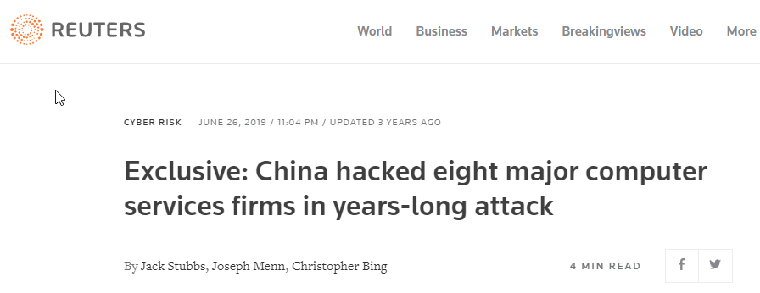
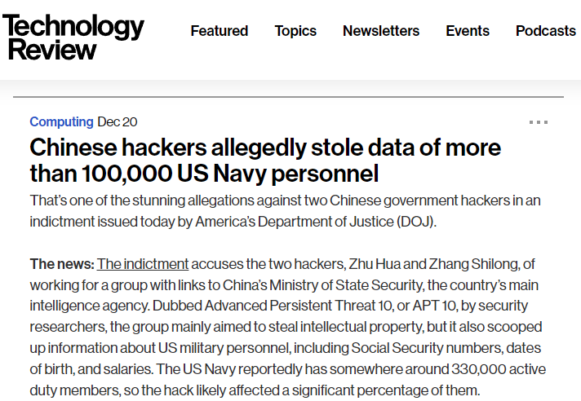
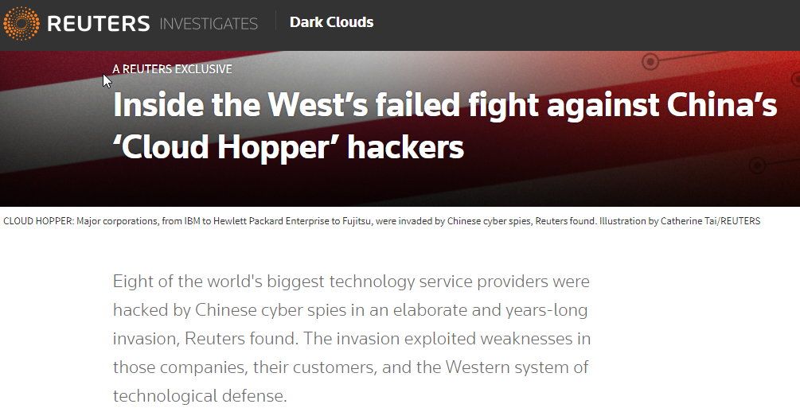
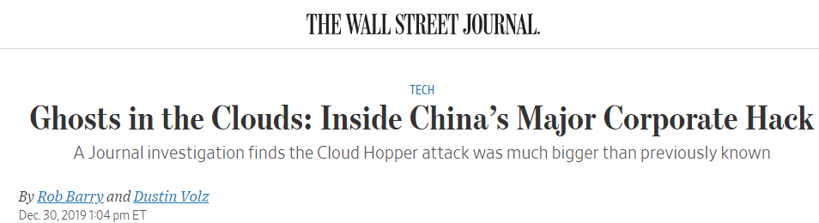
News

Slide 14
remediation
Thousands of Active Directory (AD) user account credentials (password) had to be reset.
Some of these AD account are privileged users accounts tied to other networks .
In-house developed applications had to be decommissioned & replaced.
EDRs needs to be deployed across all systems and continuous monitoring.
Company cut ties with the current MSP & replaced with another.
Notes:
just think about all the old servers in a network that nobody has touched it for 10 years and the person who set them up is long gone from the company. Yeah, well, suddenly it's not working now and the current admins have no idea where the credentials are stored in this custom application that was made. It's a mess. Which causes businesses to be impacted for quite a while.
There's a lot of consequence when you need to do a full proper activity reset. And then on top of that, we introduced active monitoring and EDR tooling because you can never be 100% short of investigation has found everything.
So you still want to have your eyes on everything that is happening at least for a while after this. Ideally forver

Slide 15
Key points
MSP's are pretty common. More and more companies are outsourcing their IT infrastructure, so to target them makes a lot of sense.
If your goal is to steal intellectual property, it's sort of like going out to the janitors key ring, which can get you access into many buildings in town
If your goal is to steal intellectual property, it's sort of like going out to the janitors key ring, which can get you access into many buildings in town.
Notes:
This is an interesting story since the threat actor targeted to go after their customers. And then carry out their objectives from there. Then MSP's are pretty common. More and more companies are outsourcing their IT infrastructure, so to target them makes a lot of sense.
If your goal is to steal intellectual property, it's sort of like going out to the janitors key ring, which can get you access into many buildings in town. so far the people indicted had not been arrested or brought to court they're still hiding out somewhere but they have been named and identified and are considered fugitives in the eyes of the US if there ever caught they're going to have to go to new york to face their charges.

Slide 16
Reference
https://podcasts.google.com/feed/aHR0cHM6Ly9mZWVkcy5tZWdhcGhvbmUuZm0vZGFya25ldGRpYXJpZXM/episode/NTgyMWVhYzItYmMxMS0xMWViLWJhZGMtYmZmYWI1ZjgyYjVj?ep=14
https://www.csoonline.com/article/3353416/what-is-mimikatz-and-how-to-defend-against-this-password-stealing-tool.html
https://www.reuters.com/investigates/special-report/china-cyber-cloudhopper
https://www.reuters.com/article/us-china-cyber-cloudhopper-companies-exc-idUSKCN1TR1D4
https://www.fbi.gov/wanted/cyber/apt-10-group
https://www.youtube.com/watch?v=277A09ON7mY
https://www.wsj.com/articles/ghosts-in-the-clouds-inside-chinas-major-corporate-hack-11577729061
https://www.technologyreview.com/2018/12/20/239760/chinese-hackers-allegedly-stole-data-of-more-than-100000-us-navy-personnel/

Slide 17
Thank you for watching.

