Slide 1
Agentic AI Research Assisstant
N8N workflow
LLM based Automation
RAG System

Slide 2
Abstarct
This project is about building an AI assistant that helps users with research work. Instead of reading long documents manually, the system can understand documents and answer questions from them automatically.
We used two main tools:
n8n for automation (to connect steps together)
Google Colab for AI processing (using Python and AI models like Gemini)
The system reads documents, finds important information, and gives clear answers. It works like a smart research helper that saves time and effort.

Slide 3
Problem Statement
The research and information process is very slow like reading long PDF etc
AI system is needed by the users for collecting data, analysing the content and generate structured insights.

Slide 4
Objectives
To build an Agentic system that automates research workflows
Can use logical decision making
Process the documents using llm and generates a structured report.
For this we used:
Google colabs
N8n automation and llm

Slide 5
Architecture of the system
N8N automation with following nodes:
Execution of workflow
Google drive Download
Http Request
Set code
Basic LLM chain with Gemini
If (decision making)

Slide 6
Architecture of System
Google Colabs:
Flask API
Document Processing
RAG (with use of Chroma DB)
LLM response

Slide 7
Google colabs workflow
Flask API receives requests
Converts documents into embeddings
Stores vectors in FAISS/ Chroma db index
Retrieves relevant chunks (RAG system)
Sends context to LLM for final answer

Slide 8
Work flow of Google Colabs
Reads the document
Breaks it into small parts
Understands the meaning using AI
Finds the best matching information
Generates answer using Gemini AI

Slide 9
How N8N system Works
It receives user input
Sends the data to AI system
Controls the flow of steps
Returns the final answer

Slide 10
Workings of N8N Automation
User asks a question or uploads a document
n8n receives the request
It sends the request to AI backend
AI reads and processes the document
It finds relevant information
Gemini AI generates the final answer
Answer is sent back to user

Slide 11
Working in Colabs
Upload and read documents
Convert text into small pieces or chunks.(Document reader)
Store them in a searchable format
When a question comes, find matching text
Use AI (Gemini) to generate final answer
AI Research Assistant successfully performs automated document understanding and question answering using AI and workflow automation.

Slide 12
Technology used
The system worked successfully after testing.
It correctly understood user questions
It read and processed documents properly
It found relevant information from files
It generated accurate and clear answers using AI
n8n successfully automated the workflow
The system responded quickly because only relevant data was used

Slide 13
Dataset that was Used
4 to 5 Research papers PDF documents of cybersecurity
PDF Documents
Text Files
Used only as a source of knowledge for AI

Slide 14
Results
The system worked successfully after testing.
It correctly understood user questions
It read and processed documents properly
It found relevant information from files
It generated accurate and clear answers using AI
n8n successfully automated the workflow
The system responded quickly because only relevant data was used

Slide 15
Key Features and limitations of this AI Research assisstant
Automatically reads documents
Answers questions from files
Uses AI to understand content
Saves time in research work
Limitations:
Needs internet connection
Depends on Gemini API
Works best with good-quality documents
Free tools have usage limits

Slide 16
Conclusion
This project successfully builds an AI Research Assistant using n8n and Google Colab.

Slide 17
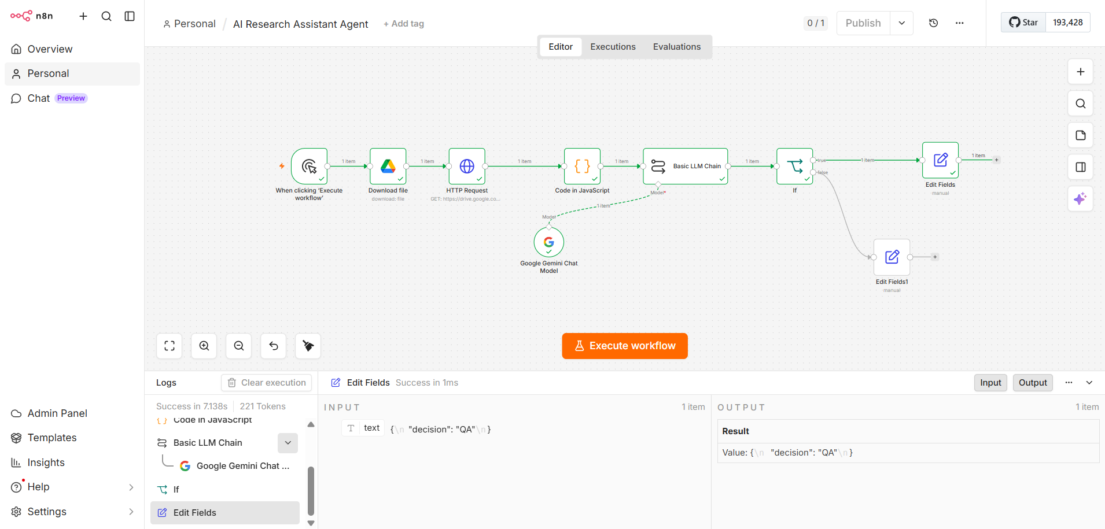
Appendix pic 1 N8n automation

