Slide 1
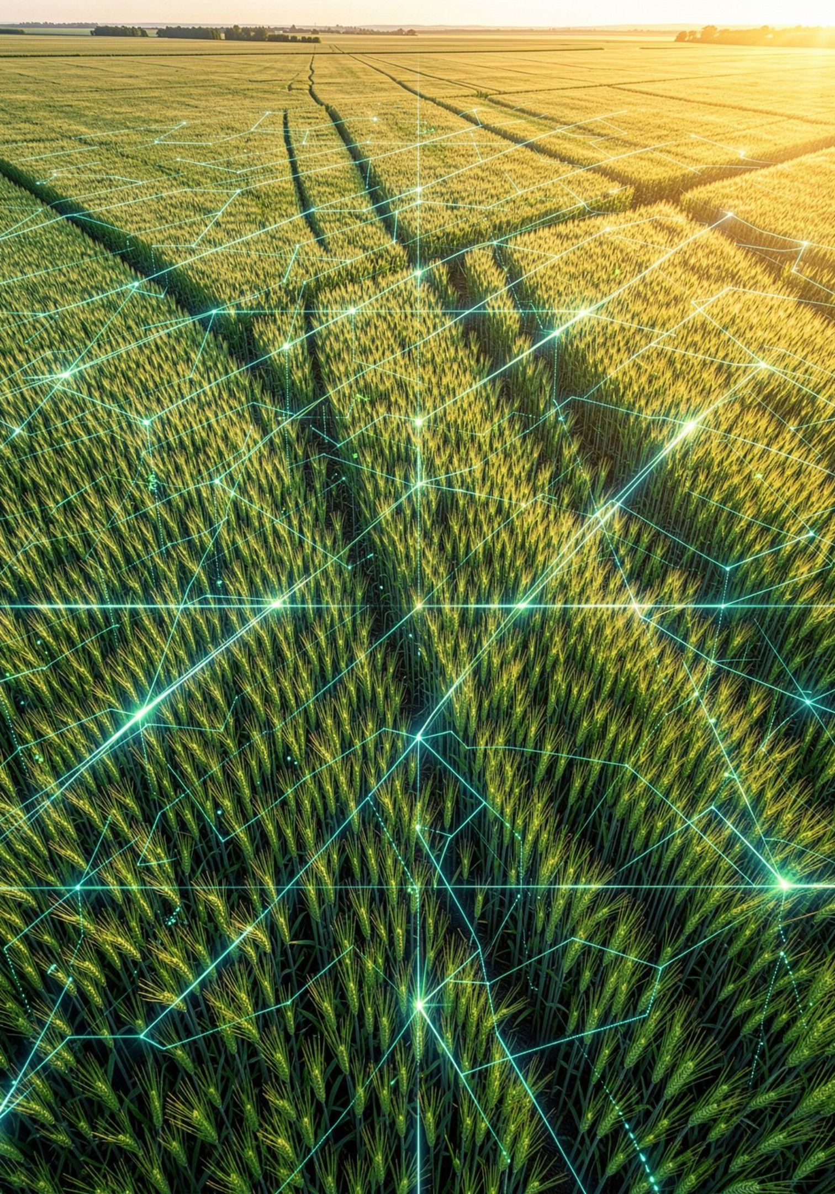
AgriMedic AIx
AI-Powered Agricultural Assistant · AI Hackathon Pakistan
Project ID: P02726 · Muzamil Asghar

Slide 2
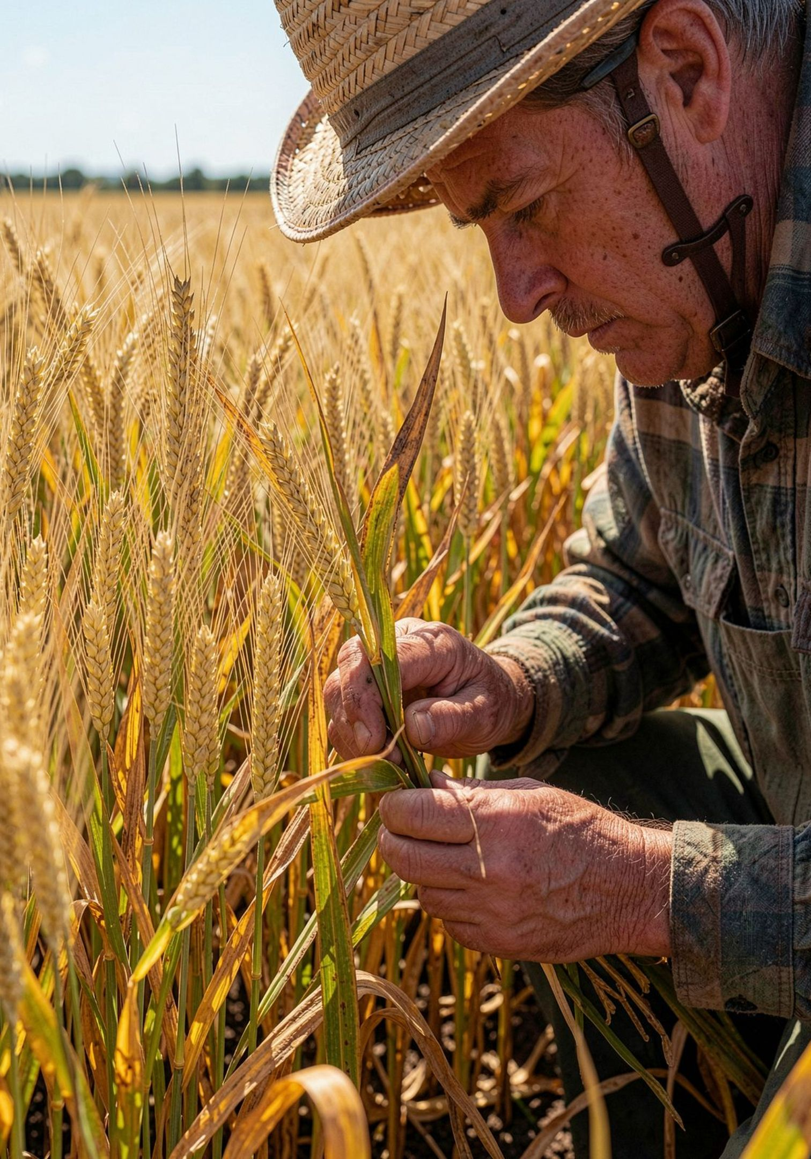
The Problem
Hard to Diagnose
Limited Access to Experts
Crop diseases, pests, and nutrient deficiencies often produce similar visual symptoms — making accurate identification challenging.
Many farmers lack timely access to agronomists or lab testing, leaving crop problems unresolved and spreading.
Need for Practical Guidance
Farmers need simple, accessible tools — not complex reports. Visual image upload can provide critical diagnostic context.

Slide 3
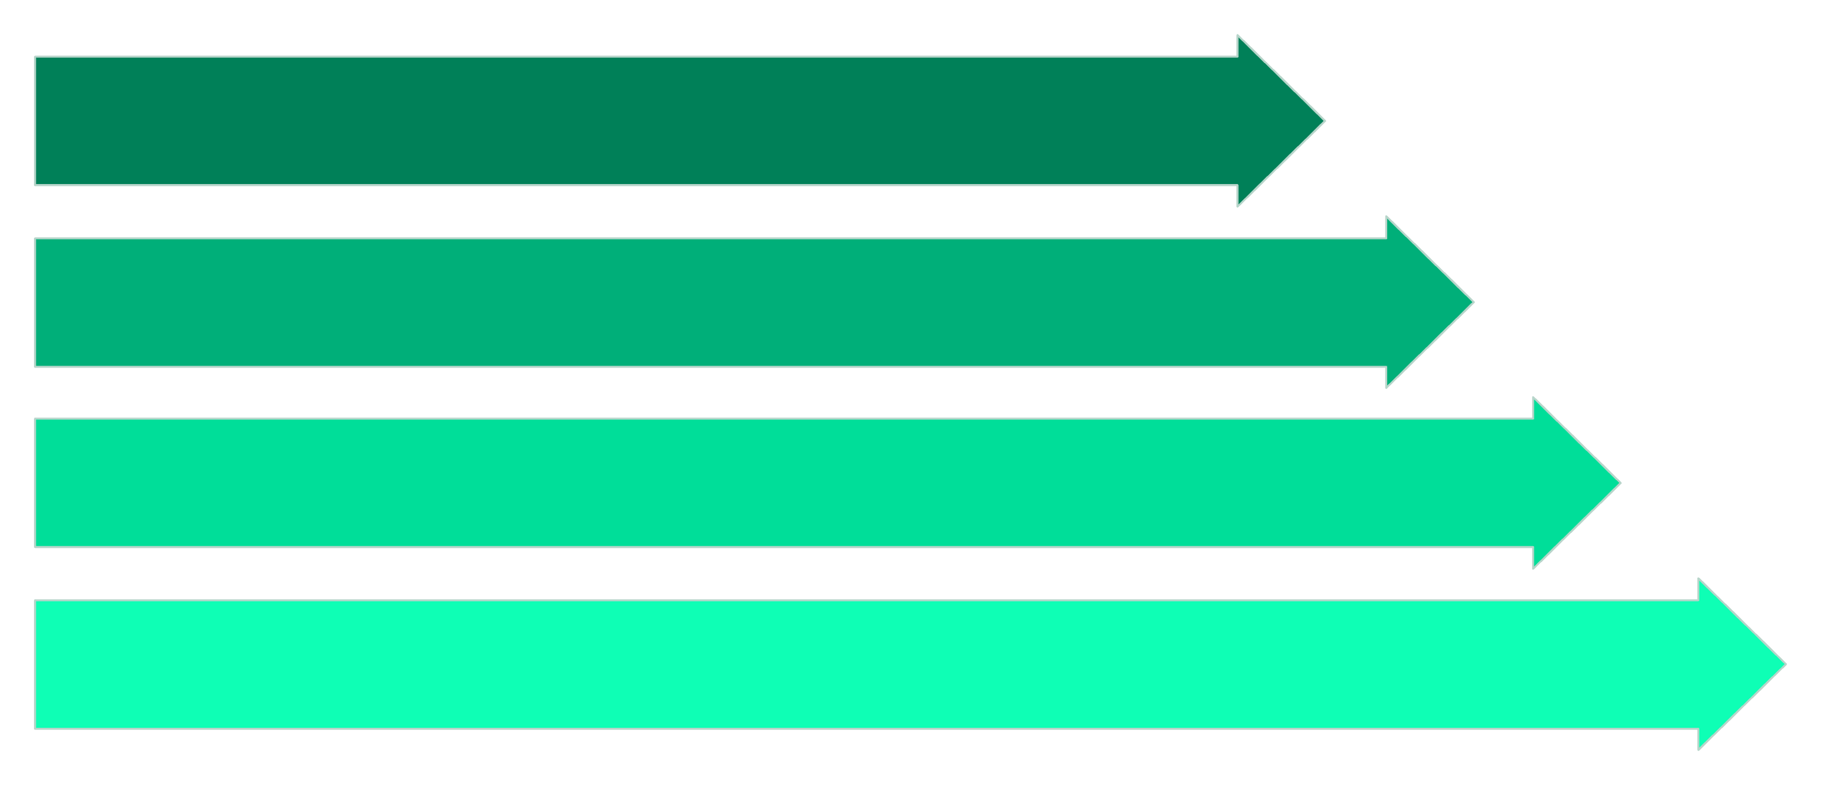
Our Solution: AgriMedic AIx
A simple AI-assisted web application that collects crop details, symptoms, and photos — then delivers practical agricultural guidance.
Farmer Input
AgriMedic AIx
Google Gemini
Guidance & Next Steps

Slide 4








How It Works
Select Crop Type
Enter Crop Age & Farm Info
Describe Visible Symptoms
Upload Crop or Leaf Photo
Ask Your Agricultural Question
AI Analyzes Data & Image
Receive Agricultural Guidance
Save or Download Report

Slide 5
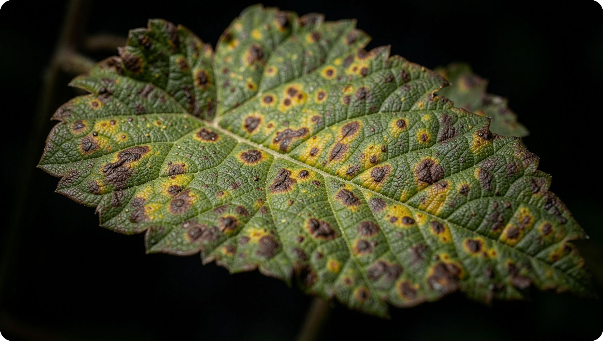

AI Crop Image Analysis
What the AI Does
Uploaded image sent to Google Gemini Vision
Analyzes visible crop and leaf characteristics
Identifies likely crop type when possible
Describes observed symptoms clearly
Suggests possible causes with confidence level
Explains limitations and requests more info if needed
⚠ AI-assisted analysis only — not a confirmed laboratory diagnosis.

Slide 6






Key Features
Crop Information Input
Symptom Reporting
Select crop type, age, location, soil condition, and fertilizer data.
Describe what you observe in plain language.
Image Upload
Irrigation & Fertilizer Guidance
Add crop or leaf photos for visual AI analysis.
Tailored recommendations based on your farm inputs.
Report History
Downloadable Reports
Access and review all previous analyses in one place.
Save AI guidance reports for offline reference.

Slide 7
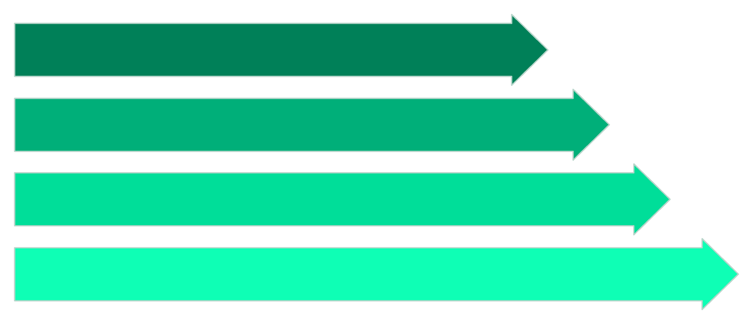
Technology & Architecture
Technology Stack
Python
Core application logic
User Interface
Streamlit
Input Data
Web application framework
Google Gemini AI
Google Gemini
Analysis & Report
AI vision and analysis
GenAI SDK + Secrets
API integration and security

Slide 8
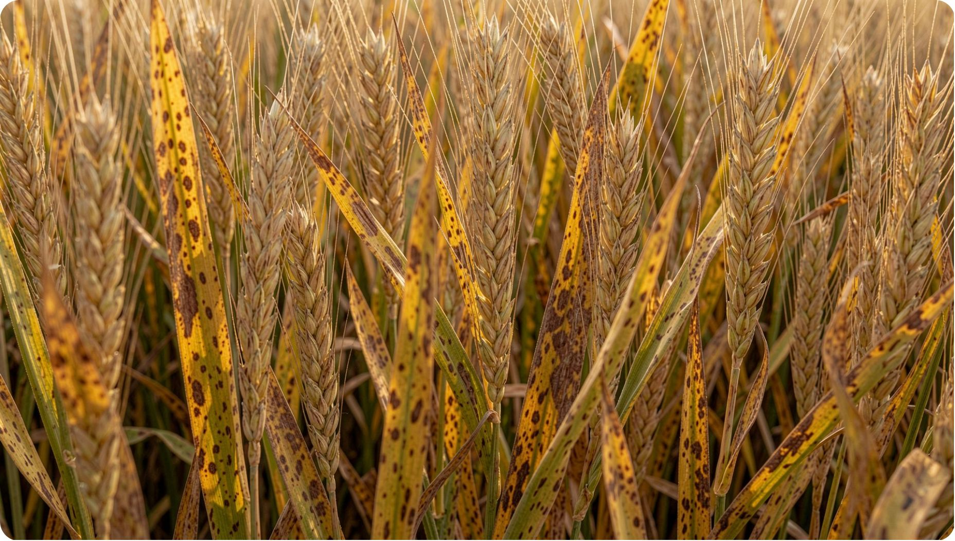

Demo: Real Use Case
WHEAT CROP EXAMPLE
Inputs Provided
Crop: Wheat | Age: 30 days
Symptoms: Yellow & brown spots, drying leaves, spreading
Question: "What could be causing yellow and brown spots on my wheat leaves?"
AI Output
Combined symptom and image analysis suggests possible causes: nutrient deficiency, fungal infection, or water stress — with cautious next-step recommendations.
⚠ AI provides possible causes only — not a confirmed diagnosis.

Slide 9

Impact, Limitations & Future Scope
Impact
Future Scope
Limitations
Analysis quality depends on image clarity
Wide or blurry images may miss leaf-level symptoms
Output is not a confirmed laboratory diagnosis
Local expert verification may still be necessary
🌐 Local Language Support
🌦 Weather Integration
Forecast-aware agricultural recommendations
Urdu and regional language interfaces
📍 GPS Guidance
☁ Cloud & Accounts
Location-based crop and soil advice
Farmer profiles and cloud-stored report history
✅ Expert Verification
Agricultural expert review layer for AI outputs
Makes AI-assisted agricultural guidance more accessible to farmers
Organizes crop data, symptoms, and image history in one place
Enables image-based assistance where expert access is limited

Slide 10
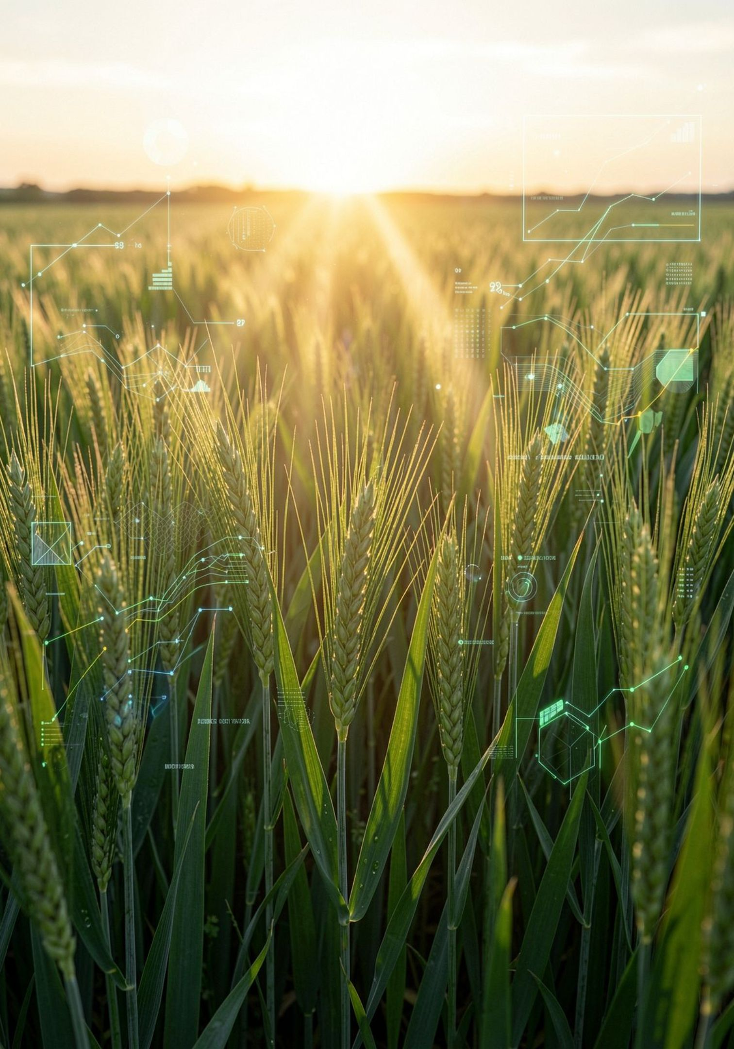
Smarter Crop Decisions with AI
AgriMedic AIx combines farmer-provided information with AI-powered crop image analysis to deliver practical, accessible agricultural guidance — putting intelligent farming tools in every grower's hands.
🌾 AgriMedic AIx
🆔 Project P02726
AI Hackathon Pakistan
Muzamil Asghar
🤖 Powered by Gemini
Google AI Vision Analysis

