Slide 1
AI-ML VIRTUAL INTERNSHIP
Mohd Muzammil Akhtar
Roll No.: 2410031716
3rd Year, 3CSE25 | IILM University, Greater Noida
8 Weeks (June – August 2026)

Slide 2
Internship Overview
AICTE–EduSkills Virtual Internship focused on Artificial Intelligence and Machine Learning.
Duration recorded on the certificate: 8 weeks, June–August 2026.
Learning emphasis: data preparation, ML workflow, model building, evaluation and responsible AI.
Industry-supported learning ecosystem with India Edu Program and Google for Developers support indicated on the certificate.
Mohd Muzammil Akhtar | 2410031716 | AI-ML Virtual Internship | 2

Slide 3
Objectives
Understand AI and ML fundamentals and their practical applications.
Learn the end-to-end machine-learning lifecycle.
Practice data preprocessing, feature preparation and exploratory analysis.
Understand model selection, training, validation and evaluation.
Recognize overfitting, underfitting, data leakage and responsible-AI concerns.
Improve technical documentation and presentation skills.
Mohd Muzammil Akhtar | 2410031716 | AI-ML Virtual Internship | 3

Slide 4
Problem Statement
Real-world datasets contain useful patterns but may also contain missing, inconsistent or noisy information.
Manual analysis is difficult to scale when decisions depend on many variables.
An AI/ML workflow is needed to convert data into useful predictions or analytical insights.
The internship focused on learning how to build this workflow systematically and evaluate its reliability.
Mohd Muzammil Akhtar | 2410031716 | AI-ML Virtual Internship | 4

Slide 5
Scope of the Internship
Problem understanding and target definition
Data inspection, cleaning and transformation
Exploratory data analysis and visualization
Feature preparation and model selection
Model training, validation and evaluation
Interpretation, documentation and responsible AI awareness
Mohd Muzammil Akhtar | 2410031716 | AI-ML Virtual Internship | 5

Slide 6
Technologies and Tools
Python
Programming and experimentation
NumPy
Numerical computing
Pandas
Data manipulation
Matplotlib
Visualization
Scikit-learn
ML algorithms and evaluation
Jupyter
Interactive notebooks
Git concepts
Version control and reproducibility
Mohd Muzammil Akhtar | 2410031716 | AI-ML Virtual Internship | 6

Slide 7
AI/ML System Architecture
Problem
→
Data
→
Preprocess
→
Features
→
Train
→
Validate
→
Evaluate
→
Use
Data quality and evaluation are essential parts of the pipeline, not optional final steps.
Mohd Muzammil Akhtar | 2410031716 | AI-ML Virtual Internship | 7

Slide 8
Methodology
1. Define the problem and success criteria.
2. Understand the dataset and identify quality issues.
3. Clean and transform the data.
4. Explore patterns using statistics and visualizations.
5. Prepare features and split data appropriately.
6. Train baseline and candidate models.
7. Validate and evaluate with suitable metrics.
8. Interpret results, document limitations and communicate findings.
Mohd Muzammil Akhtar | 2410031716 | AI-ML Virtual Internship | 8

Slide 9
Model Evaluation
Classification: accuracy, precision, recall, F1-score and confusion matrix.
Regression: MAE, MSE and RMSE.
Use unseen test data for an honest final performance estimate.
Compare training and validation performance to detect overfitting or underfitting.
Select metrics according to the practical cost of different errors.
Mohd Muzammil Akhtar | 2410031716 | AI-ML Virtual Internship | 9

Slide 10
Responsible AI and Limitations
Protect privacy and use data only for appropriate purposes.
Check for bias and unfair patterns in data and model outputs.
Avoid data leakage and unrealistic evaluation.
Explain model limitations instead of treating predictions as guaranteed facts.
Monitor performance when data or real-world conditions change.
Mohd Muzammil Akhtar | 2410031716 | AI-ML Virtual Internship | 10

Slide 11
Learning Outcomes
Stronger understanding of the complete AI/ML workflow.
Improved Python and data-analysis skills.
Better understanding of model training and evaluation.
Ability to explain common ML errors and limitations.
Improved documentation, problem-solving and presentation skills.
Foundation for future CSE projects involving AI and data.
Mohd Muzammil Akhtar | 2410031716 | AI-ML Virtual Internship | 11

Slide 12
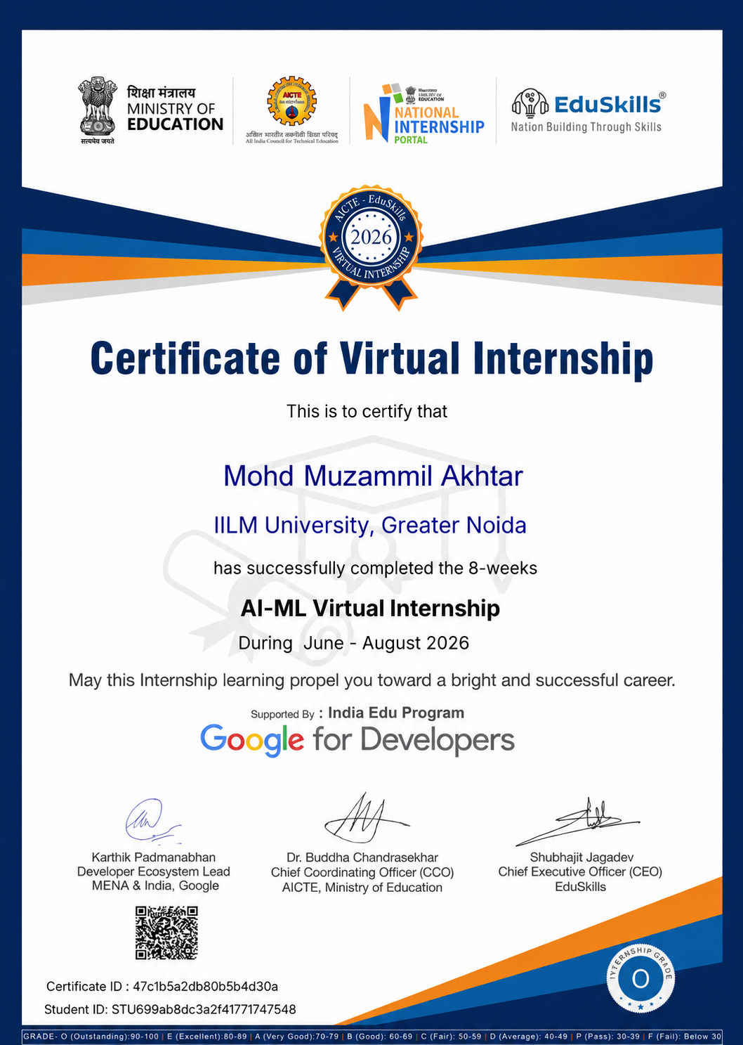
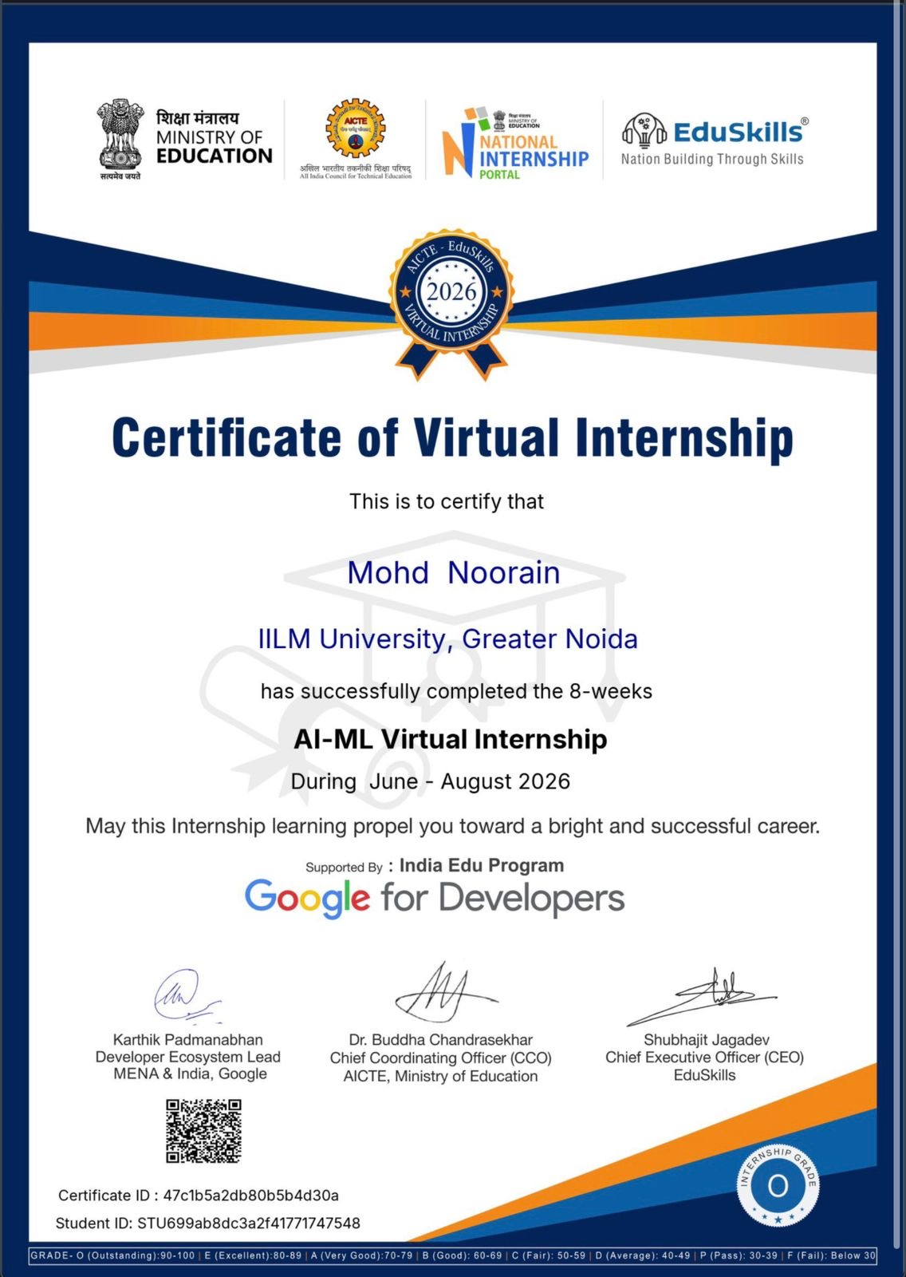
Internship Completion Certificate
Mohd Muzammil Akhtar | 2410031716 | AI-ML Virtual Internship | 12

Slide 13
Conclusion
The AI-ML Virtual Internship provided a structured introduction to practical machine-learning workflows.
The most important learning was the complete process: problem → data → preprocessing → model → evaluation → interpretation.
The experience builds a useful foundation for future academic projects and advanced AI/ML study.
The internship certificate serves as the formal completion proof included with this report.
Mohd Muzammil Akhtar | 2410031716 | AI-ML Virtual Internship | 13

Slide 14
THANK YOU
Mohd Muzammil Akhtar
Roll No.: 2410031716
3rd Year, 3CSE25 | IILM University, Greater Noida
Mohd Muzammil Akhtar | 2410031716 | AI-ML Virtual Internship | 14

