Slide 1
Frame
Stage 1
Activity
Background
Stage 2
Human
trespassing
Other
activity
Notes:
So, in order to solve the main task, this is how we model the problem. We have a two stage decision tree.
S1
In the first stage, we decide whether a particular frame is foreground frame or not.
We hypothesize that our surveillance videos are sparse in terms of trespassing activity. So, instead of trying to look at every single frame we only want to look at those frames which show some change. Secondly, we are also interested in exploring how much amount of change should be considered sufficient enough to be considered for 2nd stage processing and how does it impact the performance of whole system.
S2If it turns out that a particular frame is designated as foreground frame, then will be processed through stage2. Stage2 tries to classify where there is trespassing activity in that frame or not.
Our intuition is that we should use a relatively low complexity stage1 which can quickly take out most of the background frames. And only a subset of frames should be processed by stage2. And for stage2 we want to have a relatively stronger classifier.

Slide 2


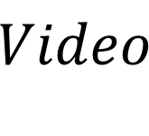
N
activity/
background
trespassing/
other
frame
Stage 1
Stage 2
$Video$
Trespassing activity
time series
Notes:
Inspired by the framework we design this pipe line. You take each frame and then try to classify whether the frame as activity or not. If it turns out that it’s a activity frame only then you process it with stage 2. And then stage 2 is going to decide whether there is human trespassing or not. At the end, you concatenate predictions for all the frames and turn it into a time series.

Slide 3
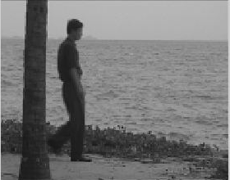
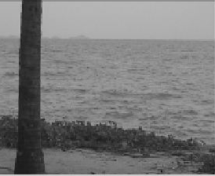
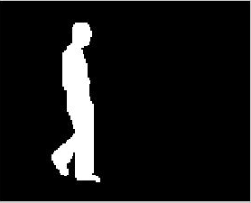
bg
model
fg
mask
1
frame
BG
Modeler
FG
Extractor
fg
mask
Threshold
0
frame
background
fg mask
Notes:
So, our stage 1 is basically a background subtraction stage. What you are doing is that you take a frame and compare it with a background model.

Slide 4
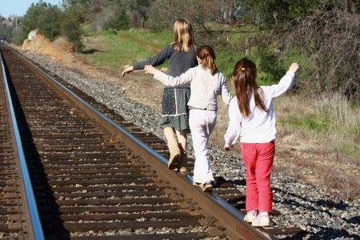
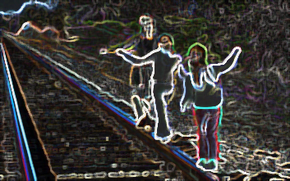
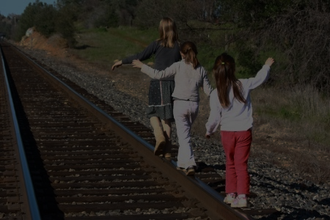
Input Image
Conv features
...
...
Conv Net
...
Classifier
RPN
ROI
Pooling
ROI

Slide 5
800
receptive field
50
Conv Net
800
50
h/w ratio
128x128
 | 1:1 | 1:2 | 2:1
8 | 8x8 | 8x16 | 16x8
16 | 16x16 | 16x32 | 32x16
32 | 32x32 | 32x64 | 64x32
8x8
anchor
input Image
scale
feature map
Notes:
Before moving on with the Faster RCNN. It is important that we understand the concept of anchors. It was a novel concept introduced by Faster RCNN and it has now become a fundamental part of object detection algorithms.
So an anchor is basically nothing but an estimate of object bounding box.

Slide 6
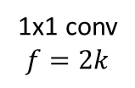
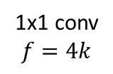
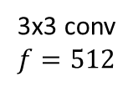
bbox
regressor
...
...
NMS
conv
1x1 conv
$$f=4k$$
regions of
interest
...
conv features
3x3 conv
$$f=512$$
objectness
classifier
1x1 conv
$$f=2k$$

Slide 7
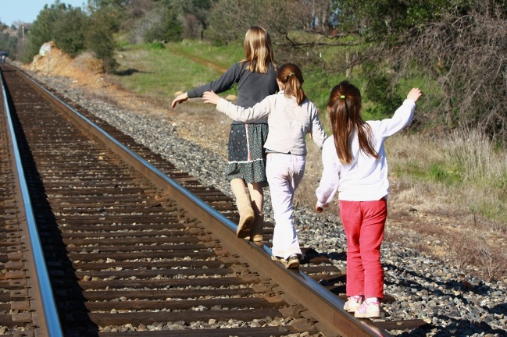
NMS
Notes:
Once, we have used RPN to predict proposals, it looks something like this. We need to clean it up to look like one on right. This is done using a process known as NMS.

Slide 8
bbox
regressor
FC
FC
proposal
conv features
object
classifier
Notes:
Now that we have applied RoI pooling on feature map, we are ready to classify it.

Slide 9
Synthetic
Dataset
Generator
Sparse activity
video
Activity ratio
Noise parameters

Slide 10
Activity block (AB)
Background block (BG)
1
2
3
4
BG
1
BG
2
BG
3
BG
4

