Slide 1

7COM1079-2024 Student Group No: A137 Names of Student Attendees: Muhammad Ibrahim , Muhammad Naeem, Usama Bin Mubarak, Saqib Rehman, Muzammil Ahmad
1
Group ID: A137 Name of Student Presenting: Saqib Rehman
Data Analysis – Tutorial Presentation for Feedback

Slide 2
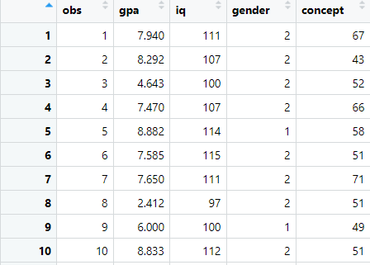
7COM1079-2022 Student Group ID: A137
We are using the dataset DS172 (gpa_iq.csv) to answer our Research question
Is there a correlation between GPA and IQ ?”
2
The dataset has 78 rows
The dependent variable is GPA
The independent variable is IQ
Notes:
2

Slide 3
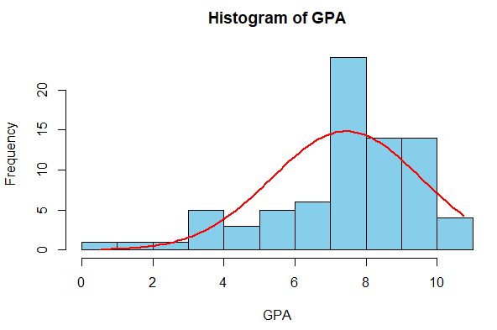
Here is a Histogram showing the frequencies of our dependent variable to include the normal curve overlay.
Our RQ asks about Correlation
For example:
The normal curve overlay does not follow the shape of the underlying data, so for our analysis we will use the non-parametric test for correlation that does not assume normality: Spearman’s Rho
3
Notes:
3

Slide 4

R Script and Results (For ALL types of test) – The Analysis
PRE 7COM1079-2022 Student Group No: ?????
4
Spearman's rank correlation rho data: df$iq and df$gpa
S = 19919,
p-value = 3.511e-15
alternative hypothesis: true rho is not equal to 0 sample estimates: rho 0.7481115
P-value is very small. It is less than 0.05
So, we can say that the result is significant
Notes:
4

Slide 5
R Script and Results (For ALL types of test) – The Analysis
PRE 7COM1079-2022 Student Group No: ?????
5
We reject the null hypothesis as the correlation value is not equal to 0.
The result basically shows that IQ matters in term of obtaining GPA. We can say that having IQ means high or good GPA
Notes:
5

