Slide 1

ICS 474 PROJECT
Uber trips dataset
NAWAF ALTHUNAYYAN
Hamza alhelal

Slide 2
Feature Description
Features include START_DATE, END_DATE, CATEGORY, START, STOP, MILES, PURPOSE
Target Variable: CATEGORY (Business or Personal)

Slide 3
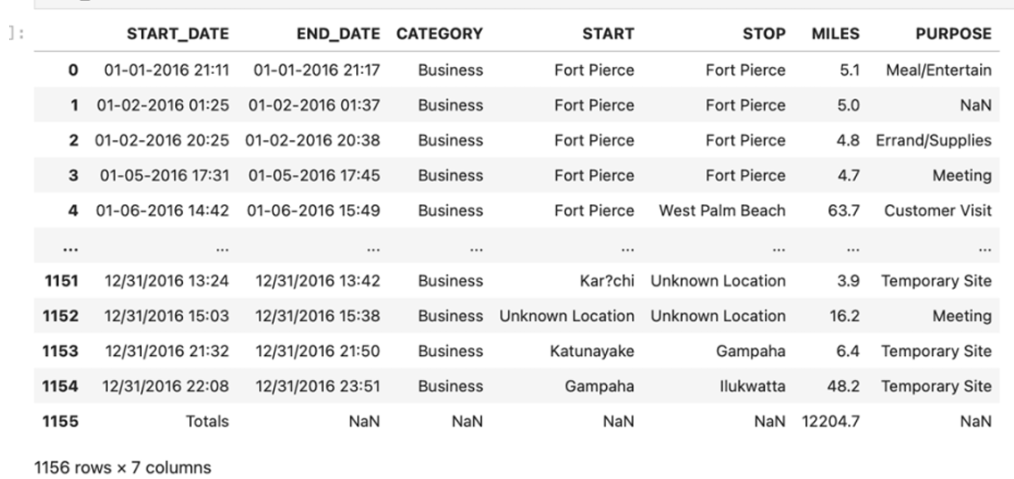
Dataset Structure
- Rows: 1,156
- Columns: 7

Slide 4
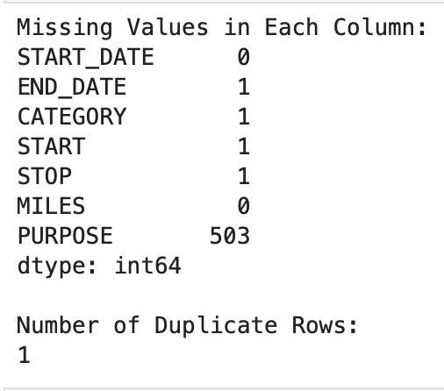
Dataset exploration
1 duplicated value
503 out of 1156 missing for purpose column
1 missing from the rest

Slide 5
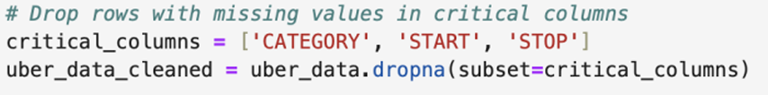
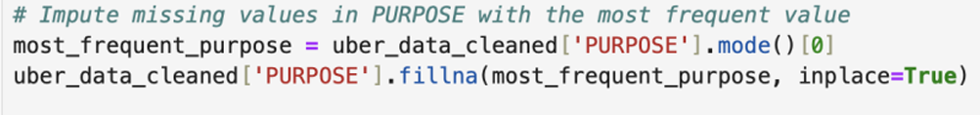
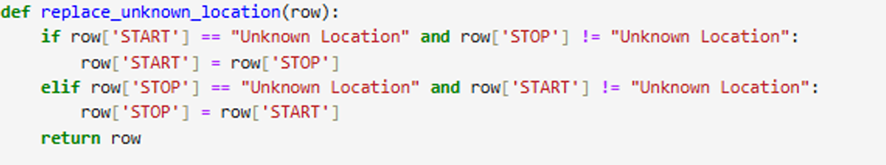
data cleaning
For important columns
for purpose column
For the locations

Slide 6
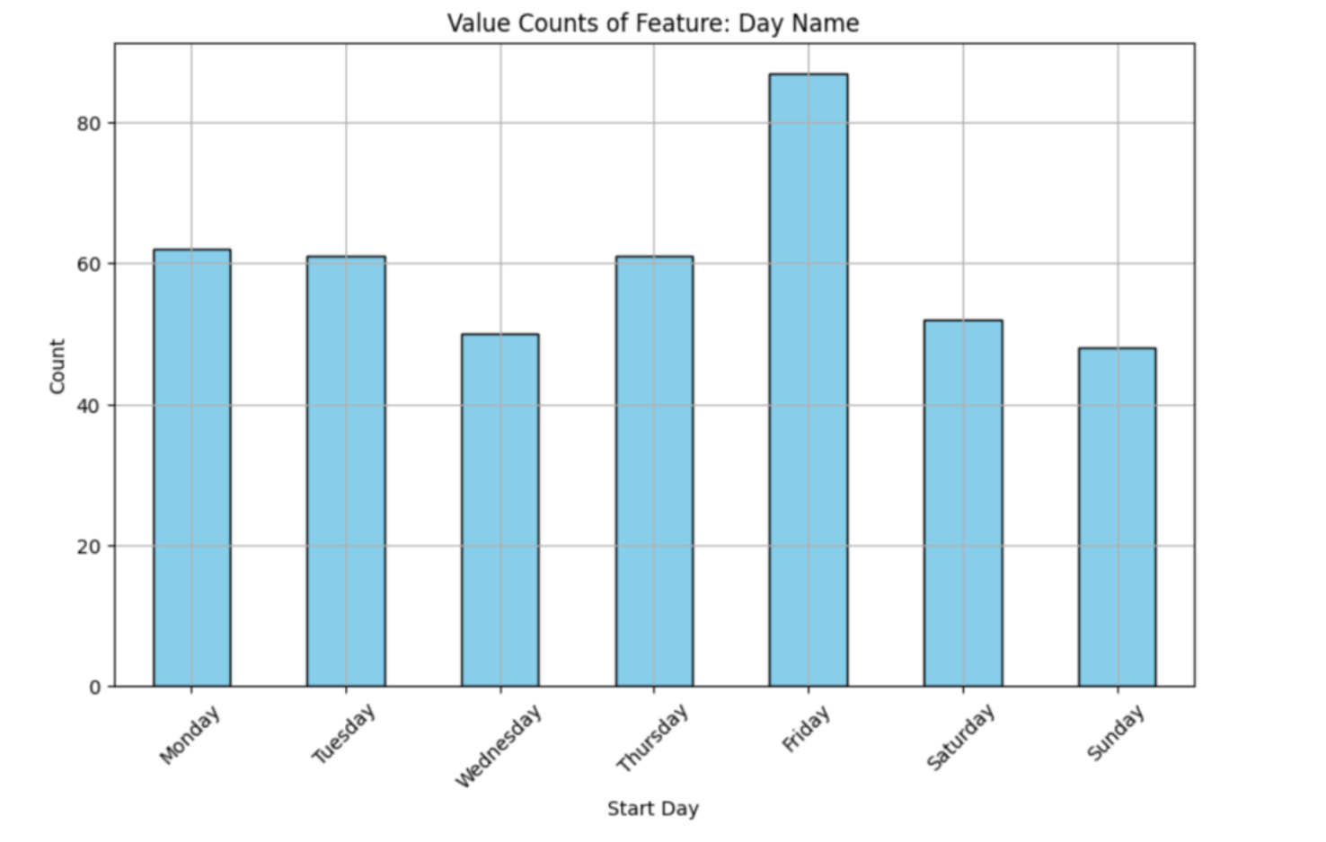
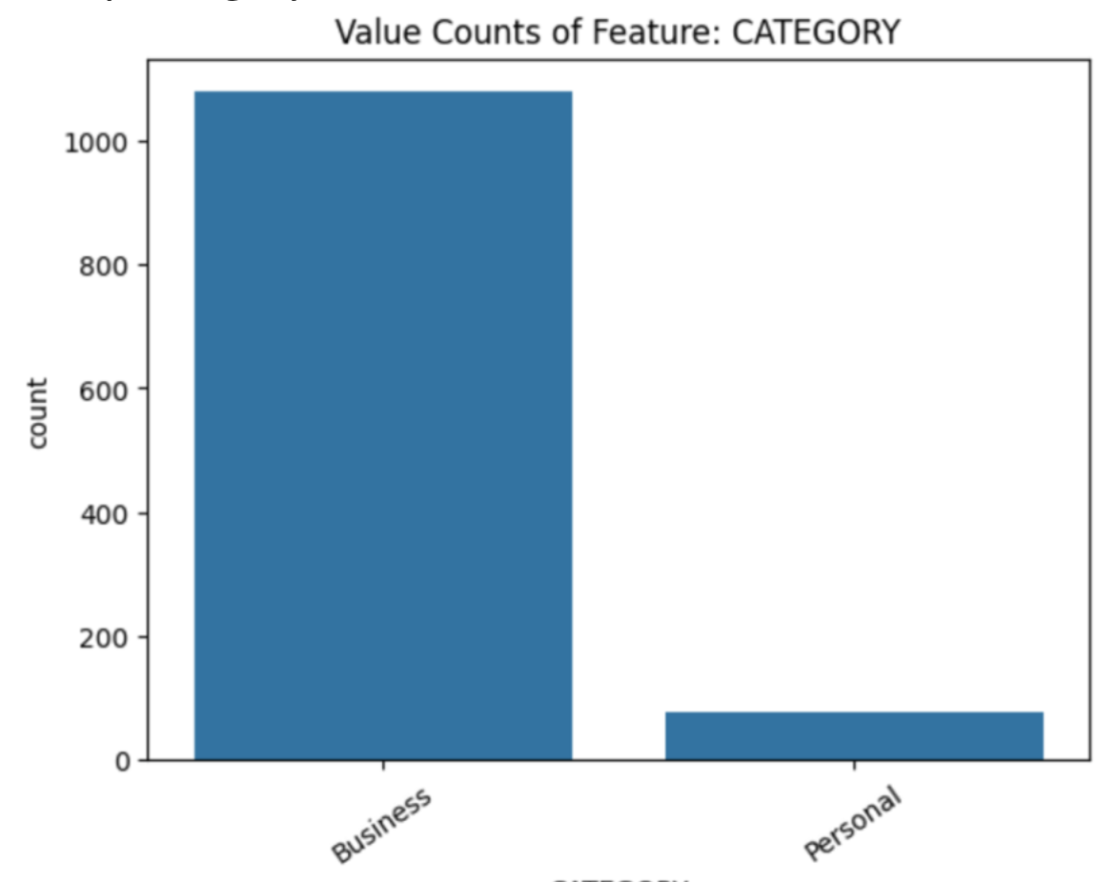
Data Distribution

Slide 7
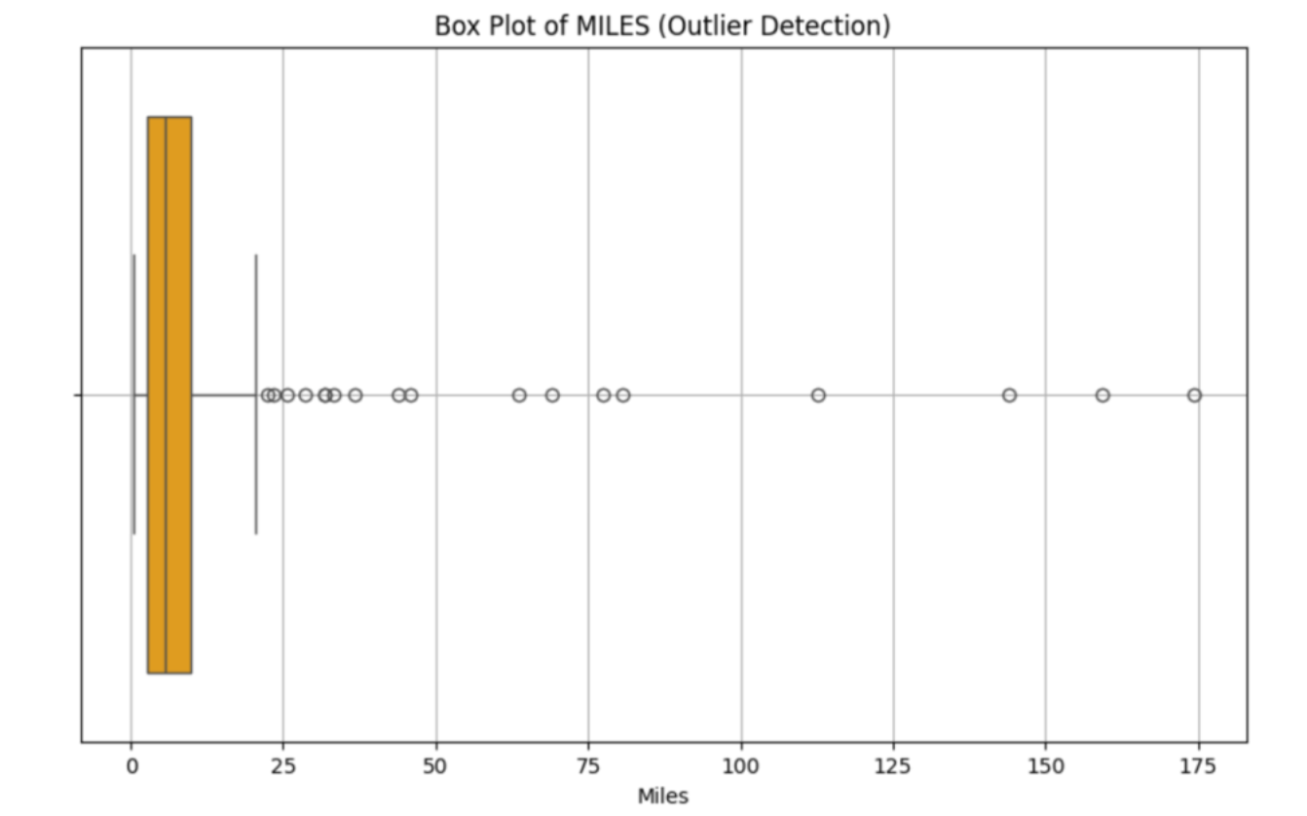
Outlier Detection
Impact of Outliers:
• Outliers can skew the mean and standard deviation, leading to misleading
conclusions.
• if building predictive models, outliers may reduce the accuracy. of
the model.

Slide 8
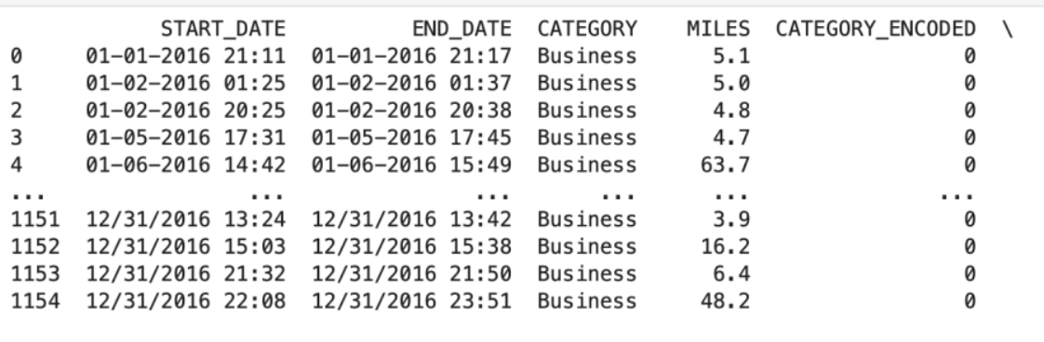
Encoding Categorical Variables
CATEGORY: Label encoding
- START, STOP, PURPOSE: One-hot encoding

Slide 9
model
Predicting the trip category by using the features:
Miles ( long trips tend to be for business )
Purpose
Start and stop

Slide 10
Training model & data distribution
Logistic Regression is for training :
Suitable for classification tasks.
Only two categories to classify.
Gives the relationship for the target and the other features.

Slide 11

Training model & data distribution Cont…
80% of data used for training and 20% for testing
Model accuracy

Slide 12

Thank you

