Slide 1
Identify Fraudulent Transactions in Credit Card Transactions Dataset
ICS 474
Mohammed AL-Weatishi - 201967350
Ahmed AL-Johani - 202065800
Ghaleb AL-Hashim - 201925590

Slide 2

Introduction
Problem Statement: Credit card fraud is a major challenge globally, and detecting it efficiently is crucial.
Objective: Build a robust model to identify fraudulent transactions with high precision and recall.

Slide 3

Dataset Overview
The dataset simulates real credit card transactions with both legitimate and fraudulent cases
The dataset contains detailed transaction information including temporal, geographical, and demographic data
The datasets specifically designed for developing fraud detection models

Slide 4
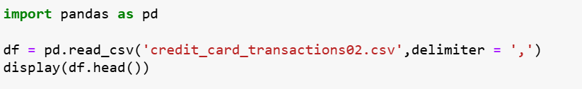
Overall Statistics
Total Records: 616,615
Memory Usage: 112.9+ MB
Missing Values: Only in merch_zipcode (93,225 missing)
Data Types Distribution:
float64: 7 columns
int64: 5 columns
object: 12 columns

Slide 5
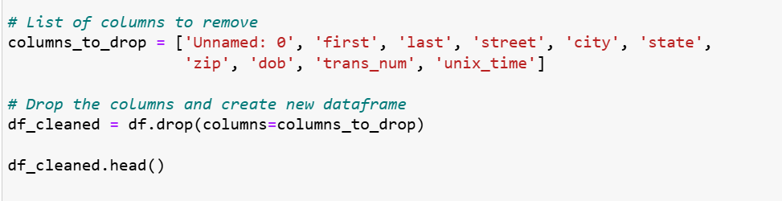
Feature Selection
The first thing we do is to remove columns that doesn't affect our model. e.g :
Unnamed: 0 , first, dob, city , …

Slide 6
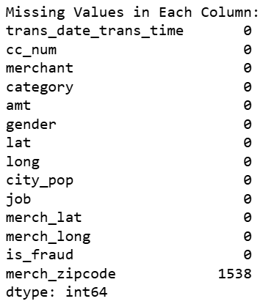
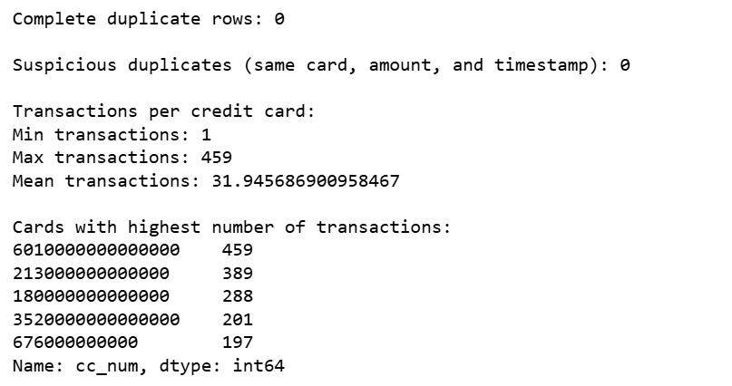
Checking & Handeling for Missing and duplicate Values
# Note: two records are considered duplicate if they share the same card, time and amount.

Slide 7
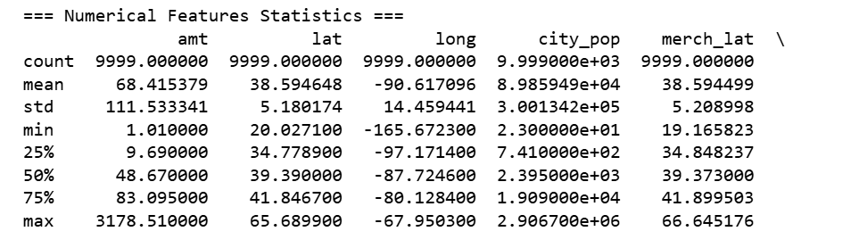
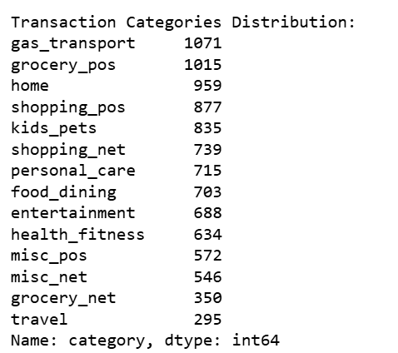
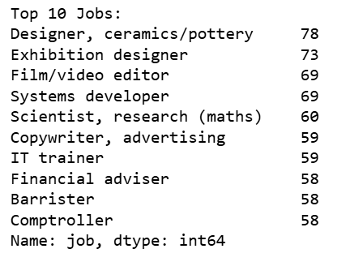
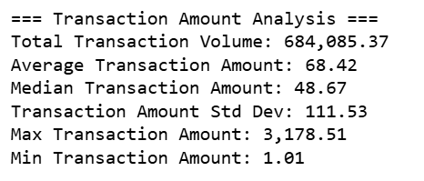
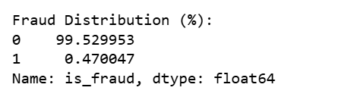
comprehensive statistical analysis
Numerical Features Statistics
Categorical Features Analysis
Transaction Amount Analysis
Target Feature

Slide 8
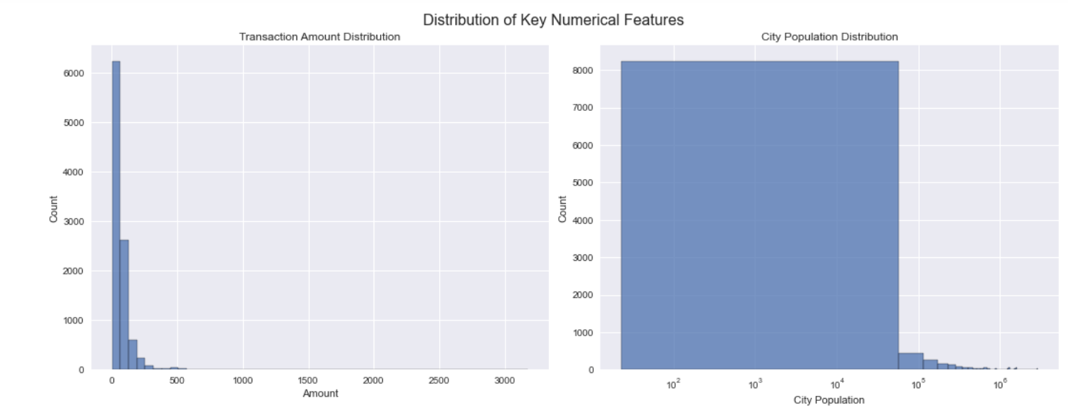
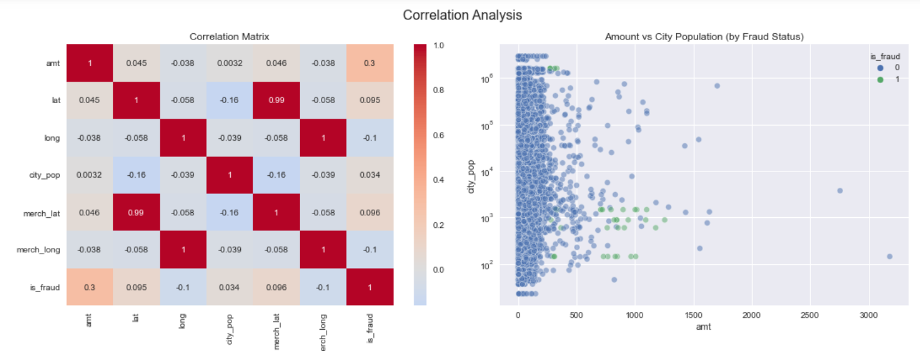
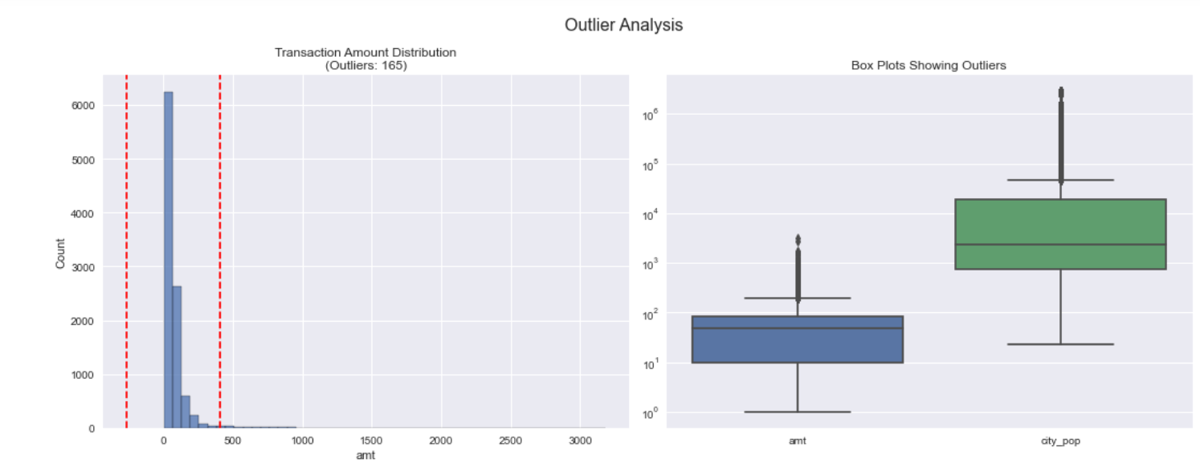
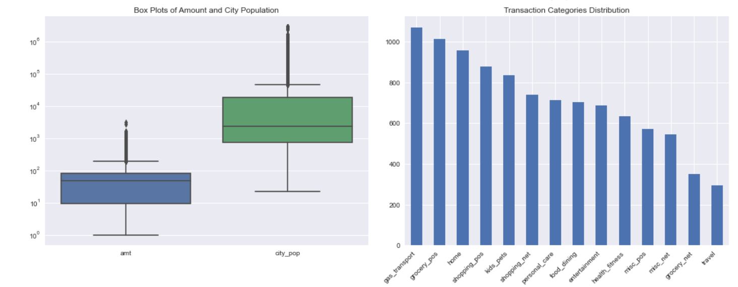
Comprehensive analysis of distributions, correlations, and outliers

Slide 9
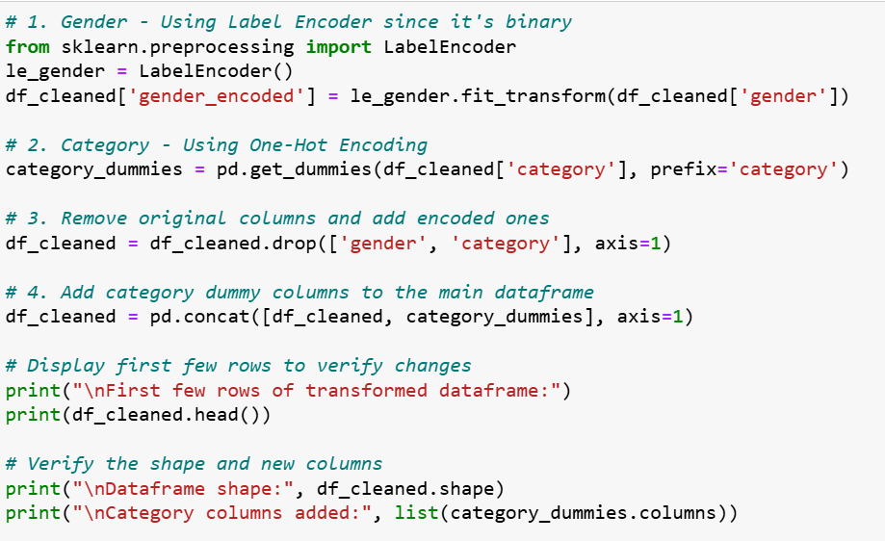
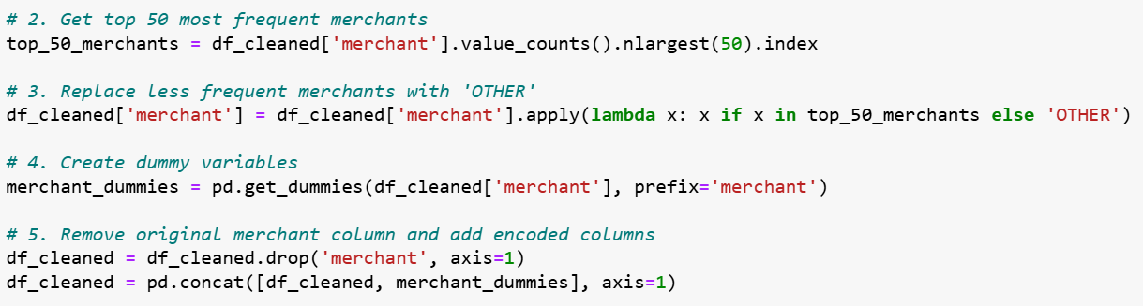

Data Preprocessing
Encoding Categorical Variables.
Encoding Gender and Category features
Removing Job Column
Hot Encoding the Merchant Feature

Slide 10
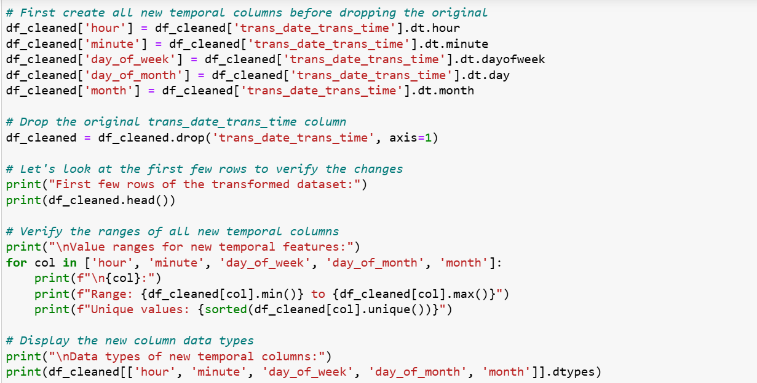
Preprocessing time data
Extract 5 features from trans_date_trans_time.
Hour of day (0-23)
Crucial for fraud detection
Fraudulent transactions often occur at unusual hours
Captures daily transaction patterns
Day of week (0-6)
Different patterns between weekdays and weekends
Some fraudsters might target specific days
Day of month (1-31)
Can capture patterns related to salary payments
Monthly billing cycles
End-of-month activities
Month (1-12)
Seasonal patterns
Holiday-related fraud patterns

Slide 11
Classification Models for Predecting Fraud Accounts
Problem Type Match
we have a binary classification problem (fraud vs. non-fraud)
Tree-based models like Decision Trees, Random Forests, or XGBoost are well-suited for classification tasks
The target variable is_fraud is clearly defined as a binary outcome
Advantages
Handle Mixed Data Types: our dataset contains:
Numerical features (amt, lat, long, city_pop)
Categorical features (merchant, category, job, gender)
Tree models can naturally handle both without extensive preprocessing

Slide 12

Cross Validation-Training/Testing
Using 5-fold stratified cross-validation. This means our data will be split into 5 equal parts, maintaining fraud/non-fraud proportions in each fold
Rationale for Choosing Cross-Validation:
More Robust Performance Estimation
Each data point will be used for both training and testing
Gets performance metrics from 5 different train-test combinations
Provides a more reliable estimate of model performance than a single train-test split

Slide 13
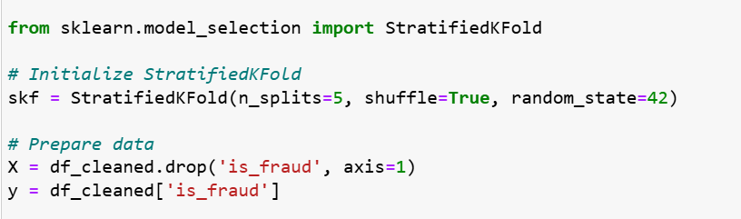
Cross Validation-Training/Testing
Better for Imbalanced Data
Our fraud detection dataset is imbalanced (few fraud cases)
Stratification ensures each fold maintains the same ratio of fraud/non-fraud cases
Reduces the risk of having folds with too few fraud cases
Training Details
Using Random Forest with parameters optimized for imbalanced fraud detection
class_weight='balanced' is crucial given your 0.47% fraud rate
Higher number of trees (200) to better capture rare fraud patterns
No max_depth restriction to allow model to learn complex patterns

Slide 14
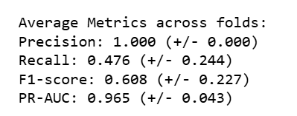
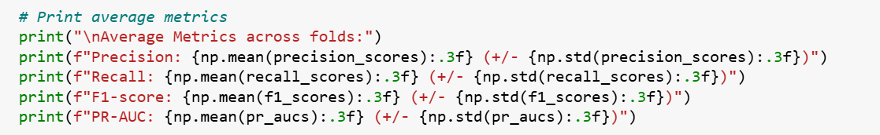
Model Evaluation Metrics Choice
Precision: Measures false positives (important for reducing false fraud alerts)
Recall: Measures missed frauds (crucial - we want to catch most frauds)
F1-Score: Balances precision and recall
PR-AUC: Better than ROC-AUC for imbalanced data

Slide 15
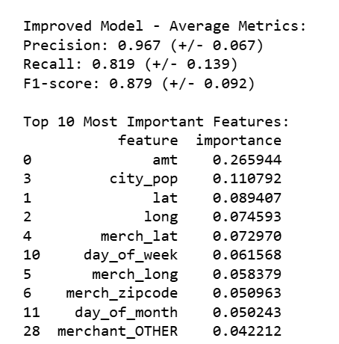
Results
Improved Metrics:
Recall increased from 47.6% to 81.9% (catching more fraud)
Precision remained high at 96.7% (few false alarms)
Feature Insights:
Transaction amount most important (26.6%)
City population second most important (11.1%)
Geographic features (lat/long) also significant
Why It Worked:
SMOTE provided better examples of fraud patterns
More trees captured complex relationships

Slide 16
Thank you

