Slide 1
ICS 474 Project Fraudulent Predictor for Credit Card Transactions Mohammed Aljamili 202024300 Omar Alromih 202019400

Slide 2
Table of contents
01
02
03
04
Data Understanding and Exploration
Data Preprocessing
Data Modeling
Visualization

Slide 3
01
Data understanding and exploration

Slide 4
Data understanding and exploration
Data Overview :
The Credit Card Transactions Dataset provides detailed records of credit card transactions, including information about transaction times, amounts, and associated personal and merchant details
The primary objective is to classify each transaction as either "fraudulent" or "non-fraudulent

Slide 5
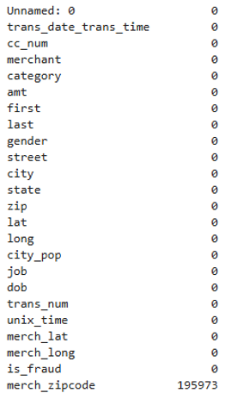
Data understanding and exploration
Missing Values:
Dataset structure:
Number of rows: 1296675
Number of columns: 24

Slide 6
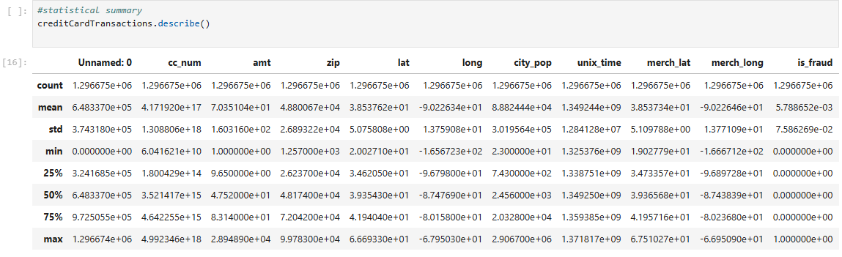
Data understanding and exploration

Slide 7
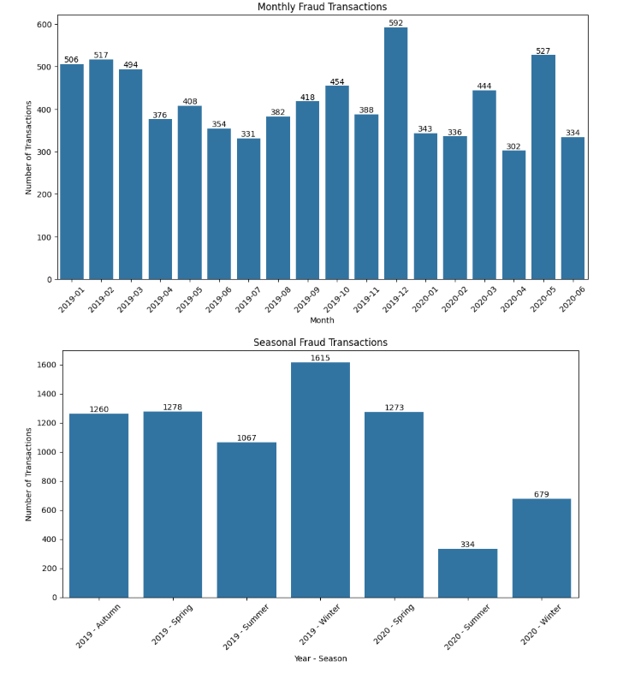
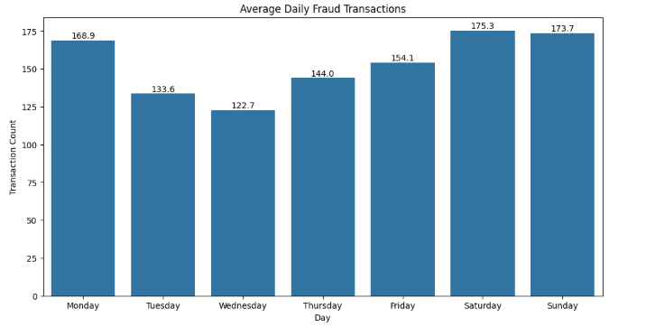
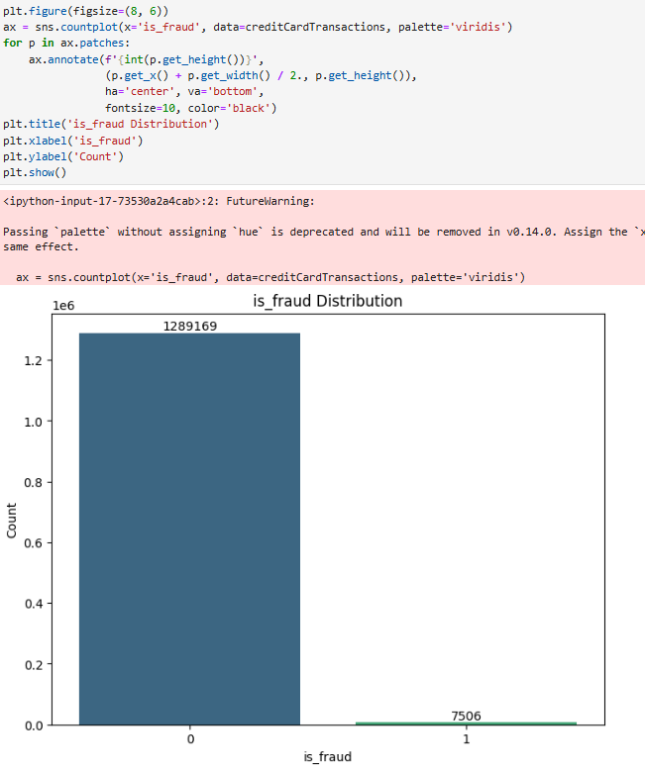
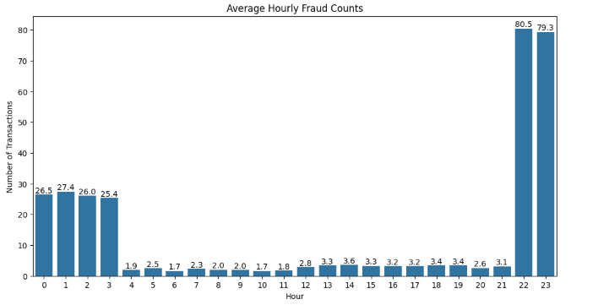
Data understanding and exploration
Data Distribution:

Slide 8
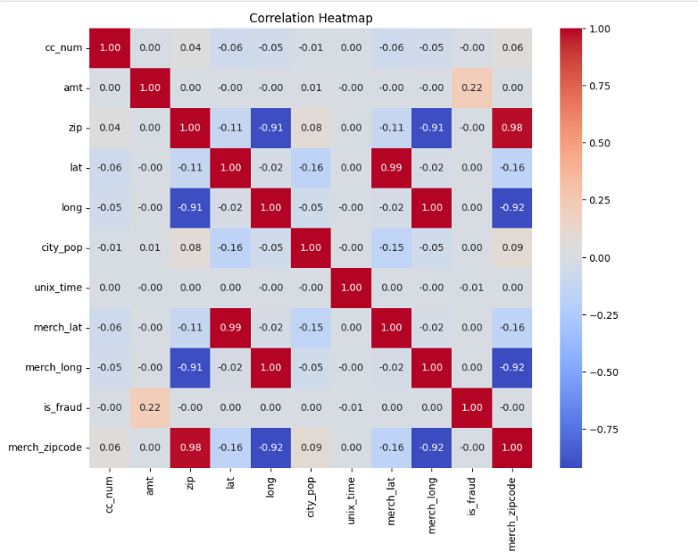
Data understanding and exploration
Correlation Analysis:

Slide 9
02
Data Preprocessing

Slide 10
Data Preprocessing
Handling Missing Data:

Slide 11
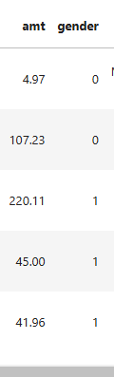
Data Preprocessing
Encoding Categorical Variables:
Label Encoding:
Label encoding is applied to the binary categorical variable gender:
"F" (Female) is encoded as 0
"M" (Male) is encoded as 1

Slide 12
03
Modeling

Slide 13
Modeling
Algorithm Selection:
Random Forest:
Ideal for categorical data.
Provides high accuracy and reliable predictions.
XGBoost:
Excels in speed and performance.
Handles large datasets and complex patterns effectively.
Well-suited for fraud detection classification tasks.

Slide 14
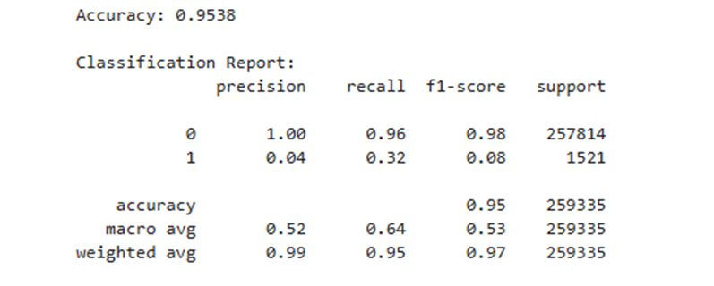
Modeling
Model Evaluation:
Random Forest:

Slide 15
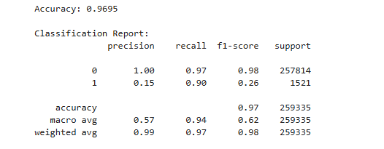
Modeling
Model Evaluation:
XGBoost:

Slide 16
04
Visualization

Slide 17
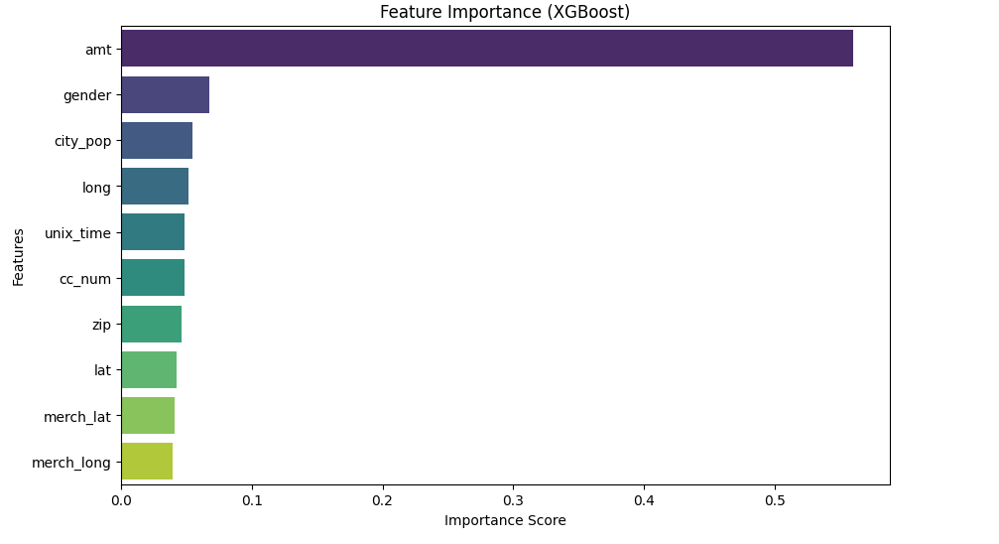
Visualization
Feature Importance:

Slide 18

Thank you for listening

