Slide 1
Uber Dataset Team G3 ICS474 Project
Abdulmajeed Alghamdi 202032860 Section02
Mohamad Alsakka 202044860 Section02
Abdullah Algada 202044680 Section01

Slide 2
1. Dataset overview
The dataset set is about uber trips data.
It focuses on the trips, purposes, start and end location of trips, category of a trip and the distance of the trip.

Slide 3
2. Feature Description
START_DATE
END_DATE
CATEGORY
START
STOP
MILES
PURPOSE

Slide 4
3. Dataset Structure
The dataset contains 1155 rows and 7 columns

Slide 5


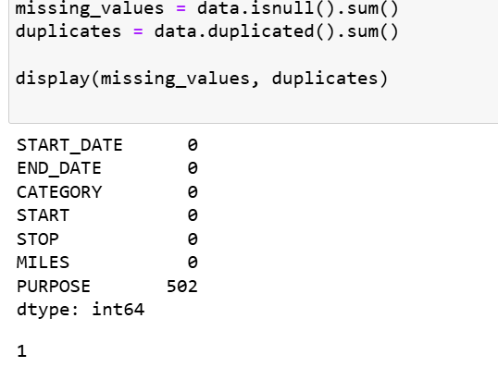
4. Missing values and duplicates
How does the missing value effect on our dataset
What do we need to do to handle this issue

Slide 6
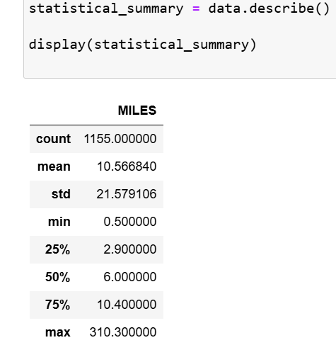
5. Statistical summary
MILES is the only numerical feature
Insights on CATEGORY and PURPOSE

Slide 7
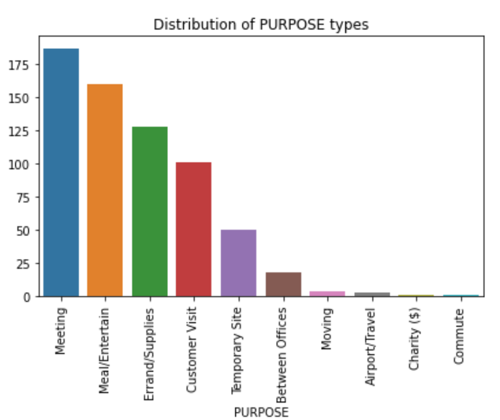
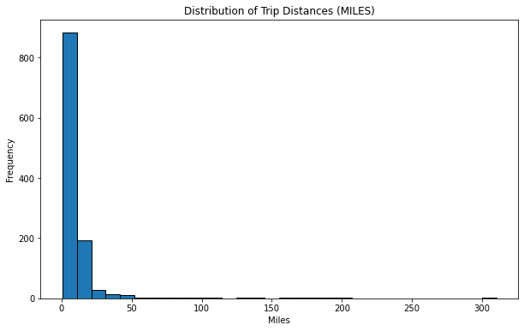
6. Data distribution

Slide 8
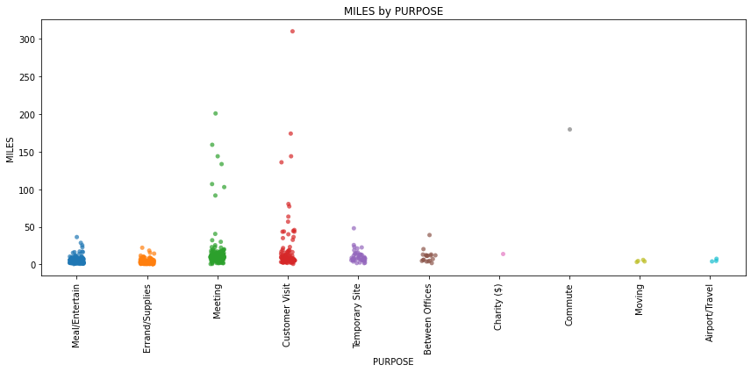
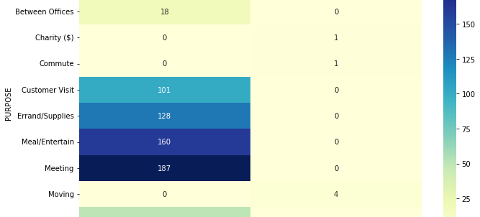
7. Correlation analysis

Slide 9
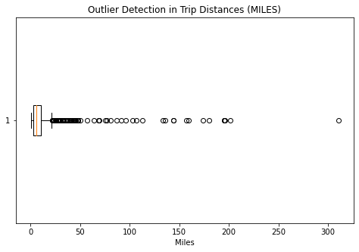
8. Outlier detection

Slide 10
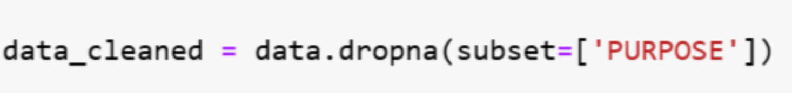
9. Handling missing datasets
The PURPOSE column has a significant portion of missing values (502 out of 1155 rows).
There are two possible approaches to handle it:
Deletion, where we could drop the rows with missing values.
Imputation, where we could fill in the missing values based on patterns in other fields.
We’ve decided to proceed by dropping rows with missing PURPOSE values.

Slide 11
10. Encoding Categorical Variables
One-Hot Encoding will create binary columns for each unique value.
Ensuring that there is no ordinal bias introduced.
Making the features compatible with algorithms that require numerical input.

Slide 12
11. Feature Scaling
MILES is the only continuous numerical feature in the dataset.
Depending on the machine learning model used, scaling may be necessary.
Standard scaling is the chosen approach, as it ensures consistent scaling across features, especially for models that rely on distance calculations.

Slide 13
12. Feature Selection
The selected features for analysis are MILES, CATEGORY, and PURPOSE.
MILES is central to the analysis.
CATEGORY provides context for the purpose of trips.
PURPOSE itself reveals insights into the types of trips.

Slide 14
13. Algorithm Selection
Classification if predicting categories like trip purpose or business/personal trips.
Regression if predicting a continuous value like trip distance or MILES.
The chosen approach is to predict PURPOSE, a categorical variable, using a classification model.

Slide 15
14. Data Splitting
The method chosen for data splitting is a hold-out approach.
80% of the data is used for training and 20% for testing.
This simple and effective method helps evaluate the model's performance while preventing data leakage.

Slide 16
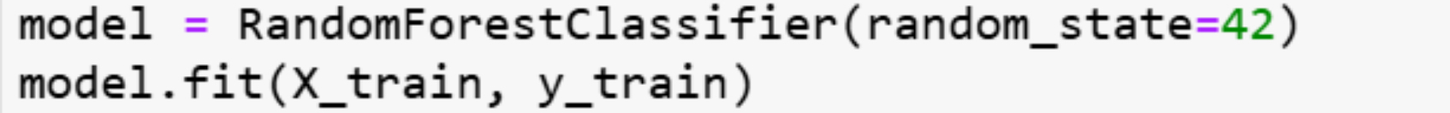
15. Model Training
For training, Random Forest will be used as the classification algorithm.
It is well-suited for handling categorical data and is robust to overfitting,

Slide 17
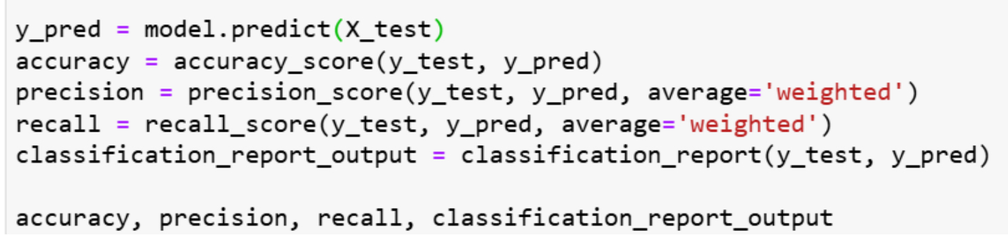
16. Model Evaluation
Accuracy will be the primary metric.
Precision and Recall will be examined to gain insights into how well the model differentiates between specific classes.

Slide 18
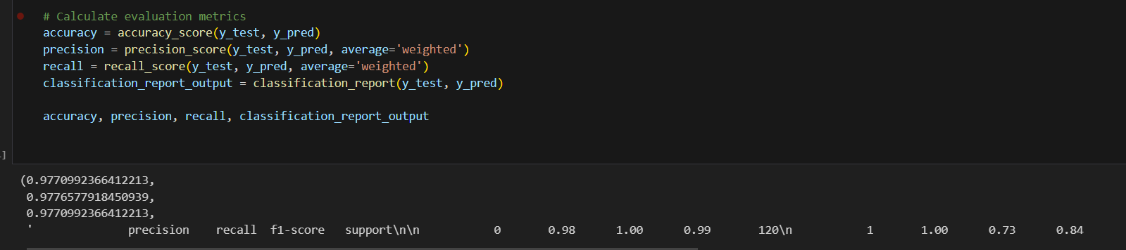
17. Performance analysis
The model achieved an accuracy of 97.7% on the test set.
Precision and Recall:
Weighted Precision: 97.8%, Showing how accurate the model is across categories.
Weighted Recall: 97.7%, Showing how accurate the model can identify the instances.
Classification Report:
The main class (0) has both precision and recall close to 1.0, but class 1 has a lower recall of 0.73 because the model has difficulty with it.

Slide 19
18. MODEL Improvement
Hyperparameter Tuning: Applying cross –validation and tuning parameters.
Feature engineering: Creating new features from START_DATE.

Slide 20
19. Validation
Cross-validation can be used to ensure the model generalizes well across categories
K-Fold Cross-Validation (e.g., with 5 folds) can provide a more robust measure of model performance
cross-validation will be used on the Random Forest model to validate its consistency.

Slide 21
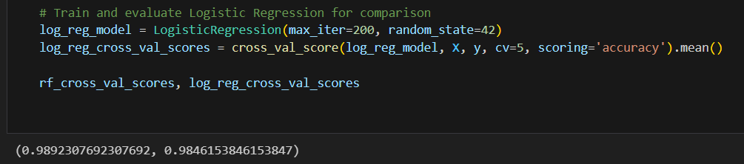
20. Final model Selection
Comparison:
Random Forest model’s performance will be compared with another classifier, such as Logistic Regression.
The final model will be chosen based on balanced performance metrics and practical considerations.
Results of cross-validation:
Random Forest: accuracy of 98.9%
Logistic regression: accuracy of 98.5%
Random Forest was chosen due to its’ higher accuracy and because it’s more suitable with dealing with out dataset.

Slide 22
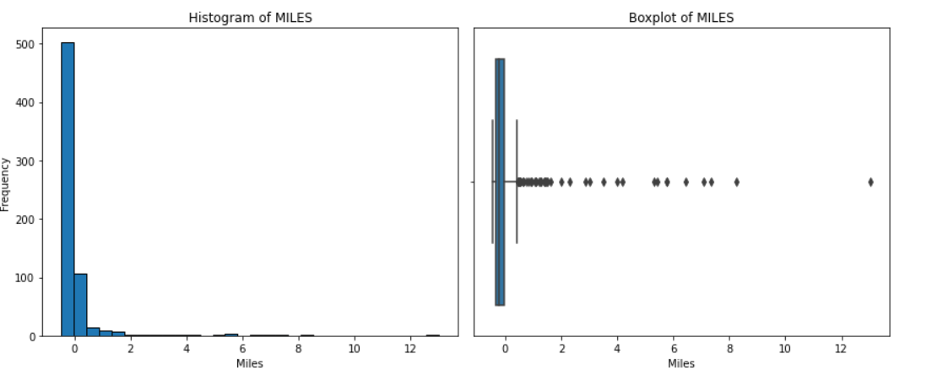
21. Data distribution
Numerical Feature (MILES): Histogram and boxplot will be created to examine its distribution and detect any outliers.

Slide 23
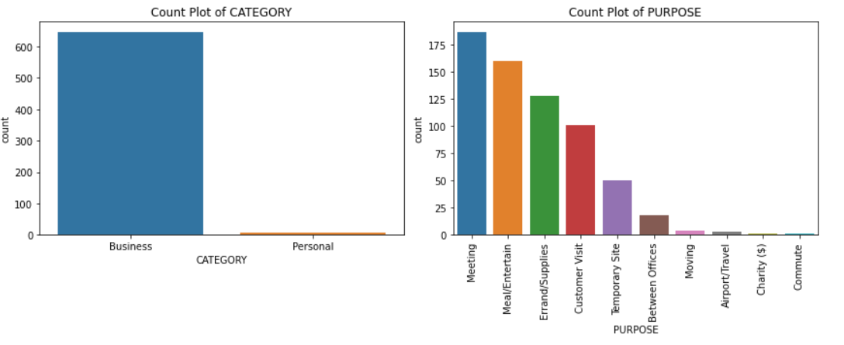
21. Data distribution – Cont.
Categorical Features (CATEGORY and PURPOSE): bar plots will be used to show the frequency of each category.

Slide 24
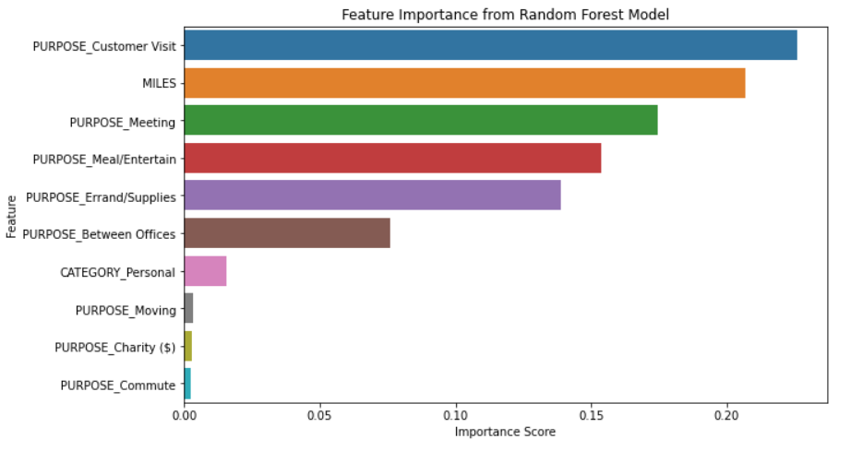
22. Feature importance
Since the final model is the Random Forest, feature importance scores can be visualized to show which features have the most impact on predictions

Slide 25
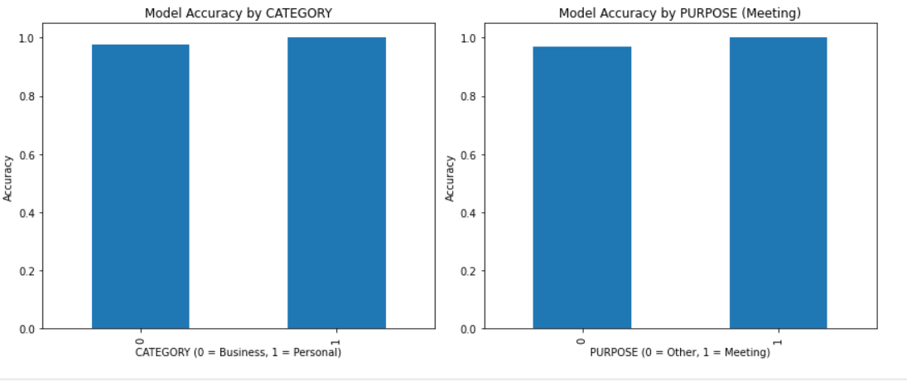
23. Model Performance across features.
We will visualize how well the model performs across various categories in PURPOSE and CATEGORY to check for any imbalances or performance variations.
Model performance will be measured using model accuracy by PURPOSE and by CATEGORY.
It can be seen from the graph that the model perform well across different categories, showing high and close accuracy rates, which indicates that the model does not exhibit performance imbalances across these categories.

Slide 26
Thank you

