Slide 1

ICS 474 Project: Credit Card Fraud Transaction Detection

Slide 2
01
Data Understanding and Exploration

Slide 3
01: Data Understanding and Exploration
Dataset Overview:
Feature Description:
Source: Credit Card Transactions Dataset from Kaggle.
Purpose: To help detect fraudulent transactions by analyzing credit card usage patterns, including transaction amounts, locations, and other relevant factors.
Info: Includes features about the card holder, the transaction and the merchant.
Data Types: Mixed between numerical & categorical

Slide 4
01: Data Understanding and Exploration
Dataset Structure:
Statistical Insights:
About 1.3 million rows and 24 columns.
No duplicates found.
Missing values identified in merch_zipcode
Majority of transactions are small amounts
High imbalance between fraudulent (0.6%) and legitimate (99.4%) transactions.

Slide 5
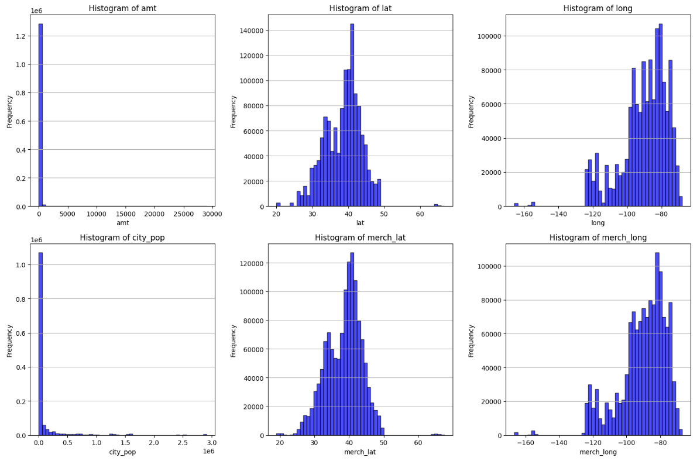
01: Data Understanding and Exploration
Data Distribution - Histograms:

Slide 6
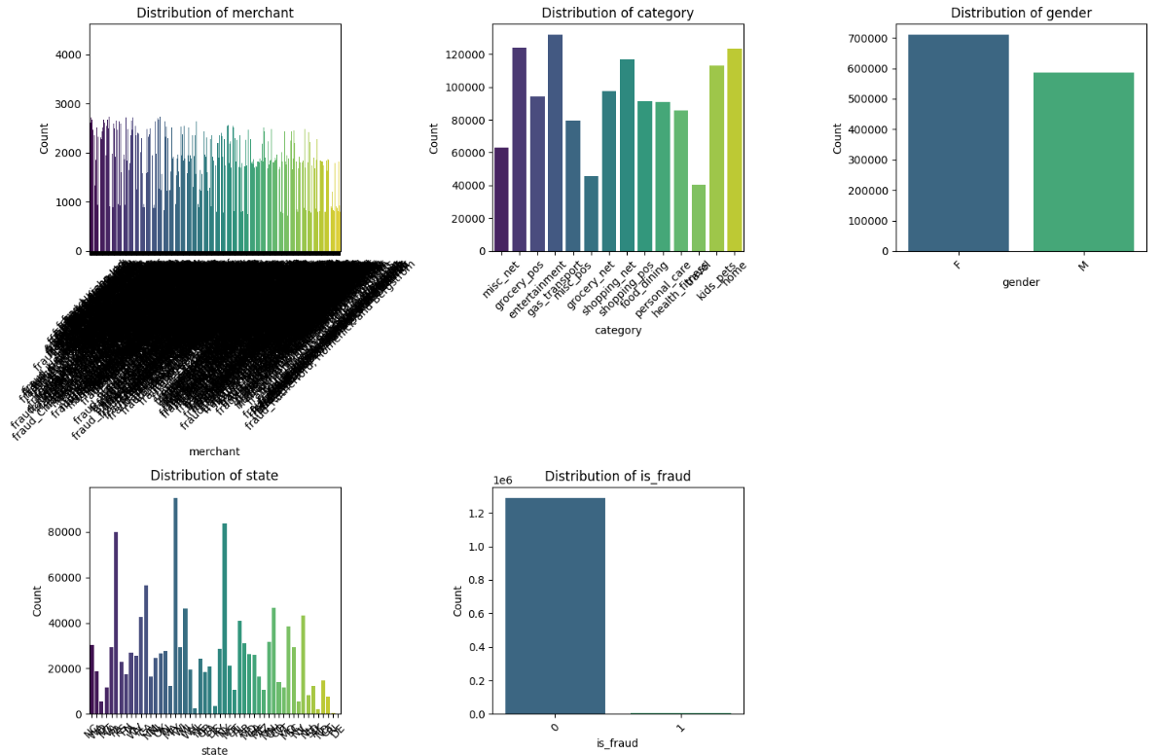
01: Data Understanding and Exploration
Data Distribution - Bar Plots:

Slide 7
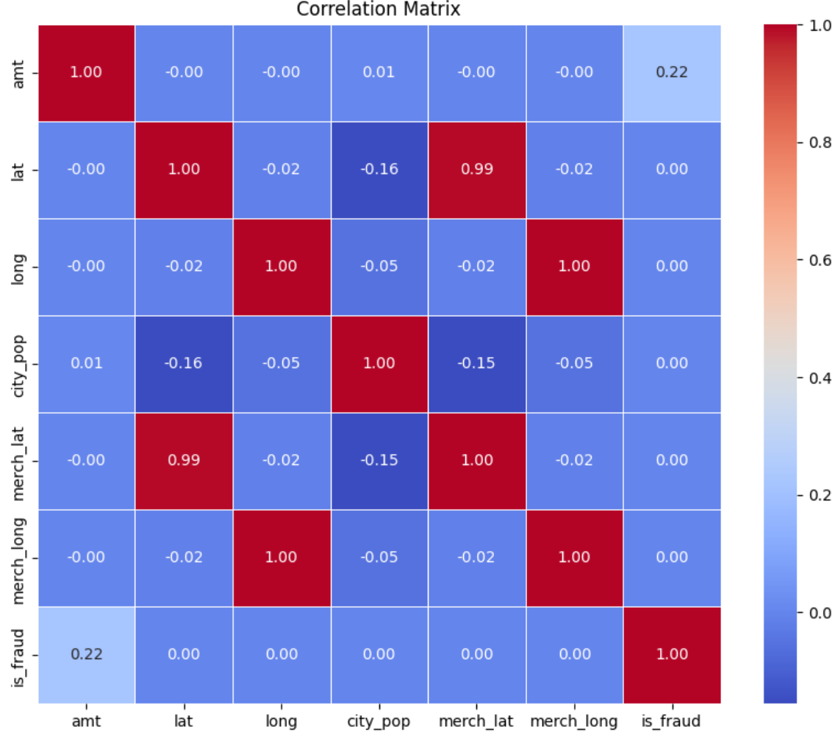
01: Data Understanding and Exploration
Correlation Analysis:

Slide 8
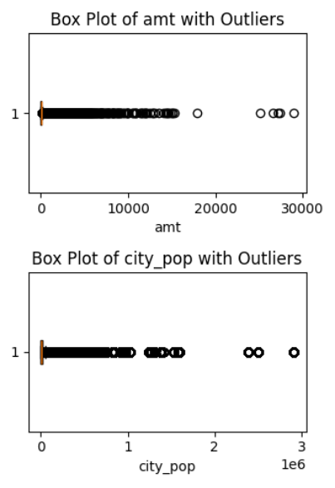
01: Data Understanding and Exploration
Outlier Detection:

Slide 9
02
Data Preprocessing

Slide 10
02: Data Preprocessing
Handling Missing Data
Encoding Categorical Variables
Replaced missing identified in merch_zipcode with the mode.
Convert categorical features using Label Encoding into numerical format for model compatibility.
Feature Engineering
Calculated age from dob & transaction time.
Feature Scaling
Normalize numerical features for uniformity across varying ranges

Slide 11
02: Data Preprocessing
Feature Selection
Strategy:
Selected features:
Correlation Analysis: Removed redundant features.
Tree-Based Feature Importance: Selected features based on their contribution to predicting fraud.
amt_scaled
trans_hour_scaled
category_index
merchant_index
age_scaled

Slide 12
03
Modeling

Slide 13
03: Modeling
Algorithm Selection:
Data Splitting:
Method: Hold-out validation
Training set: 80% of the data.
Testing set: 20% of the data.
Purpose: Evaluate generalization on unseen data.
Random Forest Classifier
Reasons:
Handles imbalanced datasets effectively.
Provides feature importance for interpretability.
Captures complex, non-linear relationships.

Slide 14
03: Modeling
Model Training:
Model Evaluation:
Accuracy: 99.82% (overall correctness).
Precision: 99.81% (low false positives).
Recall: 99.82% (high detection rate for fraud).
F1-Score: 99.81% (balance between precision and recall).
numTrees: 100(number of trees in the forest).
maxDepth: 10 (maximum depth of each tree).

Slide 15
03: Modeling
Model Improvement:
Final Model Selection:
Random Forest Classifier with tuned hyperparameters.
numTrees: 150
maxDepth: 15
0.17% of Unseen data were miss-classified.
Hyperparameter Tuning.
Re-Calculate evaluation metrics.

Slide 16
04
Modeling

Slide 17
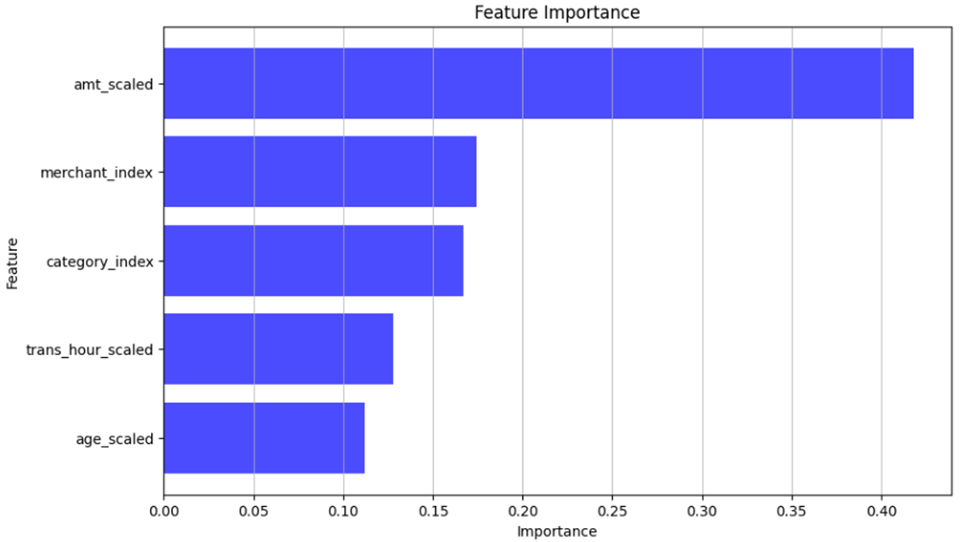
04: Visualization
Feature Importance:

Slide 18
THANKS

Slide 19
Q&A
Do you have any questions?

