Slide 1
Transactions Card Fraud Analysis
Hussain Alyami – 202066180
Mohammed Alkhunjuf – 202028400
Mahmoud Bin Laden - 202029540

Slide 2
Introduction
Content:
The Credit Card Transactions Dataset provides detailed information on transaction on approximately 1.3 millions transactions of 989 clients over two years.
Key Features of the dataset:
Transaction amounts, timestamps, and categories.
Identification information (card number, name).
Geographical information
Objectives:
To explore the dataset for insights into user transactions.
Detect fraudulent transactions by identifying anomalies.
Leverage data-driven strategies for improving transaction security.

Slide 3
Dataset Overview (1)
Client Personal Information Features:
Credit Card Number
First Name
Last Name
Gender
Date of Birth ( Age )
job
Location-Related Features:
Lat
Long
Street
City
State
Zip
Merchant _long
Merchant_lat
City population

Slide 4
Dataset Overview (2)
Transaction Information Features:
Merchant
Merchant_zipcode
Category
Amount
Trans_date_trans_time
Trans_num
Unix_time
The Target Feature:
Is_fraud

Slide 5
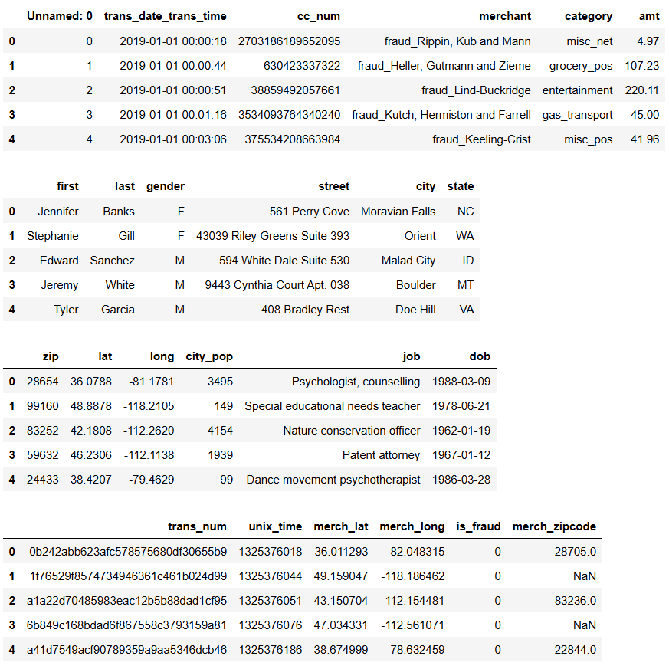
Dataset Overview (3)

Slide 6
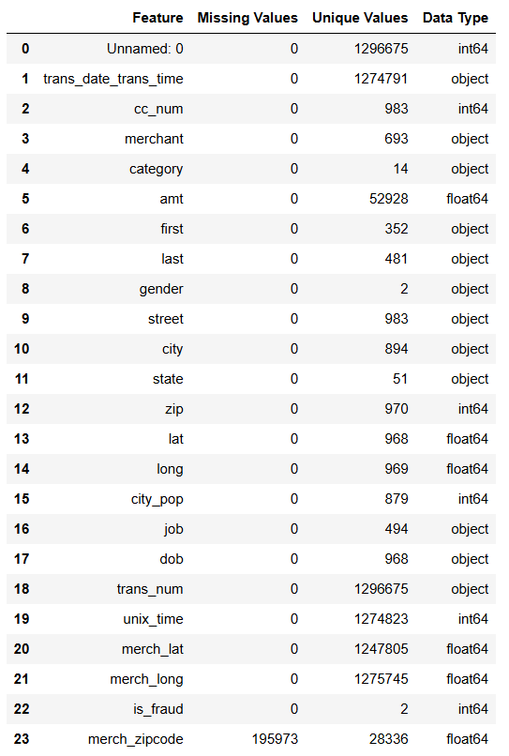
Dataset Overview (4)

Slide 7

Data Processing
Trans_date_trans_time
cc_num
dob
Hour
Day
Network
Age

Slide 8
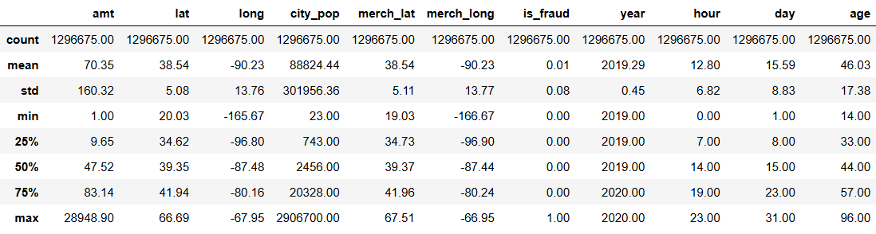
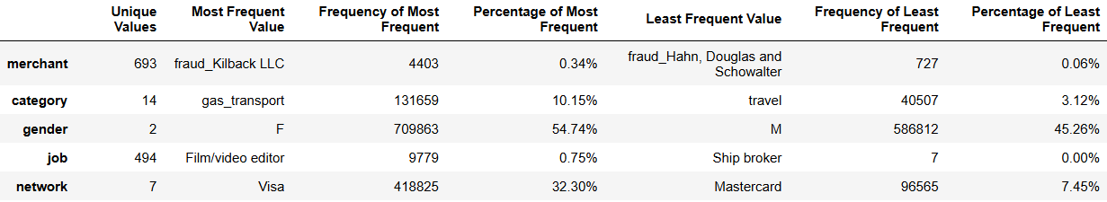
Data Statistics
Numerical Features
Categorical Features

Slide 9
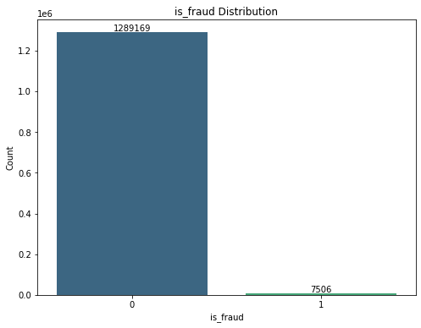
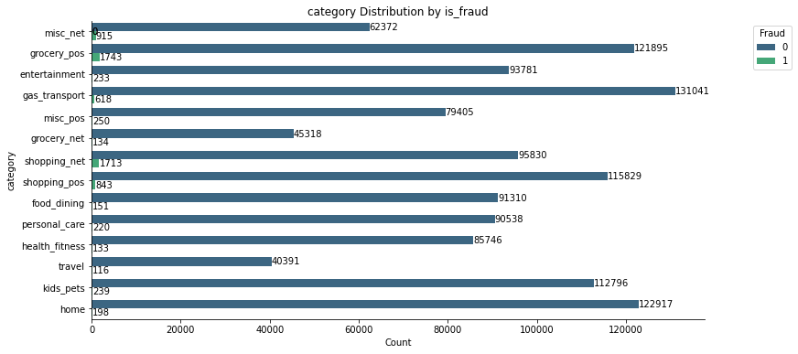
Distribution & Visualization

Slide 10
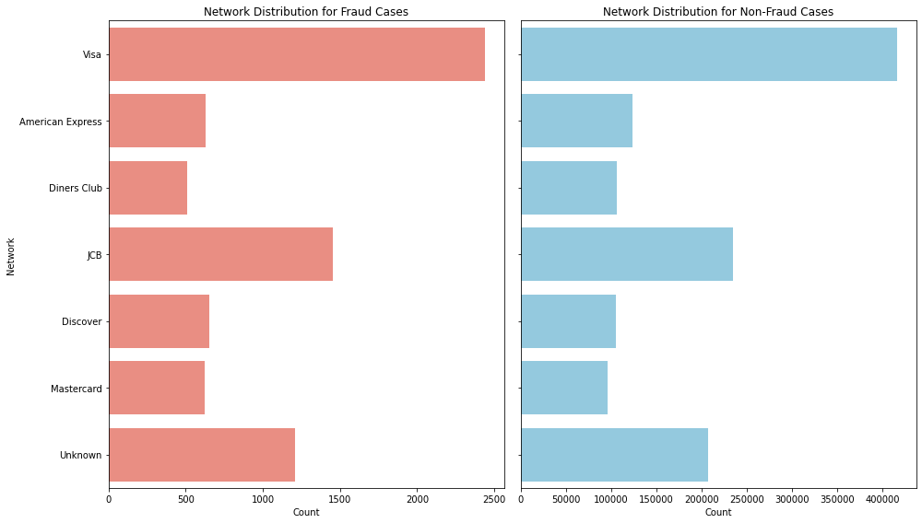
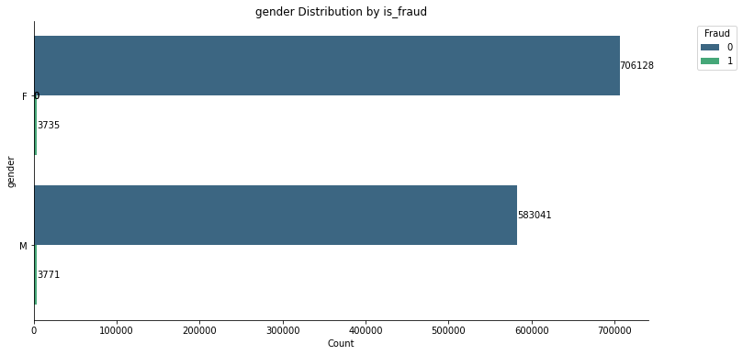
Distribution & Visualization

Slide 11
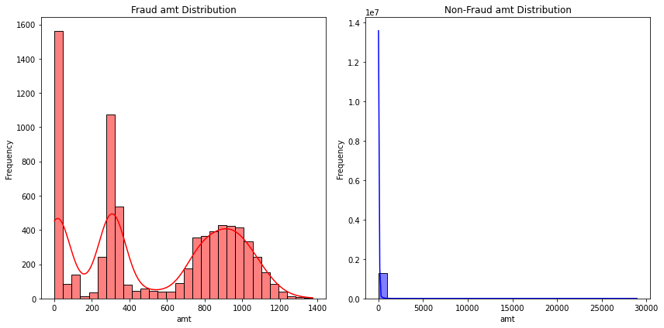
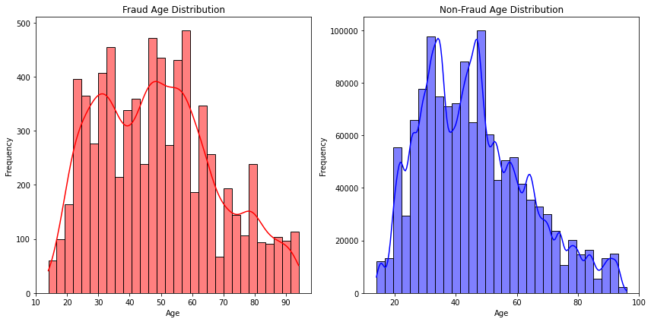
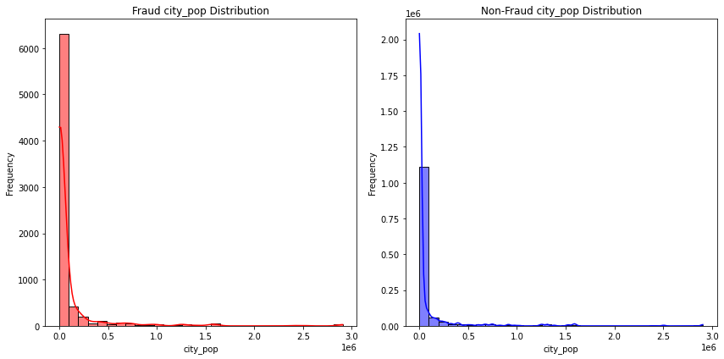
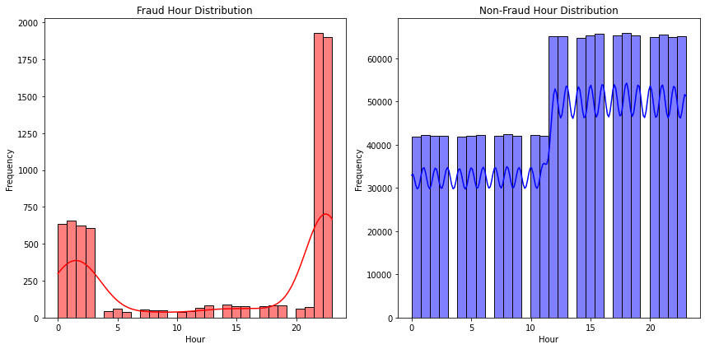
Distribution & Visualization

Slide 12
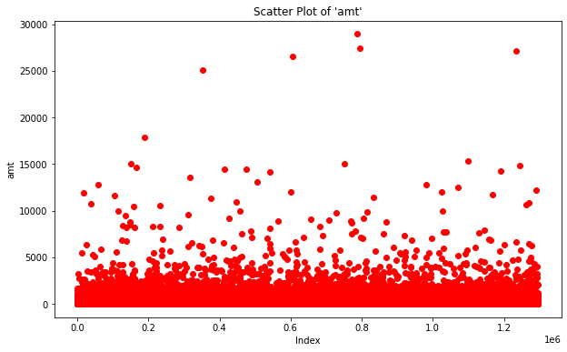
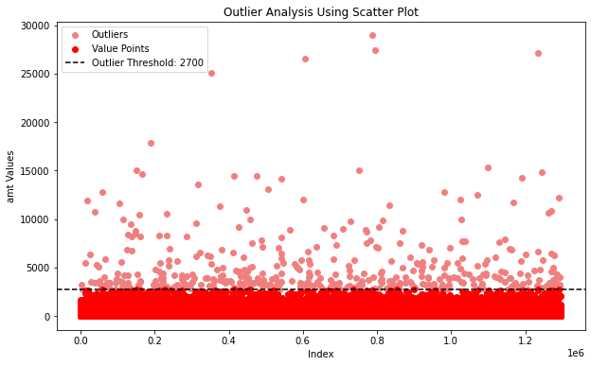
Distribution & Visualization

Slide 13
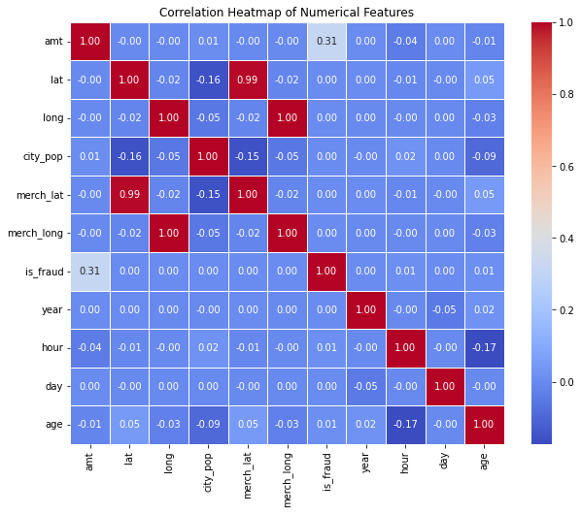
Distribution & Visualization

Slide 14
Scaling & Encoding
Label Encoding: for categorical data with high number of unique values:
Job
Merchant
One-hot Encoding: for categorical data with a low number of unique values:
Gender
Category
Network
Scaling: For all numerical Columns:
Amt
Lat
Long
City_pop
Age
hour

Slide 15
Algorithm Selection & Data Splitting
Since this is a binary classification task to detect fraudulent transactions, these algorithms offer a good balance of interpretability, performance, and diversity in approach.
Decision Tree
Logistic Regression
Random Forest
Naive Bayes (Gaussian)
Data Splitting
We used an 80-20 split for training and testing data, with stratification based on the target variable (is_fraud). Stratification ensures that the distribution of the target classes (fraud vs. non-fraud) is maintained in both the training and testing sets.

Slide 16
Criterion
We used three accuracy metrics:
F1 Score
Precision
Recall
Recall is our most significant accuracy metric
It is calculated as TP/(TP+FN)
Used when missing a positive instance is more costly or critical

Slide 17
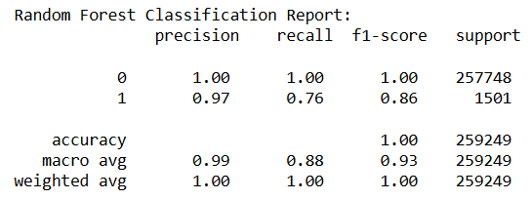
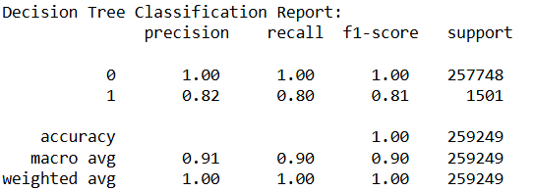
Model Training & testing (1)
Decision Tree
Random Forest

Slide 18
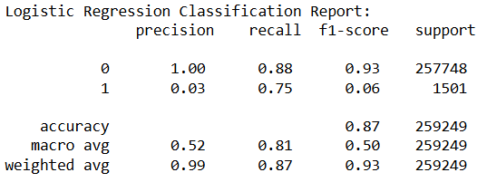
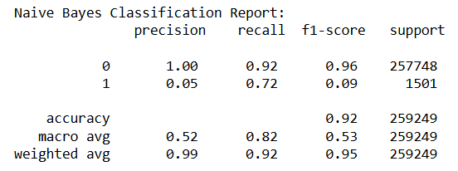
Model Training & testing (2)
Logistic Regression
Naïve Bayes

Slide 19

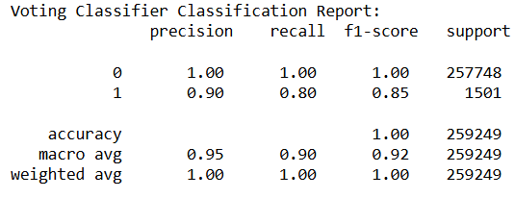
Ensembled model
We used soft voting to ensemble the models (excluding Naïve Bayes) to obtain better results.
Soft voting is a method where the final prediction of a classifier is based on the Averaged predicted probabilities.

Slide 20
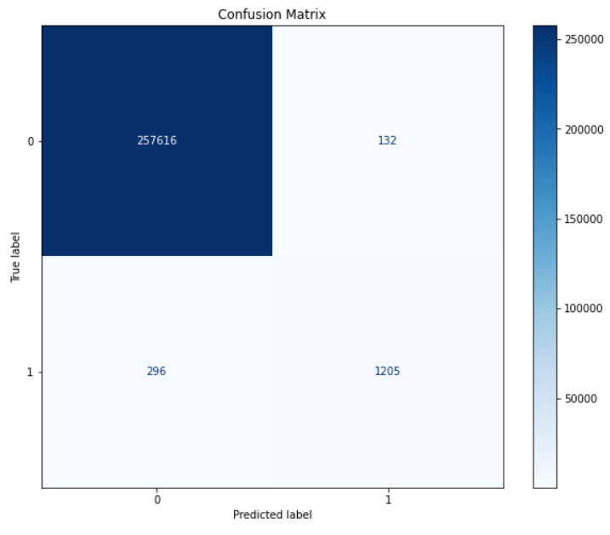
Confusion Matrix

Slide 21
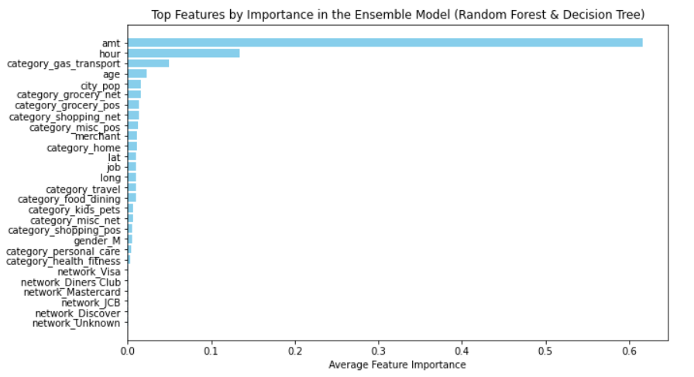
Important features for the model

Slide 22
conclusion
The model achieved a maximum recall of 80%.
The amount of transaction, the hour and the category are the most significant indicators for whether a purchase is a fraud or not.
A larger amount corresponds to a higher probability of fraud.
Purchases made late in the night (10 PM – 2 AM) are more likely to be fraud.
Purchases made over the internet are more prone to fraud.

