Slide 1
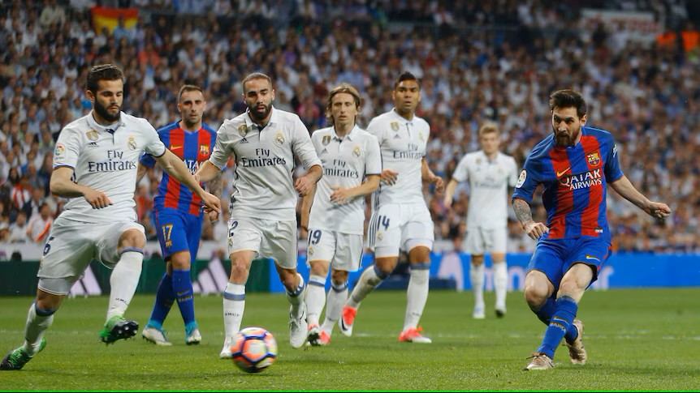
European Soccer Database
Yousef Buali 202025400
Mohammed Alnasser 202034520
Ali Al-Haddad 202170070

Slide 2
Data Understanding and Exploration
How big the data
Missing data and duplicates
Outlier and relationship

Slide 3
How big is the data?
The number of row exceed 19300 (post data handling)
Most of files contain either duplicates or missing values except one file “league”

Slide 4
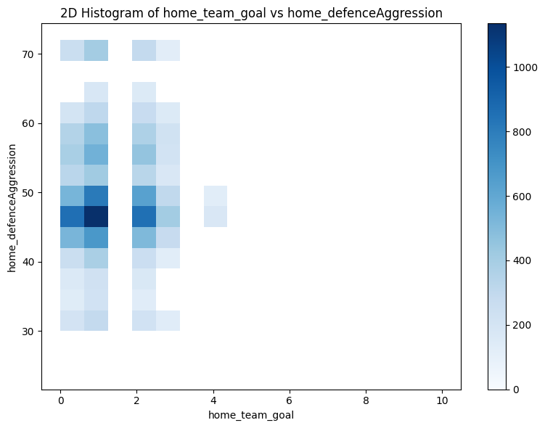
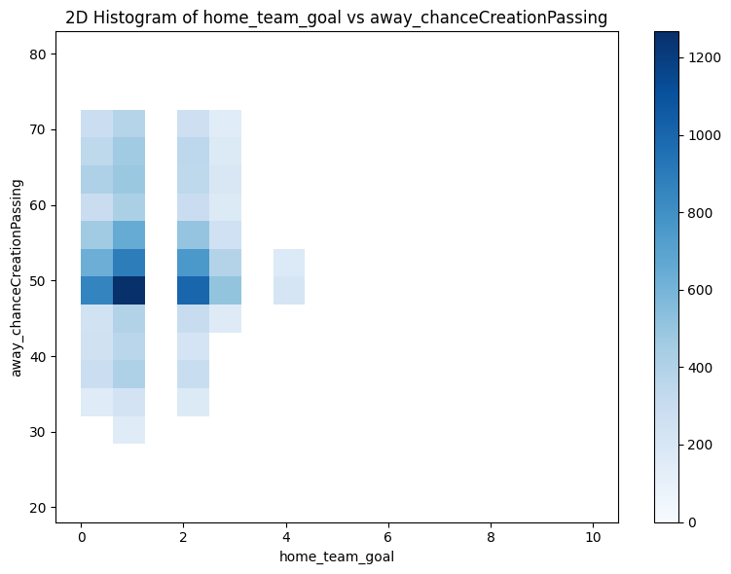
Glimpse on data

Slide 5
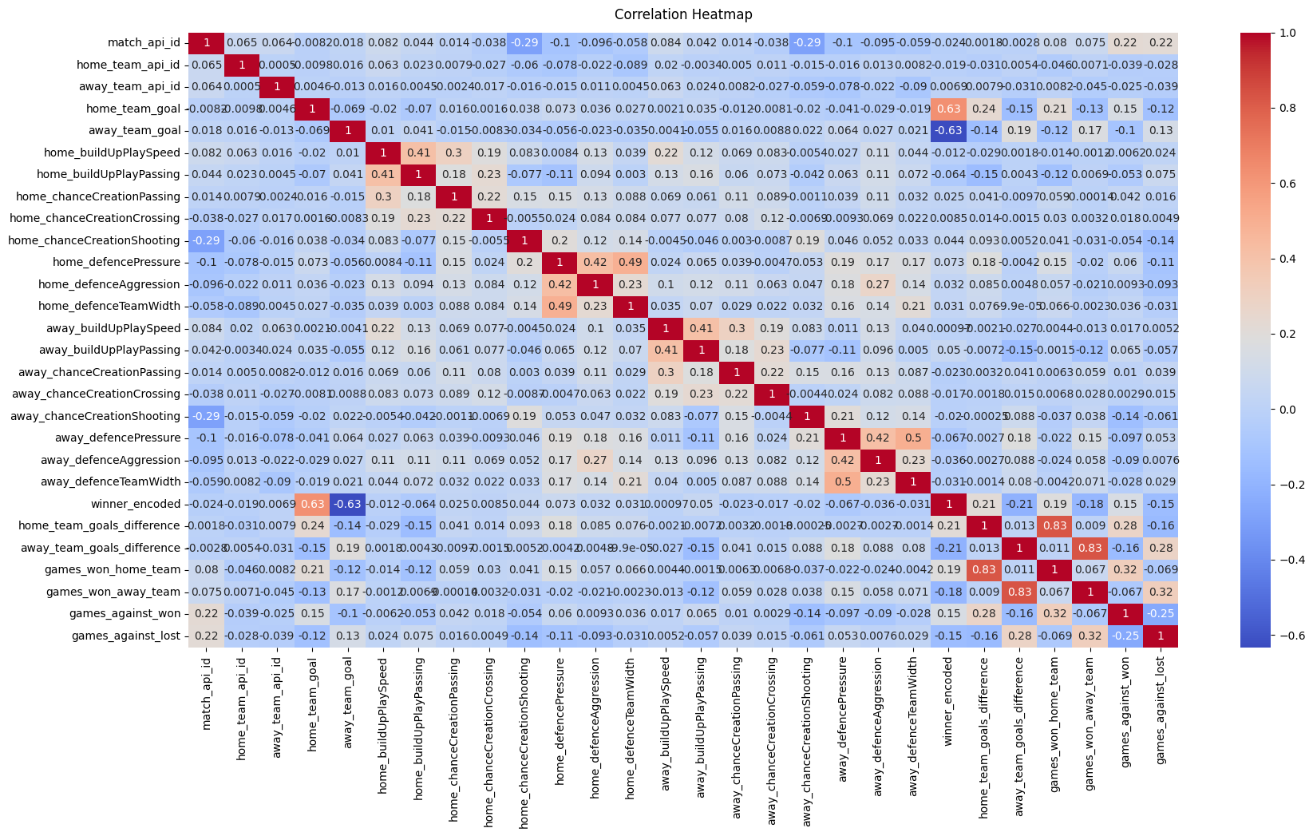
Correlation Analysis

Slide 6

Handling Missing & Unnecessary Data
Handle unnecessary Data :
Dropped Columns that are not useful : home_team_name , country_id and league_id
Handle Missing Values :
Filling them with the Mean of the respective column.

Slide 7
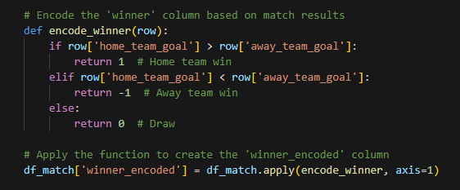
Encoding Categorical Variables
Encoding the 'winner' Column:
Compares the goals scored by the home and away teams to determine the match outcome.
The categorical variable ('winner' - home win, away win, draw) is encoded as numerical labels (1, -1, 0).

Slide 8

Feature Scaling
Feature Scaling:
StandardScaler to normalize the numeric features.

Slide 9
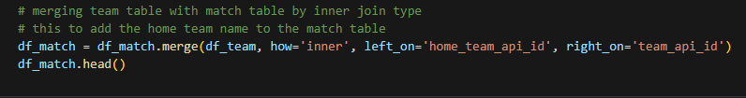
Feature Selection
Selecting Needed Features:
such as team attributes, and match results.
Combining Features :
Merges data from different files
into a single dataset.
Creating New Features:
Team performance metrics
Head-to-head performance

Slide 10
Modeling
Classification Problem with (Winner_encoded) Class
Data split to 80% for training & 20% for testing
Random Forest, Gradient Boosting, SVM, and Neural Network
Best Performance is SVM, with an accuracy of 49.8%

Slide 11
Performance Validation
Real Match Data
Real Capture Result
Dynamic Factor
Reliable
VS
Artificial Team Attributes
EA Sport’ FIFA
Aggregated Characteristics
Bais Data & unreliability

Slide 12
Deep Understanding Features
Most Important Features:
home_chanceCreationShooting
▪ home_buildUpPlayPassing
▪ away_defencePressure
▪ home_defenceAggression
Across Features
Models trained only on offensive features outperformed those with defensive features, achieving higher accuracy (~48% vs. ~42% on validation sets).

Slide 13
Thank you

