Slide 1
Investigating a Suspicious Email in Microsoft 365
Diagnostic Steps and Resolution Approach
Presented by: Muzammil Farooqui

Slide 2
Why investigating suspicious emails is critical to security.
Data breaches
Financial loss
Compromised accounts
Notes:
Email threats, such as phishing, can lead to data breaches, financial loss, and compromised accounts, When a customer reports a suspicious email received in their inbox, it's important to approach the situation with caution and take appropriate diagnostic and preventive measures.

Slide 3
Overview of tools and features available in Microsoft 365 for handling email threats.
Threat Explorer
Quarantine and Message Trace
Unified Audit Log: Track interactions like opening the email or clicking links.
Sign-in Audit Logs
Anti-Spam and Anti-Phishing Protection
Anti-Malware Protection
Threat Intelligence Reporting
Mail flow rules
Attack simulation training tool

Slide 4
Immediate Customer Response
Avoid Interaction: Do not click links, open attachments, or reply.
Report the Email: Use the built-in 'Report Phishing' or 'Report Junk' features in Outlook.
Notes:
When a customer reports suspicious email to IT , the IT response or my response should be to Advise the customer not to click on any links, download attachments, or respond to the suspicious email. And to report is a junk using the feature available in outlook

Slide 5
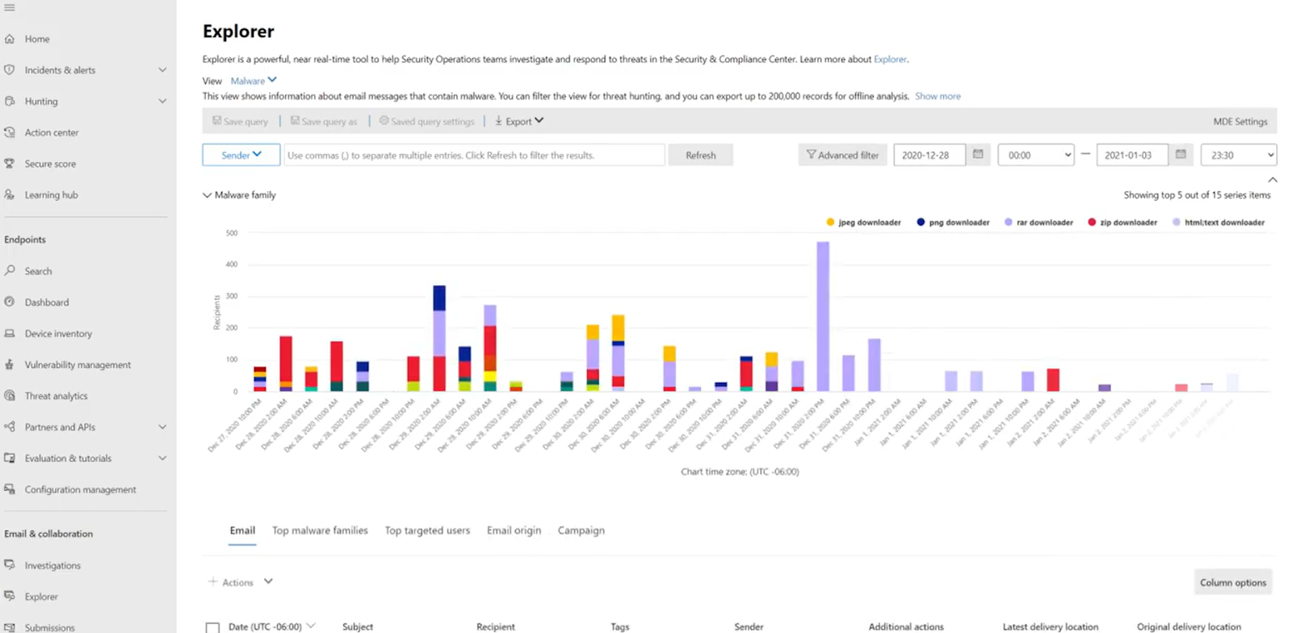
Investigating the Suspicious Email
Locate and analyse the email in Threat Explorer
Notes:
Windows defender >explorer

Slide 6
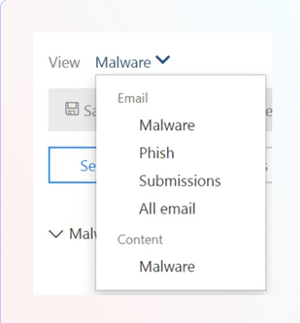
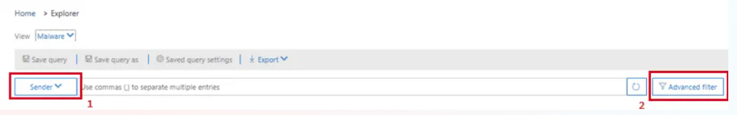
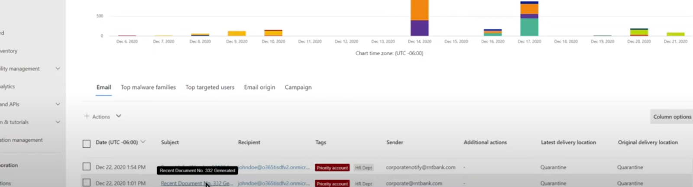

Slide 7
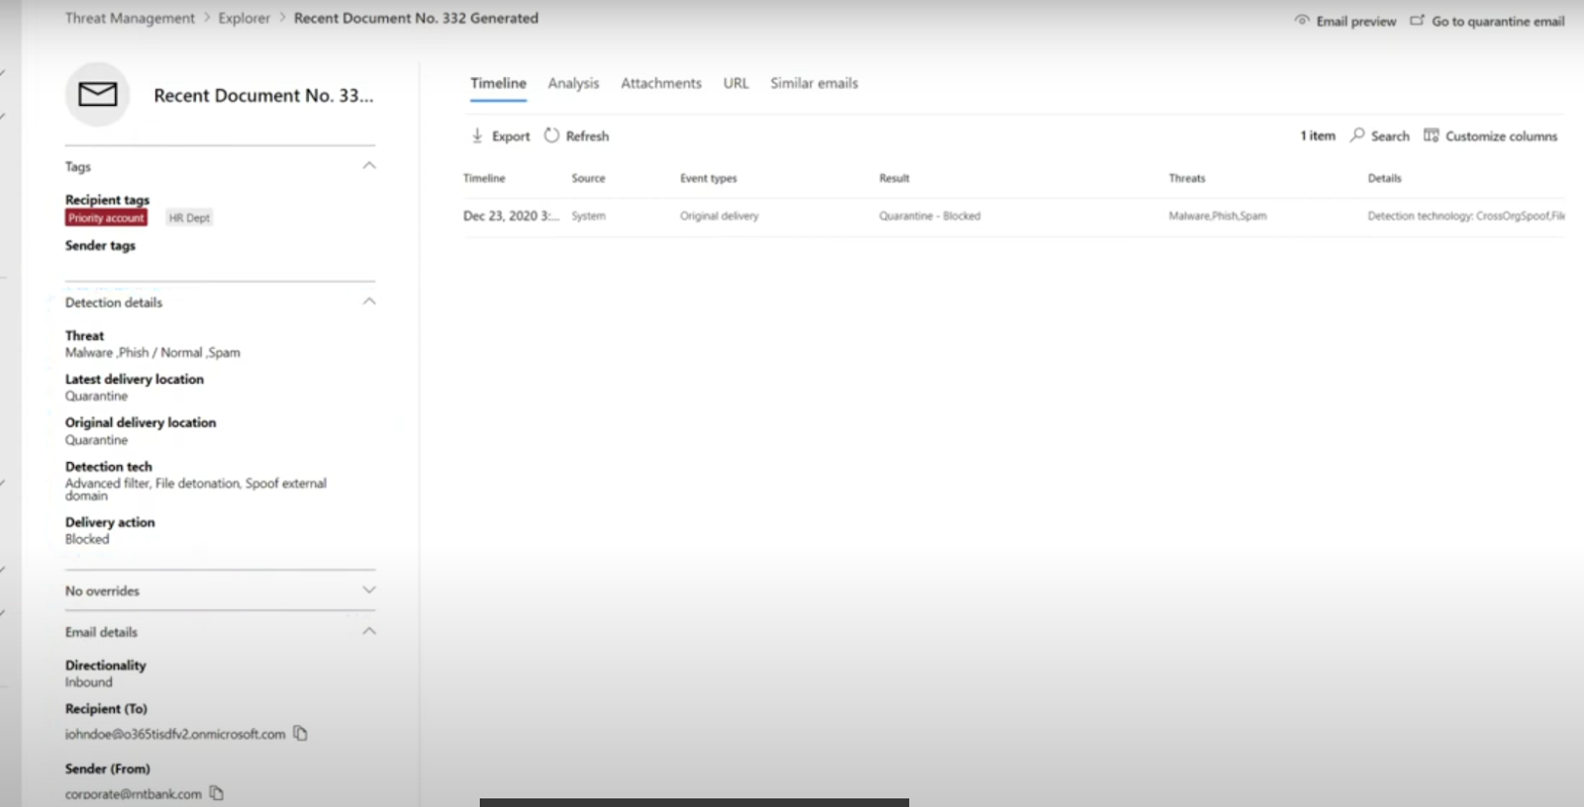

Slide 8
Investigate for Phishing and Malware
Header Analysis: Verify sender identity, return-path, and received domains for spoofing or other anomalies
01
Body Analysis: check if it contains malicious links or attachments.
02
verify the legitimacy of the email by checking for any discrepancies in SPF, DKIM, or DMARC authentication.
03
Review the detailed threat detection logs, which show whether any anti-phishing, anti-malware, or safe links policies were triggered.
04
Notes:
Header analyser:
senders email address
senders ip address
subject linne
reply to email if any
body

Slide 9
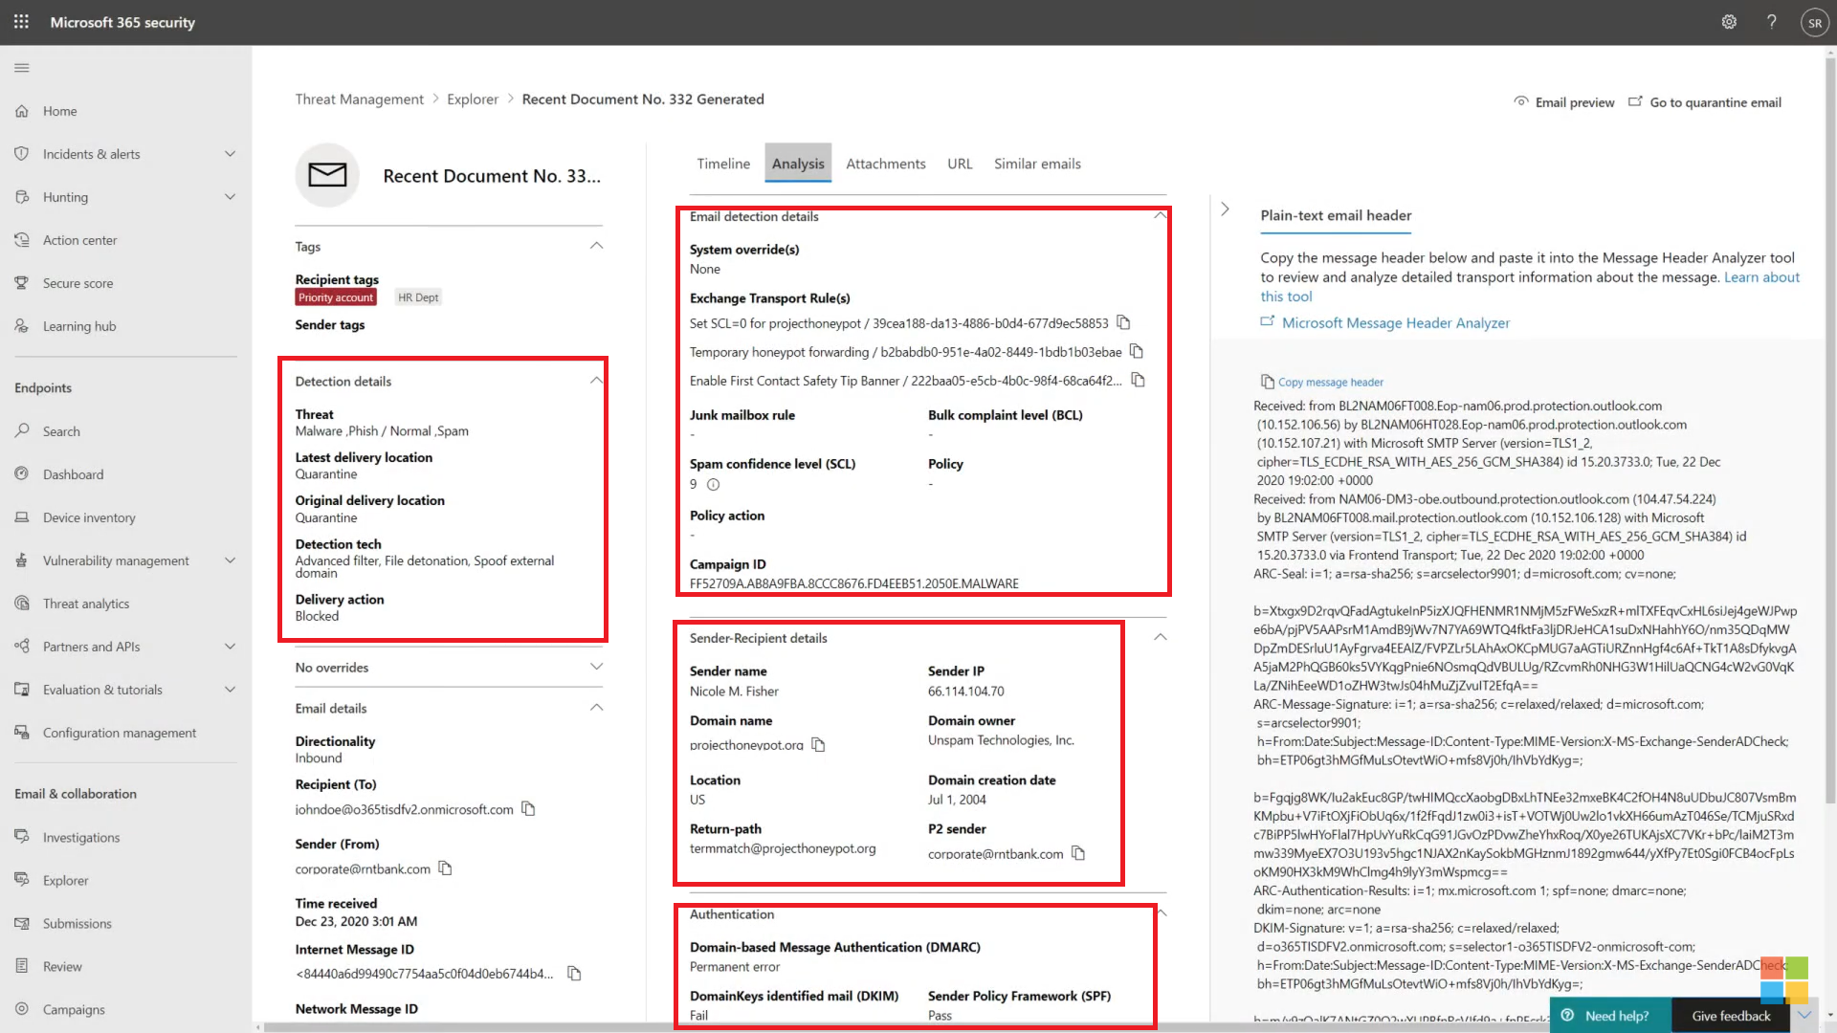

Slide 10
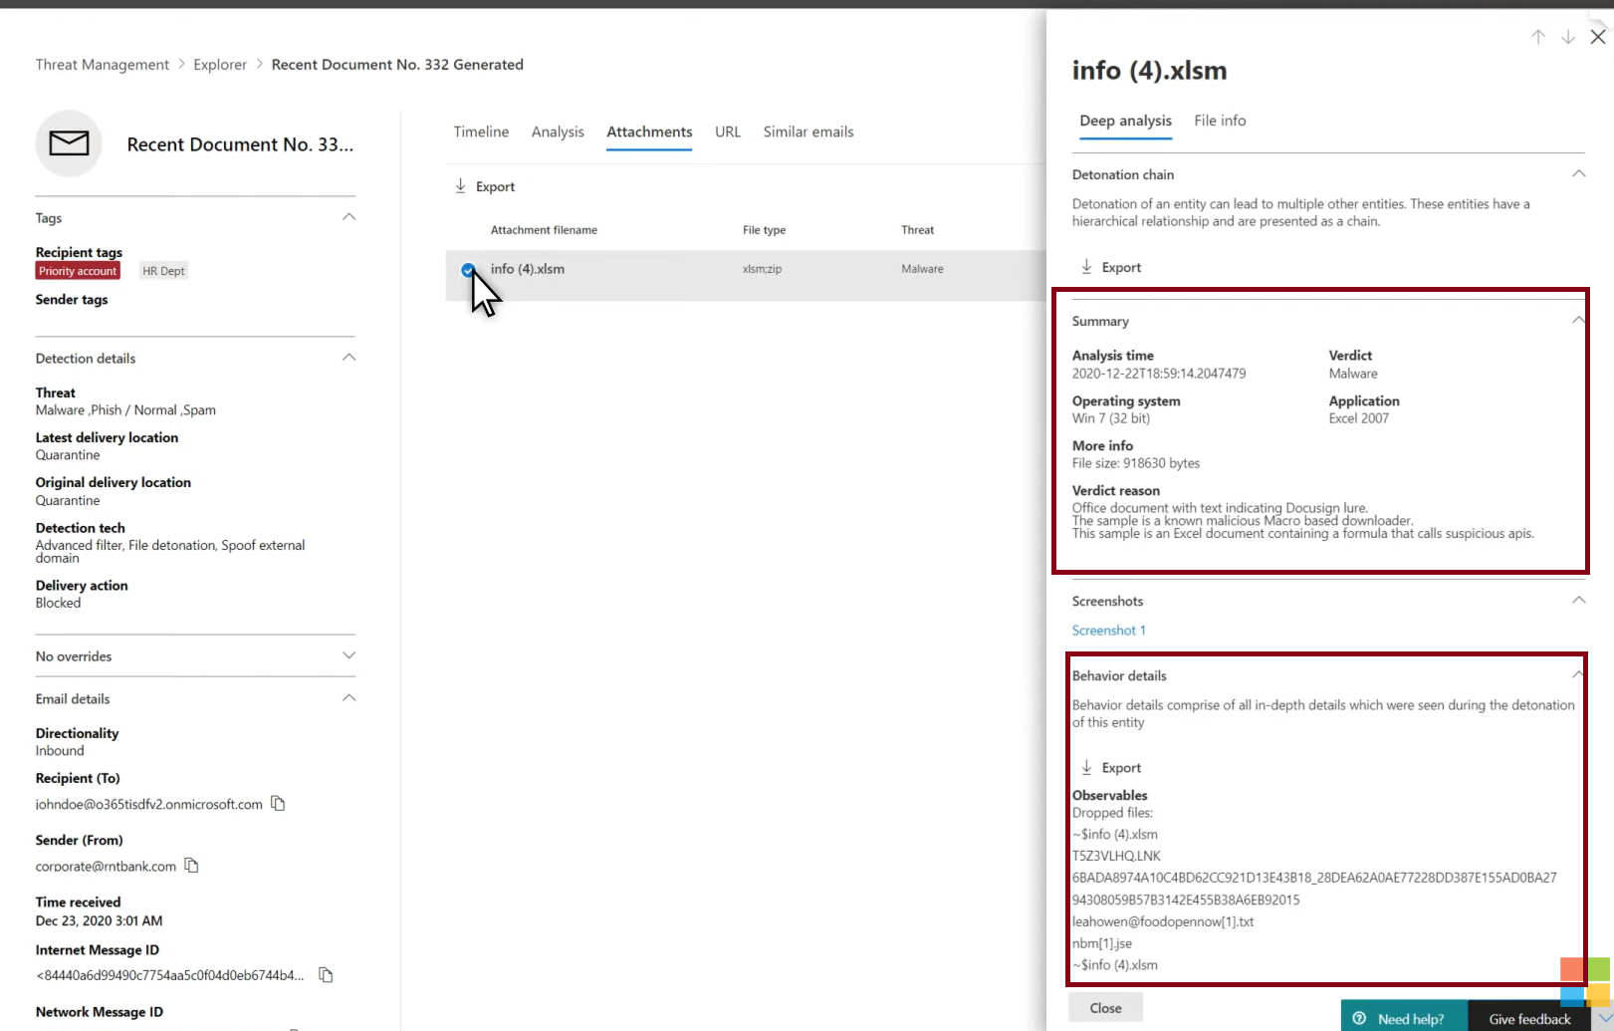
Notes:
It gives more details about the file which office365 found after detonation in a secure environment . It also calculates the hash of the file and compares it with the malicious files databases . It’s a unique string of number every file can have, and it is used to check the integrity of the file
Perform reverse lookup of the senders ip address to compare it with the domain
It also calculates the hash value of the files hash type md5 or sha256
check the file reputation using their hash type using thrid party tools available online like https://www.talosintelligence.com/talos_file_reputation , reversing labs

Slide 11
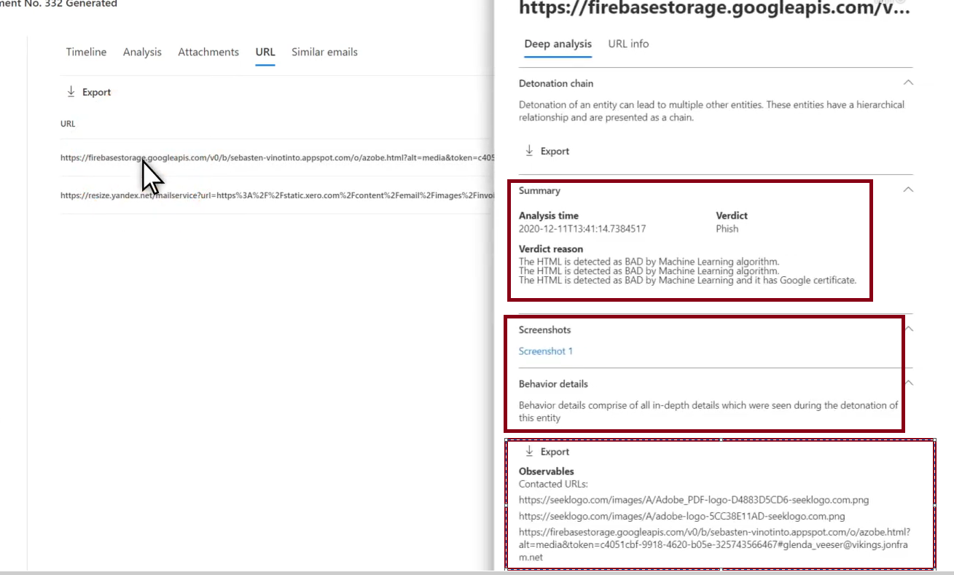
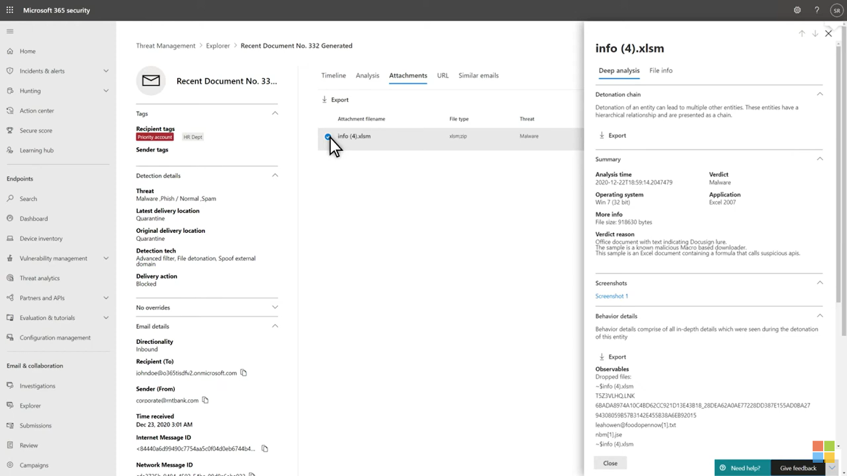
Notes:
Provide the indicators of compromise And the behaviour of the URL or attachment while detonating like the files dropped and ips it contacted
URL link if any shortner service were used

Slide 12
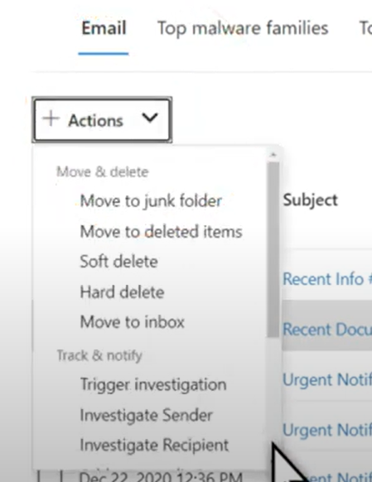
Isolate and remove email
Go to Threat Management > Review > Quarantine to block further delivery or access to the email across the organization.
Remove the Email: If the email is confirmed to be malicious, use the Threat Explorer or PowerShell to delete it from all user mailboxes.

Slide 13
Remediation steps
Check User Activity using the audit logs: Ensure the customer didn’t interact with the email.
Verify Impersonation or Compromise: Check if the user has been targeted for impersonation or if their account has suspicious login attempts (e.g., foreign IP logins) via (Azure AD) Sign-ins for this investigation.
Password Reset: If compromised, reset passwords and enable MFA.
Ensure any malicious files download onto the user machine is removed. Perform full device scan.

Slide 14
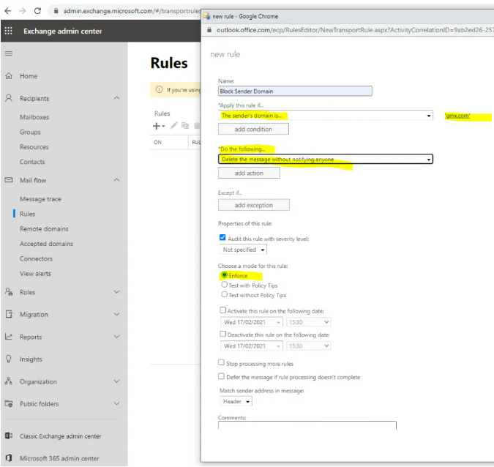
Prevent Future Incidents
Block Sender/Domain: Add malicious senders to the Blocked Senders List in Exchange Online Protection (EOP).

Slide 15
Prevent Future Incidents
Enable Anti-Phishing Policies: Safe Links, Safe Attachments, and Impersonation Protection.
Block the domain using tenant allow/block list in Defender portal
Enforce MFA for all users.
Review and update email authentication protocols SPF, DKIM, and DMARC settings for email authentication.
Regular phishing awareness and reporting processes training for the end users

Slide 16
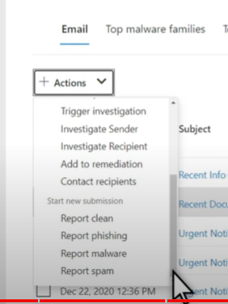
Report and Analyze Threats
Submit the Email to Microsoft for Analysis:
  If you're uncertain about the threat level of the email, submit the email to Microsoft for further analysis via the Threat Explorer.
Notes:
If the email is detected as false positive or false negative or if you’re uncertain about the threat level of the email. you can always submit the email to Microsoft for further investigation via threat explorer

Slide 17
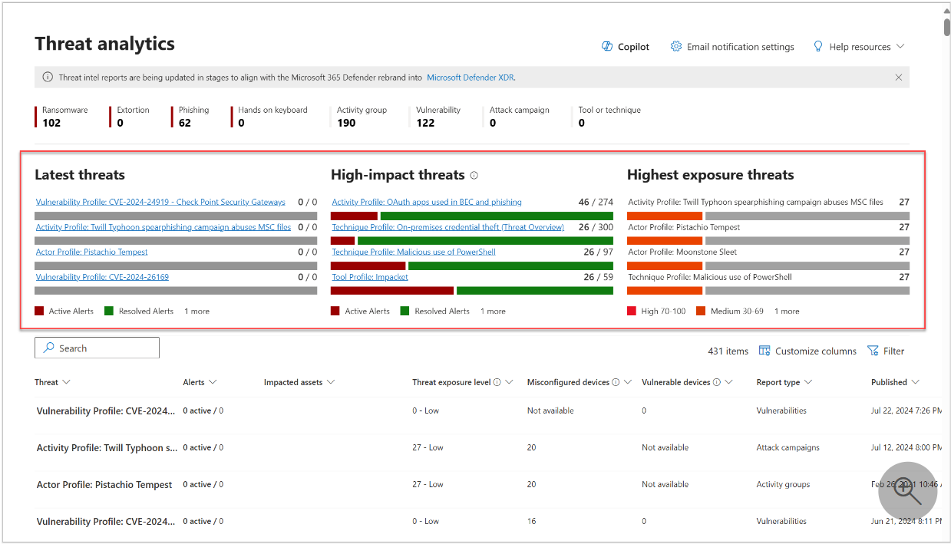
Threat Intelligence Reporting:
Use Threat Intelligence reports in Microsoft Defender to monitor any emerging threats or campaigns targeting the organization and take proactive steps to mitigate these risks.
Notes:
Latest threats—lists the most recently published or updated threat reports, along with the number of active and resolved alerts.
High-impact threats—lists the threats that have the highest impact to your organization. This section lists threats with the highest number of active and resolved alerts first.
Highest exposure threats—lists threats to which your organization has the highest exposure. Your exposure level to a threat is calculated using two pieces of information: how severe the vulnerabilities associated with the threat are, and how many devices in your organization could be exploited by those vulnerabilities.

Slide 18
Conclusion
By following these steps, you'll be able to efficiently investigate, diagnose, and remediate the suspicious email issue using the security features available in Microsoft 365

Slide 19
Email Message Trace
Track the journey of the email, including delivery details, spam filters, and any threat detection policies that were applied.
Check whether the email bypassed filtering due to allowlists or custom rules.
Check Blocklists/Allowlists: Verify if the email came from an address or domain that is on a blocklist or allowlist in your organization.
Notes:
Additional tools available for diagnostics and analysis

Slide 20
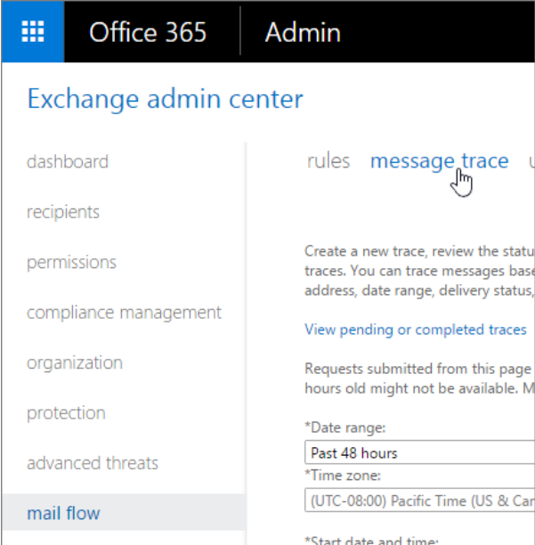

Slide 21
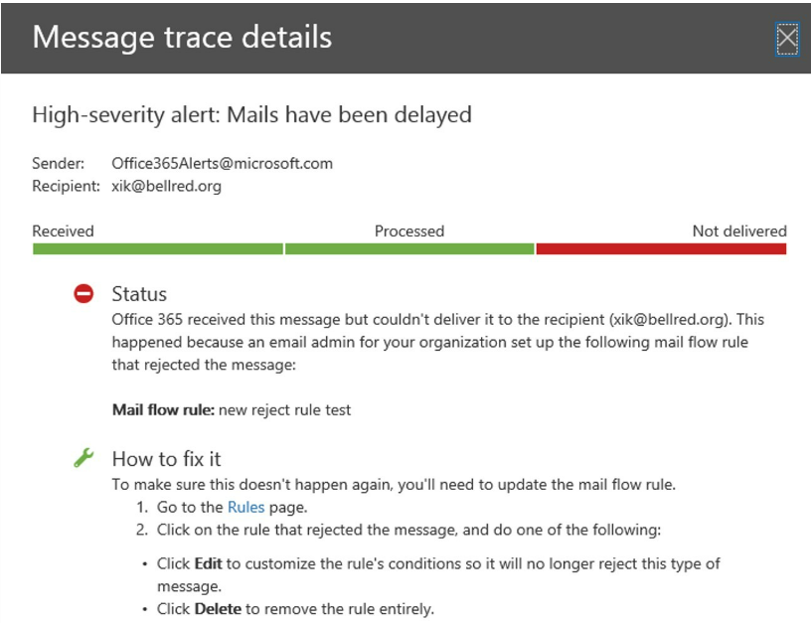

Slide 22
Review quarantine and release
If the reported email was quarantined, admins can review it by going to: Microsoft 365 Defender portal → Email & Collaboration → Review → Quarantine.
Admins can release, delete, or block the email directly from this interface.

