Slide 1
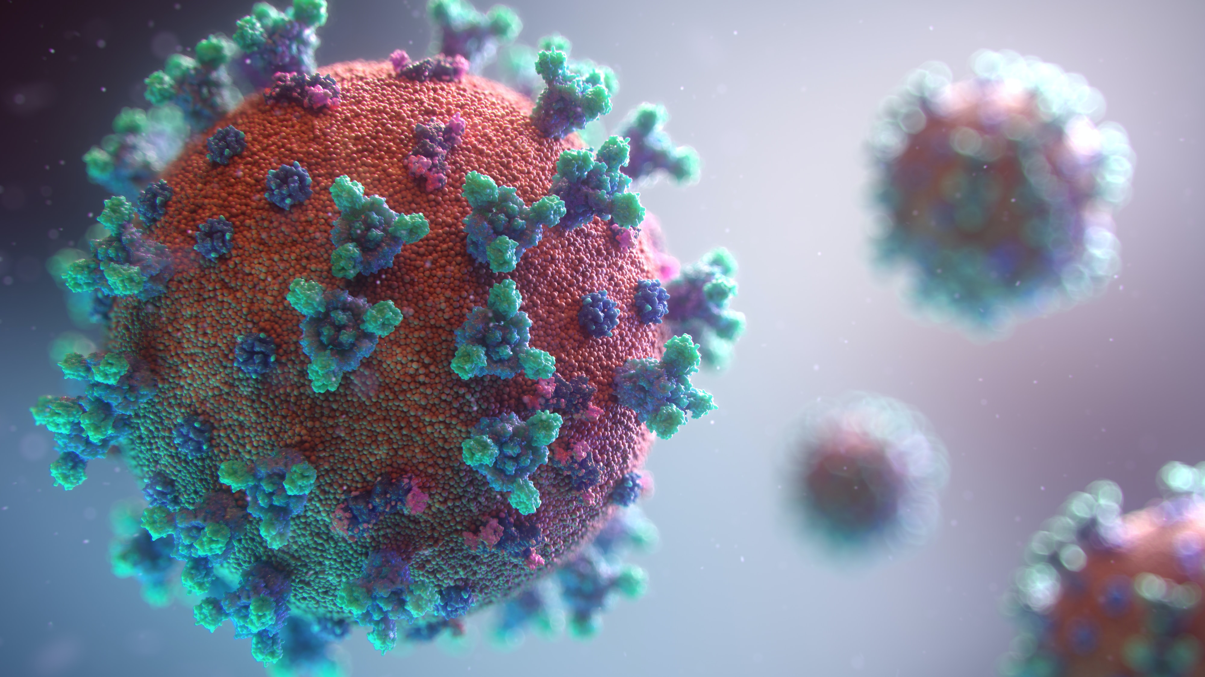
What is covid?
Covid- 19 is the infection disease caused by the most recently discovered coronavirus
This new virus and disease were unknown before the outbreak began in Wuhan,China,in December 2019
COVID -19 is now a pandemic affecting many countries globally

Slide 2

Origin of the virus
The source is most likely a virus spillover from an intermediary animal host into human populations
The first known human case had onset of symptoms from 1st December and has not been linked to the suspected market in Wuhan, China. Cases may have occurred as far back as mid-November or earlier
The market could be the origin of the virus or played a role as an amplifying setting for the initial spread

Slide 3
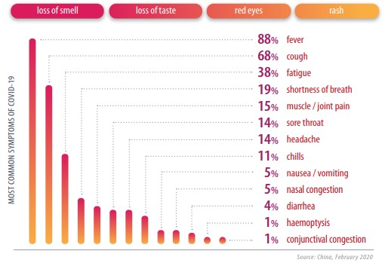
symptoms

Slide 4
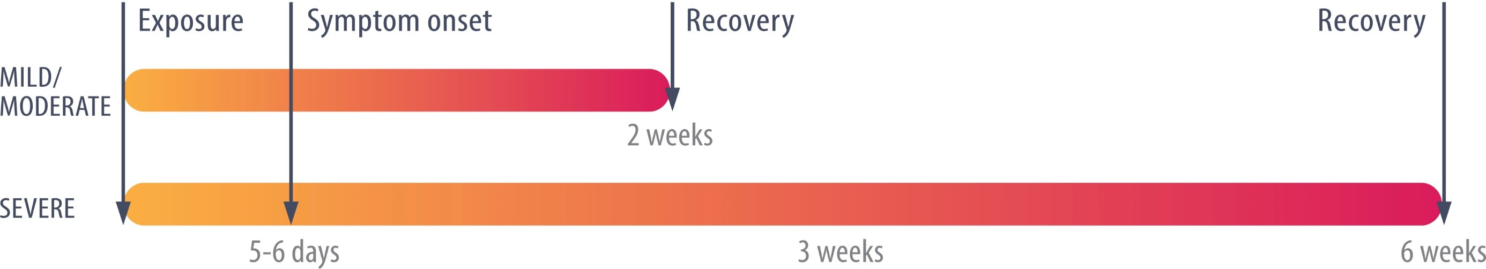
Transmission
COVID-19 is spread primarily from person to person through small droplets from the nose or mouth, expelled when a person with COVID19 coughs or sneezes. People can catch COVID-19 if they breathe in these droplets, or by touching objects or surfaces where the droplets have landed, then their face
The time between infection and first symptoms (incubation period) ranges from 1 to 14 days, with an average of 5 to 6 days. More than 97% of people experience symptoms within 14 days

Slide 5
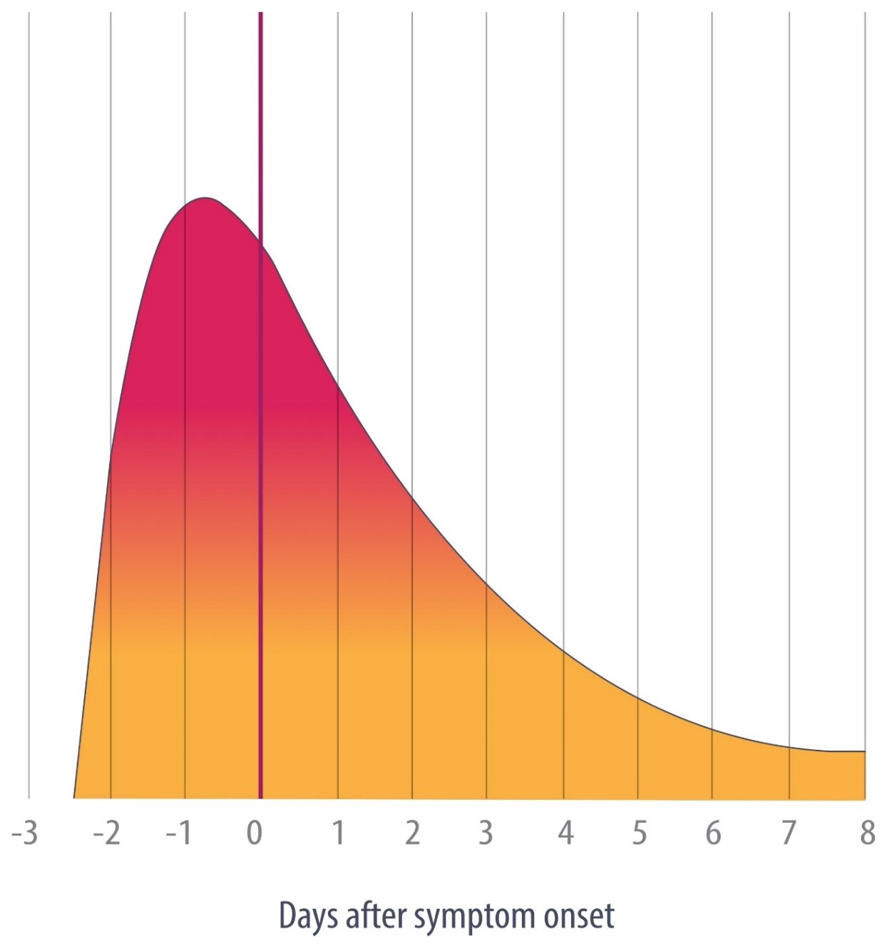
Transmission
Active viral replication occurs in the Viral Shedding upper respiratory tract and lungs. Early studies indicate that the virus replicates in the gastrointestinal tract but faecal oral transmission has not been confirmed
Pre-symptomatic transmission is likely to occur. However, the absence of a cough (a key mechanism for viral expulsion) may limit transmission

Slide 6











Supper-spreading events
Super-spreading events occur with a single person transmits the virus to an unusually large number of people. Aggravating situations that may contribute to a super-spreading event include
Mass-gatherings
Ageing population
Displaced populations
International exposure
Density of urban areas
Lack of government transparency
Lack of press freedom

Slide 7
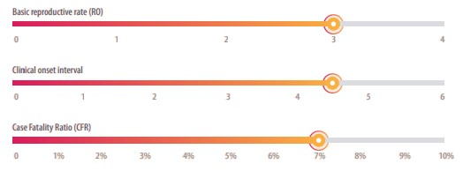
Disease specifications: reproductive rate, severity
Basic Reproductive Rate (R0) is the average number of people infected by one person in a susceptible population. R0 for COVID-19 is estimated to be between 2 and 4
Clinical Onset Interval is the time between onset of symptoms in successive cases in a chain of transmission. In most studies, the average time is between 4 and 5 days
Case Fatality Ratio (CFR) is the proportion of episodes of illness that are fatal. The global crude CFR is 7% (Dec 2019-May 2020)

Slide 8
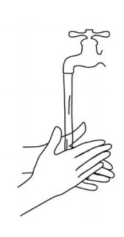
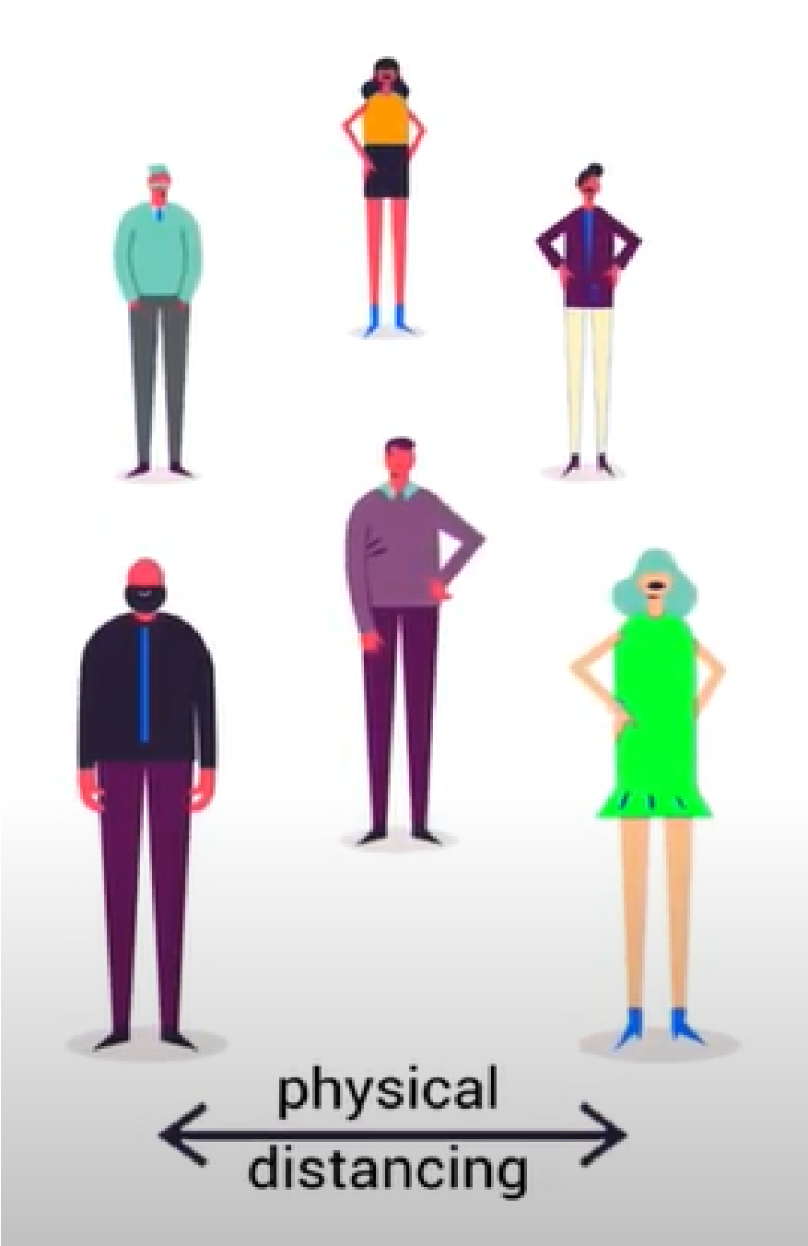
Personal- Measures
Hand and respiratory hygiene is important at ALL times and is the best way to protect yourself and others
When possible maintain at least 1 meter distance between yourself and others. Some infected persons may not be exhibiting symptoms or their symptoms may be mild so maintaining a physical distance with everyone is important if you are in an area where COVID-19 is circulating

Slide 9
Public Health Measures
Quarantine means restricting activities or separating people who are not ill but may have been exposed to COVID-19. The goal is to prevent the spread of disease if or when people develop symptoms [5] Isolation means separating people who are ill with symptoms of COVID-19 and may be infectious to prevent the spread of the disease. Physical distancing means being physically apart. WHO recommends keeping at least 1-metre distance from others. This is a general measure that everyone should take even if they are well.

Slide 10
Social and economic impact
The COVID-19 pandemic and the associated economic crisis poses huge global and local challenges
The health, social and economic impact has affected all segments of the population but is particularly detrimental to social groups in vulnerable situations including; people living in poverty, older persons, persons with disabilities, youth, and indigenous peoples
The global crises requires coordination, solidarity, and effective socio-economic and public health policy

Slide 11
