Slide 1

CAISA: Voice based AI client for
Therapist Training
For AI Software Engineer KTP position at the School of Computing at University of Ulster and Pneuma Healthcare Ltd
By Muzammil Tariq

Slide 2
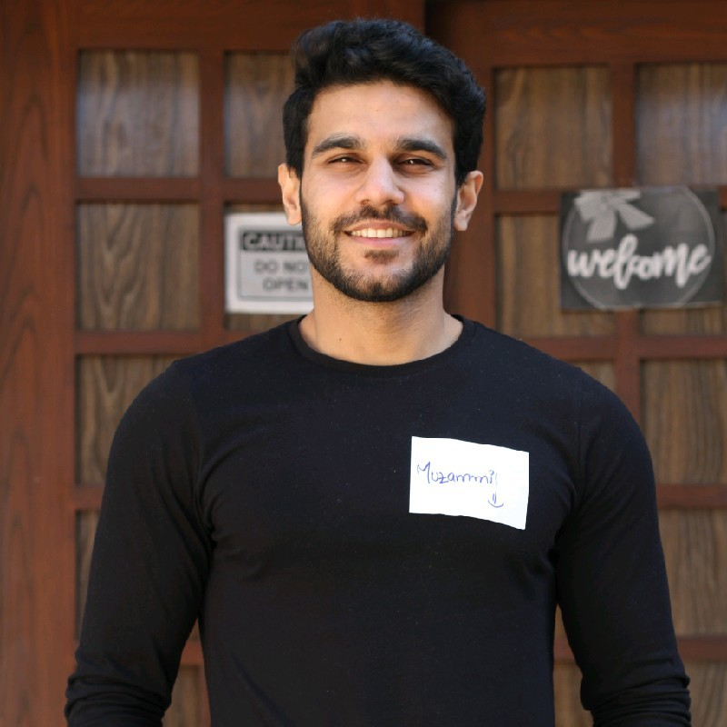
About me
A Data Scientist and Machine Learning Engineer with over 4 years of experience.
Worked with Generative AI, Agentic AI, LLMs, Machine Learning models, and Software development.
I excel in cross collaborative teams where I translate data into meaningful products
Excited to bridge the gap between research and scalable products.

Slide 3

About Pneuma Healthcare Limited
Founded by Ulster University’s Dr. Colin Gorman
Provides advanced public and private Psychological Wellbeing Practitioners (PWPs) service.
Tackling UK-wide NHS waiting list for mental health services, working with Greater Manchester Health trust
Offers shorter waiting times through different mediums.

Slide 4
Technical Task Overview
The development of CAISA – an AI powered training platform to support mental health practitioners through realistic, voice-based simulated therapy sessions.
The goal of CAISA is provide hands-on practice through realistic voice-driven role-play, not clinical care.

Slide 5
What users need (therapists and supervisors)
Realistic practice: a natural client voice & affect; short turn talking.
Safety: No clinical advice from AI; crisis reduction
Privacy: no PHI retention by default
Feedback: quick signals on empathy, specificity, risk
Low friction: click → speak → hear reply

Slide 6
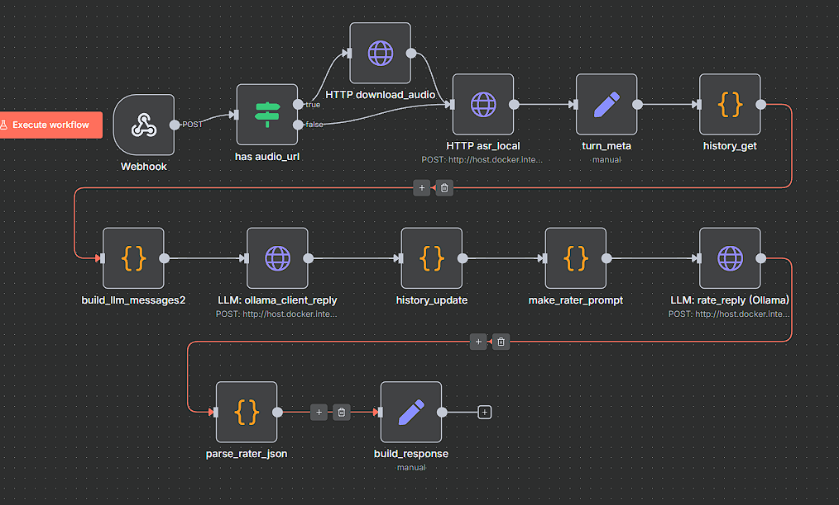
End to end flow

Slide 7
CAISA
Persona bound system prompt that plays the role of the client only
Short rolling memory
(6-10 turns)
Post reply metrics: empathy/specificity/risk

Slide 8
Core Architecture
Speech input and transcription:
Using whisper (OpenAI model) to turn therapist voice input to text for LLM.
FastAPI:
Multi-user concurrency, streaming input directly to model.
Data warehouse:
Store therapist client chats and responses (databricks lakehouse, Postgres)
LangChain (LLM):
RAG based centrepiece of the whole software. Takes in data from therapist, gives output as client (GPT-4, Deepseek).

Slide 9
Challenges and Limitations
ASR robustness:
Accents, cross talk, mic quality, background noise, code-switching, clinical jargons.
Possible solutions: VAD/denoise, fallback ASR, allow quick text override
Streaming latency:
Live turns need 300-800ms delay, LLM context windows add lag.
Possible solutions: Streaming ASR/TTS + small fast LLM path
Hallucinations and Safety drift:
LLM may invent facts, give advice beyond a client role, wander into unsafe territory
Possible solutions: Hard system rules, post-gen filter, crisis templates
Privacy and compliance:
Voice + text can be identifying: logs, backups.
Possible solutions: Encryption, on device/in- region recording, short retention

Slide 10
Challenges and Limitations
Evaluation Reliability:
Self rating can be gamed or inconsistent, empathy and specificity are subjective for each model
Possible solutions: Hybrid rater (rules + small LM + human regular checks)
Bias and representativeness:
Stereotyped personas or uneven behaviour across cultures and dialects.
Possible solutions: Diverse scenario sets; bias eval suit, targeted fine tune
Context scaling and memory drift:
Long sessions exceed context; summaries may lose their nuance
Possible solutions: structured state + retrieval over notes
Cost and scalability:
Per session compute cost spike with concurrency
Possible solutions: Tiered models, quantization, caching

Slide 11
Evaluation Experiments
Design:
  Pre/post fine-turn (or LoRA) on therapist client chat history, randomized A/B prompts vs fine-tuned model using identical scenarios
Measures:
  Human rubric (for empathy)
  Model assisted rater
  Behavioral: response length variance, context carryover rate, refusal rate on risky prompts
Stats:
  Paired t-test or Wilcoxon on per scenario empathy; report the effect size.
Monitoring over time:
  Rolling weekly dashboards, empathy means, risk flag rates, alert and notify drift offs.

