Slide 1
TEXT ANALYTICS
PROJECT
GROUP 11
PAKISTAN VS INDIA CRICKET MATCH TWEETS ANALYSIS

Slide 2
TEAM
Muzammil Raza Soomro
Muhammad Adnan
Thaharim Khan
DS & BI Student with background of Computer Science
DS & BI Student with background of Computer Science
DS & BI Student with background of Computer Science
Muhammad Shayan
DS & BI Student with background of Computer Science

Slide 3
Contribution from members
Muzammil Raza Soomro
Data Collection
Data Cleaning
Thaharim Khan
Labeling data
Sentiment analysis
Muhammad Adnan
Model Training
Model Testing
Muhammad Shayan
Manual labeling for model validation
Tested manually collected data for validation

Slide 4
Challenges
Sarcasm Detection
Domain dependence
Identifying text's subjective elements
Entity Recognition
Internationalization

Slide 5
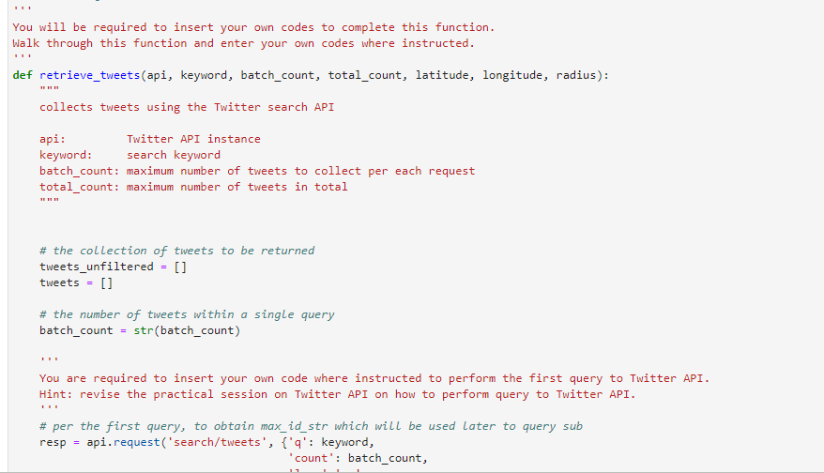
Data collection

Slide 6
Data understanding and preparation

Slide 7
Statistics of Collected Dataset
Using Twitter API
Total Tweets Collected:272270
Unique Tweets: 260884
Duplicate Tweets: 11386
Users: 143879
Hashtags used: #PAKvsIndia, INDvPAK, #INDvsPAK2022
Date Range: 2022-10-18 to 2022-10-24
Language Classified By Twitter: 54

Slide 8
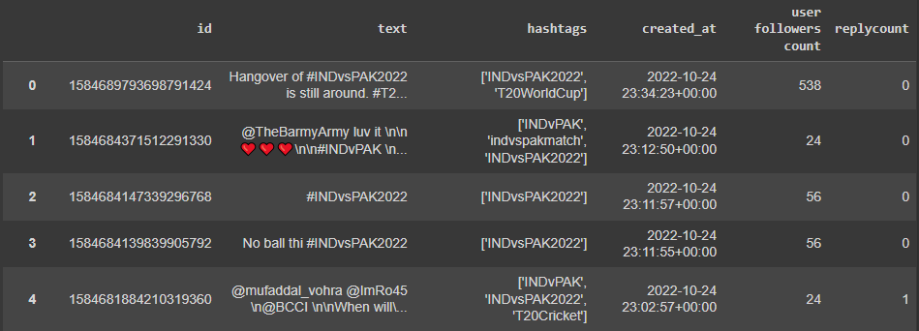
Snapshot of Dataset

Slide 9
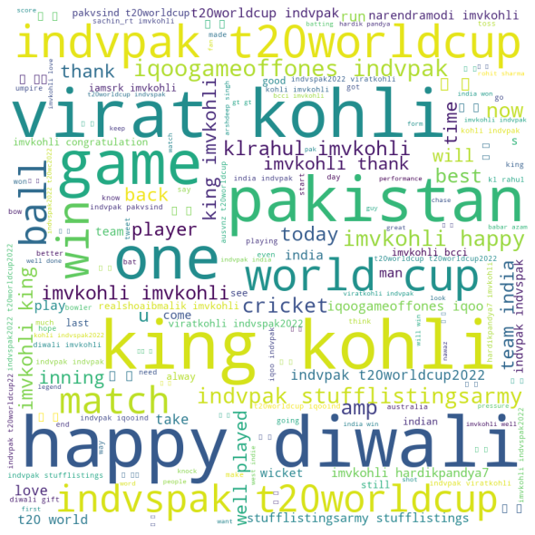
Word CLOUD

Slide 10
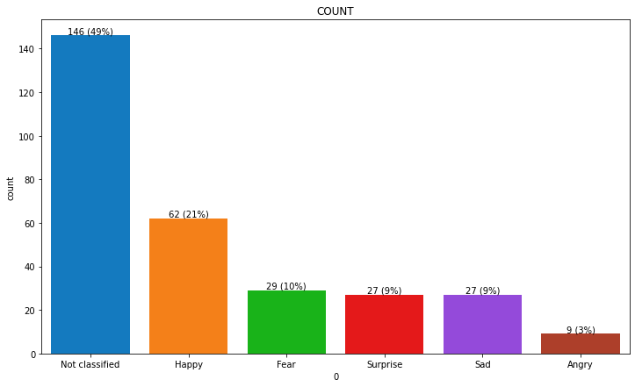
AUTO-LABELLING ON SAMPLE (WITHOUT CLEANING)

Slide 11
Data Cleaning

Slide 12
Steps of Data cleaning
Remove the duplicate tweets from our dataset the amount of duplicate tweet on our dataset is around 11386 so that we can work on remaining 260884 data to avoid redundancy.
we have removed stop words.
we have removed html tags from the text and
We have removed URLs as well.
remove character references from the text
remove repeated characters in elongated words

Slide 13
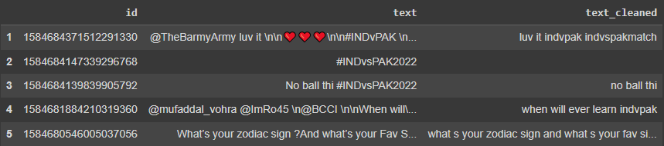
Cleaned data

Slide 14
Auto labeling

Slide 15
Emotion labeling
We used in our project Text2emotion python package for labeling our dataset. get_emotion () function is used here for doing this process after that we export it for getting all labeled data in an Excel file an.

Slide 16
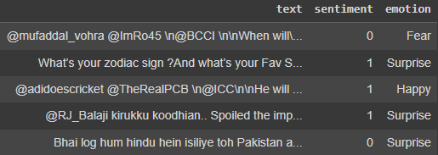
Labeled dataset

Slide 17
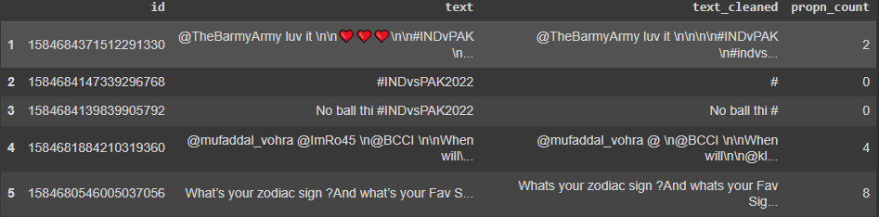
Sentiment Intensity Analyzer using NLTK
NLTK helps the computer to analysis, preprocess, and understand the written text. After applying NLTK we define a function using NTLK that returns the number of proper nouns in a string below figure showing the noun count. then create a new feature for the number of proper nouns in each tweet after that we have checked the result.

Slide 18
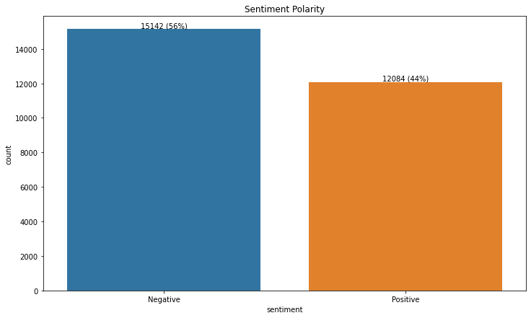
Polarity
Analyzing sentiment without context gets difficult as machines cannot learn about contexts if it is not trained explicitly. The most crucial disadvantage that arises from context is changing in polarity. So, we have checked the SentimentIntensityAnalyzer with polarity score which is most important while using the SentimentIntensityAnalyzer.

Slide 19
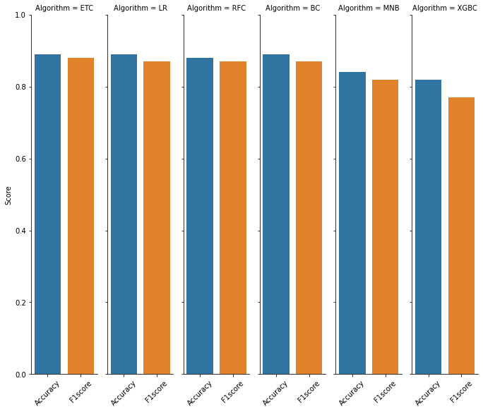
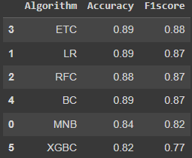
Machine Learning for Evaluation

Slide 20
best model among top three
Voting Classifier
Accuracy | F1 score
0.8868894601542416 | 0.8752025931928686
Stacking Classifier
Accuracy | F1 score
0.8868894601542416 | 0.8752025931928686

Slide 21
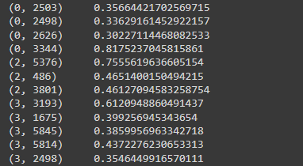
Vectorization
After going for further procedure, we have used the cleaned text for vectorization. While managing the vectorization we have used tf-idf vectorization the main task of this vectorization is converting text data to numerical vectors

Slide 22
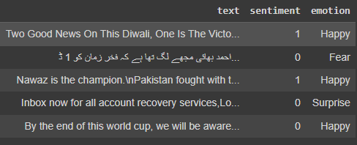
Validation of the model
As we have worked on pretrained model with our dataset. So that for validating it we have chosen the way of validating it with some labelling data. we have taken the labelled data by our own for checking the accuracy of our model.

Slide 23
Accuracy score for the validated model
Accuracy | F1 score
0.8948374760994264 | 0.8801742919389979

Slide 24
Conclusion
The age of getting meaningful insights from social media data has now arrived with the advance in technology. It’s time for organizations to move beyond overall sentiment and count based metrics. Companies have been leveraging the power of data lately, but to get the deepest of the information, one has to leverage the power of AI, Deep learning and intelligent classifiers like Contextual Semantic Search and sentiment analysis.

Slide 25
QUESTIONS?

