Slide 1
Optical Components of Sensors
Presented by: Muhammad Umar Zeshan
Student ID: 6217000118

Slide 2
Optical components
Light phenomena such as reflection, refraction, absorption, interference, polarization, and speed are the powerful utensils in a sensor designer’s toolbox. Optical components help to manipulate light in many ways. The same phenomenon used in optical components of sensors.

Slide 3
Optical Components
Radiometry
Photometry
Windows
Mirrors
Lenses
Fresnel Lenses
Fiber Optics and Waveguides
Concentrators
Coatings for thermal absorption
Nano Optics

Slide 4
Radiometry
Radiometry is a set of techniques for measuring electromagnetic radiation, including visible light. Radiometric techniques in optics characterize the distribution of the radiation's power in space, as opposed to photometric techniques, which characterize the light's interaction with the human eye. Radiometry is distinct from quantum techniques such as photon counting.
The use of radiometers to determine the temperature of objects and gasses by measuring radiation flux is called pyrometry. Handheld pyrometer devices are often marketed as infrared thermometers.
Radiometry is important in astronomy especially radio astronomy, and plays a significant role in Earth remote sensing.

Slide 5
Photometry
Photometry is the science of the measurement of light, in terms of its perceived brightness to the human eye. It is distinct from radiometry, which is the science of measurement of radiant energy(including light) in terms of absolute power. In modern photometry, the radiant power at each wavelength is weighted by luminosity function that models human brightness sensitivity. Typically, this weighting function is the photopic sensitivity function, although the scotopic function or other functions may also be applied in the same way.

Slide 6
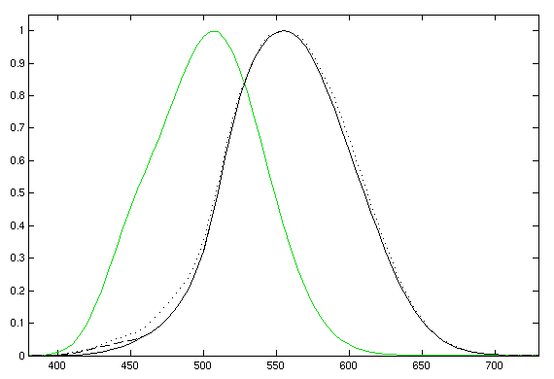
Photometry

Slide 7
Windows
In optics, it means a (usually at least mechanically flat, sometimes optically flat, depending on resolution requirements) piece of transparent (for a wavelength range of interest, not necessarily for visible light) optical material that allows light into an optical instrument. A window is usually parallel and is likely to be anti reflection coated, at least if it is designed for visible light. An optical window may be built into a piece of equipment (such as a vacuum chamber) to allow optical instruments to view inside that equipment.

Slide 8
Mirrors
A mirror is an object that reflects light in such a way that, for incident light in some range of wavelengths, the reflected light preserves many or most of the detailed physical characteristics of the original light, called specular reflection. This is different from other light-reflecting objects that do not preserve much of the original wave signal other than color and diffuse reflected light, such as flat-white paint.
The most familiar type of mirror is the plane mirror, which has a flat surface. Curved mirrors are also used, to produce magnified or diminished images or focus light or simply distort the reflected image.

Slide 9
Lenses
A lens is a transmissive optical device that focuses or disperses a light beam by means of refraction. A simple lens consists of a single piece of transparent material, while a compound lens consists of several simple lenses (elements), usually arranged along a common axis. Lenses are made from materials such as glass or plastic, and are ground and polished or moulded to a desired shape. A lens can focus light to form an image, unlike a prism, which refracts light without focusing.

Slide 10
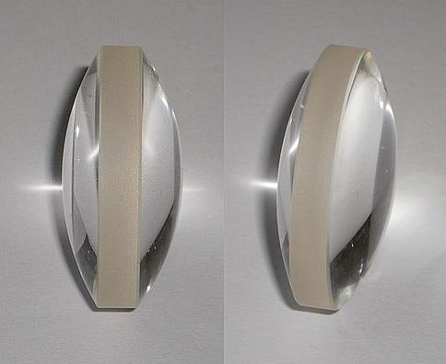
A bioconvex lens

Slide 11
Fresnel Lens
Fresnel lens is a type of compact lens originally developed by French scientist Augustin-Jean Fresnel for lighthouses. The design allows the construction of lenses of large aperture and short focal length without the mass and volume of material that would be required by a lens of conventional design. A Fresnel lens can be made much thinner than a comparable conventional lens, in some cases taking the form of a flat sheet. A Fresnel lens can capture more oblique light from a light source, thus allowing the light from a lighthouse equipped with one to be visible over greater distances.

Slide 12
Fiber Optics and Waveguides
An optical waveguide is a physical structure that guides electromagnetic waves in the optical spectrum. Common types of optical waveguides include optical fiber and rectangular waveguides.
Optical waveguides are used as components in integrated optical circuits or as the transmission medium in local and long haul optical communication systems.
Optical waveguides can be classified according to their geometry (planar, strip, or fiber waveguides), mode structure (single-mode, multi-mode), refractive index distribution (step or gradient index) and material (glass, polymer etc.)

Slide 13
Concentrators
In fiber-optic distribution systems which offer triple-play services (voice, television, internet) the digitization has arrived at the customer premises and signals are digitized at the source and combined using customer edge routers. This traffic enters the distribution network at an Optical Network Termination and is carried to the central office using Wavelength division multiplexing and Passive optical networking.

Slide 14
Nano Optics
Nano-optics deals with the interaction of light with particles or substances, at deeply subwavelength scales. Nano-structure-based optics, or nano-optics, is a class of optical devices based on finely patterned materials with critical dimensions several times smaller than the wavelength of light at which they are applied.

Slide 15
Thank You

