Slide 1
TÜRKİYE BİLİŞİM DERNEĞİ 2. BİLİŞİM YAZ KAMPI
JAVA KURSU
1-GİRİŞ
Mustafa Şenel
Ankara, 2018

Slide 2
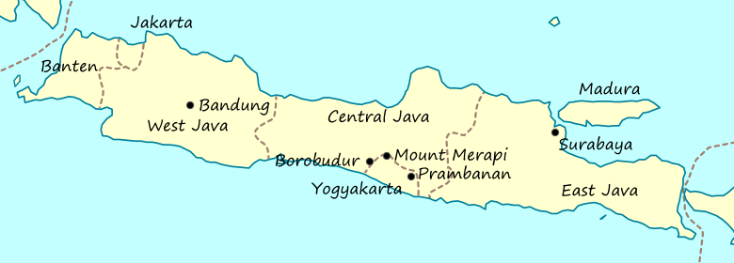

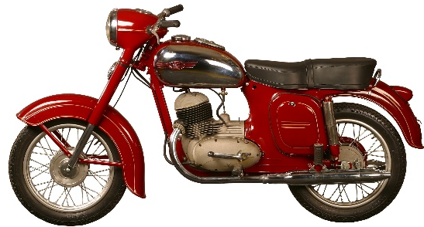
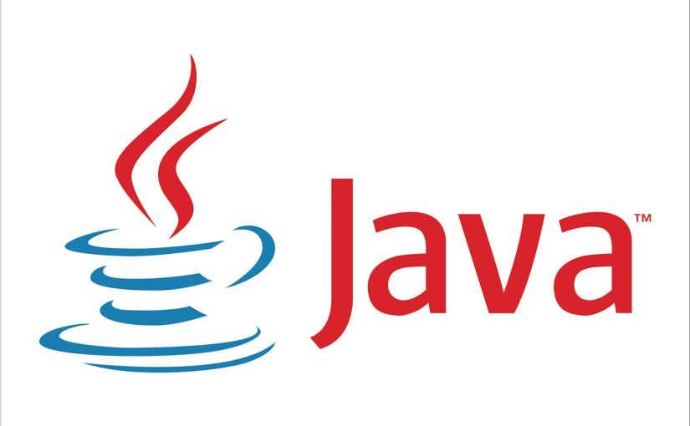
JAVA deyince aklınıza ne geliyor?
JAVA ADASI
JAVA KAHVESİ
JAWA MOTORSİKLET
JAVA PROGRAMLAMA DİLİ

Slide 3
Java Nedir?
Java is a programming language and computing platform first released by Sun Microsystems in 1995. ¹
James Gosling
Java ME, Java SE, Java EE
Write Once –like a man-, Run Anywhere. (WORA)
¹: java.com

Slide 4
The Java Programming Language is
Simple Object oriented Distributed Multithreaded Dynamic | Architecture neutral Portable High performance Robust Secure

Slide 5
The Java Programming Language is
Simple Object oriented Distributed Multithreaded Dynamic | Architecture neutral Portable High performance Robust Secure

Slide 6
The Java Programming Language is
Simple Object oriented Distributed Multithreaded Dynamic | Architecture neutral Portable High performance Robust Secure

Slide 7
The Java Programming Language is
Simple Object oriented Distributed Multithreaded Dynamic | Architecture neutral Portable High performance Robust Secure

Slide 8
The Java Programming Language is
Simple Object oriented Distributed Multithreaded Dynamic | Architecture neutral Portable High performance Robust Secure

Slide 9
The Java Programming Language is
Simple Object oriented Distributed Multithreaded Dynamic | Architecture neutral Portable High performance Robust Secure

Slide 10
The Java Programming Language is
Simple Object oriented Distributed Multithreaded Dynamic | Architecture neutral Portable High performance Robust Secure

Slide 11
The Java Programming Language is
Simple Object oriented Distributed Multithreaded Dynamic | Architecture neutral Portable High performance Robust Secure

Slide 12
The Java Programming Language is
Simple Object oriented Distributed Multithreaded Dynamic | Architecture neutral Portable High performance Robust Secure

Slide 13
The Java Programming Language is
Simple Object oriented Distributed Multithreaded Dynamic | Architecture neutral Portable High performance Robust Secure

Slide 14
The Java Programming Language is
Simple Object oriented Distributed Multithreaded Dynamic | Architecture neutral Portable High performance Robust Secure

Slide 15
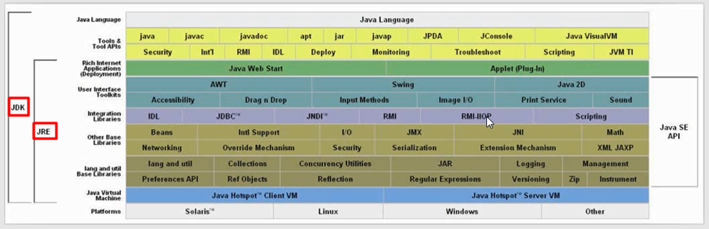
Java Platformu

Slide 16
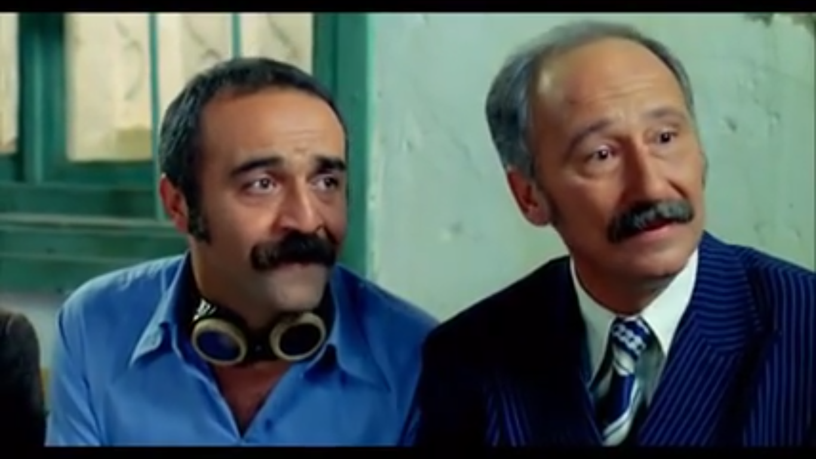
«Demek bir de kütüphanemiz olsa…»

Slide 17
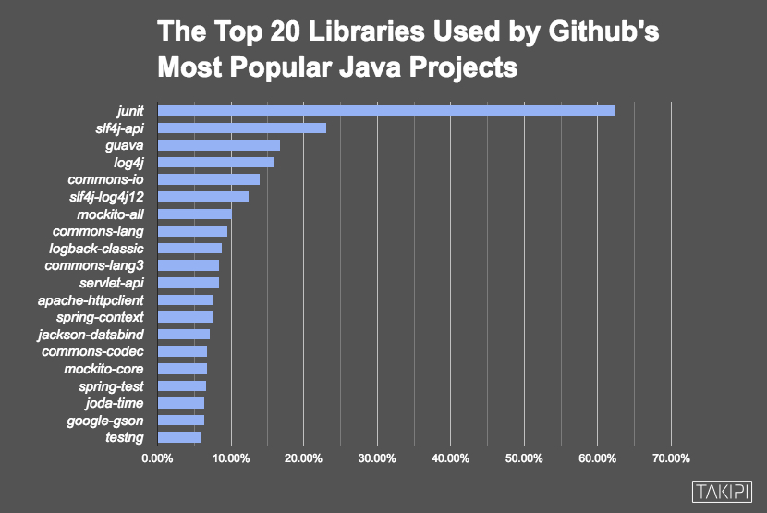

Slide 18
Java Editions
Java ME (Java Micro Edition)
Mobil uygulamalar geliştirmek için kullanılan Java sürümü.
Java SE (Java Standart Edition)
Temel Java programlama platformudur. İçinde birçok temel kütüphaneyi barındırır.
Java EE (Java Enterprise Edition)
Kurumsal ve web uygulamaları geliştirilmek için kullanılan platformdur. Java SE üzerine kuruludur ve içinde Servlet, JSP, JSF, EJB, JPA gibi teknolojileri barındırır.
JavaFx
Kullanıcı arayüzü barındıran uygulamalar geliştirmek için kullanılır.

