Slide 1
TÜRKİYE BİLİŞİM DERNEĞİ 2. BİLİŞİM YAZ KAMPI
JAVA KURSU
2-GELİŞTİRME ORTAMININ KURULMASI VE İLK PROGRAMIMIZ
Mustafa Şenel
Ankara, 2018

Slide 2
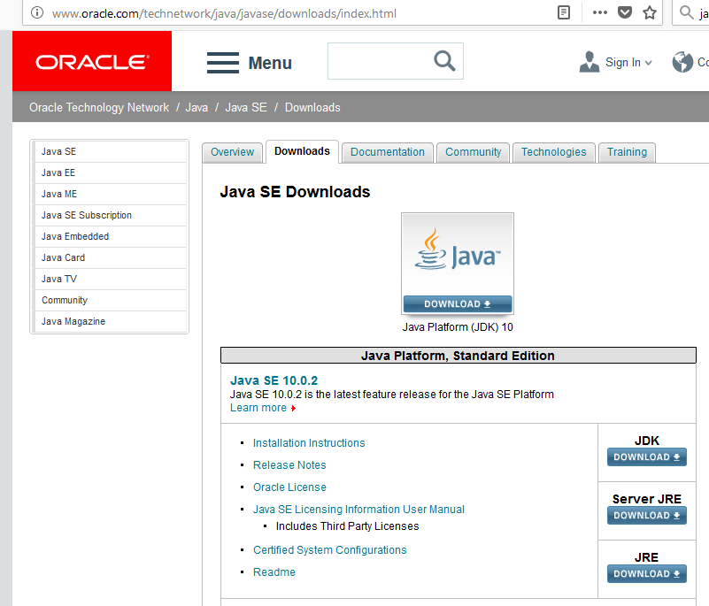
Java Development Kit (JDK) Kurulumu

Slide 3
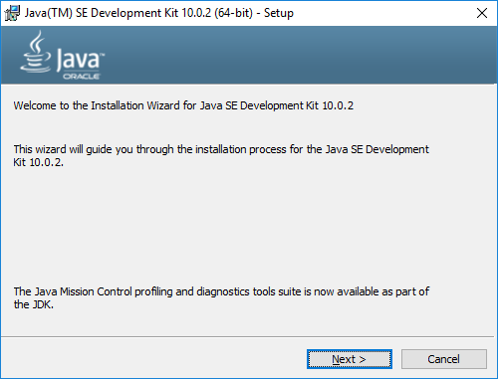
Java Development Kit (JDK) Kurulumu

Slide 4
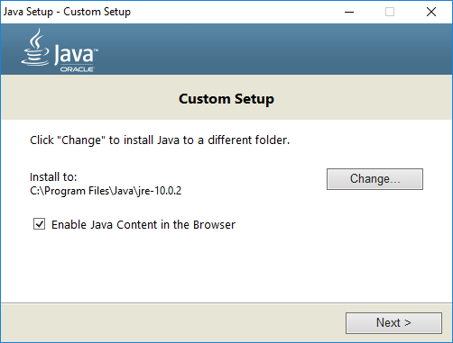
Java Development Kit (JDK) Kurulumu

Slide 5
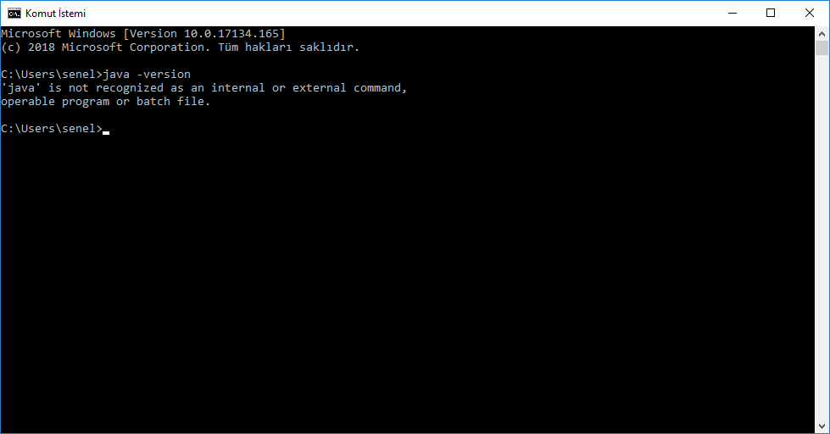
Java Development Kit (JDK) Kurulumu

Slide 6
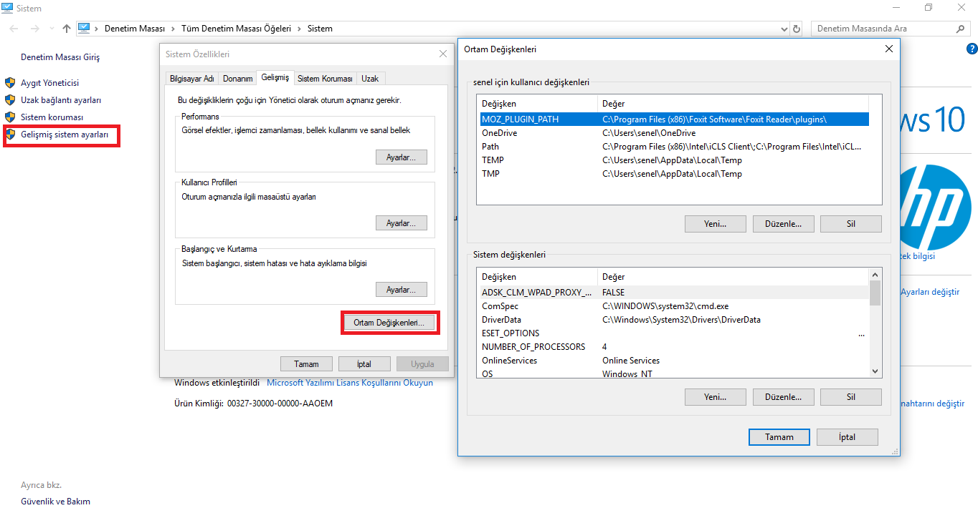
Java Development Kit (JDK) Kurulumu

Slide 7
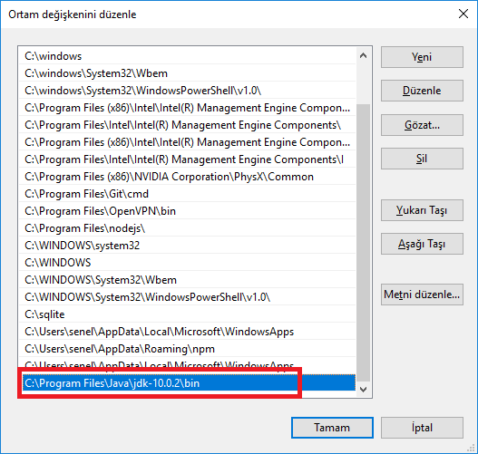
Java Development Kit (JDK) Kurulumu

Slide 8
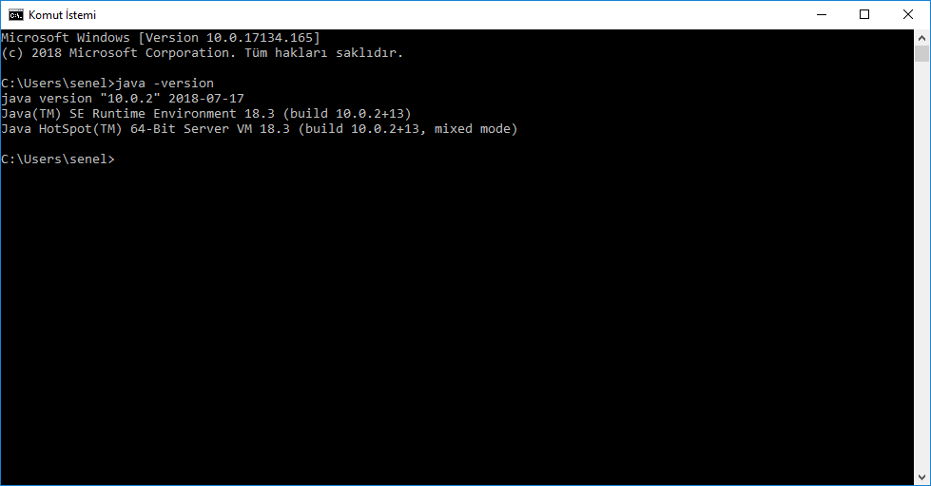
Java Development Kit (JDK) Kurulumu

Slide 9
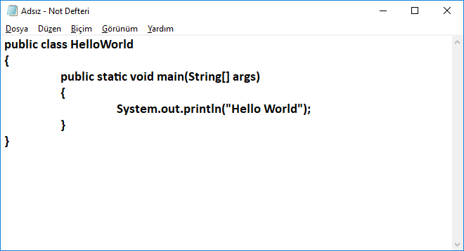
Hello World!

Slide 10
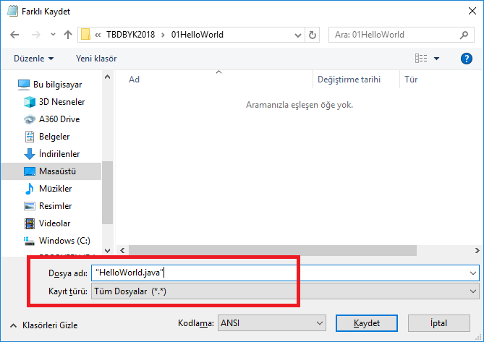
Hello World!

Slide 11
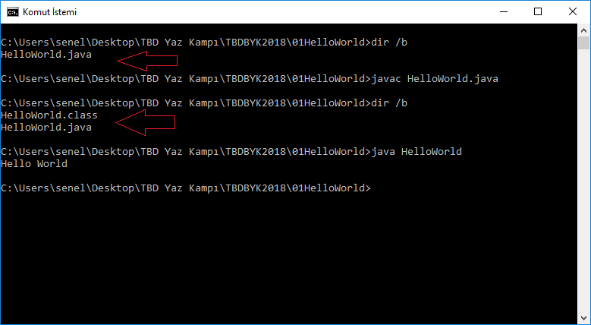
Hello World!

