Slide 1
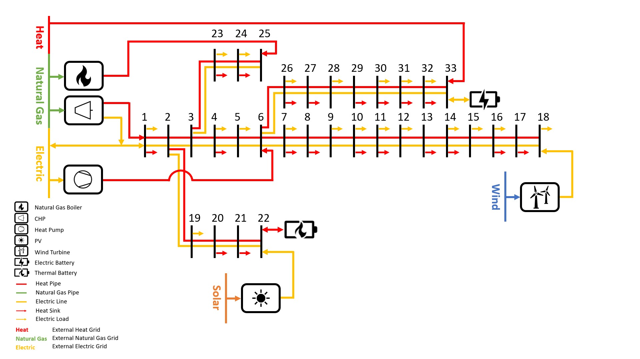

Slide 2





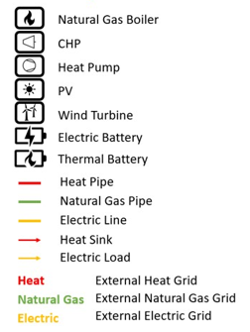


Heat
22
23
24
25
26
27
28
29
30
31
32
Natural Gas
0
1
2
3
4
5
6
7
8
9
10
11
12
13
14
15
16
17
Electric
Wind
18
19
20
21
Solar

