Slide 1
Intellectual property rights and firm performance in Europe
Econometric Analysis
Muzio Grilli, CEU Unit 03.11.2020

Slide 2
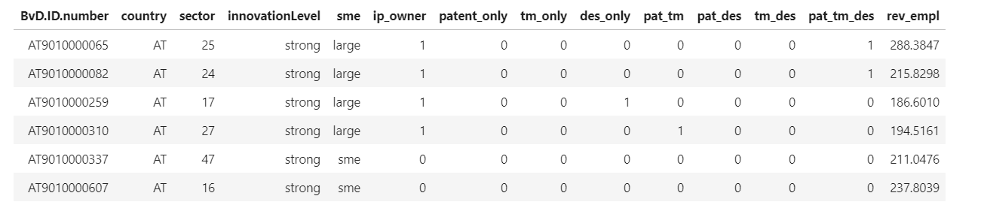
Dataset Description
Muzio Grilli, CEU Unit 03.11.2020

Slide 3
Dataset Exploration – IP Rights Strategy vs Size
Full Sample
SMEs
Large companies
Muzio Grilli, CEU Unit 03.11.2020

Slide 4
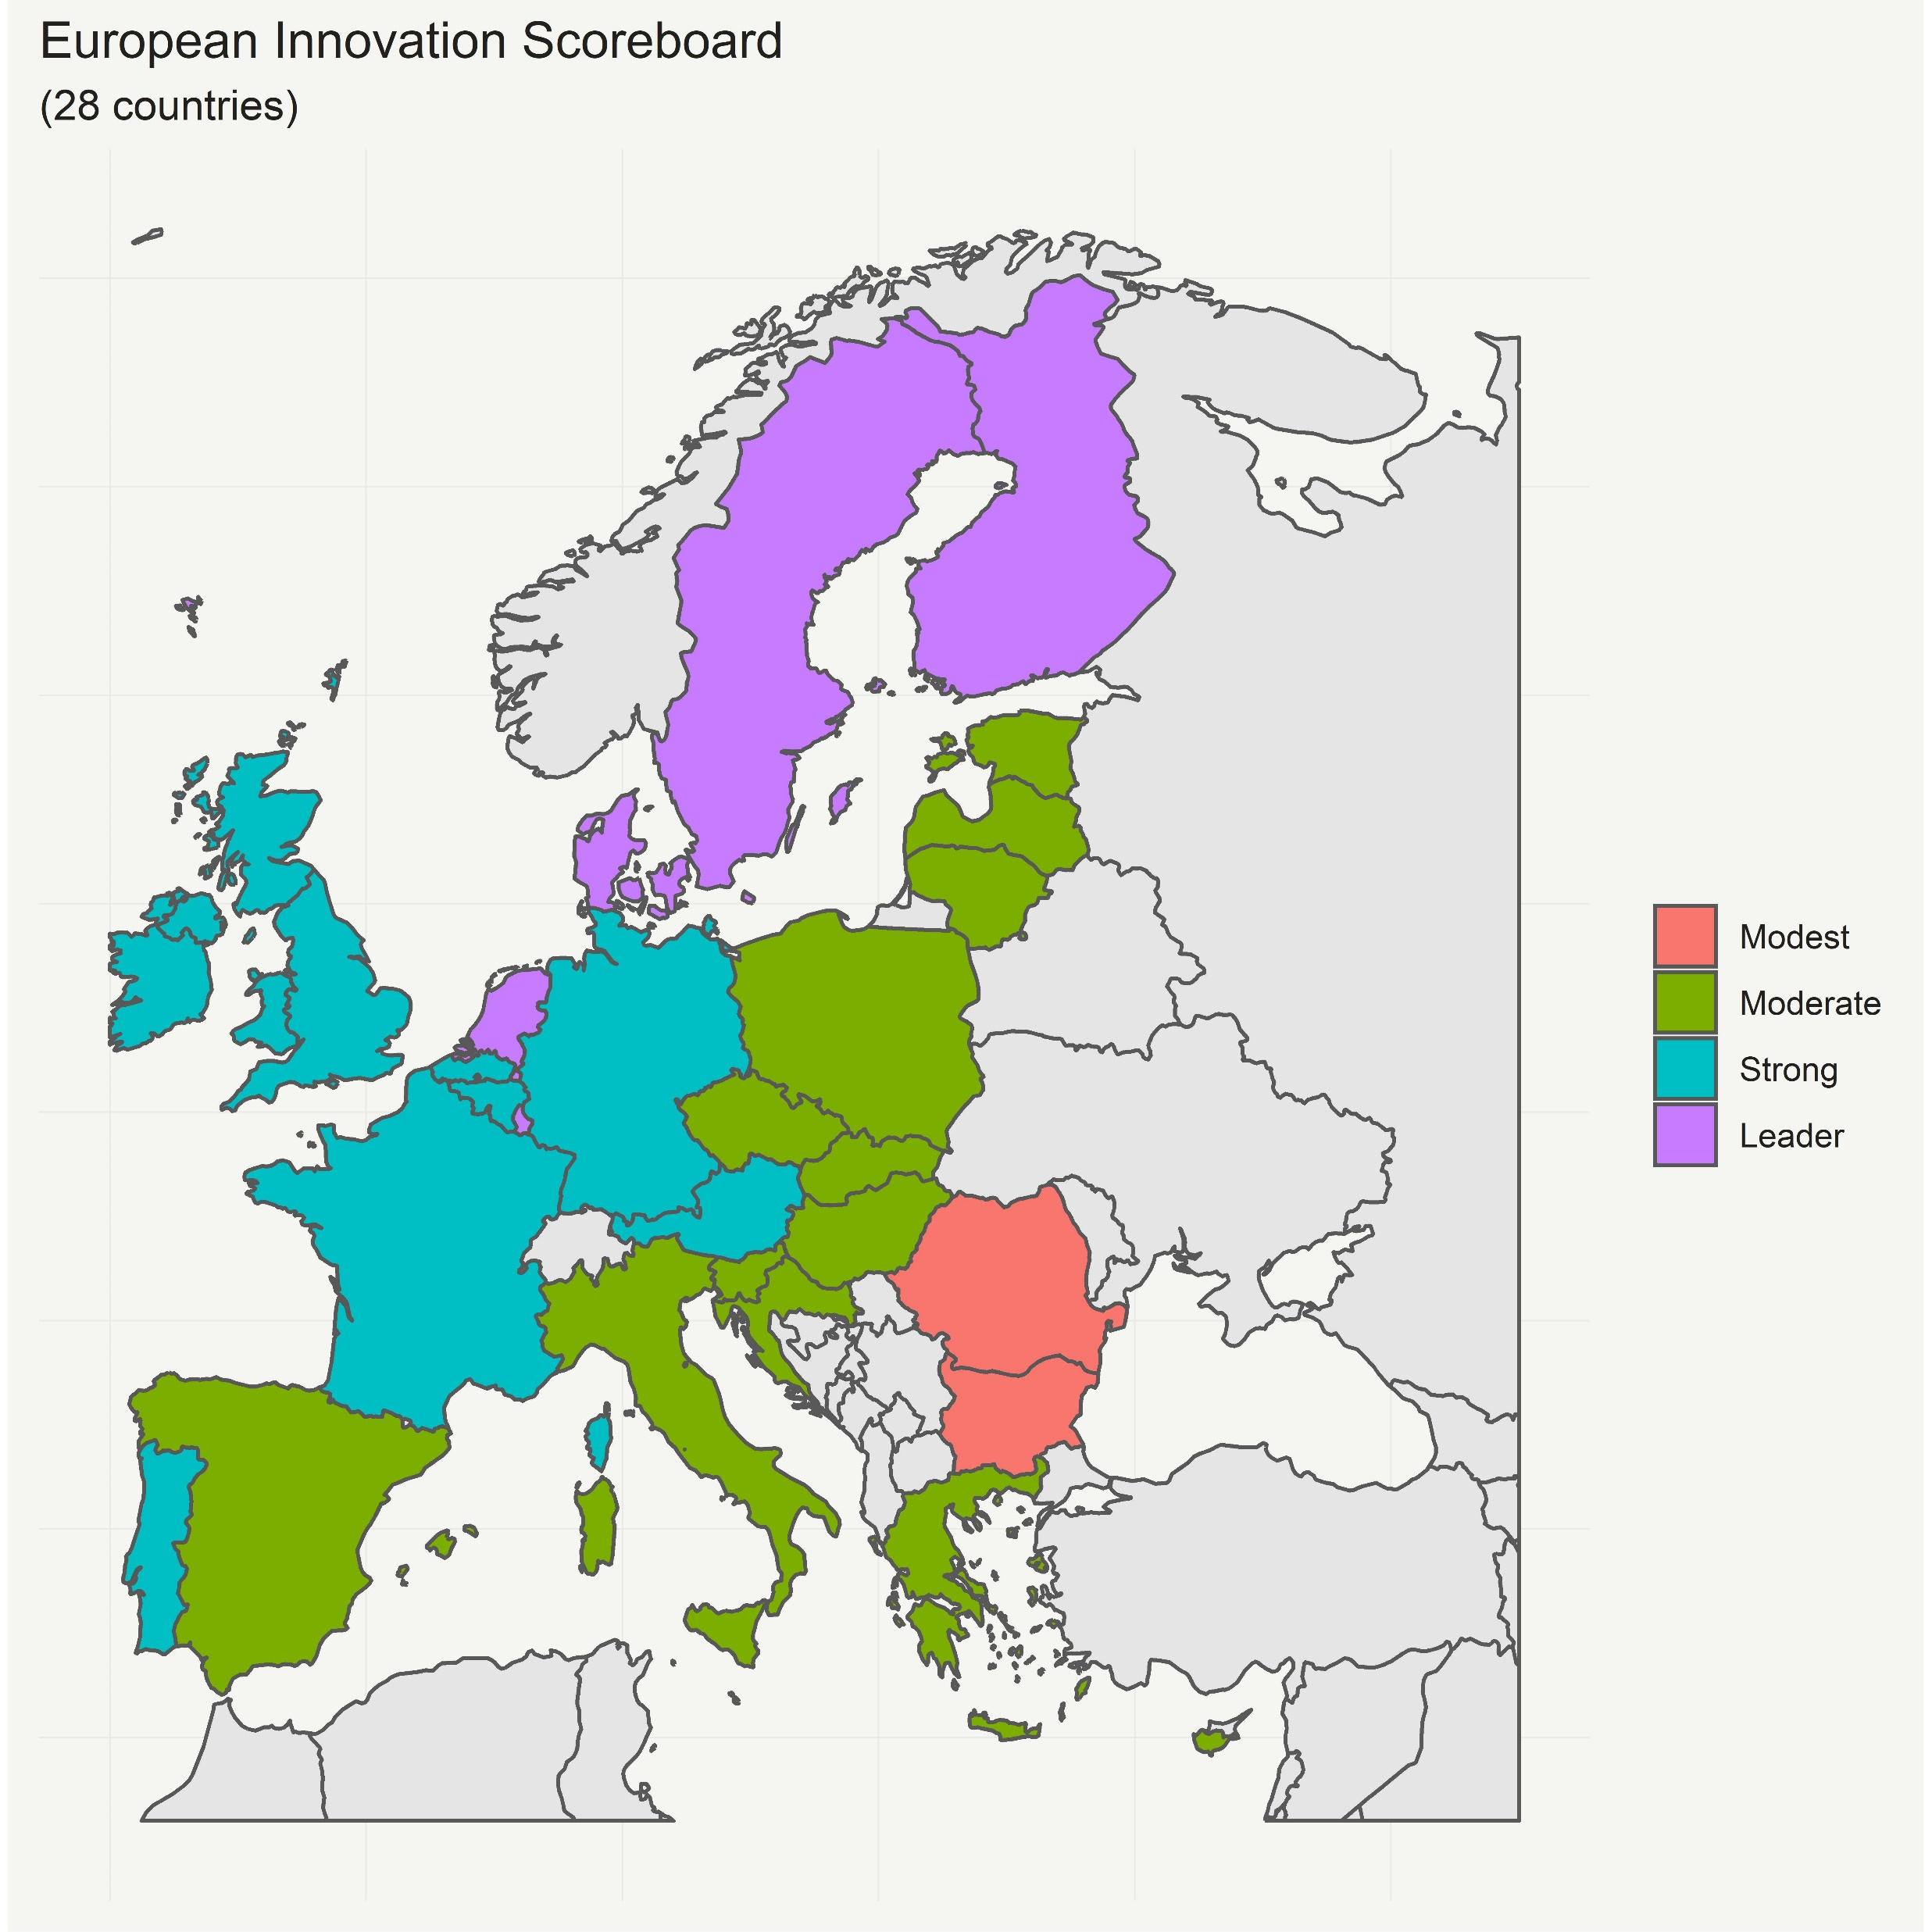
Dataset Exploration – IP Rights Strategy vs ISC
European Commission: Innovation Scoreboard 2020
Muzio Grilli, CEU Unit 03.11.2020

Slide 5
Dataset Exploration – IP Right Strategy vs ISC
Full Sample
Modest + Moderate
Strong + Leading
Muzio Grilli, CEU Unit 03.11.2020

Slide 6
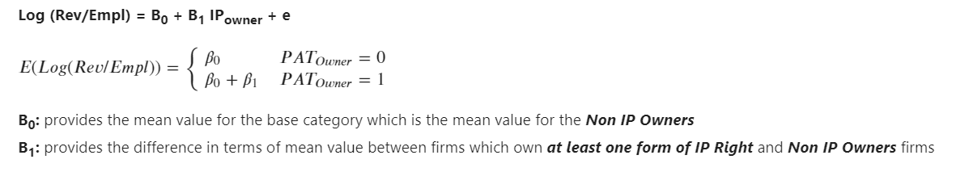
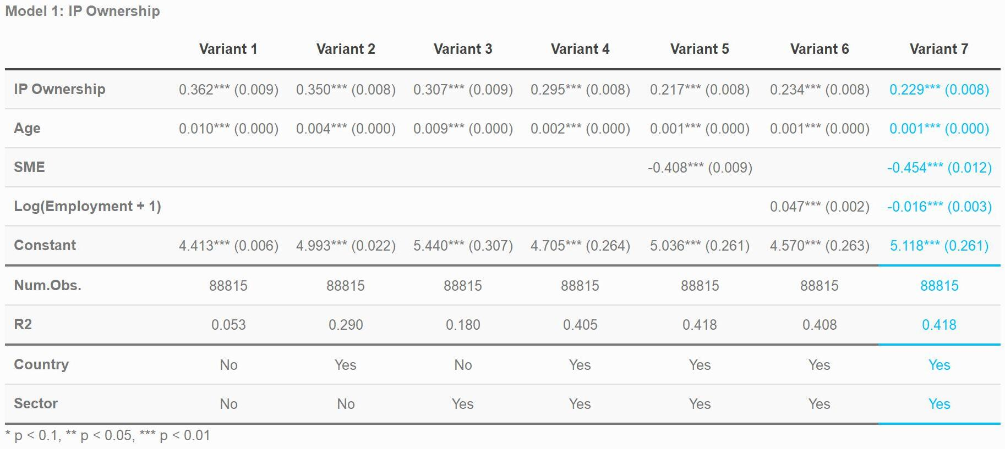
Econometric Analysis: Model 1
Muzio Grilli, CEU Unit 03.11.2020

Slide 7
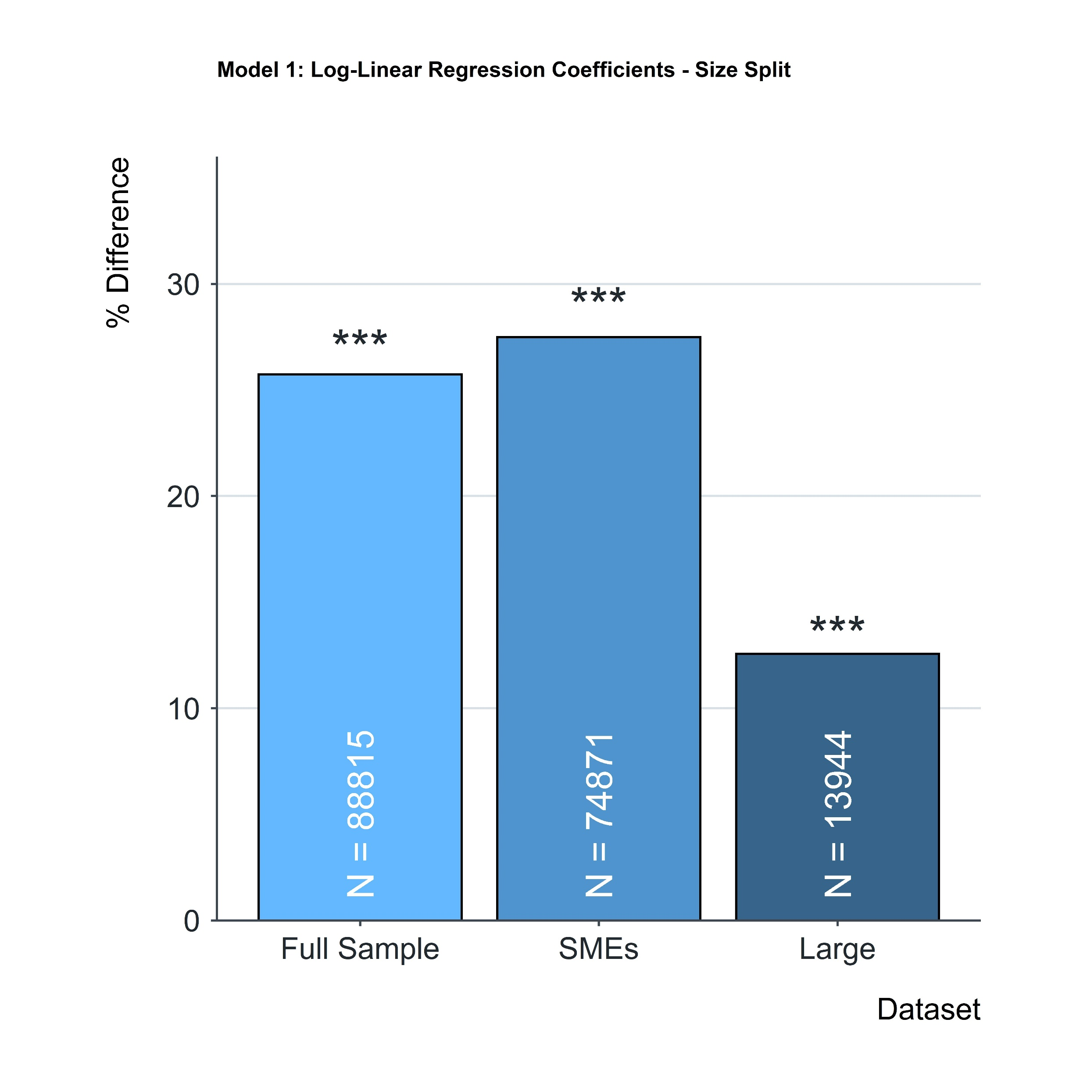
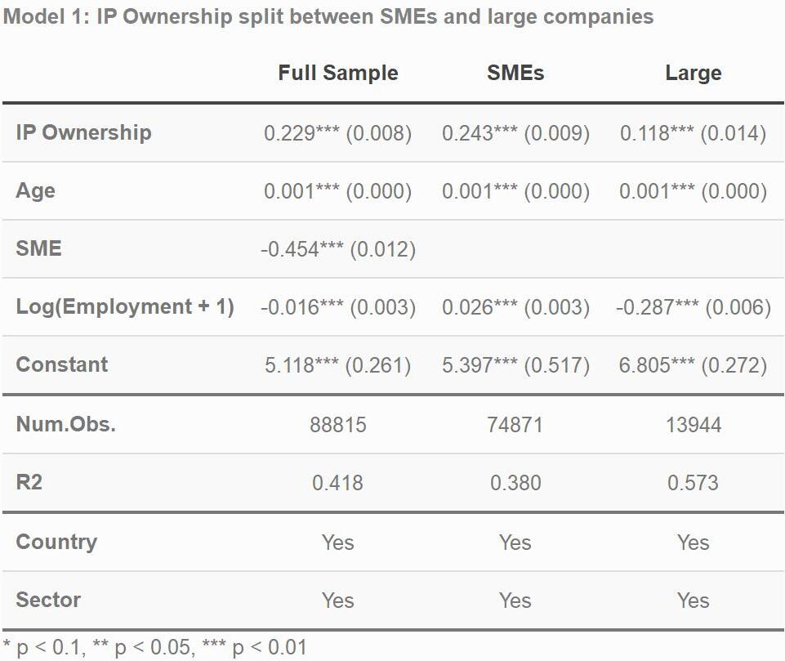

Econometric Analysis: Model 1 – Size Comparison
Muzio Grilli, CEU Unit 03.11.2020

Slide 8
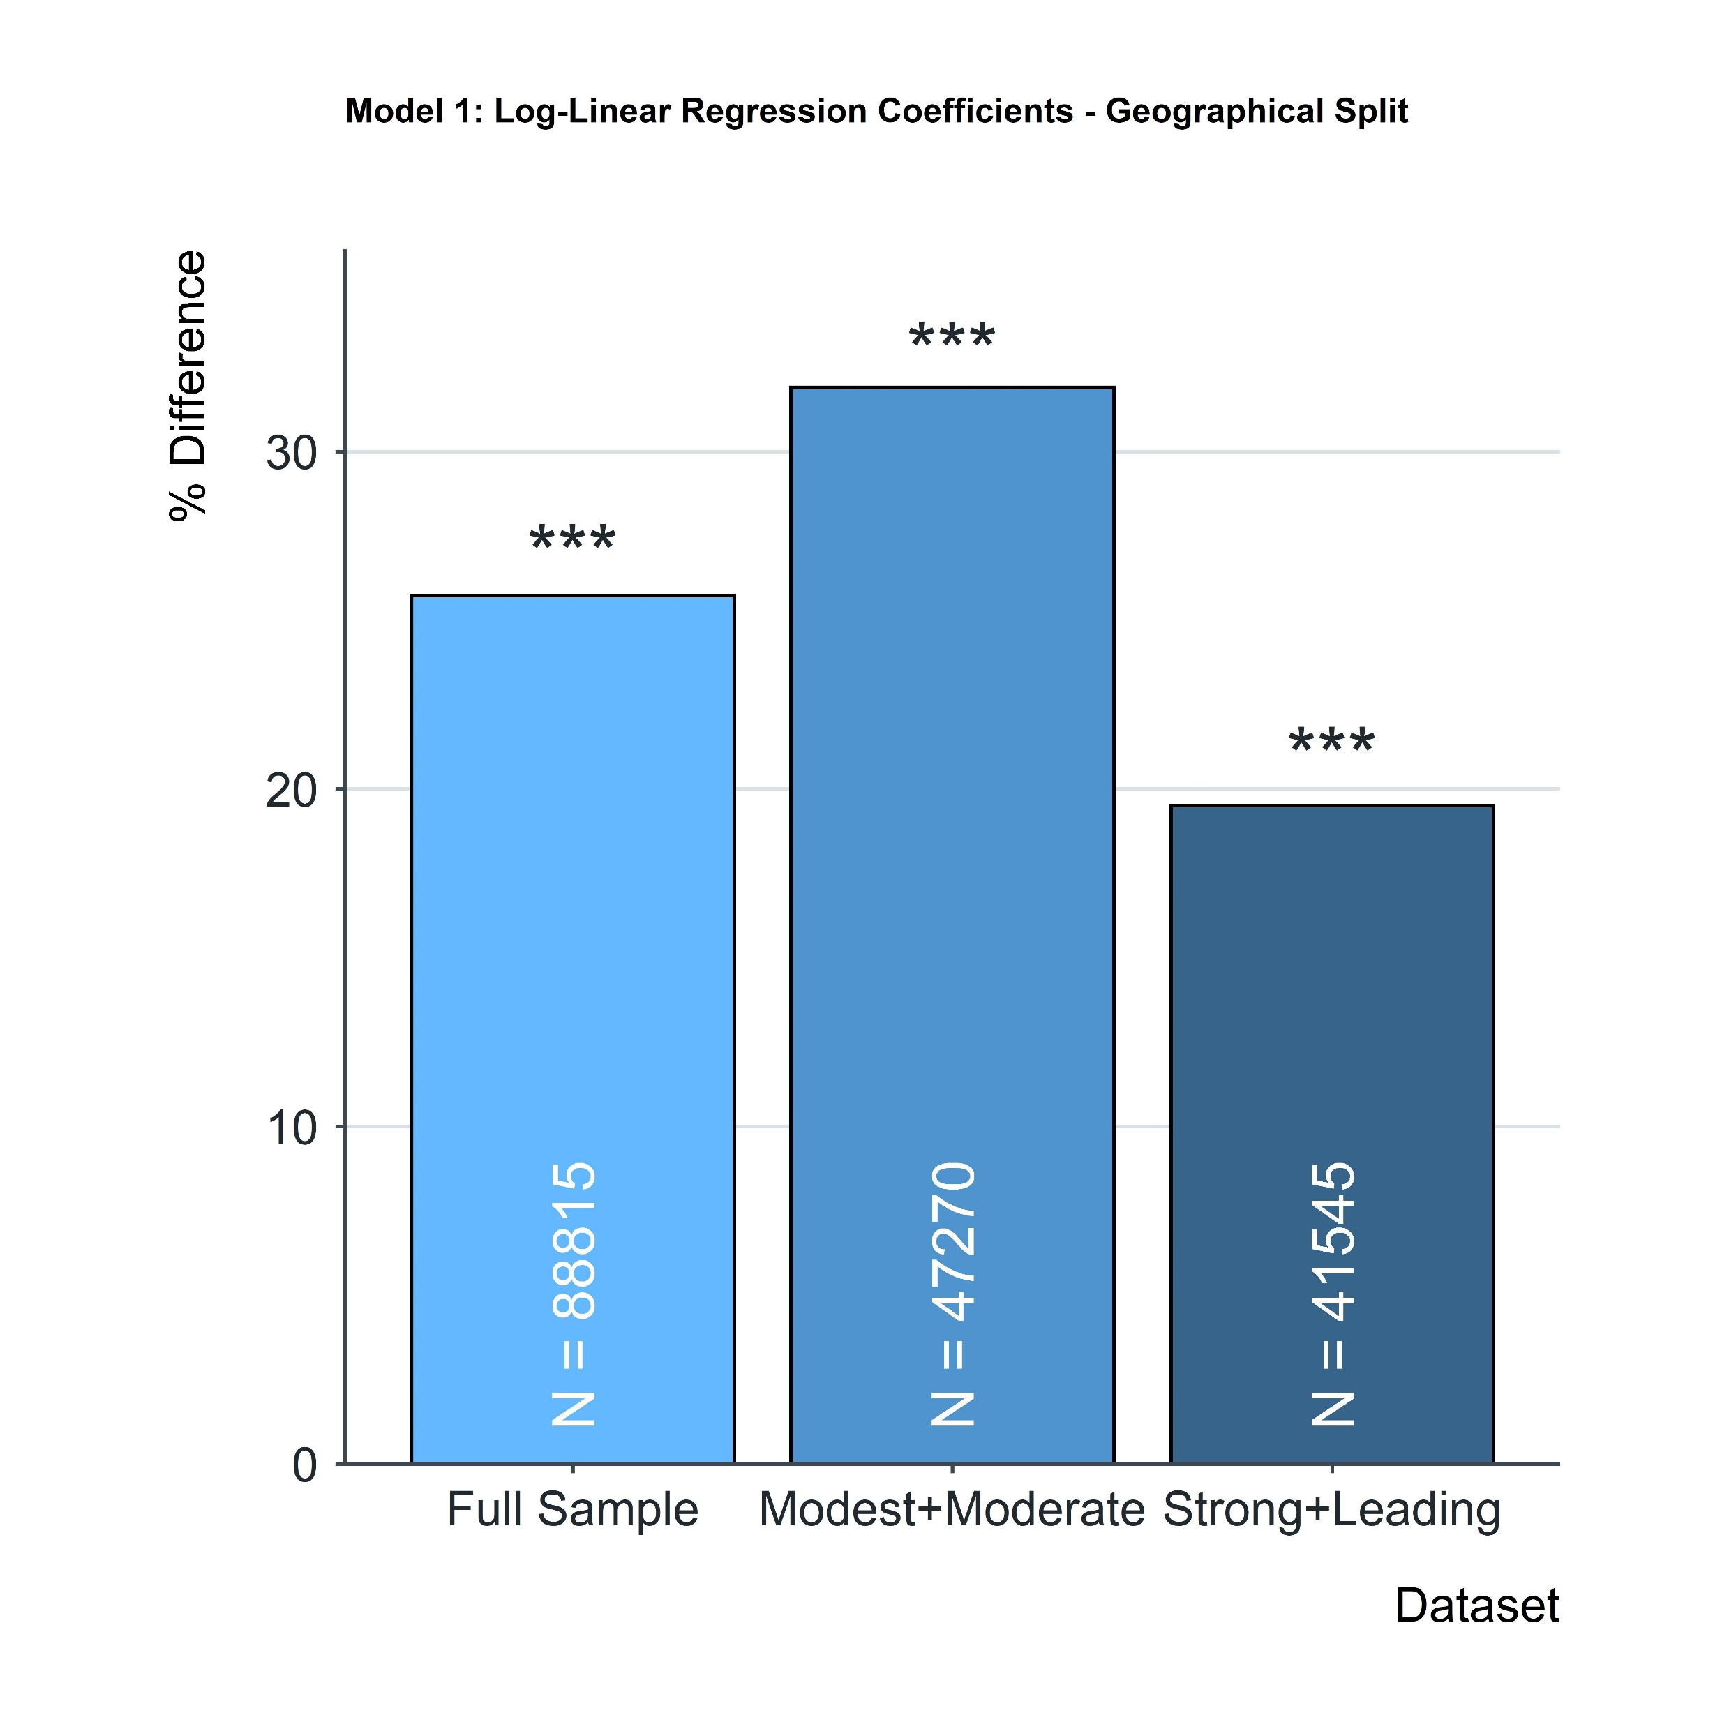
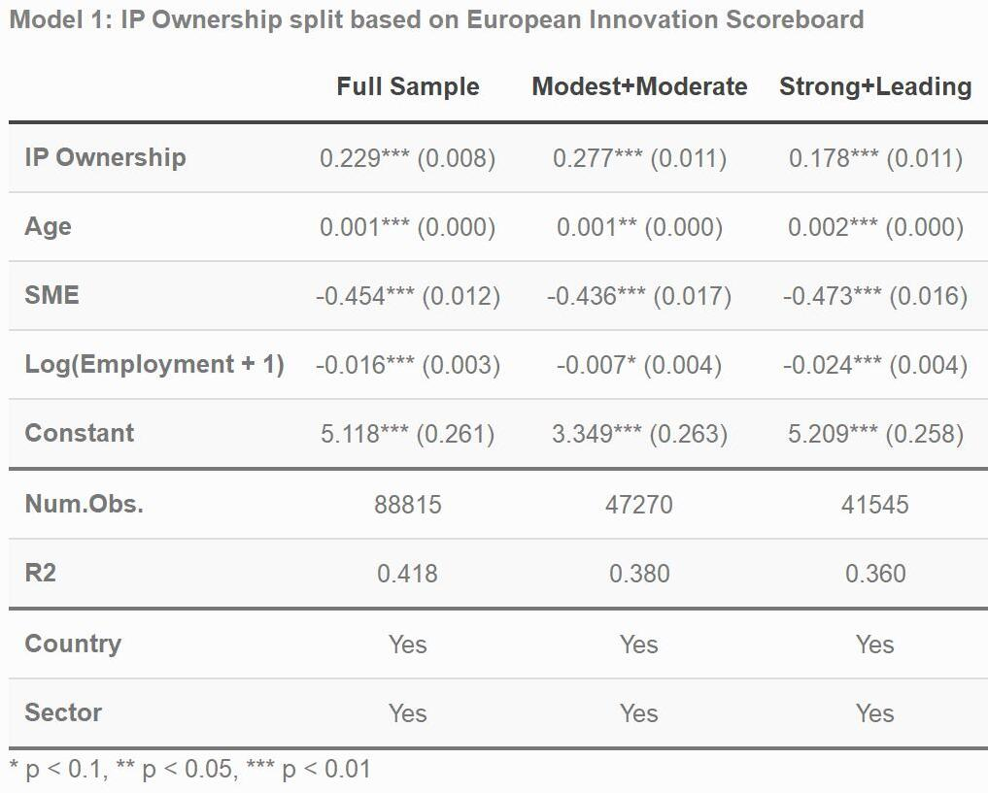
Econometric Analysis: Model 1 – ISC Comparison
Muzio Grilli, CEU Unit 03.11.2020

Slide 9
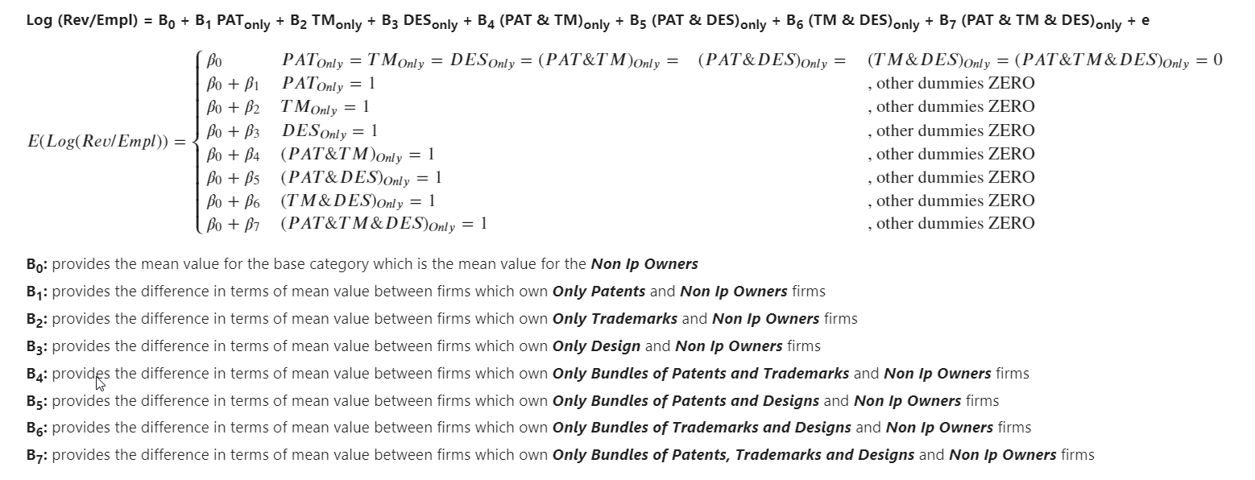
Econometric Analysis: Model 2
Muzio Grilli, CEU Unit 03.11.2020

Slide 10
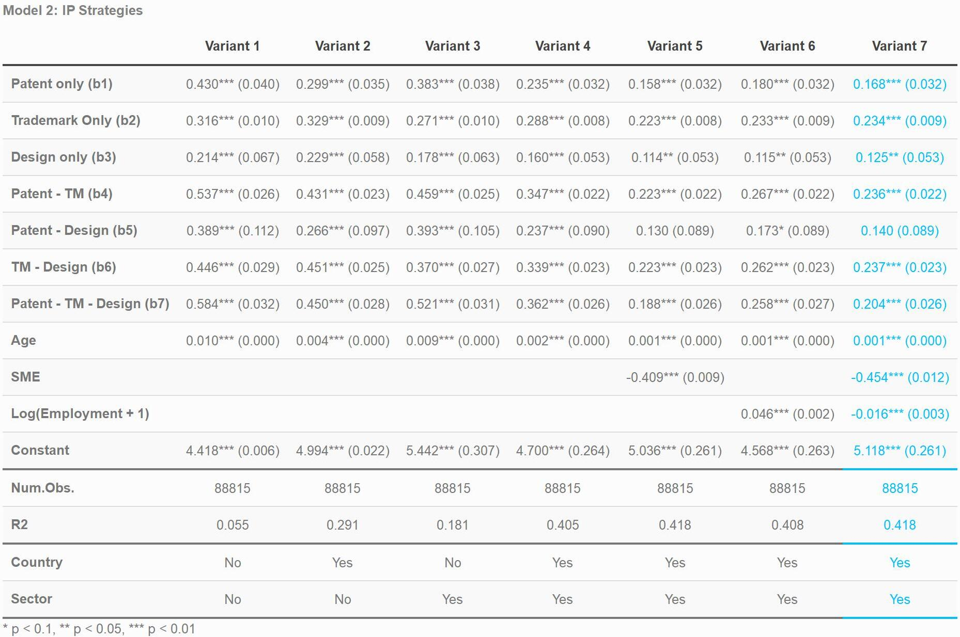
Econometric Analysis: Model 2
Muzio Grilli, CEU Unit 03.11.2020

Slide 11
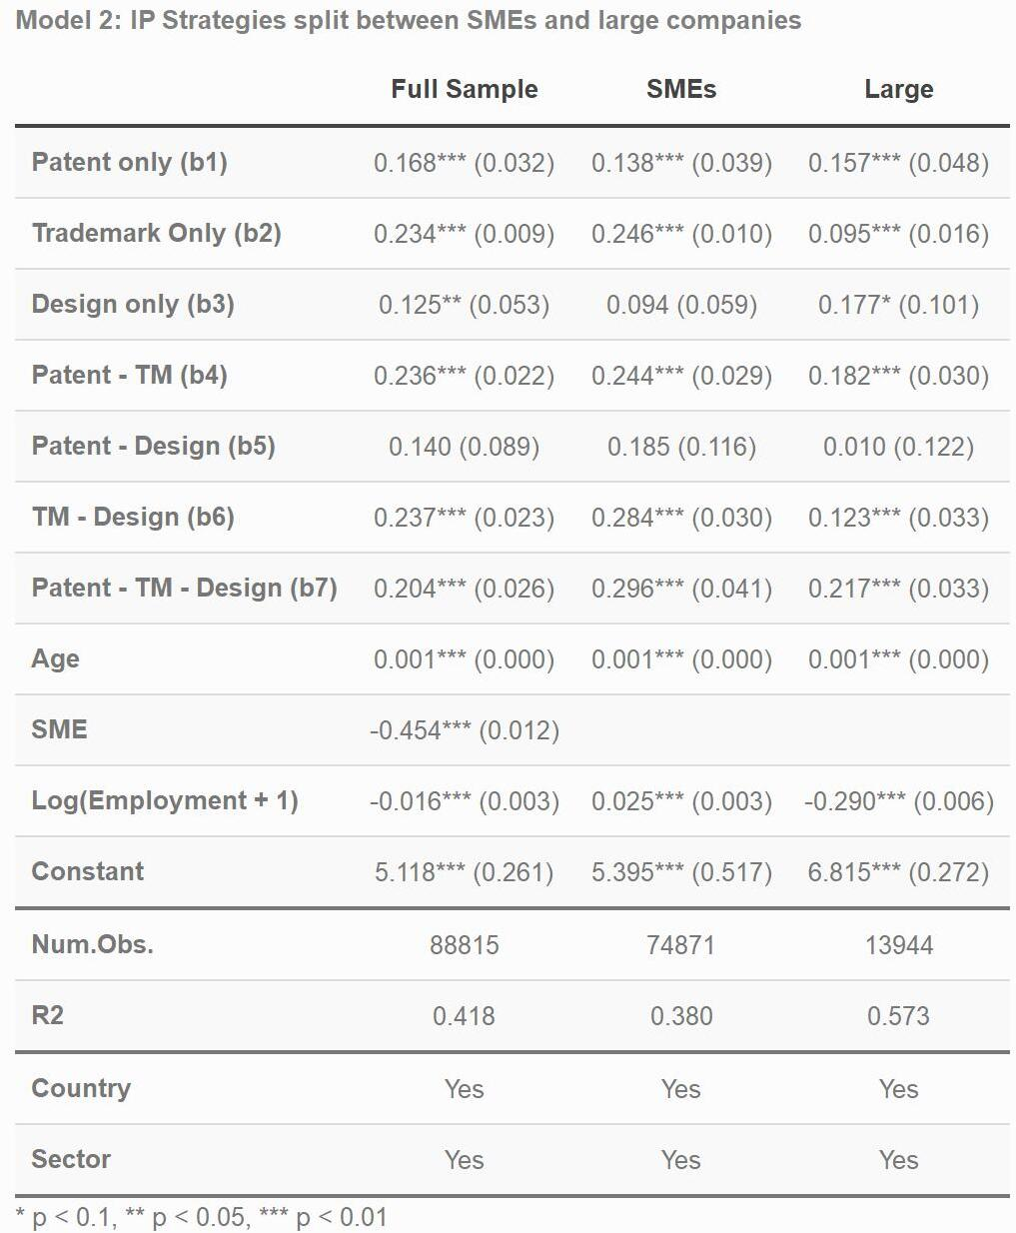
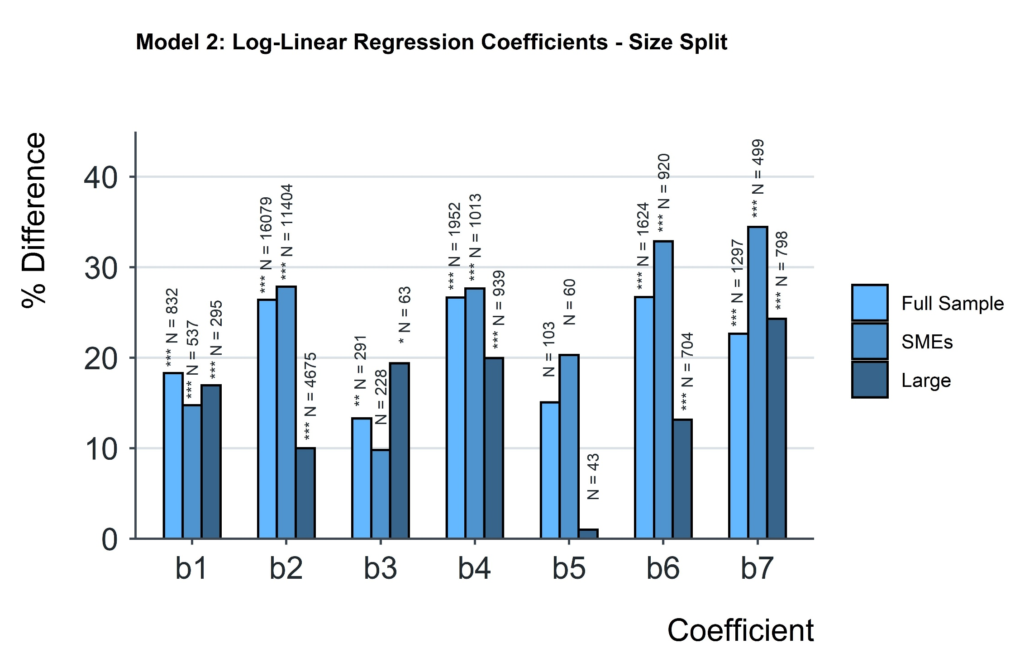

Econometric Analysis: Model 2 – Size Comparison
Muzio Grilli, CEU Unit 03.11.2020

Slide 12
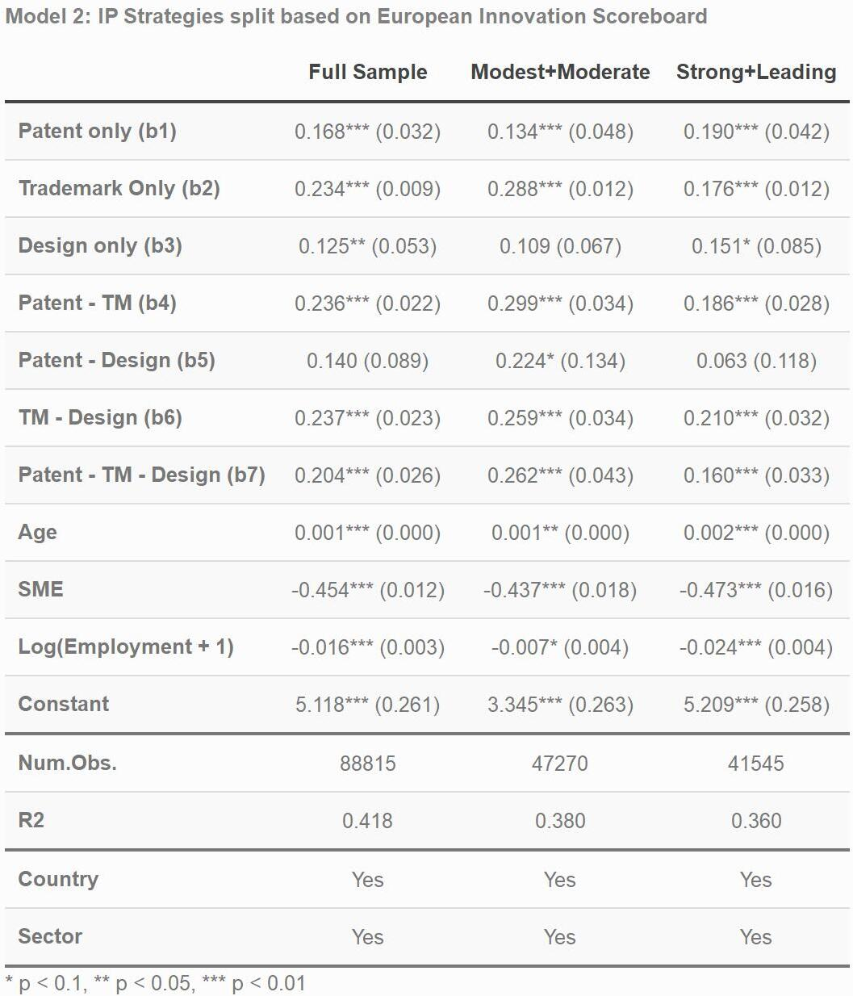
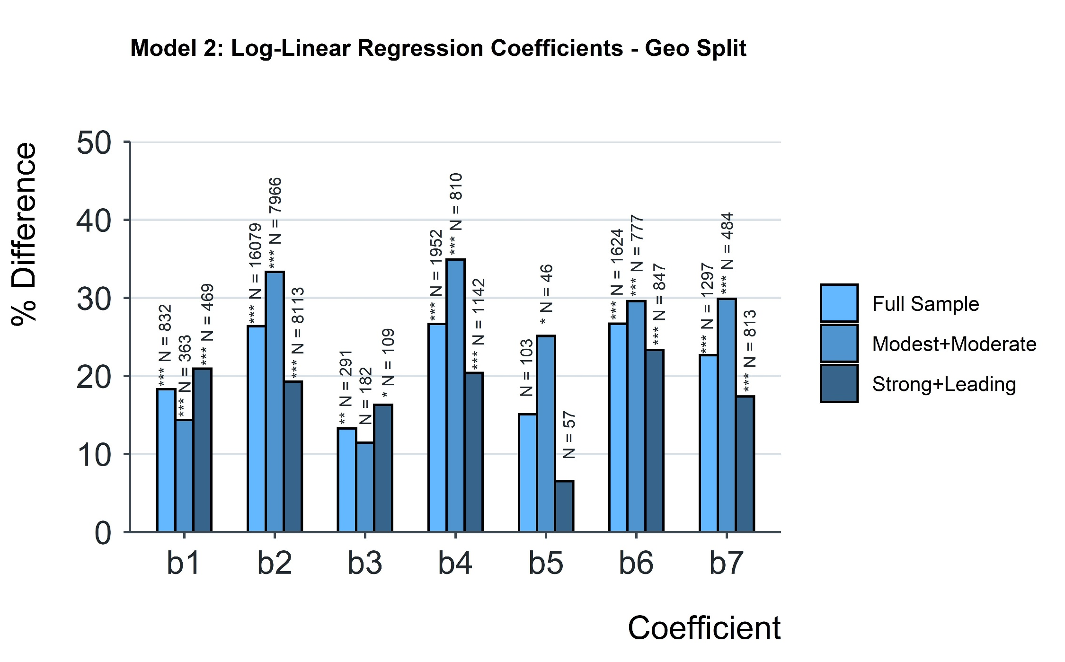
Econometric Analysis: Model 2 – ISC Comparison
Muzio Grilli, CEU Unit 03.11.2020

