Slide 1


内容
如何使用仪表排错
接入层协议测试-PPPoE&DHCP
CN2大BRASE叠加测试演示

Slide 2
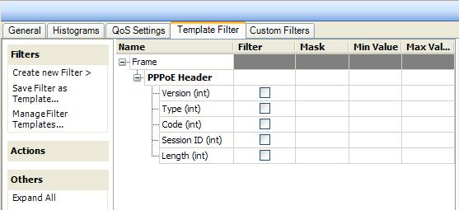
Introduction to New
Access Features in 2.0
PPP
  Up to 32,767 subscribers per port
  Up to 32,767 servers per port
  Up to 100 host blocks per port
  VLAN, and VLAN Q-in-Q support for subscriber and server
  Support for IPTV and IGMP over PPP
  Ability to analyze traffic, filtering on different fields of the PPP frame

Slide 3
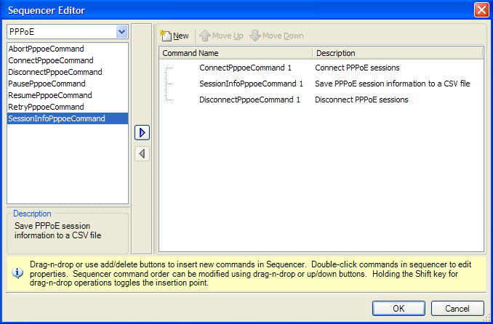
Introduction to New
Access Features in 2.0
PPP
  PPP commands are integrated into the new Command Sequencer:

Slide 4
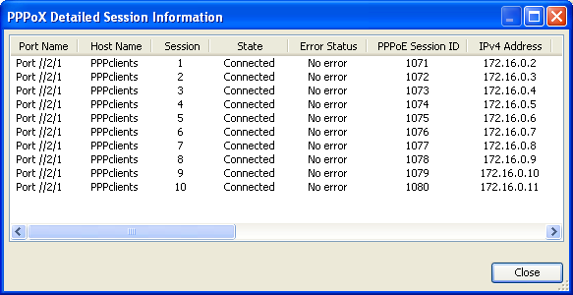
Introduction to New
Access Features in 2.0
PPP
  Relay Agent support with wildcard string substitution for both RFC 2516 and DSL Forum methods for Circuit ID and Remote Session ID’s
  Ability to view PPP client session information

Slide 5
PPP Review
  PPP can be used to connect a single remote user to a central office, or to connect a remote office with many users to a central office.
  PPP provides the following services
    Network layer protocol multiplexing
    Link configuration
    Link-quality testing
    Link-option negotiation
    Authentication
    Header compression
    Error detection

Slide 6
PPP Review
  Current standard for PPPoE is RFC 2516 and outlines methods to connect a network of hosts over a simple bridging access device to a remote Access concentrator.
  Access control, billing and type of service can be done on a per-user, rather than a per-site basis.
PPPoE
PPPoE
PPPoE
Ethernet Segment
IP
Workstation
Cable Modem
Cable Modem
IP
Termination
IP
IP
IP
PPP
System
PPP
BRAS
PPPoE
(
CMTS
)
PPPoE
Some
Some
Ethernet
Ethernet
RF
RF
Ethernet
Ethernet
L
2
L
2
PHY
PHY
PHY
PHY
PHY
PHY
PHY
PHY

Slide 7
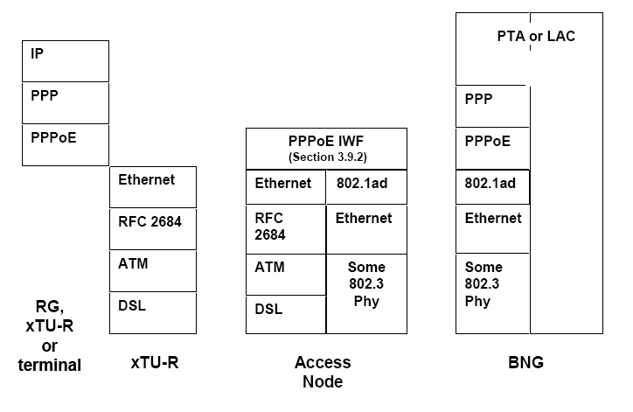
PPP Review
  PPPoE over ATM

Slide 8
PPPoE Protocol协议交互图
{
PADI (B)
Client send Active Discovery Initiation
PADO (U)
Server sends offer.
PPPoE
PADR (U)
Client sends request.
PADS (U)
Server sends session confirmation.
{
LCP Config Request (P)
Link control establishment.
LCP
LCP Config Ack (P)
Link control established
PPP Client
PPP Peer

Slide 9
PPP协议交互图
{
Authenticate (P)
AAA Login (sends user id/password)
AAA
Authenticate ACK (P)
{
IP Config Request (P)
Client requests IP address.
NCP
IP Config ACK (P)
{
LCP Echo Request (P)
LCP
Keep-alives exchanged periodically.
LCP Echo Reply (P)
PPP Client
PPP Peer

Slide 10
PPP Review
Typical PPP Relay / Intermediate Agent solution:
  An Access node acting as a PPP Relay is a trusted device on the network.
  It will attach a tag to the PPPoE discovery packet (destined for the BNG/BRAS) that will contain information about the clients session and connection.
  The BRAS/BNG then receives the tagged packet, decodes the tag and inserts the line identifier into RADIUS packets destined for the RADIUS Server.

Slide 11
PPP Review
Two currently used methods for adding the client information to the PADI/PADR:
  RFC 2516
    Relay agent forwards Relay Agent MAC and Session ID of the client
  DSL Forum 2004 – 071 / TR 101
    Relay agent forwards circuit ID and remote ID of DSL line

Slide 12
PPP Review
RFC 2516 Method adds a tag that contains the following:
  Session-ID
    In combination with the MAC address, this will uniquely identify each session.
  MAC Address
    This is the MAC address of the next hop from the subscriber client group to the Access concentrator.

Slide 13
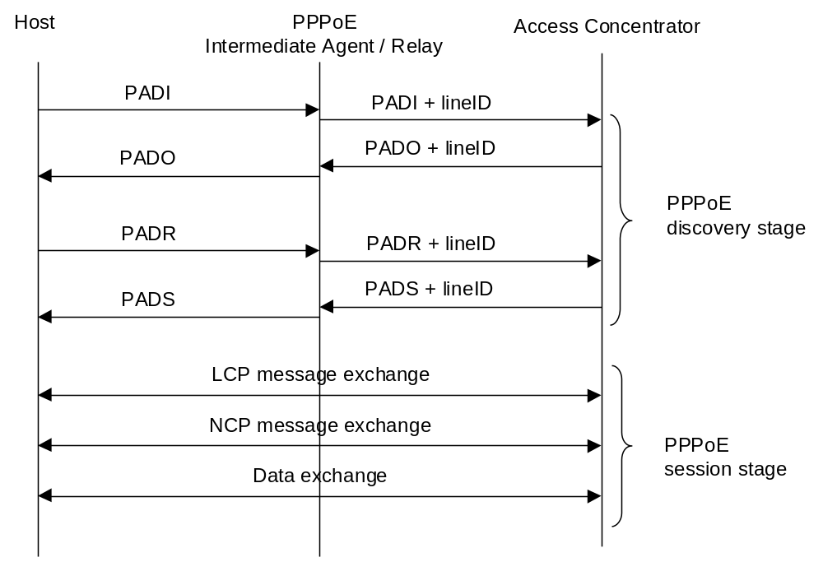
PPP Review
Exchange of packets during the PPPoE negotiation when DSL Forum method of relay agent tagging is used:

Slide 14
Introduction to New
Access Features in 2.0
DHCP
  Up to 32,767 subscribers per port
  Up to 1024 host blocks per port
  DHCP custom option editor including support for Option 60 (Vendor Class ID) using wildcard string substitution
  Support for IPTV and IGMP with DHCP clients

Slide 15
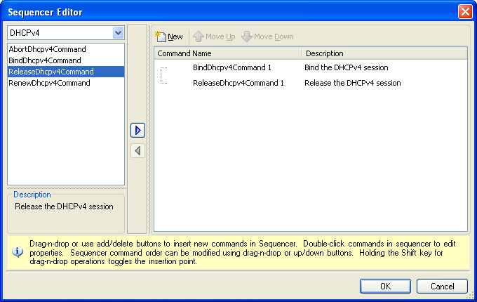
Introduction to New
Access Features in 2.0
DHCP
  DHCP commands are integrated into the new Command Sequencer

Slide 16
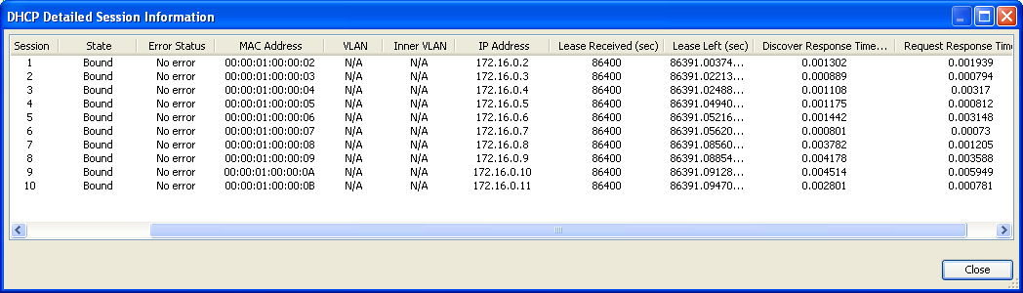
Introduction to New
Access Features in 2.0
DHCP
  System will respond to ARP requests from the server
  Ability to have the client ARP using Option 3 address if selected and provided by the server
  Ability to view and save DHCP client session information

Slide 17
DHCP / DHCP Relay Review
  DHCP Relay concepts are growing in popularity and usage but testing the technology is sometimes less understood
  Due to the broadcast nature of DHCP, it lends itself to being a bit of a security and scaling problem in large networks
    Ie:
    You need to keep the broadcast domains as small as possible to cut down on broadcast traffic (overall goal)
    Untrusted users can use the broadcast nature of DHCP to request addresses on the network and steal bandwidth (MAC address spoofing)

Slide 18



DHCP / DHCP Relay Review
  Operation Overview:
    DHCP Clients broadcast a “DHCP Discover” to request an IP address from available servers
    After the client receives a unicast “DHCP Offer” from a server, it must also broadcast a “DHCP Request”. The reason for the broadcast is to also tell the other servers which server the client has accepted the offer from (there may be multiple servers responding).
DSLAM
BRAS/DHCP Server
User
User
DHCPDISCOVER (broadcast)
That’s two broadcasts for every client binding
DHCPOFFER (unicast)
User
DHCP REQUEST (broadcast)
DHCPACK (unicast)

Slide 19


DHCP / DHCP Relay Review
DHCP relay allows clients in different broadcast domains to request IP addresses using DHCP, from servers that are not in the same physical network
Relay Agent
DUT / DHCP Server
ISP Host IP: 172.20.12.2
DHCP Client
Relay Agent
Pool IP
172.30.10.2
Relay Agent
Local IP
192.168.30.2
VLAN 30
Relay Agent
Server IP
192.168.30.1
VLAN 30
Int GigE 0/3.x
IP Address 172.20.12.1 /24

Slide 20
DHCP / DHCP Relay Review
  The DHCP Relay Agent is usually a router or a DSLAM
  Relay Agents receive DHCP messages and then generate a new DHCP message to send out on another interface
  The Relay Agent sets the gateway address (giaddr field of the DHCP packet) and, if configured adds option 82 and forwards to the server.
  Relay agent strips the option 82 information when sending the DHCP Offers back to the client but only on the correct circuit.
  The DHCP Relay Agent will add information such as the circuit ID and session ID with Option 82 to support client tracking and troubleshooting.

Slide 21
DHCP / DHCP Relay Review
Applicable Standards for Reference:
  RFC 2131; Dynamic Host Configuration Protocol
  RFC 3046; DHCP Relay Agent Information Option (ie: Option 82)
  RFC 4243; Vendor-Specific Information Sub-Option for the Dynamic Host Configuration Protocol Relay Agent Option (Vendor Class ID; Option 60)
  DSL Forum TR-101; Migration to Ethernet-Based DSL Aggregation

Slide 22

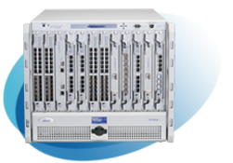
PPPoE / DHCP LAB
12.0.0.1/24
client
network
12.0.0.2/24
任务：
1。理解端口下全局参数的配置以及对DUT的影响
2。PPPoE 100 user VLAN：11/1-100 username/password: spirentX/spirentX
IP:11.0.0.1-100 注：X为序列号
3。DHCP 100 user VLAN：10/1-100 gateway:10.0.0.1 Pool:10.0.0.2-10.0.0.101 /24
4。和网络侧发送双向流量，流量大小XX，字节大小为XX，注意如何发送双向线速流量
的设置
5。拿出10％的PPPoE用户震荡，震荡间隔为5S，震荡5次，观察流量变化情况

