Slide 1
METRO STORES
DATA ANALYSIS USING
SPARK AND DELTA LAKE

Slide 2
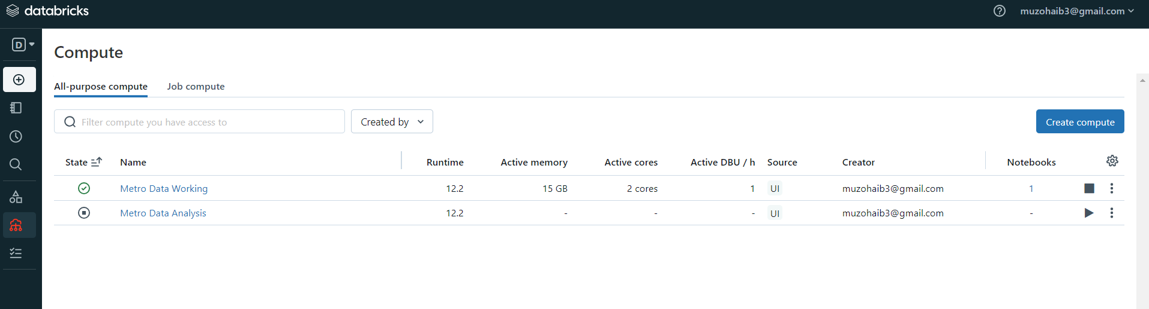
Purpose and Use of Data bricks Clusters:
Enable Large-Scale Data Processing: Data bricks clusters provide a scalable, distributed computing environment for handling massive datasets and complex data workloads.
Accelerate Processing and Analysis: They optimize performance for tasks like data engineering, data science, machine learning, and business intelligence.
2. Guidelines for Creating Data bricks Clusters:
Consider Workload Requirements: Choose the appropriate cluster configuration (e.g., instance types, worker nodes, memory, and disk size) based on the specific tasks and data volumes you'll be handling.
Manage Costs and Utilization: Balance performance with cost by selecting resources wisely and using features like autoscaling to optimize resource allocation.

Slide 3
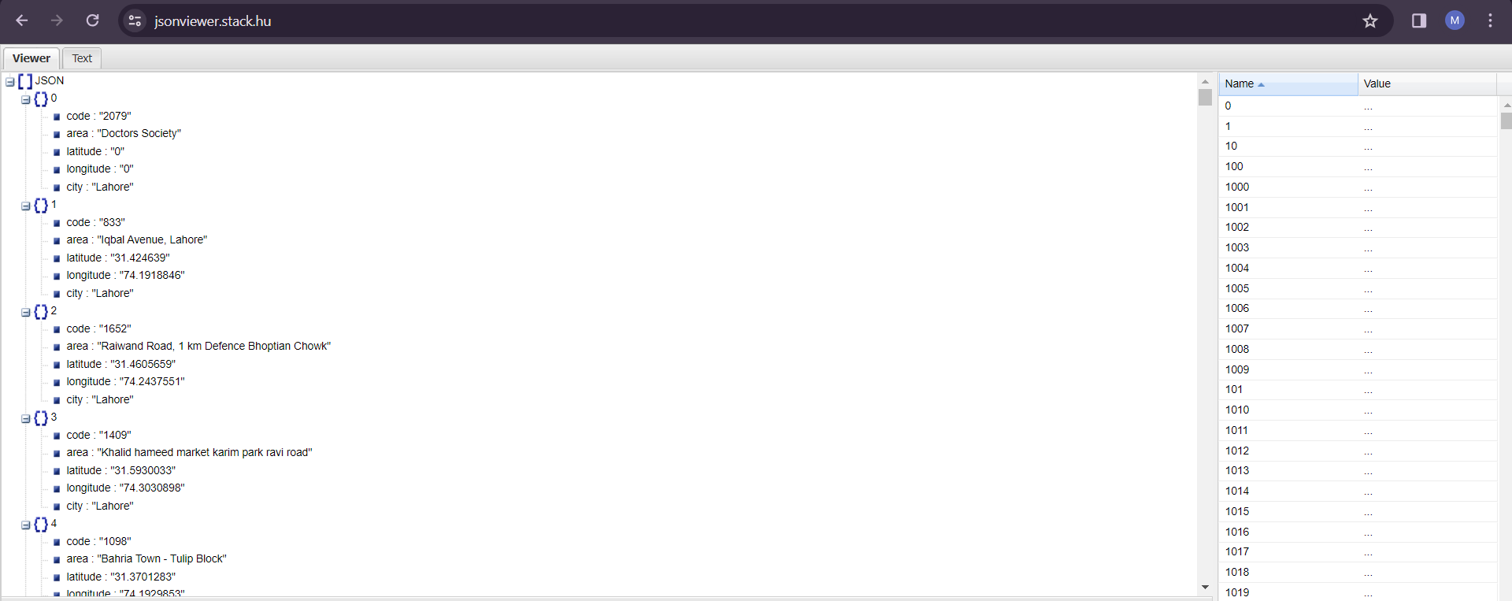
We are using the live API request containing city code, area, latitude, longitude and city name. The API is simple is GET Request format.

Slide 4
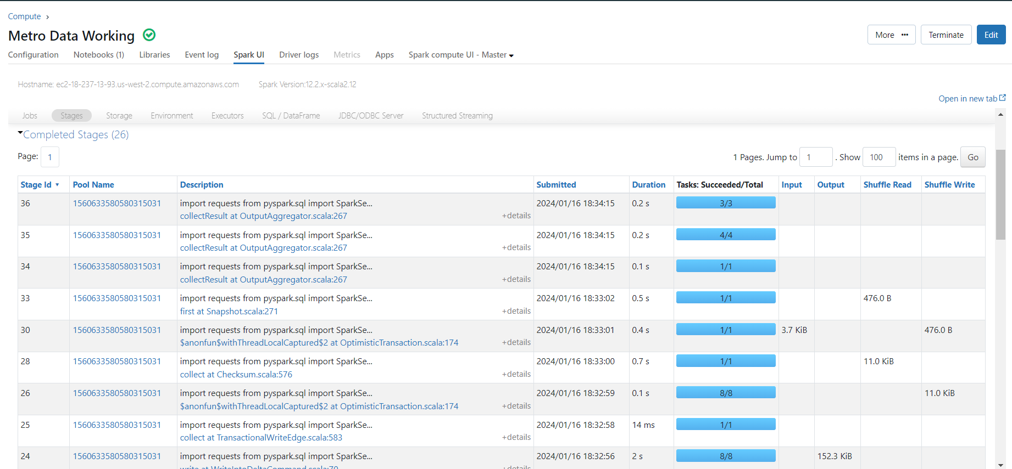
It is the showing the that the spark session and the jobs success rate and how much time taken to proceed and it also maintaining logs of when spark session is executed

Slide 5
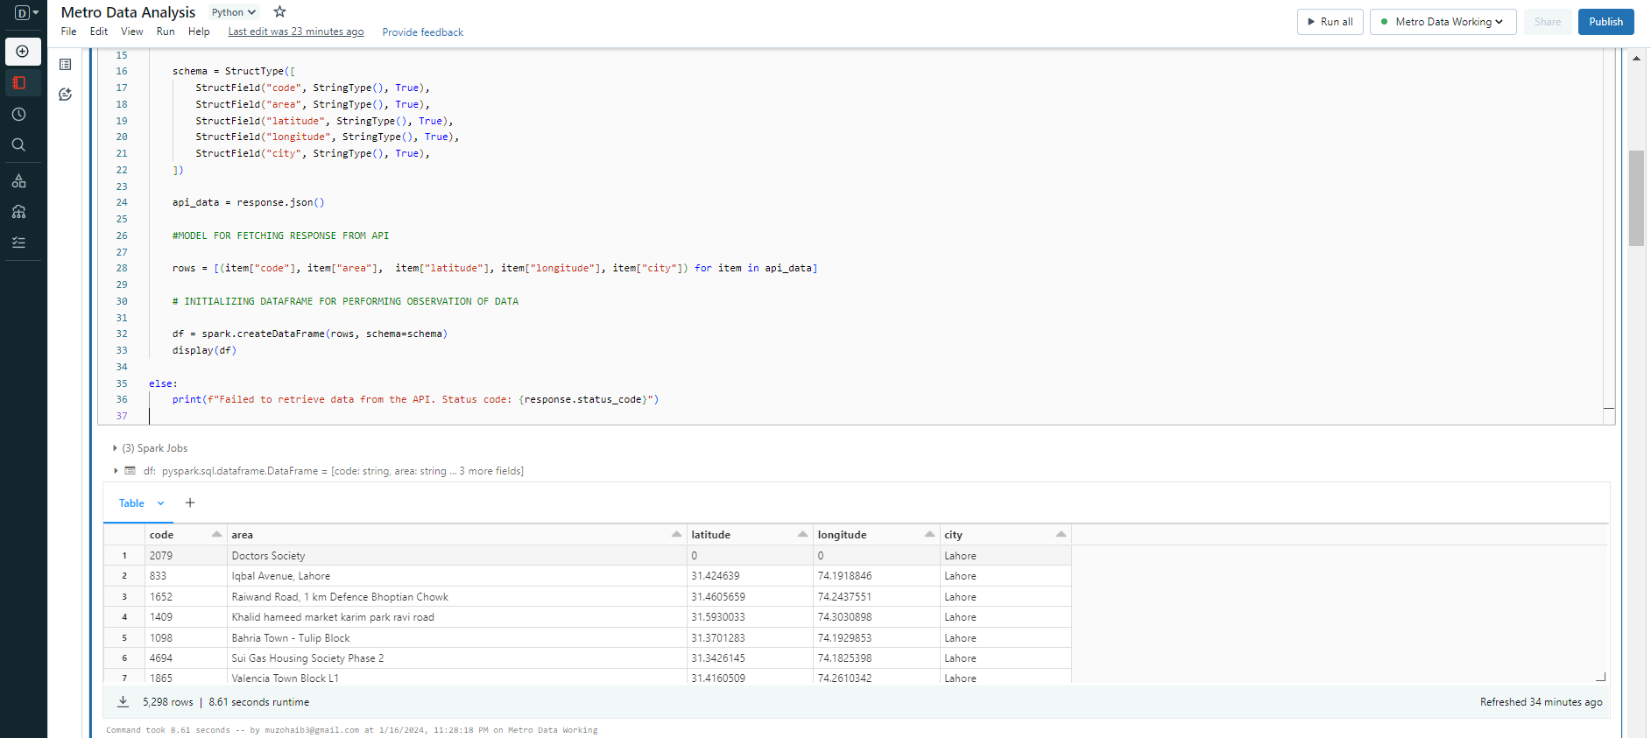
Here we have ingest the data from the API and then create table with according to the API response schema

Slide 6
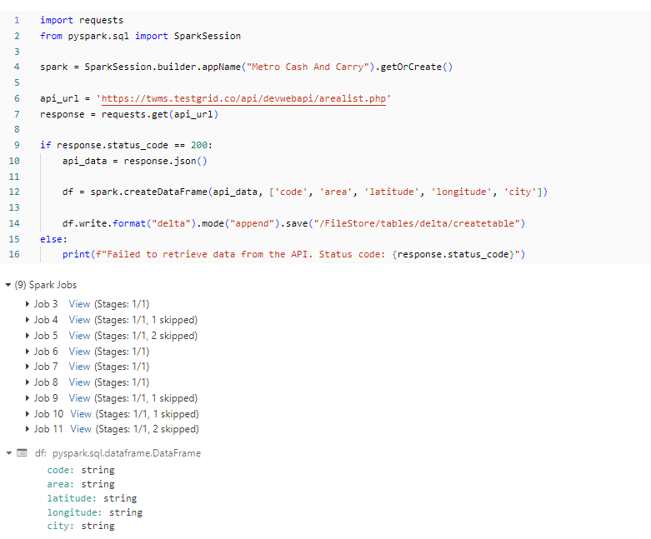

Slide 7
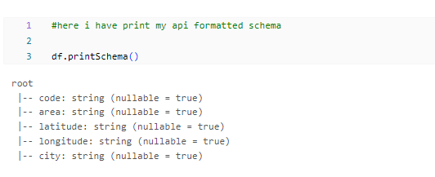

Slide 8
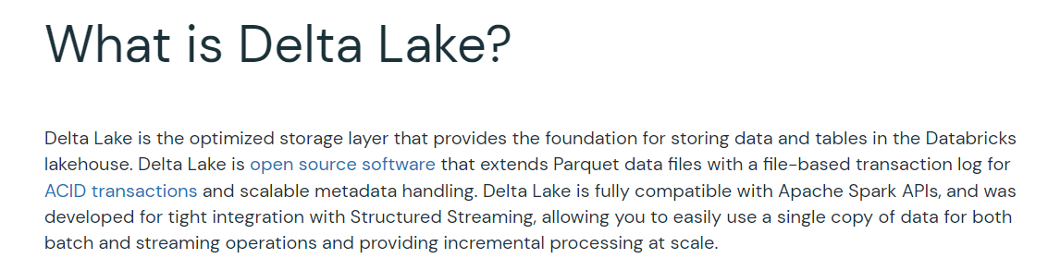
Delta Lake Table Setup:
Optimized Storage: The code leverages Delta Lake to create a table for efficient storage and management of the data, offering features like ACID transactions and time travel.
Structured Streaming Capabilities: The foundation for real-time data processing is established, enabling continuous updates and insights from the live data stream.

Slide 9
Difference b/w usage (Spark vs Delta Lake)
Spark Session:
Creates traditional tables in Hive metastore or in-memory.
Optimized for read-only operations or basic write-once, read-many scenarios.
Limited support for schema evolution and transaction management.
Tables are not versioned or time-travel capable.
Delta Lake:
Builds on top of Spark, adding ACID transactions, time travel, schema enforcement, and more.
Ideal for data lakes and complex analytical workloads requiring data reliability and governance.
Enables multiple writers and readers to access the same table concurrently.
Tables are versioned, allowing you to revert to previous states or audit changes.

Slide 10
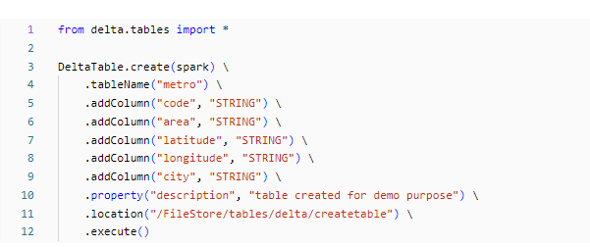
Delta Lake Table Setup:
In summary, this code creates a new Delta table named "metro" with columns "code," "area," "latitude," "longitude," and "city," all of type STRING. It adds a description property and specifies the location for storing the Delta table. Finally, it executes the creation of the Delta table.

Slide 11
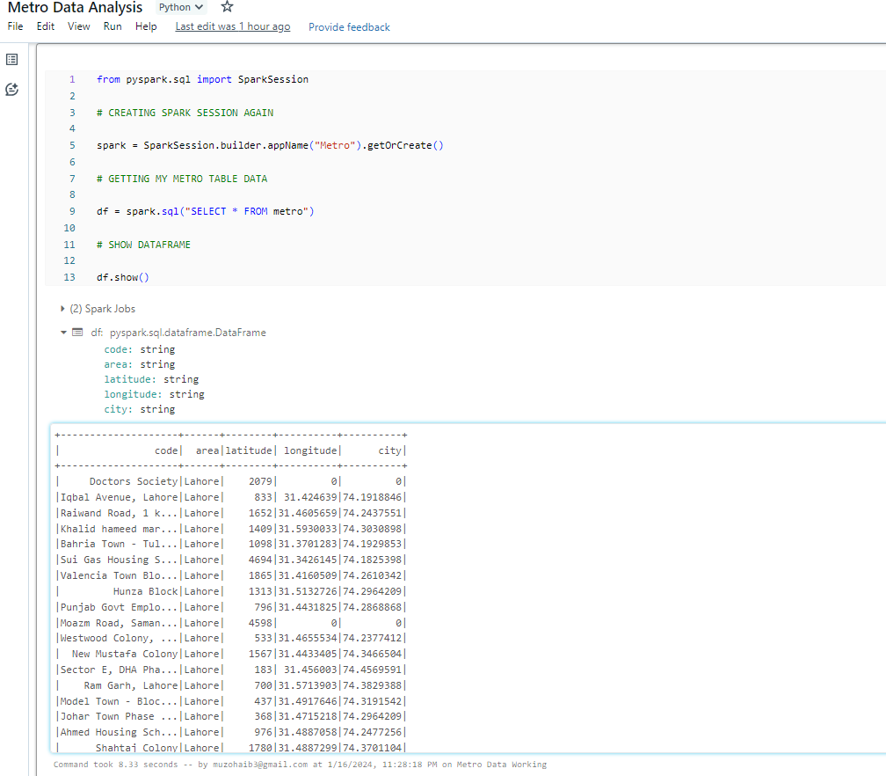
Imports the SparkSession class, which is the entry point for reading data and executing Spark operations.
Initializes a new Spark session named "Metro" using the SparkSession.builder method.
appName("Metro"): Specifies the name of the Spark application as "Metro".
getOrCreate(): Gets an existing Spark session or creates a new one if it doesn't exist.
Executes a SQL query on the Spark session to retrieve all columns and rows from the "metro" table.
The result is stored in a DataFrame named df.
Displays the contents of the DataFrame df in the console.
The show() method is used to print the first 20 rows of the DataFrame.

Slide 12
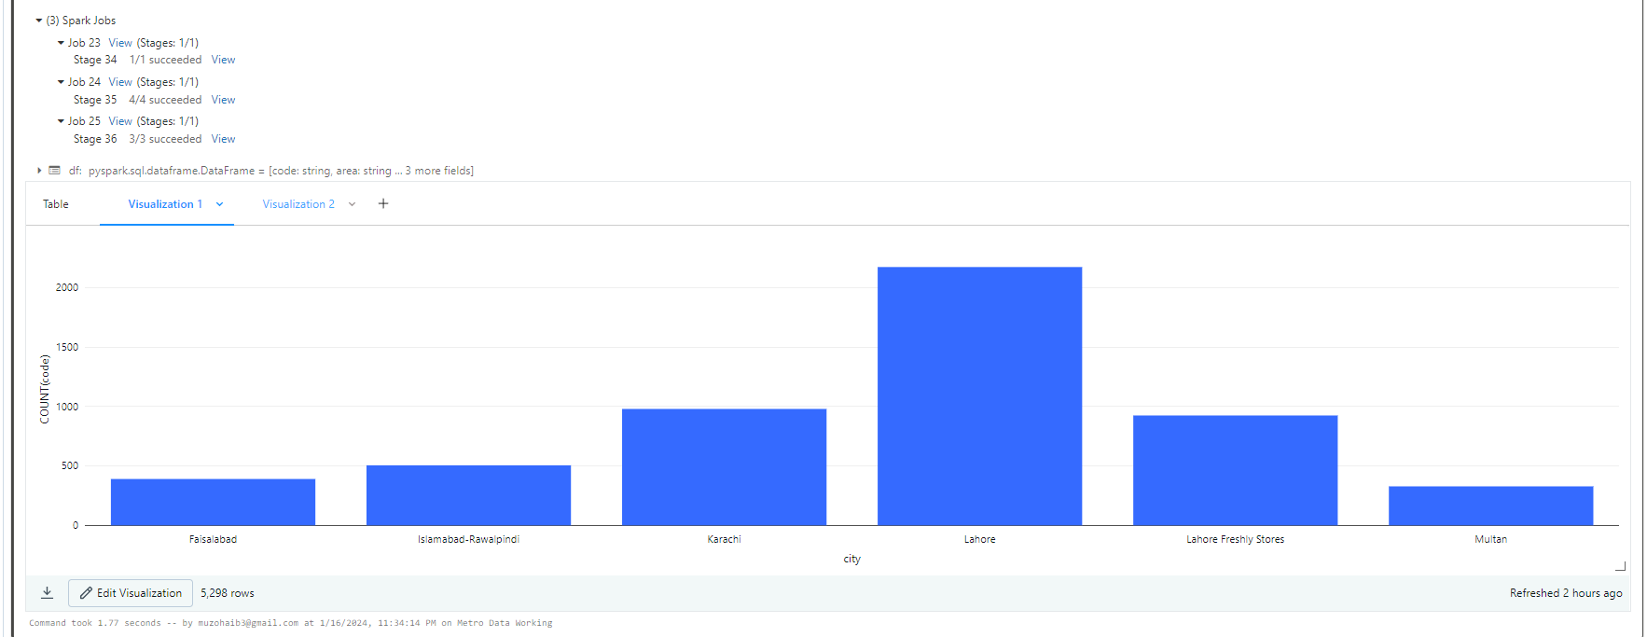
Visualization of stores sell (City Wise):
In this bar chart we are exploring the stats of how much stores sells are present each city as per count denoted on each percentage.

Slide 13
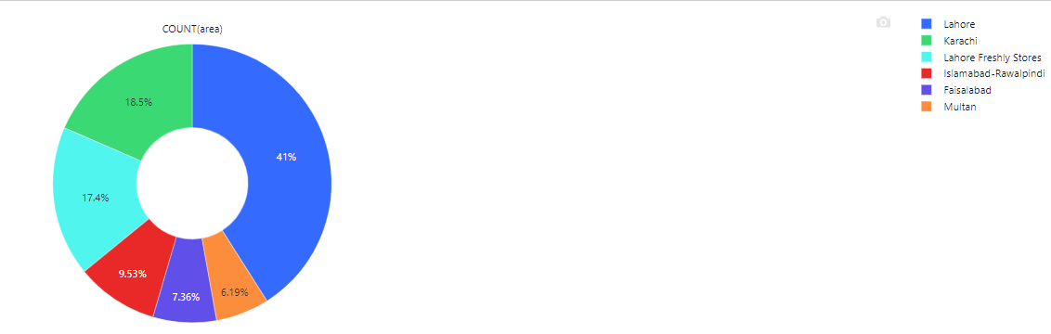
Visualization of stores with ration (City Wise):
In this pie chart we are exploring the stats of how much stores are present each city as per count denoted on each percentage.
Total Stores:
Lahore : 41
Karachi : 41
Lahore-Freshly : 41
Islamabad : 41
Multan : 41

Slide 14
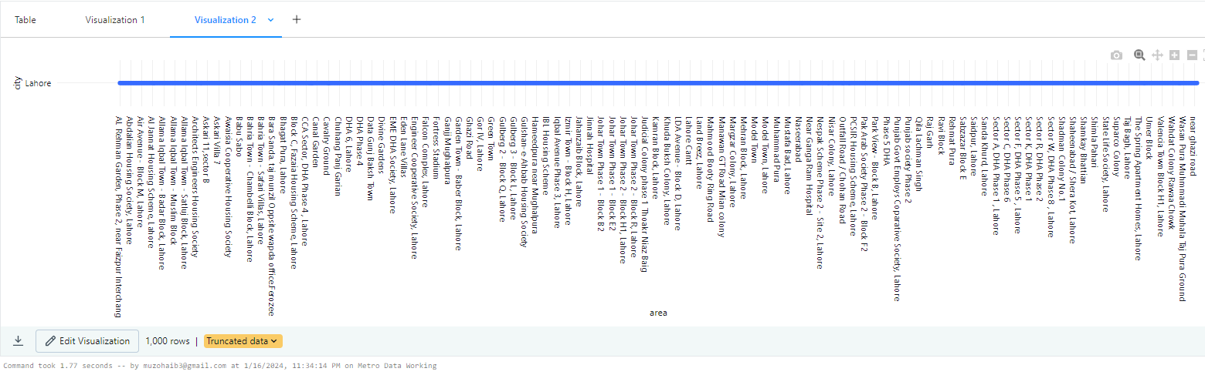

Slide 15
Simple Data Analysis Performed in Dataset
Data Exploration:
Dive deeper into the data using descriptive statistics, visualizations, and exploratory analysis techniques to uncover patterns, trends, and potential anomalies.
Data Cleaning:
Address any inconsistencies, missing values, or errors in the data to ensure its quality and reliability for downstream analysis
Analysis Goals:
Define clear objectives for your project, such as identifying customer behavior patterns, predicting sales trends, optimizing inventory management, or personalizing customer experiences.

