Slide 1

Understanding Convolutional Neural Networks (CNNs)
A Deep Dive into Architecture and Training
Exploring How Machines Understand Images
Presented By: Rohit Ranjan
Course: Artificial Intelligence / Deep Learning Date: 27 February 2026

Slide 2
What is CNN? & Technologies Used
What is CNN?
A Convolutional Neural Network (CNN) is a type of deep learning algorithm designed specifically for processing image data. It automatically learns important visual features such as edges, textures, and shapes directly from images. Unlike traditional neural networks, CNNs use special layers that preserve spatial relationships between pixels, which makes them highly effective for tasks like image classification and object detection.
CNNs are widely used in applications such as facial recognition, medical image analysis, autonomous vehicles, and object detection systems.
Technologies Used in CNN
CNN models are typically developed using Python as the main programming language. Popular deep learning frameworks include TensorFlow and Keras, which are widely used for building and training neural network models. PyTorch is another powerful framework commonly used in research and production. OpenCV is often used for image preprocessing and real-time computer vision tasks, while NumPy is used for handling numerical and multi-dimensional array operations.

Slide 3
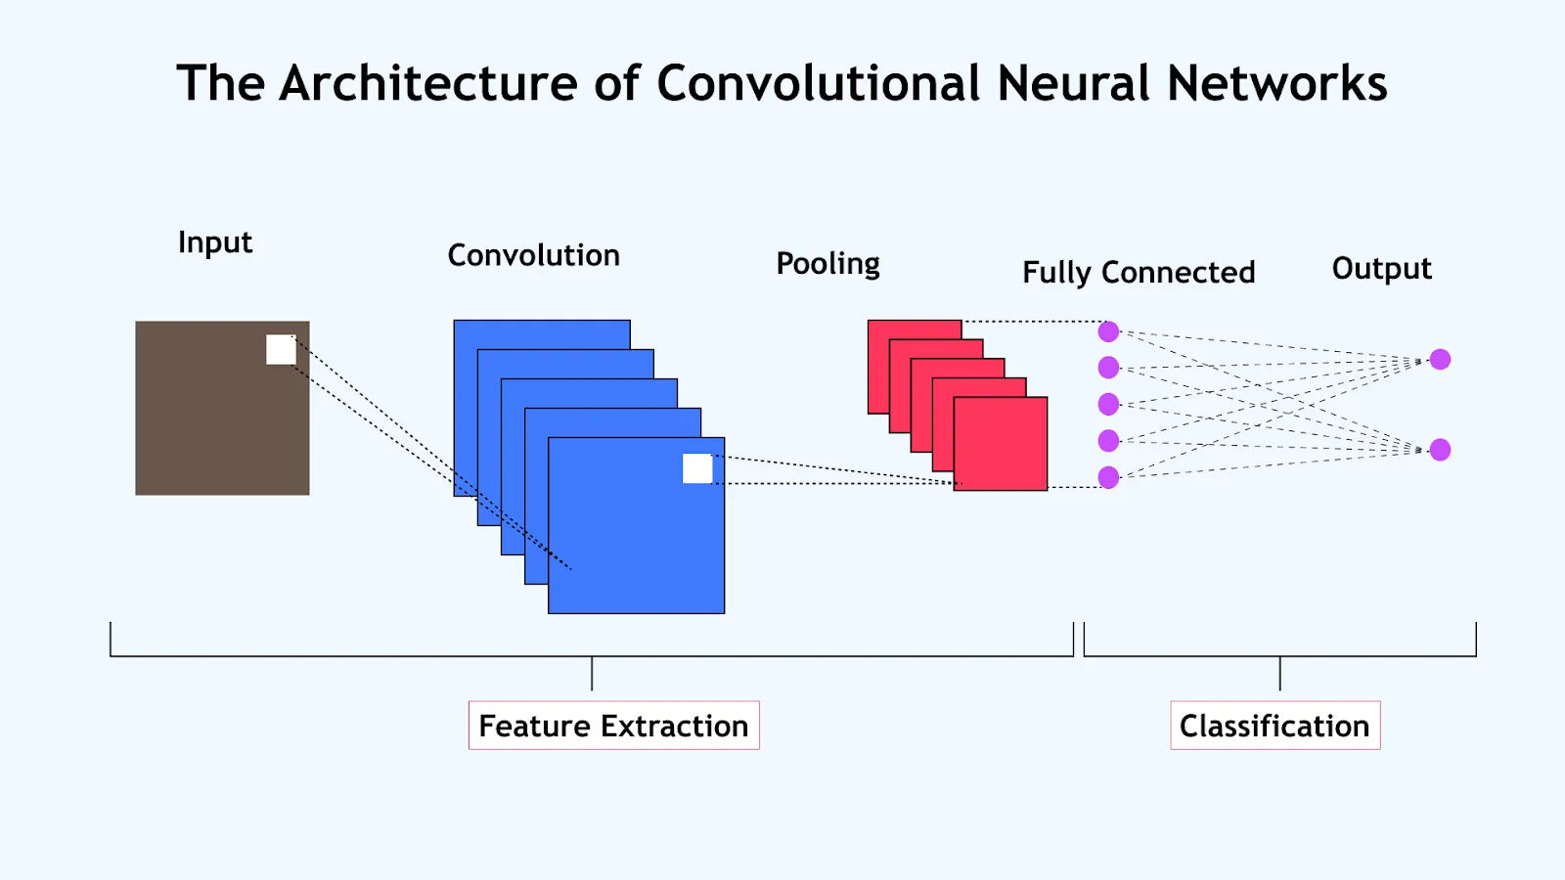

Slide 4
Core Components of CNN
1. Convolution Layer
The convolution layer is the main building block of a CNN. It uses filters (also called kernels) that slide over the input image to extract important features. These filters detect patterns such as edges, corners, and textures and generate feature maps.
2. Activation Function Layer (ReLU)
After convolution, an activation function is applied. The most commonly used function is ReLU (Rectified Linear Unit).
Formula: f(x) = max(0, x)
ReLU removes negative values and introduces non-linearity, allowing the network to learn complex patterns.
3. Pooling Layer
The pooling layer reduces the spatial size of the feature maps. This decreases computation and helps prevent overfitting.
The most common type is Max Pooling, which selects the maximum value from a region.
4. Fully Connected Layer
The fully connected layer is the final layer of the CNN. It connects all extracted features and produces the final classification output (for example, Dog or Cat).

Slide 5
Training Process in CNN
1. Data Propagation
In this step, labeled training images are collected and converted into numerical pixel values. The data is then fed into the CNN model for learning.
2. Forward Path
The input data moves forward through all layers: Convolution → ReLU → Pooling → Fully Connected Layer.
The network generates a prediction based on current weights.
3. Loss Calculation
The predicted output is compared with the actual label using a Loss Function (such as Cross-Entropy).
Loss measures how far the prediction is from the correct answer.
4. Backpropagation
The error is sent backward through the network. Using the Chain Rule, gradients are calculated to determine how much each weight contributed to the error.
5. Optimization
An optimization algorithm (such as SGD or Adam) updates the weights to reduce the loss.
This process repeats for many iterations until the model improves.

Slide 6
Input Data (Images)
↓
Forward Pass
(Conv → ReLU → Pool → FC)
↓
Prediction Output
↓
Loss Calculation
(Compare with Actual Label)
↓
Backpropagation
(Error Sent Backward)
↓
Optimization
(Update Weights)
↓
Repeat

Slide 7
import cv2
# Start webcam
cap = cv2.VideoCapture(0)
while True:
ret, frame = cap.read()
if not ret:
break
# Green box coordinates
start_point = (200, 150)
end_point = (450, 400)
color = (0, 255, 0)
thickness = 3
cv2.rectangle(frame, start_point, end_point, color, thickness)
cv2.imshow("Webcam - Press Q to Exit", frame)
if cv2.waitKey(1) & 0xFF == ord('q'):
break
cap.release()
cv2.destroyAllWindows()
Live Demonstration – Real-Time Image Processing
To demonstrate basic image processing, we use OpenCV to capture live webcam frames and draw a green box on the screen.
This shows how image frames can be processed in real time, which is similar to how CNN models analyze images.

Slide 8
Thank You
Thank You for Your Time and Attention
I hope this presentation helped you understand how Convolutional Neural Networks work.
Infosys springboard

