Slide 1
Commuter Reservation System (CRS)
Includes Tables, Package, Procedures, Views, Test Cases
Built using Oracle SQL & PL/SQL
Final Project Presentation
Team One
Amruta Mazumdar
Dhruvi Mehta
Guhan Santhanam

Slide 2
Project Overview
Built a simplified railway reservation system using Oracle SQL & PL/SQL.
Supports passenger registration, ticket booking, waitlisting, and cancellations.
All objects (tables, package, procedures, views) created under a single application user.
Enforces key business rules like seat limits, schedule validation, and duplicate prevention.
Includes reporting views and a full test suite to validate the system’s behavior.

Slide 3
Data Model (Tables)
CRS_TRAIN_INFO – Stores train details such as number, route, seat counts, and fares.
CRS_DAY_SCHEDULE – Reference table containing all 7 days of the week.
CRS_TRAIN_SCHEDULE – Maps trains to the days they operate.
CRS_PASSENGER – Holds passenger information with unique email and phone constraints.
CRS_RESERVATION – Stores booking records, seat class, status (confirmed/waitlist/cancelled), and dates.

Slide 4
Business Rules Implemented
Each passenger must have a unique email and phone number.
Tickets can only be booked if the train exists and operates on that date.
Advance booking limited to 7 days from today.
Only two seat classes allowed: First Class (FC) and Economy (ECON).
Each class allows 40 confirmed seats + 5 waitlist positions.
Duplicate bookings (same passenger, train, date, class) are not allowed.
Cancellation promotes the first waitlisted passenger to confirmed.
Travel date must be today or future, not in the past.

Slide 5
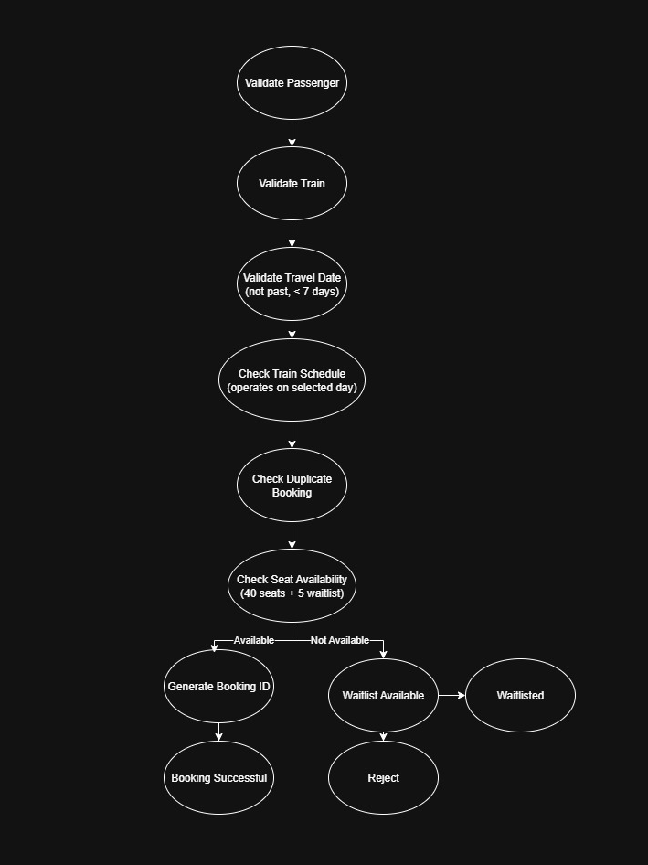
Booking Workflow
Validate passenger & train
Validate date, class, operating schedule
Check confirmed & waitlist capacity
Decide CONFIRMED or WAITLISTED
Generate booking ID & insert record

Slide 6
Reporting Views
v_passenger_bookings - Shows each passenger’s booking history with train, date, class, status, and fare.
v_train_availability - Summarizes trains, routes, total seats, fares, and the days they operate.
v_daily_booking_summary - Aggregates bookings per day and class (confirmed, waitlisted, cancelled, available seats).
v_waitlist_status - Lists all waitlisted passengers with train, date, class, and waitlist position.
v_revenue_report - Calculates monthly revenue per train and class based on confirmed bookings.
v_passenger_demographics - Groups passengers by age category (minor, adult, senior) for simple demographic analysis.

Slide 7
Contributions
Security & ERD – Dhruvi Mehta
Procedure & Scripts– Amruta Mazumdar
Views & Documentation – Guhan Santhanam

Slide 8
Test Cases
19 total test cases covering:
• Valid/invalid passenger registration
• Booking (success & failure scenarios)
• Waitlist behavior
• Cancellation & promotion
• View validation

Slide 9
DEMO

